Slide 1
Benzene

Slide 2
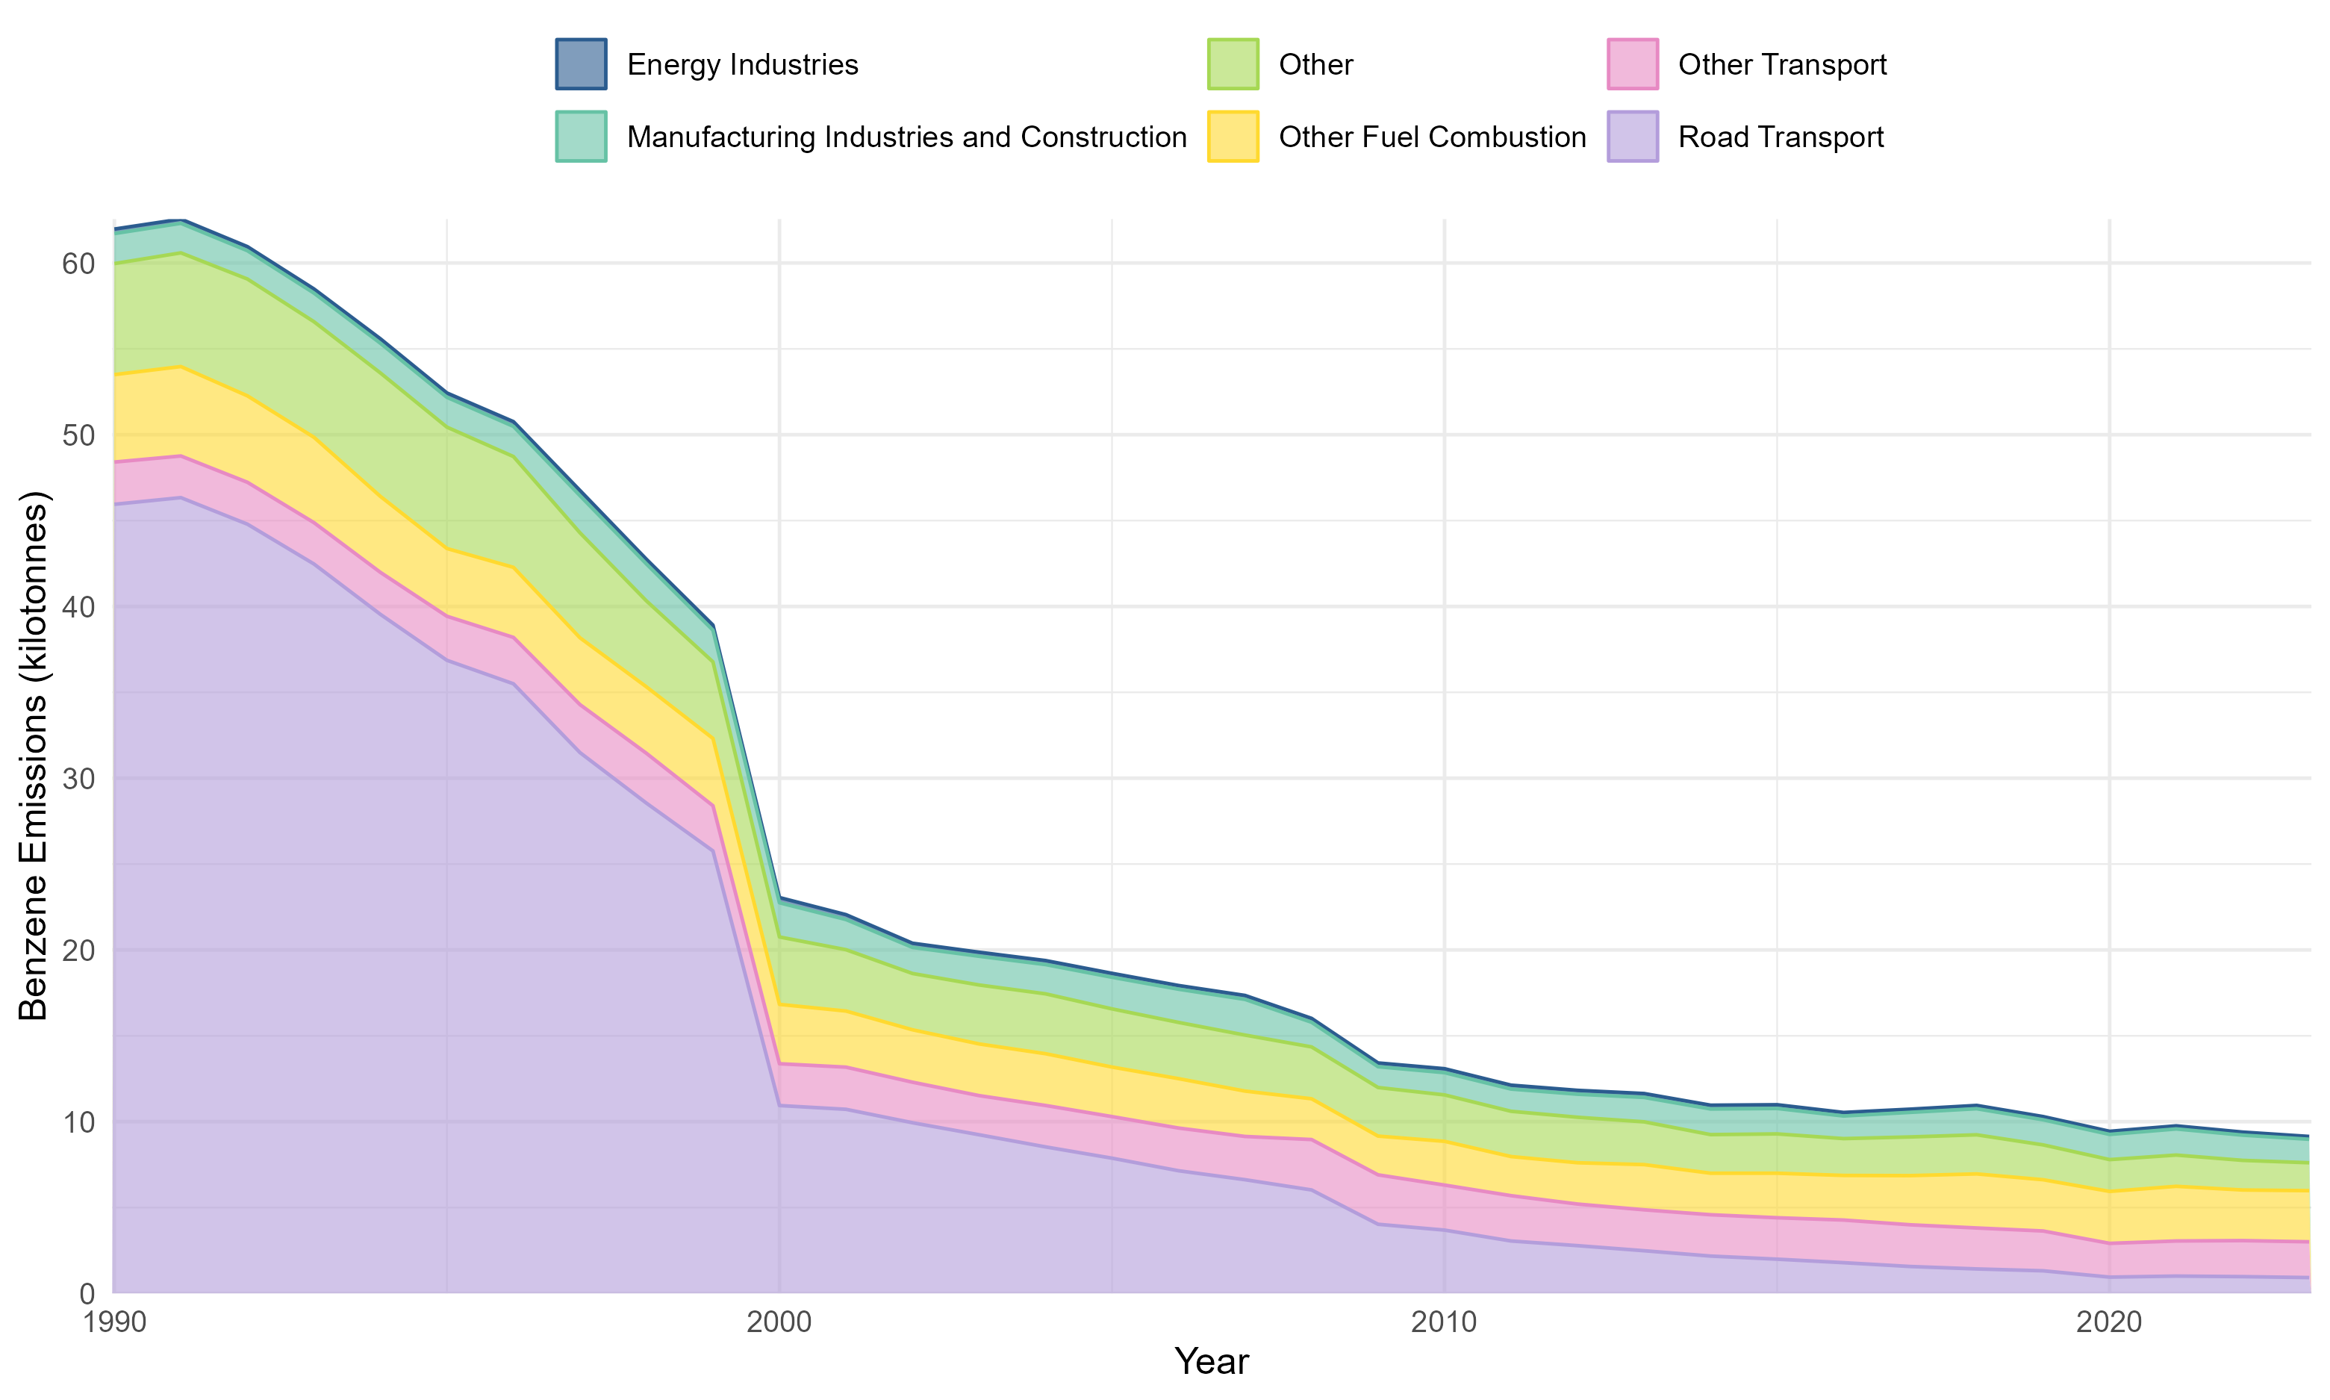
Basics
~8% of emissions from point sources

Slide 3
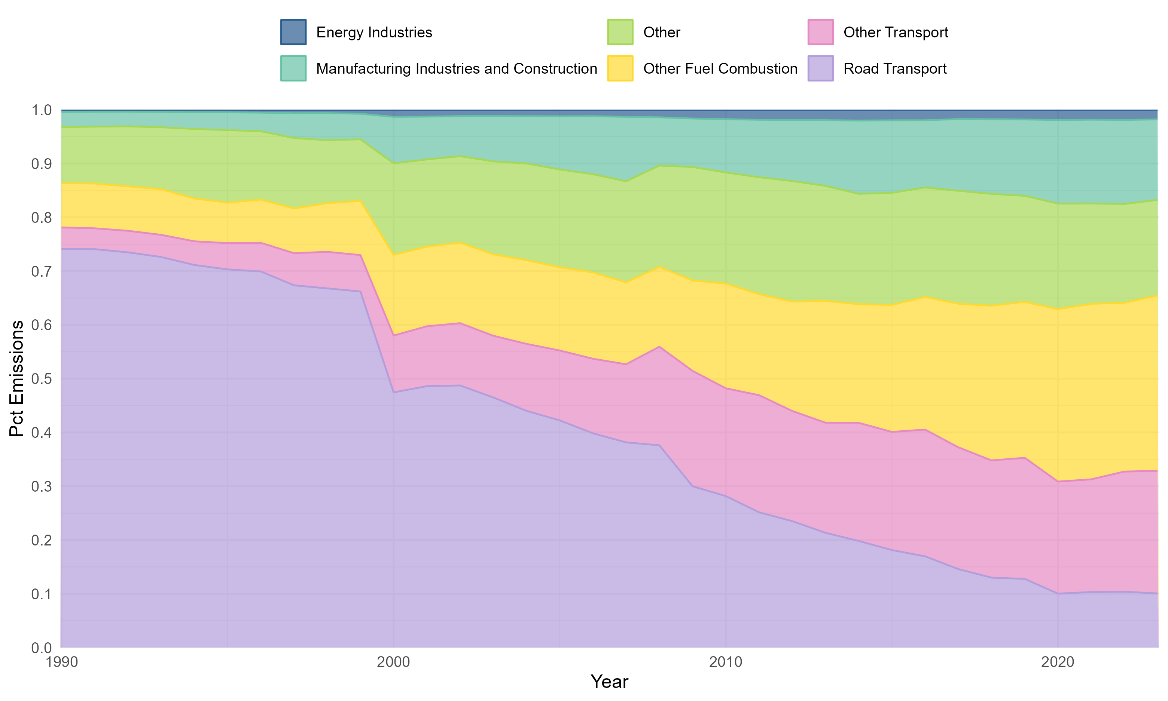
Basics
~8% of emissions from point sources

Slide 4
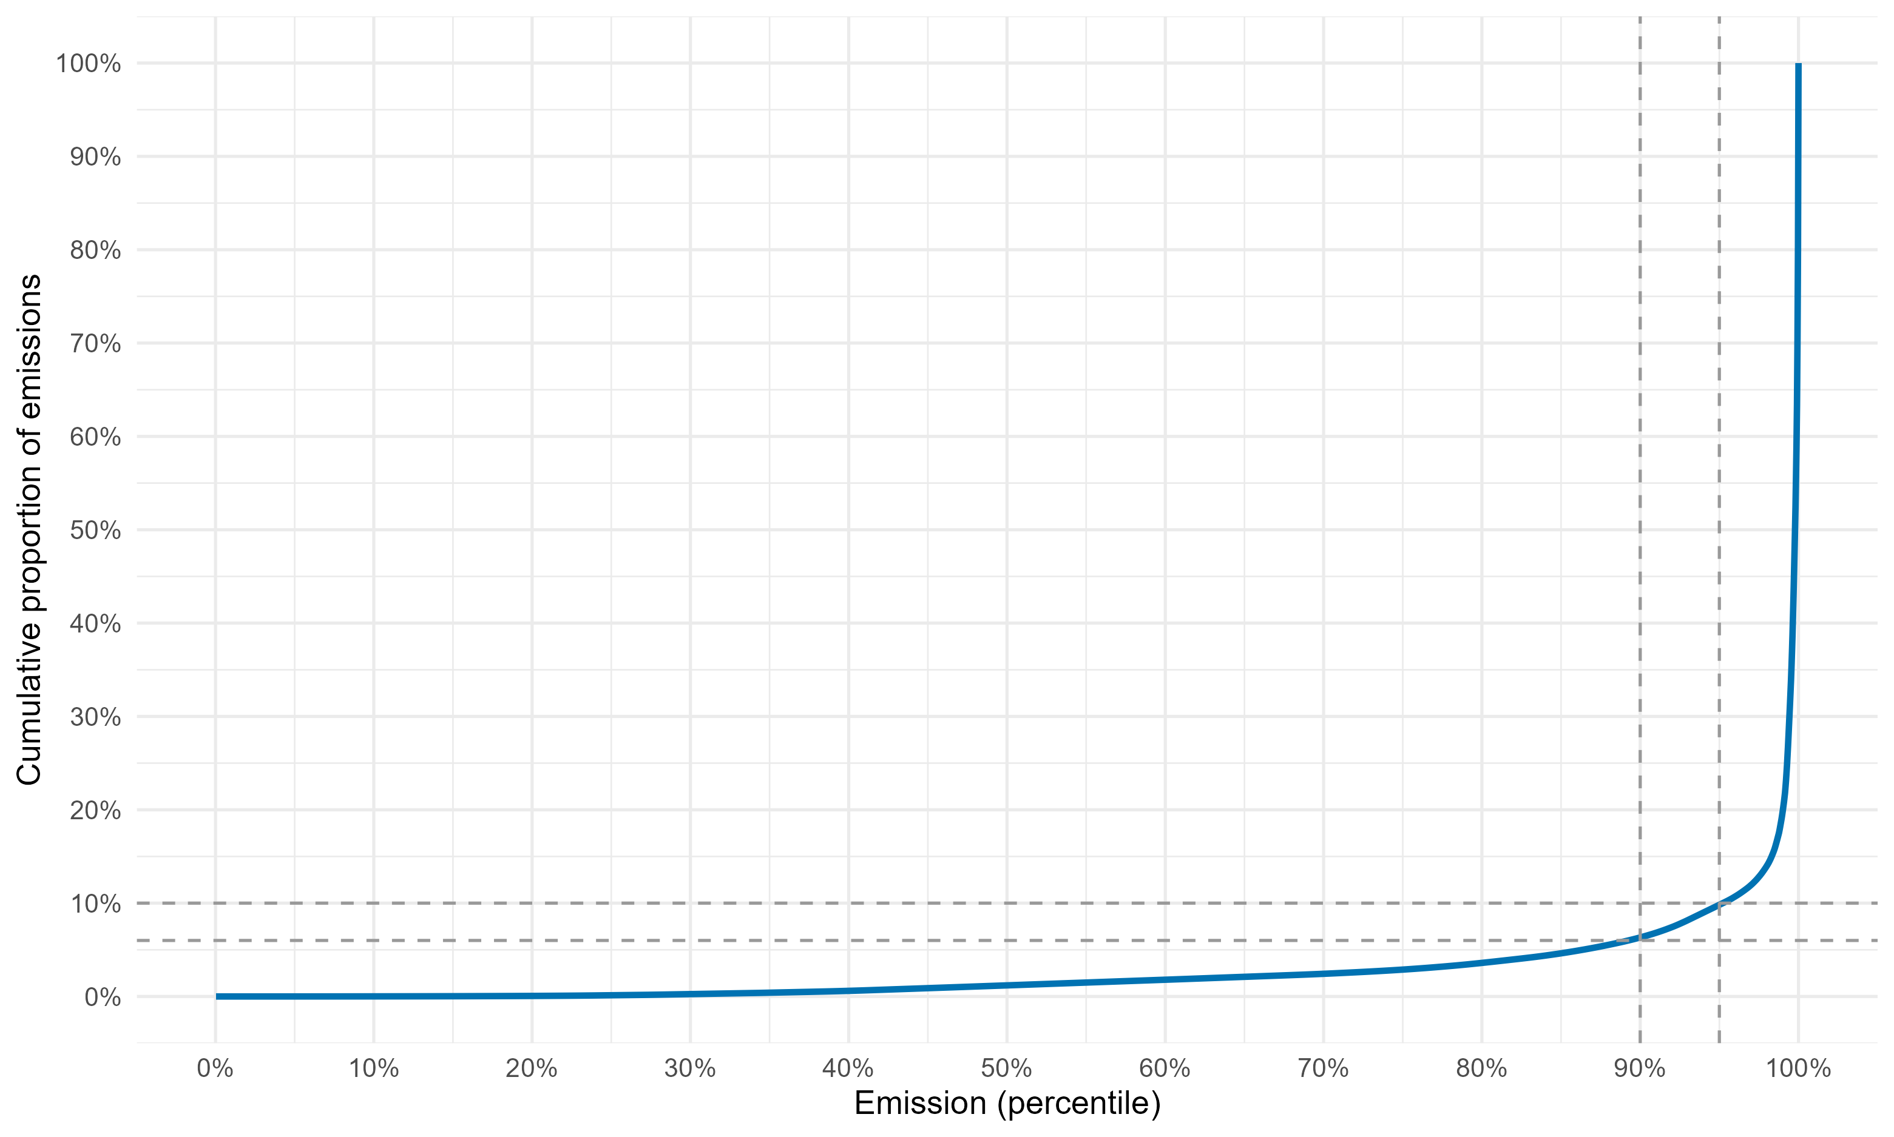
Top 10 sources contribute 55% of total point source emissions – 439 tonnes.

Slide 5
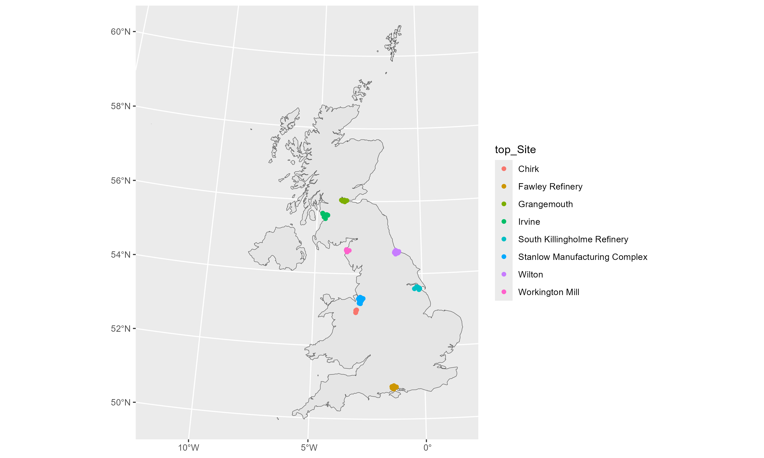
Filtered all sources to retain emissions within a 10km radius of these top 10 sources. Forms 8 cluster areas.

Slide 6
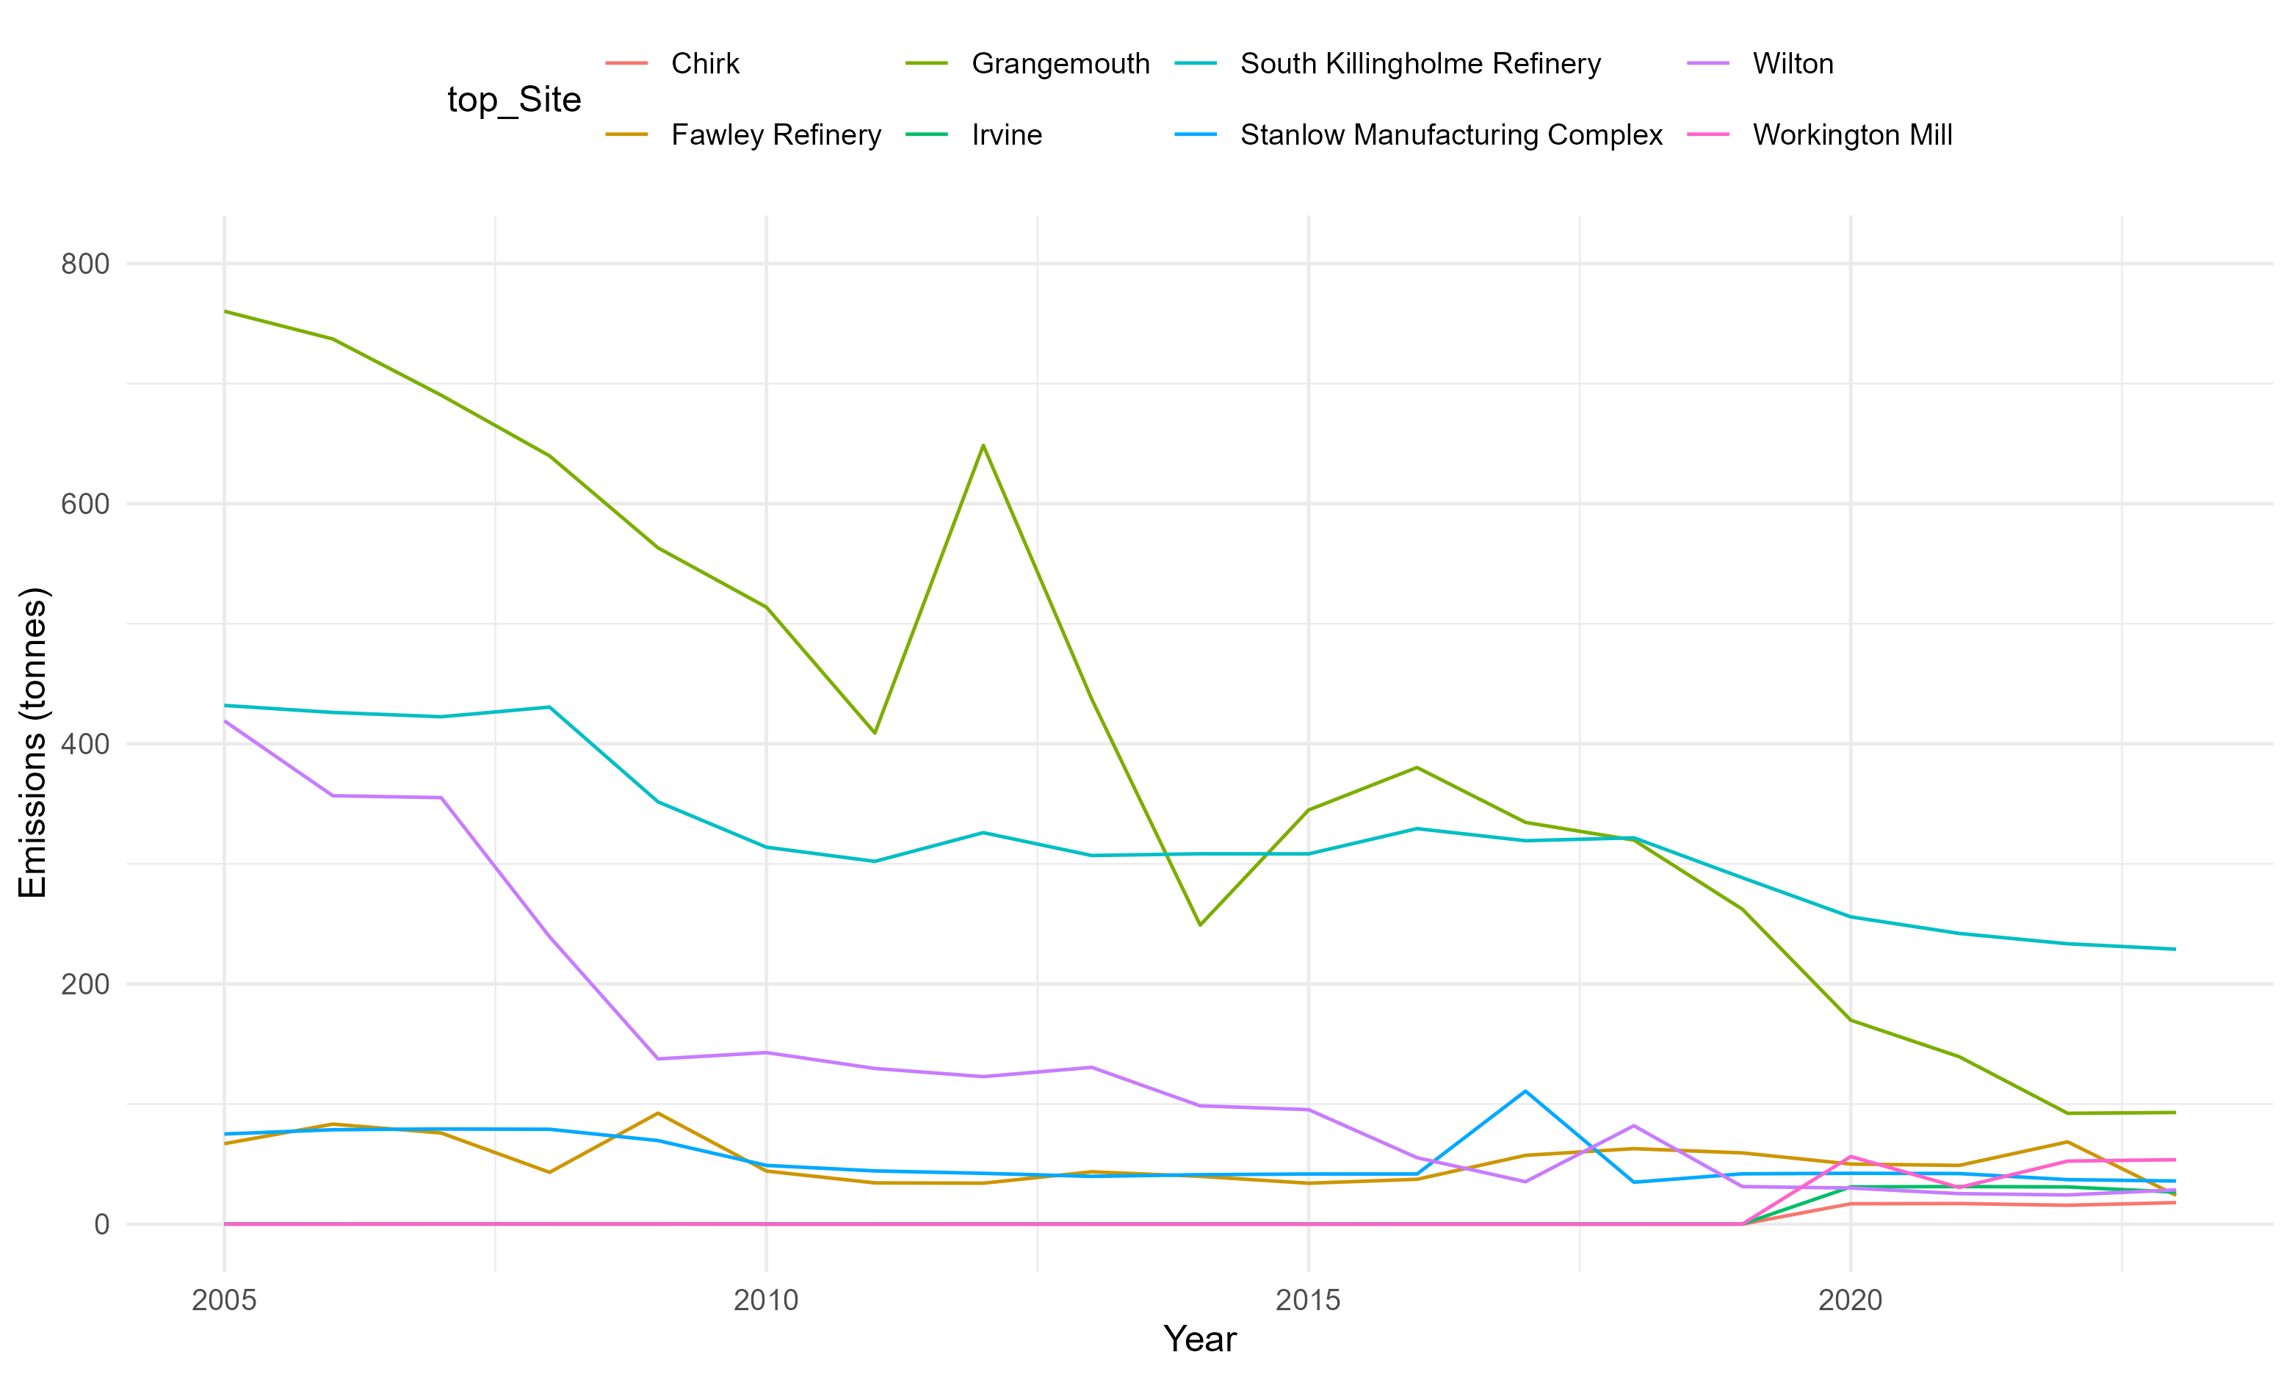

Slide 7
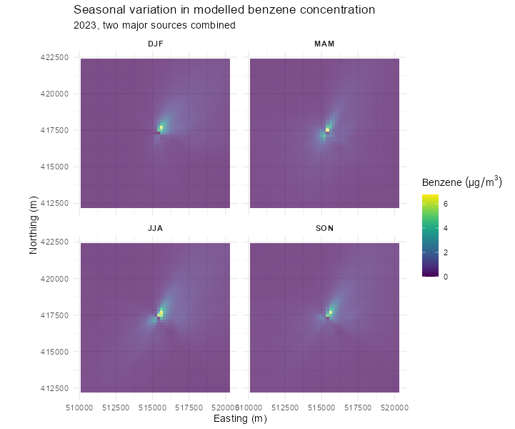
ADMS Modelling:
South Killingholme and Lindsey Oil Refinery
Annual emissions from NAEI averaged over the year as a constant emission rate.
Weather from met station approx. 8km away.
Combine with IMD, population density etc.

Slide 8
Monitoring Sites

