Slide 1
Factors Affecting S5 Score Analysis
Team: Data Daters
Members: Ruofan Bi (Pauline), Hanrui Dou (Lisa),
Yao Yao (Lucy), Xuan Zhong (Grace)
Notes:
[婷婷]旗舰店https://[婷婷]

Slide 2
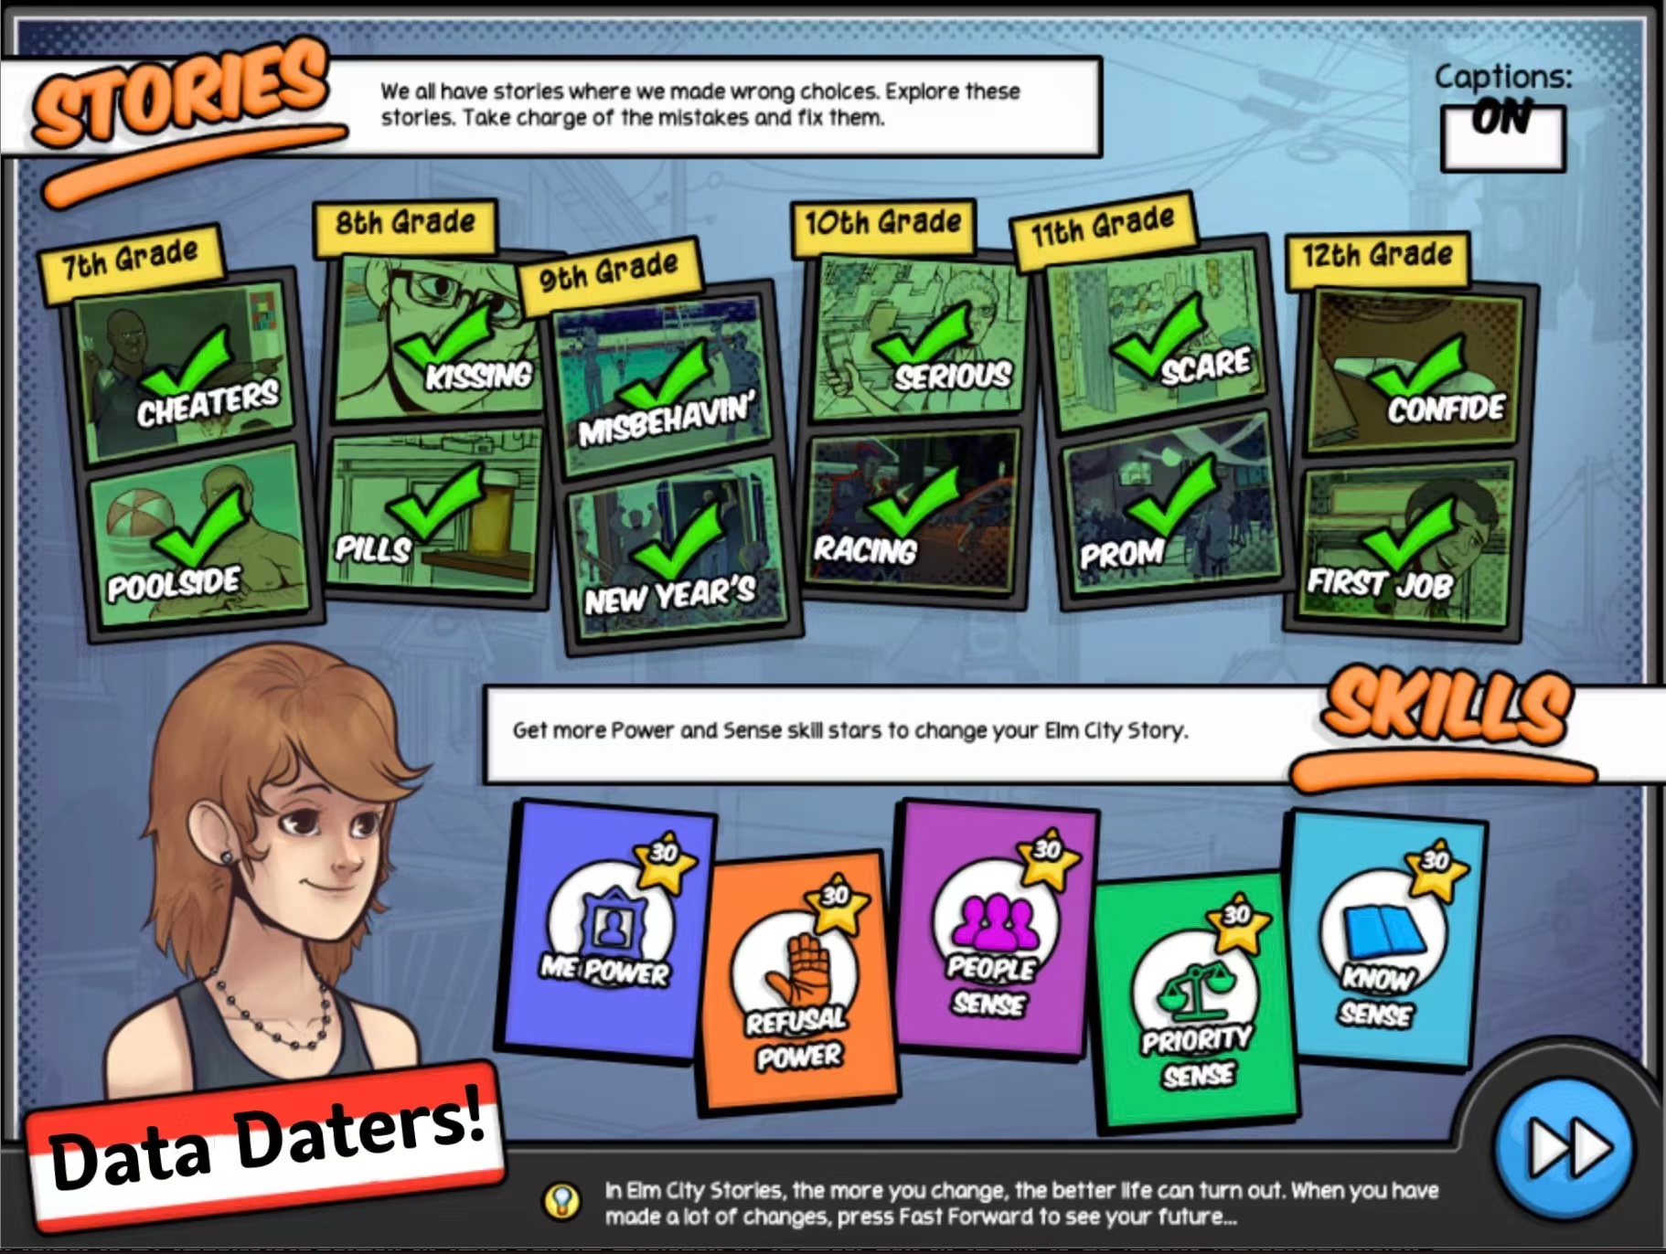

CONTENT OVERVIEW
Introduction
Data Cleaning and Visulization
Model
Limitations and Conclusion

Slide 3
Research Question
What are the main factors determining how much the player changes in efficacy of resisting drugs after playing this game?

Slide 4
Possible variables
Avatar gender
Range of clicking the
fact in the game
Times that click
epilogue
Number of checking
“change decision” in the game
Replay times for
refusal minigame
Replay times for
the whole game
Player's final
skill level

Slide 5
DATA CLEANING
We first constructed a dataset by searching the data of these 61 participants from the primary data. And then, for our statistical analysis, we created a new dataset containing all the variables which are mentioned above. These variables are from event 515(refusal), 407(fact), 703(epilogue), 1000(replay), 200(skill), 221(decision),906-909(seconds).
.

Slide 6
DATA CLEANING
Besides, we created a new variable called difference. It is actually the difference between the participants’ S5 mean scores in the first and last week. If the difference is higher meaning the game is more efficient on that participant.
After that, we cleaned the data to a proper type. We divided the fact click range into 5 parts, 0-500, 500-1000, 1000-1500, 1500-2000 and over 2000, and we also calculated the sum of participants’ final skill level of each minigames and considered it as our final skill level.
.

Slide 7
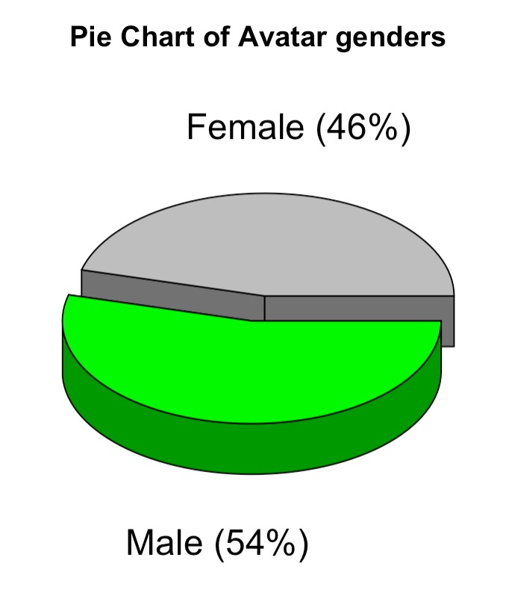
Data Visualization
Pie Chart of Avatar Genders
The pie chart of avatar genders represents the ratio of male to female players choosing their gender at the beginning of the game.
As we can see, 46% players choose female, and 54% players choose male.
46%
54%
Female Players
Male Players

Slide 8
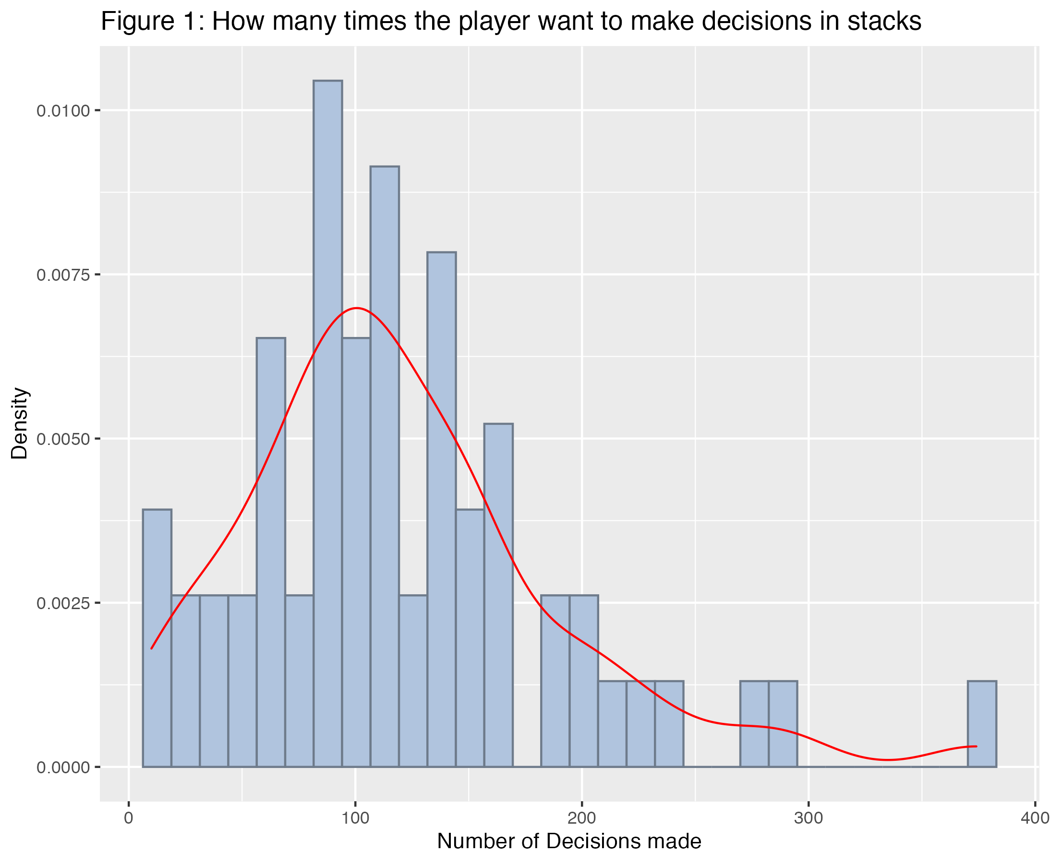
Data Visualization
How many times the player want to make decisions in stacks?
It is a left-skewed distributed image, and its density is maximum when making the decision between 90 and 110 times.

Slide 9
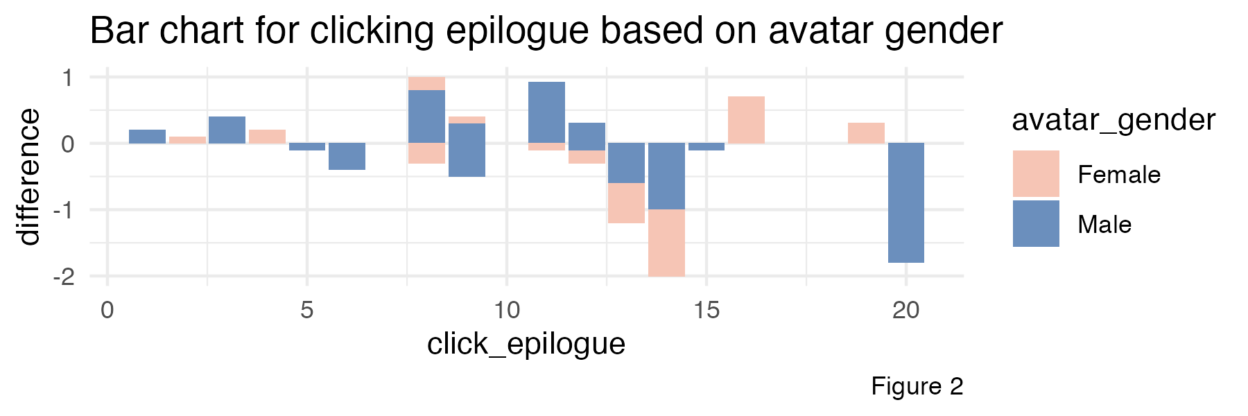
Data Visualization
Bar chart for clicking epilogue based on avatar gender
Bar chart for clicking epilogue based on avatar gender shows that if difference is positive, it means progress; if difference is negative, it means regression. The colour represents the different genders, and x represents the number of times the ending was clicked. The fewer the number of clicks to see the ending, the more people progress. We can see that the proportion of men is larger among those who progress.
.
Male
Female

Slide 10
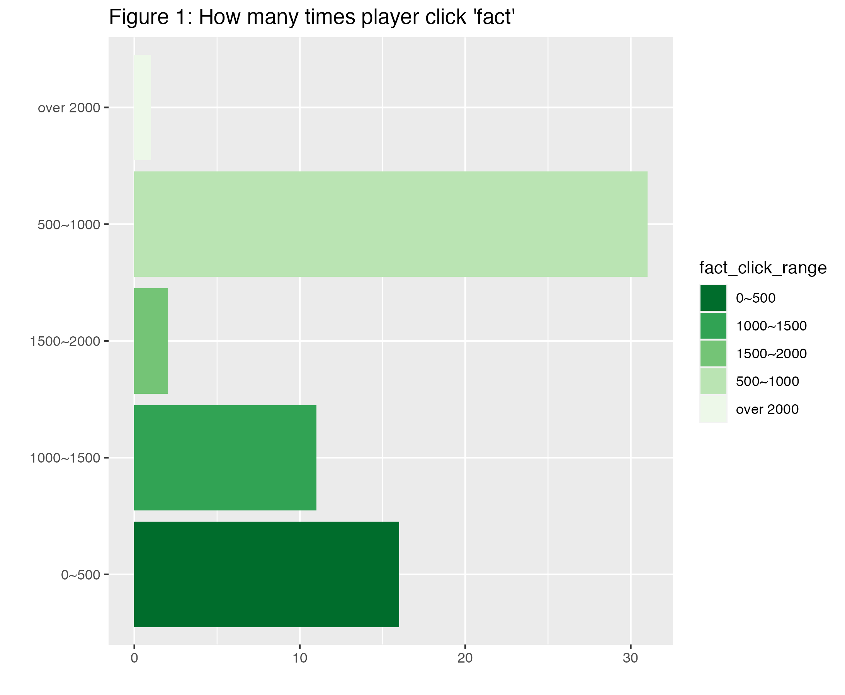
Data Visualization
How many times players click ‘fact’?
This image shows about 15 players clicked 0-500 times;
More than 30 players clicked 500-1000 times to see the 'fact ‘
11 players viewed it 1000-1500 times;
Only two or three players viewed it 1500-2000 times;
Only one player viewed it more than two thousand times.
We can see that most players click on 'fact' is concentrated in 500-1000 times.

Slide 11
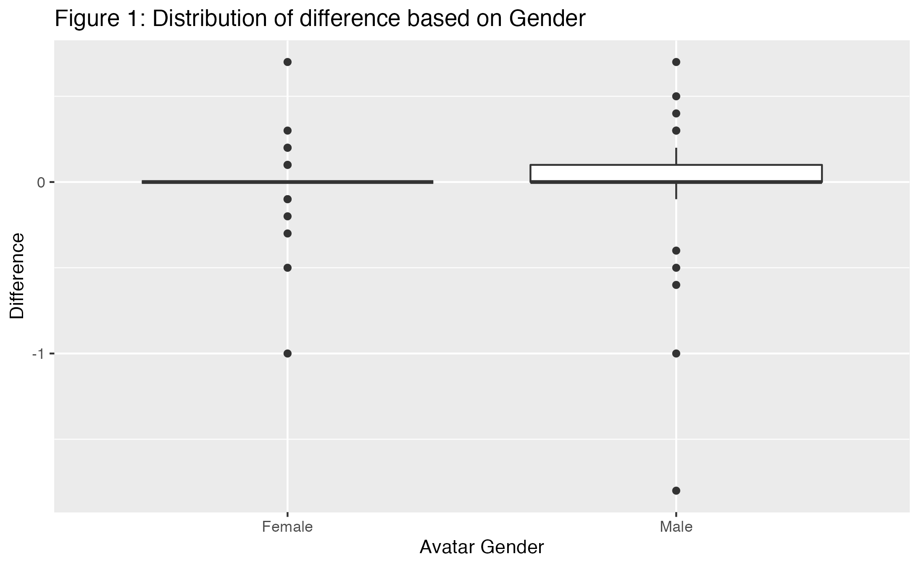
Data Visualization
Distribution of difference based on Gender
X-axis is gender and y-axis is the difference in scores. We can see that male students are more widely distributed and have more positive numbers; female students are not as widely distributed and have fewer positive numbers than male students. This also corresponds to one of our previous pictures’ Bar chart for clicking epilogue based on avatar gender', where they represent similar meanings.

Slide 12
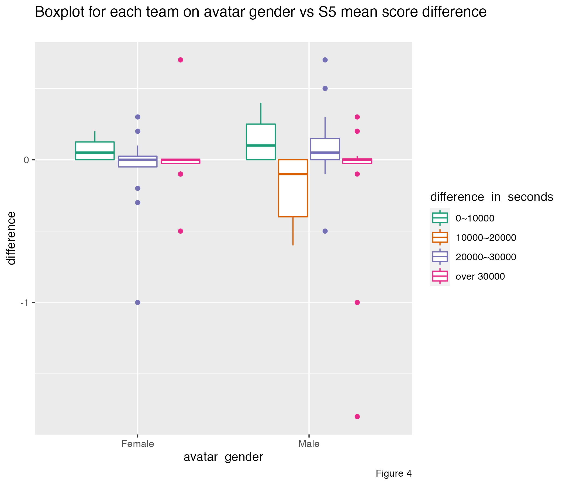
Data Visualization
Boxplot for each team on avatar gender vs S5 mean score difference
Difference from 10,000 to 20,000 will obviously lead to a negative difference, the rest is mostly positive. Through this graph, we also find that there are some outliers.

Slide 13
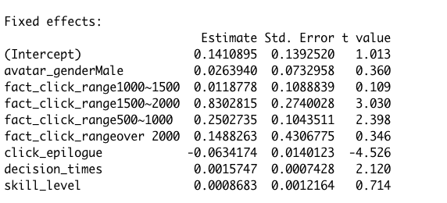
MODEL
Linear Mixed Model - Result
Holding all other explanatory variables in the model fixed
• males S5 mean score difference is 0.026 higher than females.
• If the times of clicking epilogue increases by 1, then on average, the S5 mean score difference would decrease 0.063.
• If the times of checking change decision increases by 1, then on average, the S5 mean score difference would increase 0.002.
• If the final total skill level increases by 1, then on average, the S5 mean score difference would increase 0.0009.
• Compared to participants whose fact click range is less than 500, the S5 mean score is 0.25 higher with range in 500-1000, 0.012 higher with range in 1000-1500, 0.83 higher in range 1500-2000 and 0.15 higher in range over 2000.

Slide 14
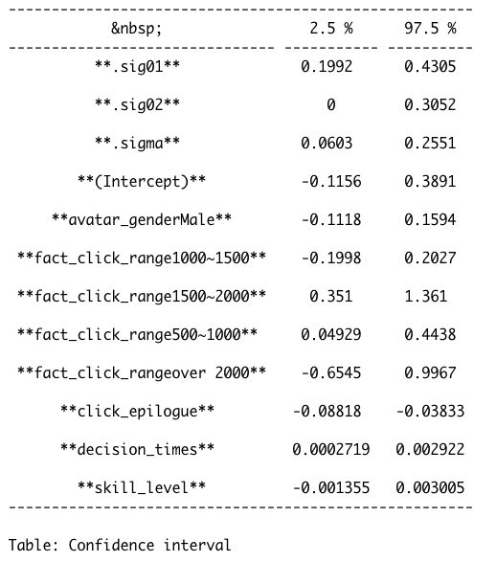
MODEL
Linear Mixed Model – Confidence Interval
Significant Variables (CI contains 0)
Times of clicking epilogue,
Times of checking “change decision” button in the game
The player click "fact" between 1500-2000 times
The player click "fact" between 500-1000 times
Consistent with our visulization!

Slide 15




Limitation & Weakness
Team Data Daters
1
2
3
4
All of the variables about counting the number of events happened may be influenced by the percentage of game completion of players.
The player may not choose their real gender as the “avatar_gender”, so maybe this variable is not that representative.
We assume that people who click more “Fact” will know more physiological knowledge, but maybe they click more just because they did not remember it carefully;
We thought that if a player have higher skill level in the end, they should have more knowledge from the game and have some positive change but turns out it is not significant to the change.

Slide 16
Conclusion
Team Data Daters
Overall, this is a complex game and the result can be influenced by many factors, but for our research question:
“What are the main factors determining how much the player changes in efficacy of resisting drugs after playing this game”,
based on our model, we can see that “How many times player check the epilogue”, “How many times player make decisions” and “How many time player click “fact” in a certain range” played important roles, and they are considered as our main factor.

Slide 17

THANKS FOR WATCHING!
Team: Data Daters

