Slide 1

The Unix shell
Imperial College London
14.06.18
Lucy Whalley (Instructor)
Katerina Michalickova, Jazz Mack Smith (Helpers)

Slide 2
You can use the Unix shell to…
automate repetitive tasks
make your science more easily reproducible
access High Performance Computing resources (aka Supercomputers)

Slide 3

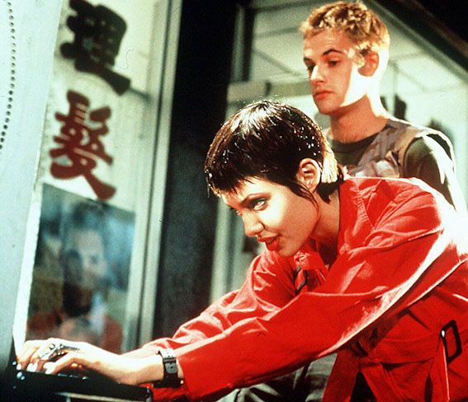

You can use the Unix shell to feel like a Hacker
You can use the Unix shell to ……

Slide 4
Outline
Introduction to the Unix shell
Navigating directories
cd, pwd, ls
Creating and editing files and directories
nano, mkdir, mv, cp, rm
Combining commands
wc, cat
Repeating commands with loops
tail, sort, head
Saving commands for later use
history

Slide 5
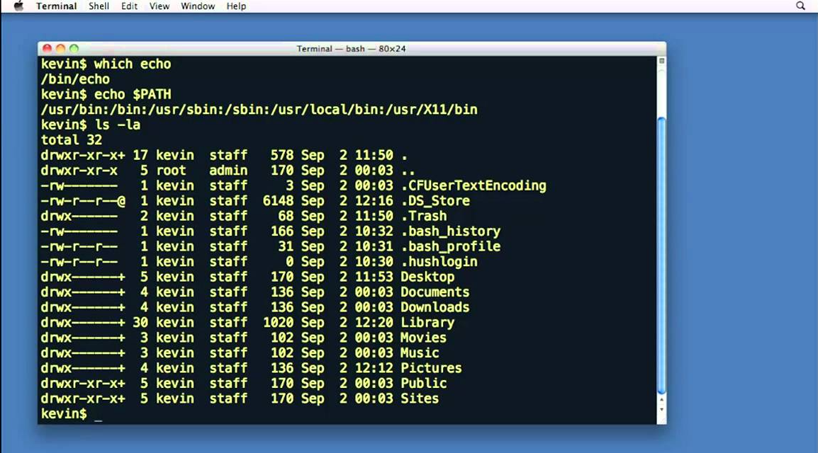
Unix is an operating system
A Terminal is the programme which runs the shell
The prompt
The Unix shell is a command line interface to Unix
Bash is a popular Unix shell

Slide 6
Where do I go from here?
You will practice using the Unix shell during the Git session this afternoon
Don’t forget the man command, eg: `man ls`
Follow the lesson at
https://swcarpentry.github.io/shell-novice/
Write a script which will automate part of your research workflow
Attend the HPC drop-in clinic (Tuesdays, 2pm, Library room 204)
Watch Hackers
“We learn from failure, not
from success!”
Return at 2pm: GIT

