Slide 1
A Mendelian randomization study
Estimating the causal relationship between blood pressure and eosinophil count in African Ancestry
Group names
Itunuoluwa Isewon
Festus David Lutaaya
Okwir Julius
Arinda Shinah
Lucy Goudswaard

Slide 2
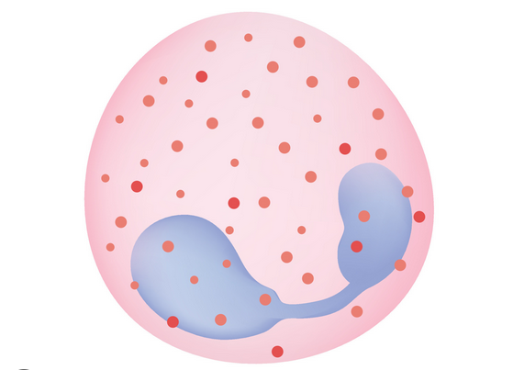
Background
Eosinophils are a type of white blood cell that plays an important part in the immune system's response to infections, allergies, and illnesses.
Notes:
Eosinophils are characterised by their unique cytoplasmic granules, which contain a variety of enzymes and proteins.
These granules allow eosinophils to produce powerful chemical mediators involved in inflammation and immunological control.
Eosinophils have also been implicated in other physiological processes such as the regulation of blood pressure.

Slide 3
Background
Elevated blood pressure was found to influence eosinophil function and behaviour.
Elevated blood pressure triggers their migration to affected tissues where they contribute to inflammatory response.
Conversely, eosinophils were also found to impact blood pressure regulation suggesting a potential bidirectional relation between eosinophils and blood pressure.
(Siedlinski et al., 2020)

Slide 4
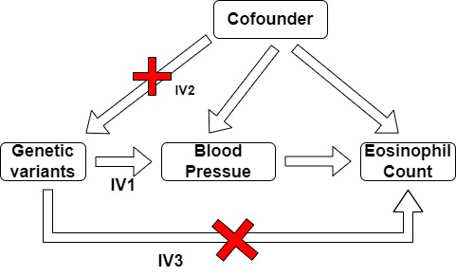
Aim
Our study aims at estimating a causal relationship between blood pressure (systolic and diastolic) and eosinophil count.

Slide 5
Methods
Exposure blood pressure GWAS
Population
N
Genotyping panel
QC – what did they adjust for?
Outcome GWAS in Uganda and DDS
For the Eosinophil blood cunt, 7000 individuals were sampled (~2000 taken).
Genotyping panel used was Illumina Human Omni 2.5M octo array.
First performed standard GWAS, then multi-variate GWAS.
QC, Excluded individuals due to gender check criteria and those too related.
For multiple testing, adjustment of GEMMA was done for multi variate GWAS.

Slide 6
Methods – MR methods
Two Sample MR Method.
Involves analyses in which the genetic IV risk factor association and genetic IV outcome association are ideally generated from different samples.
Inverse Variance Weighted Random Effect Method.
Combines ratio estimates together in an inverse variance weighted meta-analysis adjusting for heterogeneity.
MR-Egger Repression Method
Combines ratio estimates together into a meta-regression to estimate the causal effect adjusted for any directional pleiotropy.
MR Weighted Median Method
MR Weighted Mode Method

Slide 7
Results – SBP on eosinophil count

Slide 8
Results – DBP on eosinophil count

Slide 9
Results
SNP | Exposure, Blood Pressure | Gene | Disease or trait
rs10270361 | Diastolic | RP11-421N10.1 | N/A
rs1245187 | Diastolic | RASSF3 | - Mean platelet volume - Platelet count
rs11962385 | Systolic | TMEM14C | N/A
rs142131717 | Systolic | AC116606.1 | N/A
rs370532269 | Systolic | TARBPI | N/A
rs429988 | Systolic | RP11-944L7.4 | - Heel bone density - Femoral neck mineral density
rs74734735 | Systolic | TOMM22P4 | N/A
Table1 showing disease or traits associated with the SNPS

Slide 10
Conclusions & future directions

