Slide 1

Strategic Design
In Practice
Implementing GDS, User-Centred Design, and Agile at scale.
© Globefox Ltd 2026 CC BY-NC 4.0. ND

Slide 2
Contents
Introduction 2
UCD 4
GDS 9
Agile 13
Strategic design 19
© Globefox Ltd 2026 CC BY-NC 4.0. ND
Strategic Design In Practice 2026

Slide 3
Introduction
The systems being built now will shape public services for a generation. The UK's £2 billion AI investment and further smart data schemes due by 2035 depend on those foundations being right. Good design reduces rework, surfaces challenges before they build into barriers, and generates the data that makes improvement possible and visible. There is so much more to be done. 60% of digital projects at risk, satisfaction down 11 points in a decade, and an employment gap that costs the economy billions in lost earnings and unrealised potential annually.
So how do we best bring change?
Build value by meeting everyone's needs Good design aligns purpose, usability and impact so that users, operational staff and organisations all benefit.
Structure activity and effort over time A sound design framework delivers now and creates the conditions for future ambition.
Measurably deliver and improve Good design makes outcomes visible, testable, and improvable over time.
Enable data-led working and change Design asks the right questions - and builds systems that generate the right data to answer them.
© Globefox Ltd 2026 CC BY-NC 4.0. ND
Strategic Design In Practice 2026

Slide 4
User-Centered Design
© Globefox Ltd 2026 CC BY-NC 4.0. ND
Strategic Design In Practice 2026

Slide 5
UCD as a Journey
ITERATE
DISCOVER
DEFINE
DESIGN
MEASURE
IMPROVE
Surface real needs - including those existing data has not been able to see.
Delivers: User insight, data gaps identified, inclusion risks surfaced.
Frame the right problem, with the right people, before solutions are fixed. Delivers: Problem statements, user profiles, journey maps, equity of access analysis.
Refine functional requirements, align objectives define standards.
Delivers: tested assumptions, prototypes, roadmap, validated user stories
Ensure the service can be measured and is responsive to changes in need. Delivers: user metrics, performance baselines, captures live issues and ideas
Use what you learn to close gaps and make continuous improvements
Delivers: Outcome data, reach metrics, evidence of impact and value over time.
© Globefox Ltd 2026 CC BY-NC 4.0. ND
Strategic Design In Practice 2026

Slide 6
UCD Approaches and Methods
UCD Approaches
UCD Methods
Inclusive Design
User Research
Accessibility, plain language, and logical user pathways. Include all service users in research - including research design.
Capture and interpret user and stakeholder needs and objectives.
Prototyping & Iteration
Journey Mapping
Explore design options, test early, refine regularly.
Visualise tasks, touchpoints, and pain points across roles.
Show & Tells / Playback
Service Blueprinting
Share progress with stakeholders to validate findings.
Map how functions and systems deliver the service.
Evidence-Based Working
UCD Roles (DDaT)
User insights and system data guide all decisions.
Defines roles and competencies for UK Public Sector Digital.
© Globefox Ltd 2026 CC BY-NC 4.0. ND
Strategic Design In Practice 2026

Slide 7
UCD evidence
UK Public Sector Projects are required to continuously evidence and document how they are:
Aligning with real user needs
Collaborating with stakeholders
Establishing structured insight streams to understand users, tasks, and service challenges.
Creating regular engagement points to shape direction across all teams.
Strengthening design capability
Driving evidence-based improvement
Building access to UCD roles through internal uplift or targeted partnerships.
Making the most of research, support data, and MI to inform design and planning.
Supporting iterative delivery
Ensuring priorities reflect user value
Using MVPs and phased improvements to reduce risk and embed learning.
Enabling governance that balances strategic goals with user evidence.
Delivering measurable impact
Supporting compliance and assurance
Defining outcomes linked to usability, efficiency, and compliance.
Aligning design outputs with GDS, accessibility, and other standards from the outset.
© Globefox Ltd 2026 CC BY-NC 4.0. ND
Strategic Design In Practice 2026

Slide 8
UCD and AI
.
Responsible Public Sector AI is already delivering significant cost saveing and efficiency.
This depends on the decisions and models behind it being transparent, explainable and representative, and making sure that errors do not proliferate and affect model decision-making and outcomes.
AI requires ongoing validation and human oversight, and accountability when something goes wrong, or representation, inclusion, data quality and other key criteria slip.
Responsible AI embeds UCD approaches to ensure that bias and errors can be actively anticipated and detected, establishes the alert thresholds and triggers for action, and the means to make effective corrections.
UCD provides the means to keep models and their framing accountable, and to help ensure that AI-derived insights form reliable evidence and insights that can be confidently acted on.
© Globefox Ltd 2026 CC BY-NC 4.0. ND
Strategic Design In Practice 2026

Slide 9
GDS - Government Digital Service
© Globefox Ltd 2026 CC BY-NC 4.0. ND
Strategic Design In Practice 2026

Slide 10
GDS - Government Digital Service
GDS is the UK government's central team, established in 2011, responsible for making government digital services simpler, clearer, and faster to use.
GDS also provides the standards, tools, and shared infrastructure that help service teams work effectively and consistently across government.
Using established shared standards and components means that services can be more consistent and effective from the outset.
Beyond tools, GDS offers assurance - service assessments that apply honest, evidence-based scrutiny at key stages, grounding decisions in research rather than assumption.
The overall offer is coherence: teams operate within a framework that is open, tested, and built on shared values - user need first, evidence over opinion, transparency by default.
Integrated Digital Framework
Shared platforms, technologies, and processes for consistent government services.
GOV.UK Design System
Standardised styles, components, and patterns across .GOV services.
Shared Services
GOV.UK Pay and GOV.UK Notify - streamlining payments and communications.
Communities of Practice
Cross-government Slack and peer networks for shared knowledge and implementation.
© Globefox Ltd 2026 CC BY-NC 4.0. ND
Strategic Design In Practice 2026

Slide 11
GDS Principles
This is for everyone
Start with user needs
Design for inclusion the outset, including those with access needs, low digital confidence, or non-standard devices.
Focus on the real goals of all users — end users, delivery teams, stakeholders, and policy roles. Aligned and balanced user needs drive every decision.
Understand context
Do less
Know how, where, and why people use a service, and design around their real circumstances, not assumed ones.
Reuse GOV.UK tools and platforms; avoid duplicating effort or expense. Concentrate resource and effort where it adds greater value.
Build digital services not websites
Design with data
Think across the whole user journey, not just the key screens. The service is everything from first contact to final outcomes – and how feedback is utilised.
Use MI, feedback, and real usage patterns to inform priorities and choices. Let evidence lead, and use it to challenge and refine assumptions and approaches.
Be consistent, not uniform
Do the hard work to make it simple
Apply common patterns and language where they help users — but build in flexibility for where the context or the user need demands it.
Make functions such as complex forms and processes easy to understand and complete. The effort belongs with the design team, not the user.
Make things Open
Iterate. Then iterate again.
Share code, design patterns, key decisions, and learnings openly. Transparency builds trust and also prevents duplication across government.
Make continuous improvement core to how the service runs. Update regularly, learn from every cycle, and seek to take managed risks and learn from them.
© Globefox Ltd 2026 CC BY-NC 4.0. ND
Strategic Design In Practice 2026

Slide 12
GDS In Practice
Service Standards
Leadership Advocacy
Clear standards for usability, compliance, accessibility, security, and performance applied throughout the project. Where standards cannot be fully met, this should be noted, and clear timebound commitments made in the service roadmap.
Leadership actively champions GDS principles and integrates them into decision-making, delivery and assessment. Insights, knowledge and learning outcomes are shared across teams and Departments.
Empowering People
End-to-End Delivery
Teams apply and evolve design principles in daily work, supporting delivery and continuous improvement, both for services and ways of working. People should feel empowered to speak up especially around team challenges and project risks.
Services are designed holistically - from user engagement, testing onboarding and defining service standards, to operations, support and service evaluation. Services are grounded in user needs from the outset, and designed to meet open standards, common components and the right technology choices.
Data-Driven Decisions
Transparency & Collaboration
Decisions are made using a clear evidence base. Data from MI, user feedback, and behavioural insight are used to guide ongoing improvements and prioritisation. Care is taken to ensure that data is representative and unbiased.
Plans and decisions are recorded and shared, to build trust and maintain clear direction, both inside and outside the team. Public Sector commitments to transparency and accountability should be met wherever possible.
© Globefox Ltd 2026 CC BY-NC 4.0. ND
Strategic Design In Practice 2026

Slide 13
Agile
© Globefox Ltd 2026 CC BY-NC 4.0. ND
Strategic Design In Practice 2026

Slide 14
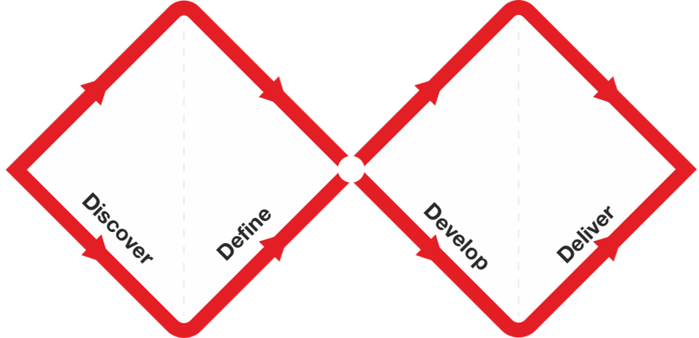
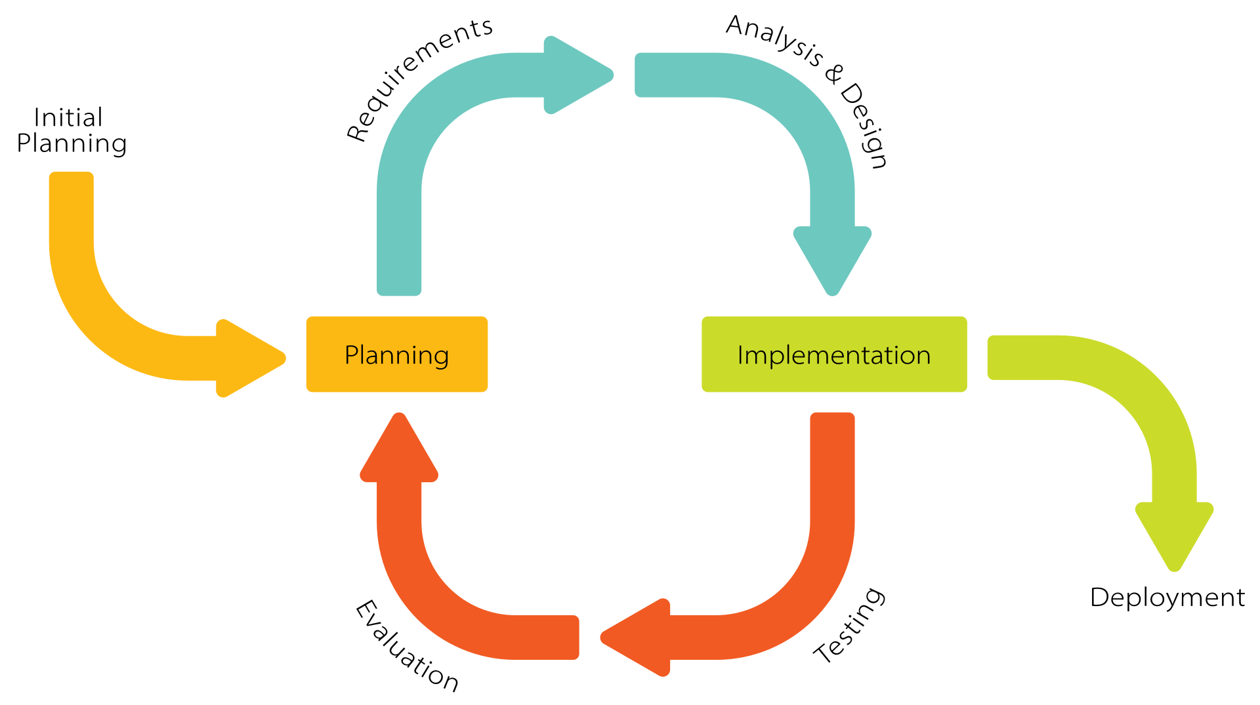
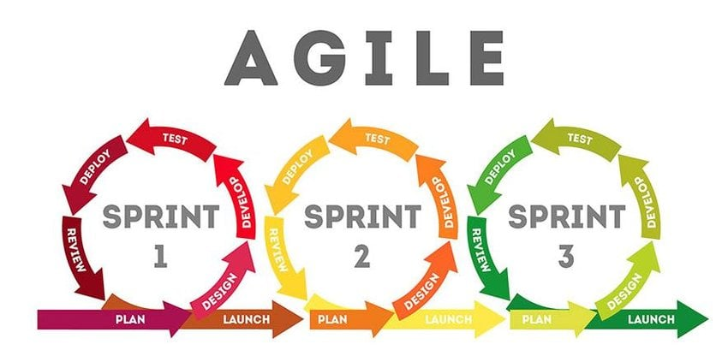
Design meets Agile
The Double Diamond
Agile
Iterative Working
The Double Diamond is a visual representation of a design and innovation process.
It is often interpreted as being linear - but it's cyclical. Divergent thinking (discover and define) alternates with convergent thinking (develop and deliver).
Agile is best understood as a continuous, layered cycle - enabling a roadmap that continually responds to user insight, compliance, and technology changes.
Agile emerged as a reaction against rigid, documentation-heavy 'waterfall' methods, seeking a more flexible, iterative, and human-centric approach.
Iterative working means delivering in short cycles - building something, testing it with real users, learning from what you find, and improving it before the next cycle begins.
The service can improve continuously, not just when things go wrong.
© Globefox Ltd 2026 CC BY-NC 4.0. ND
Strategic Design In Practice 2026

Slide 15
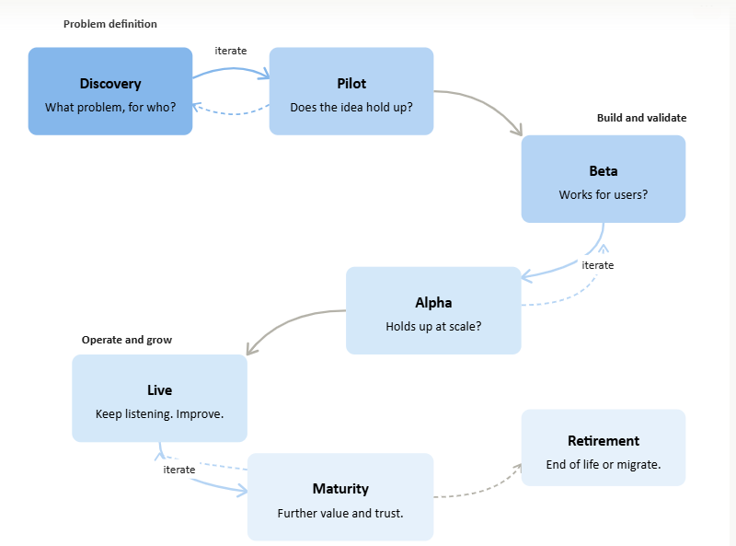
Agile lifecycles
Agile enables the creation of value at every stage, and makes the most of new technologies and approaches as they emerge.
It is a repeatable, iterative cycle that builds on what works, addresses what doesn't, and enables measurable increase of usability, reach and impact.
Discovery - What problem are we solving and for who? Pilot- Does the idea hold up when it's real? Beta- Does it work for the people who need it?
Alpha - Does it hold up at scale? Live - Keep listening. Make continuous improvements
Maturity – looking to add further value, trust
Retirement – end of life, and/ or migration to a new service
Items in italics are not usually framed as part of GDS cycles. Considering them adds value at every stage.
© Globefox Ltd 2026 CC BY-NC 4.0. ND
Strategic Design In Practice 2026

Slide 16
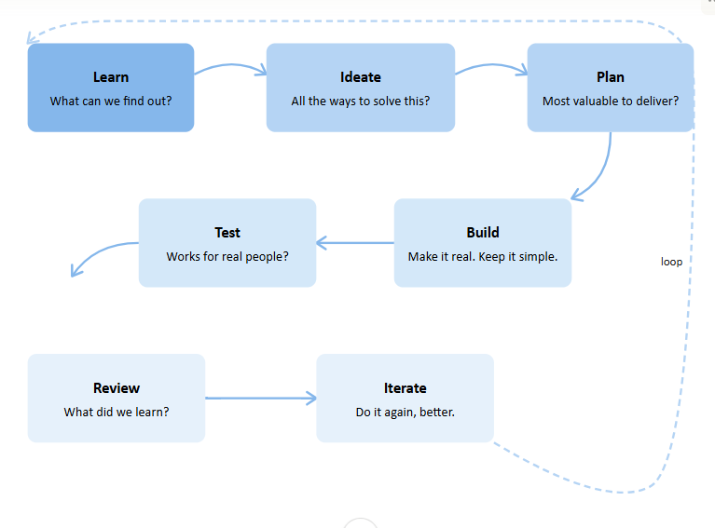
Agile and UCD together
Working in short cycles to learn, design test and iterate before moving to any deployment
Learnings and insights come before making changes becomes too expensive.
Learn - what can we find out? Ideate - What are all the ways we could solve this?
Plan - What's the most valuable thing we can deliver?
Build - Make it real, keep it simple. Test - Does it work for real people? Review - What did we learn? Iterate - Do it again, better.
© Globefox Ltd 2026 CC BY-NC 4.0. ND
Strategic Design In Practice 2026

Slide 17
Agile Themes, Epics, Stories
Effective use of all layers of Agile helps connect strategy to delivery in a consistent way.
Themes
Epics
Stories
Tasks
Define high-level goals, and how they are expected to be met. What objectives, outcomes and value are being sought and how? What is the business case? What does success look like, how will it be measured?
Group related work by service area or user journey or related objectives.
Set out expected approaches, assumptions, and success criteria.
Ensure these balance project priorities and policy commitments effectively.
Break work into aligned, actionable, user-focused objectives.
“As a [user] I need [x] so that [y]. “
Be sure to align user and organisational needs, usibily, and inclusion,as we as design and build.
Work items that make the stories deliverable. Each needs to have clear remit, and detail who will do what and when by. Cover deadlines, deliverables, dependencies and a clear definition of done.
© Globefox Ltd 2026 CC BY-NC 4.0. ND
Strategic Design In Practice 2026

Slide 18
Agile Ceremonies and success factors
Standups
Kanban
Retros
Daily touchpoints that keep teams aligned, surface blockers early, and maintain shared momentum. Avoid using calls as the main way to ‘check in’ on what everyone is up to – make them strategic.
A visual system that makes work in progress visible and prevents overload across the team. Be strategic about what you show – and how you will map and demonstrate progress visually.
Structured reflection that turns team feedback about what has happened into opportunities for the next sprint, and to improve ways of working. Most effective when people are free to speak up, and actions are owned and followed up.
Planning
Prioritisation
Reflection
Establishing what gets built next, why it matters, and what done looks like – and when pivots may be needed.
Involve the people doing the work, not just those in commissioning or management roles,
Explicit shared decisions about what will deliver most value and opportunities, for whom, and when.
Best supported by a roadmap and clear vision statement. If everything is a priority, nothing is!
Stepping back from delivery often to assess direction, impact, value of approaches, and risks.
Ask: Are we building it right - and are we building the right thing, in the most effective way?
© Globefox Ltd 2026 CC BY-NC 4.0. ND
Strategic Design In Practice 2026

Slide 19
Strategic Design
© Globefox Ltd 2026 CC BY-NC 4.0. ND
Strategic Design In Practice 2026

Slide 20
Strategic Design Tools
These tools balance and align user needs, success criteria, and organisational intent — connecting immediate delivery with longer-term ambition, and building sustained value over time. From building the investment case to mapping priorities and developing reusable design approaches, they help ensure design choices and project objectives support intended outcomes.
Business Case
Roadmaps
Design system, and patterns
Ensures design activity is aligned with organisational goals. Builds the investment case using user insight, performance data, and the cost of known pain points. Demonstrates how improvements will increase value, compliance, and operational assurance.
Provides a shared, aligned view of how services, features and priorities unfold over time. Connects user needs to policy, technical, and resource planning. Enables phased, iterative delivery while maintaining strategic direction. Encourages an ambitious approach to inclusion.
Developing reusable components and approaches that address recurring design problems, providing tested, reliable approaches to common requirements. This reduces rework, ensures consistency, and leaves more time for meeting specific needs.
© Globefox Ltd 2026 CC BY-NC 4.0. ND
Strategic Design In Practice 2026

Slide 21
Strategic Design Best Practice
Strategic design connects vision, evidence, and delivery. It gives organisations a principled way to navigate complexity — aligning what services are meant to do with what they actually do, and building the capability to improve over time.
It depends on the right people being in the room: leaders who champion it, practitioners who apply it, and the people who use services having a genuine voice throughout. Without that, best practice stays on the page.
The three principles below set out what good looks like in practice.
Reflective
Structured
Data Driven
Establish Theory of Change; and take time to reflect and ensure that activities and actions are well considered, appropriate and effective.
Review design and operational approaches for fitness for purpose - at all project stages, and learn and adapt as needed. Create communities of practice, and foster learning across Departments, roles and functions.
Bridge current and future services with strategic thinking and managed, consistent approaches.
Establish key change drivers, take emerging trends into account, and create transparent means to make informed decisions, and share outcomes. Be accountable for what you have not yet been able to deliver, and commit to a timeframe
Use data insights to navigate opportunity and risk.
Ensure design and technology decisions - and their rationale - are transparent, evidenced, and adaptable. Look for bias and seek to break siloes.
Actively monitor the performance and real-world implications of AI and automation.
© Globefox Ltd 2026 CC BY-NC 4.0. ND
Strategic Design In Practice 2026

Slide 22
Strategic Design Maturity Journey
1 PRODUCT CENTRIC
2 CUSTOMER CENTRIC
3 USER CENTRIC
4 SYSTEMS THINKING
5 PLATFORM LED
6 SERVICE MATURITY
Success is measured through satisfaction scores, NPS, and commercial performance.
Individual user needs are often buried in KPIs and user segmentation.
User research informs design and development.
Services are shaped around how people actually work. Decisions are grounded in evidence.
Design works across networks, integrations, and data flows.
Aligned objectives connect teams and functions around shared outcomes.
Services depend on shared data pipelines, reporting systems, and common capabilities.
Many changes can now be made 'on the fly', yet care is needed to manage impacts,esp for AI.
Value is measured by the response of the users, roles, and partnerships the service exists to serve.
Design, policy, resourcing, technology and data, need to be improved and validated continuously.
Focused on outputs and delivery against specifications. Foundational - but user needs may be assumed rather than evidenced. Success is defined by function and performance.
Each stage builds on the last - you cannot skip to 'Services' without understanding users, systems, and the platforms that connect them. Most organisations sit between User and Systems thinking; the goal is to move forward, and make intentional, evidence-led progress.
© Globefox Ltd 2026 CC BY-NC 4.0. ND
Strategic Design In Practice 2026

Slide 23
Standards & Assurance
Service Standards
Service Assurance
Standards are highly contextual, however will usually include:
Government Design Principles (GOV.UK)
Principles for Good Services (Lou Downe)
Data Ethics Framework (GOV.UK)
WCAG 2 Web Accessibility Initiative
AI Playbook for the UK Government
Public Sector Equality Duties (PSED)
General Data Protection Regulation (GDPR)
The Civil Service Code
National Disability Strategy
W3C Standards
Programme specific expectations
Platform / Technology
Uptime, response times, helpdesk, recovery, maintenance, and transition planning.
SLA
Expectations, KPIs, thresholds, responses, workflows, mitigations, penalties, and reporting.
Design Assurance
Documented decisions demonstrably aligning needs and priorities; managing design tensions; embracing continuous improvement.
Service Assurance
Setting standards, establishing KPIs, monitoring user satisfaction, leveraging data to demonstrate good decisions.
© Globefox Ltd 2026 CC BY-NC 4.0. ND
Strategic Design In Practice 2026

Slide 24
Top Takeaways
Design joins the dots
Restorative AI
Working collaboratively helps to make the most of resources time, and to align strategy, delivery, policy, and service commitments.
User insights help surface problems upstream, informing smarter decisions, and ensuring services deliver optimal public value, consistently and at scale.
Due to historic bias and the tendency for AI to optimise for what appears common, it is necessary to reevaluate and validate data and assumptions.
Services, processes, and decisions must be based on representative data that includes everyone, not just set personas, or the apparent majority case.
Service maturity
GDS, UCD, and Agile approaches.
Good services measure how well they are meeting user needs, and map the gaps that are preventing systems and data from being fully inclusive.
Mature services commit to closing gaps, and set ambitious roadmaps to further improve effectiveness, efficiency and deliver positive impact.
GDS helps define good services. UCD uncovers what users need, and what may be getting missed. Agile working enables teams to respond to those insights and adapt to changing demands and commitments.
Bringing these proven frameworks together supports the design, development and management of services that really work for the people who need them.
© Globefox Ltd 2026 CC BY-NC 4.0. ND
Strategic Design In Practice 2026

Slide 25
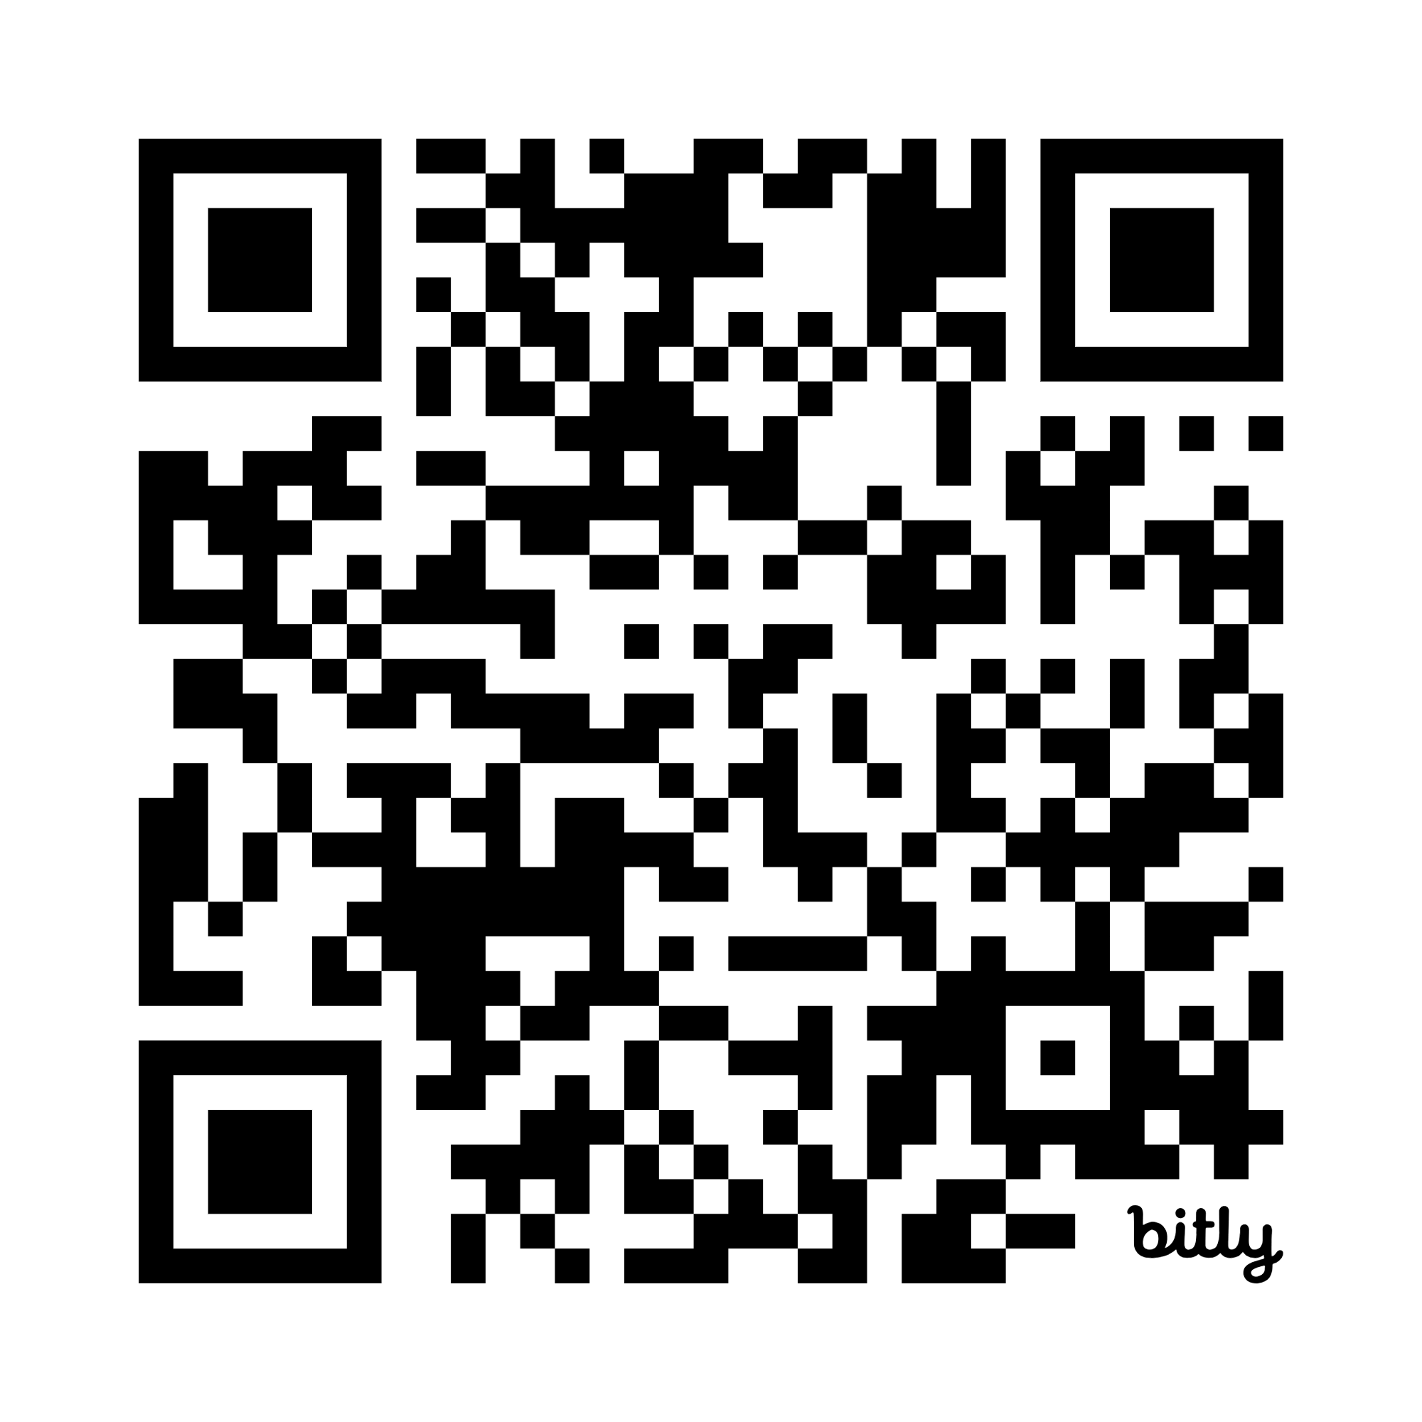
About This Document
I live on Git!
Aims:
A practical reference for organisations embedding design-led ways of working. Covers UCD, Agile, GDS principles, service maturity, and strategic design in a public sector delivery context.
AI use:
Claude (Anthropic) was used to draft and refine content, and to support layout refinement. All content was reviewed, edited, and approved by the author. All creative and editorial decisions are the author's own.
Sources:
Published frameworks, standards, and guidance - including GDS, DDaT, and occupational health research - were referenced to ground content in established practice. Sources are not reproduced; they informed the author's own synthesis.
Images:
Working diagrams (slide 6) are reproduced from third-party sources for illustrative purposes and attributed. All other visual elements are original to this deck.
Key references
Disclaimer:
This document is for guidance only. It does not constitute professional advice. Organisations should apply judgement appropriate to their own context, constraints, and governance requirements.
2035 Smart Data Strategy https://assets.publishing.service.gov.uk/media/69c11f9ed588c92c483e4b66/smart-data-strategy.pdf
GDS Standard and related resources https://www.gov.uk/service-manual/service-standard
Copyright:
© Lucy K Wills / Globefox 2026. Licensed under CC BY-NC 4.0. ND. You may share and utilise it as-is for non-commercial purposes, with attribution, and on the same terms. You may not adapt it or create derivative works without written consent.

