Slide 1
the computational role of motor cortex in trial-and-error learning
lucy lai
03-25-2019
olveczky lab meeting

Slide 2
today
the role of MC in state discovery
model 1.0: partially observable markov decision processes (POMDPs)
model 2.0: continuous inference over world states
the role of MC in exploration of action space
reward gradients
future directions and summary
learning over reward gradients
a surprise…!

Slide 3
today
the role of MC in state discovery
model 1.0: partially observable markov decision processes (POMDPs)
model 2.0: continuous inference over world states
the role of MC in exploration of action space
reward gradients
future directions and summary
learning over reward gradients
a surprise…!

Slide 4
today
dfsdf

Slide 5
today
dfsdf

Slide 6
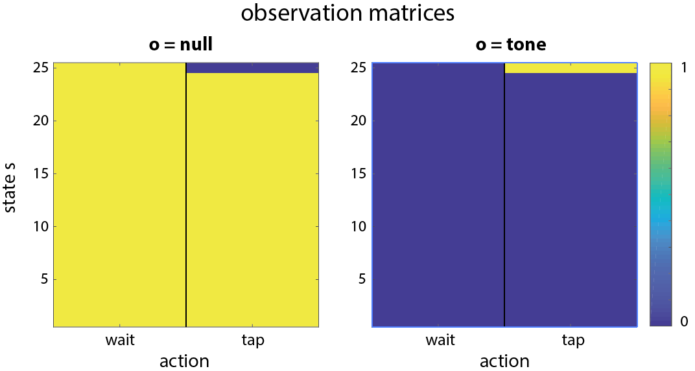
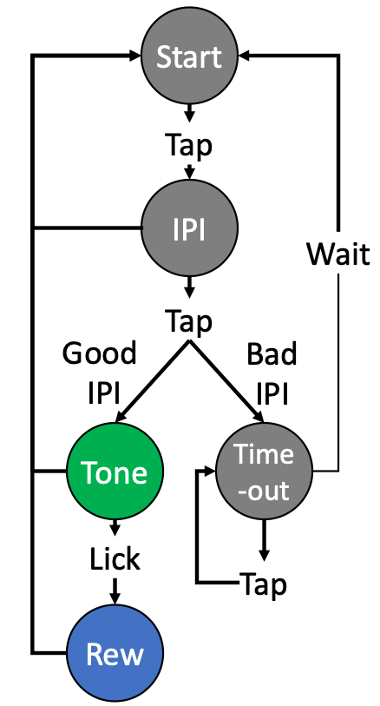
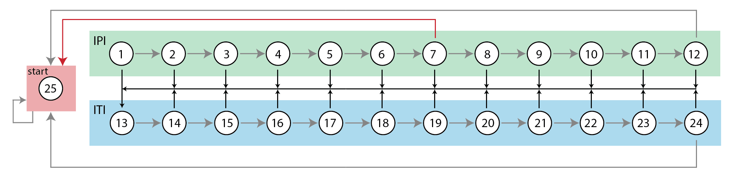
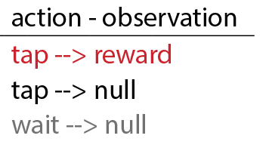
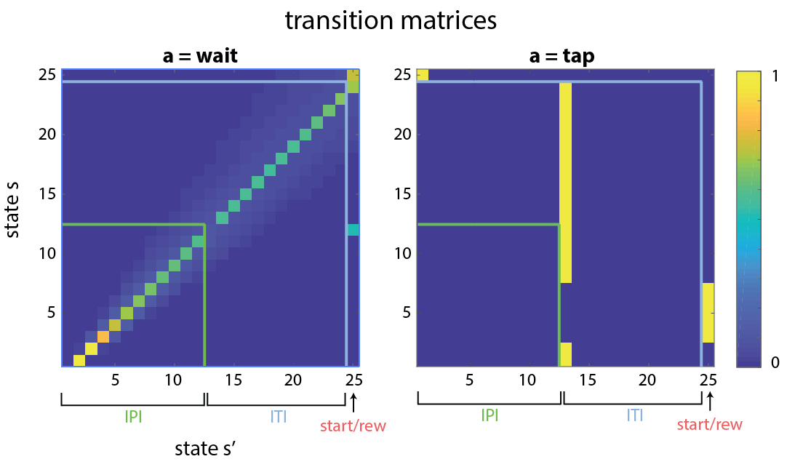
POMDPs for state space inference
Components:
25 States: IPI and ITI separated into 100ms sub-states
2 Actions = {wait, tap}
2 Observations = {null, reward}
Transition matrix T(s,s’,a) = p(s’|s,a)
Observation matrix O(s’,a,o) = p (o|s’,a)
Assumptions:
Relevant parameter is time…
T and O matrix have already been learned
Agent learns via actor-critic methods

Slide 7
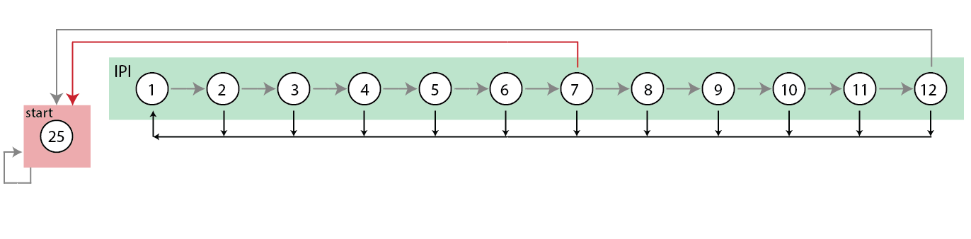
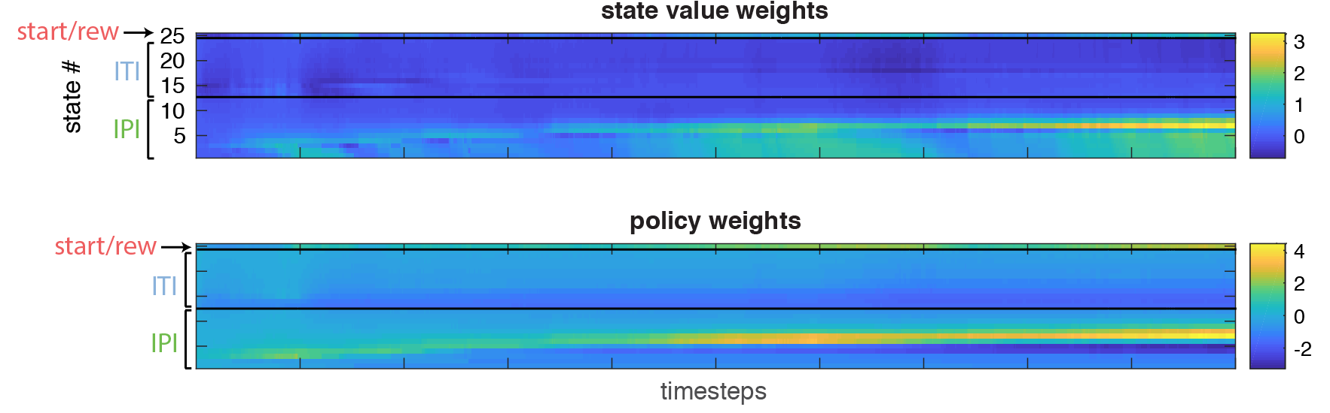
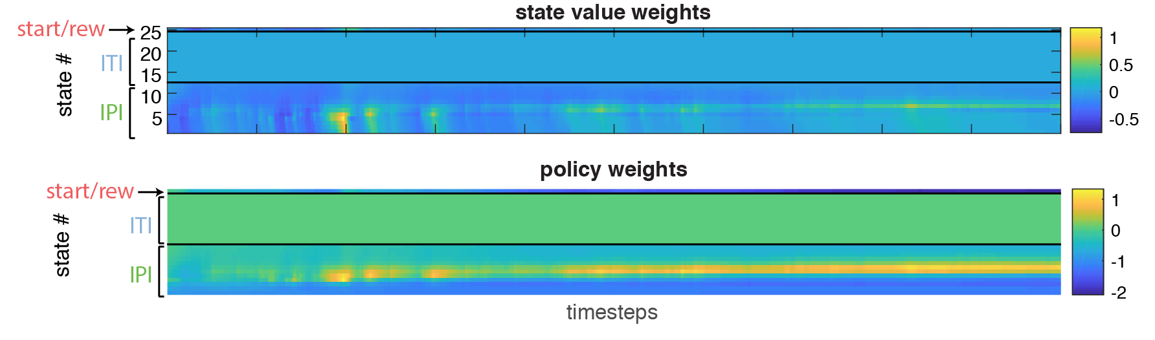

RL agents with different inferred state spaces
Agent 1: Knows ITI
Agent 2: Does not know ITI

Slide 8
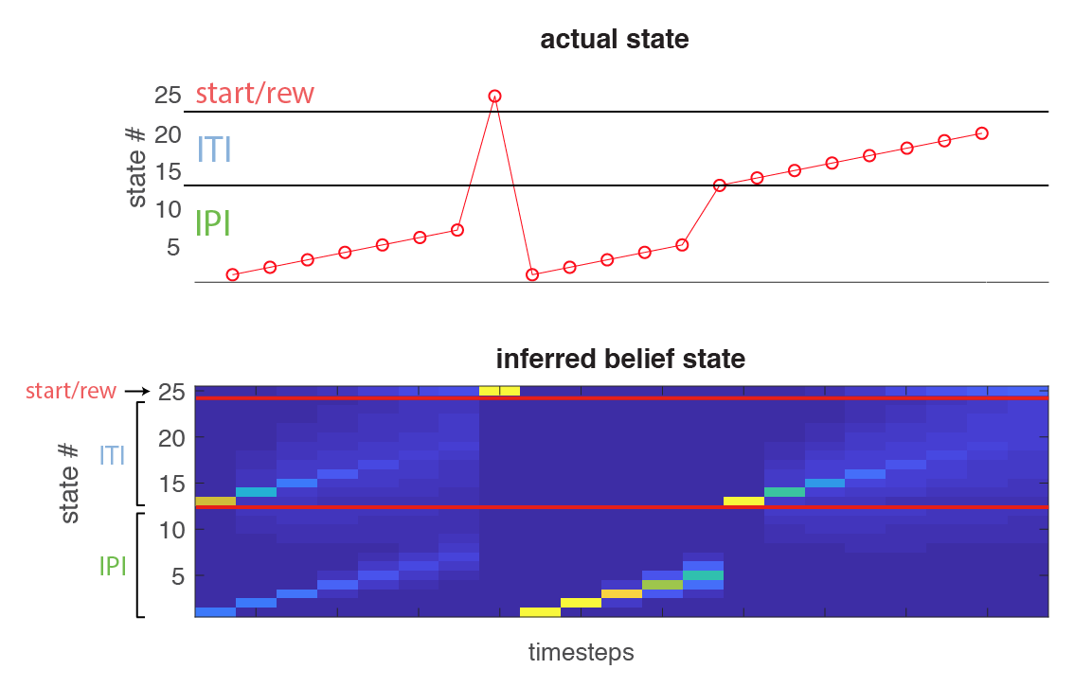
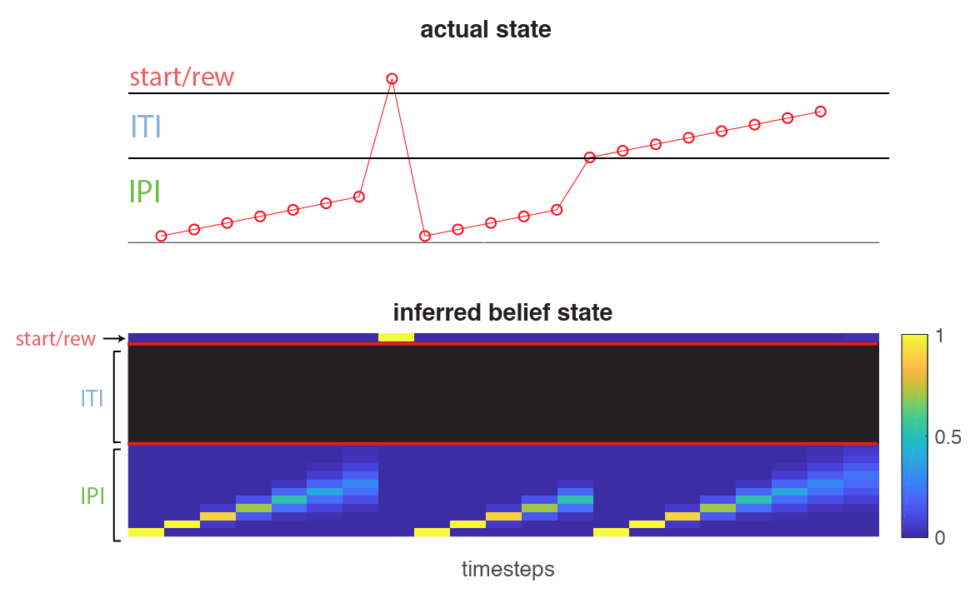
RL agents with different inferred state spaces
Agent 1: Knows ITI
Agent 2: Does not know ITI
tap
tap (early)

Slide 9
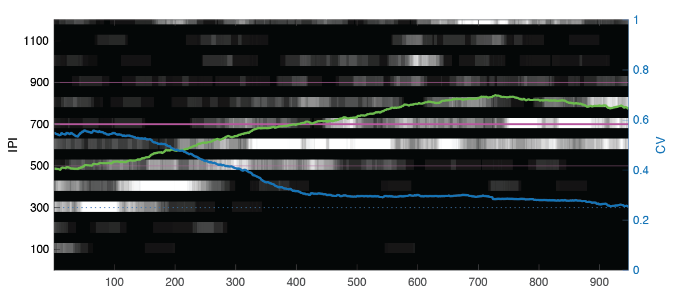
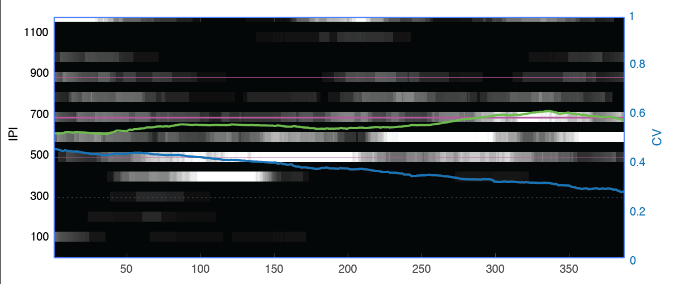
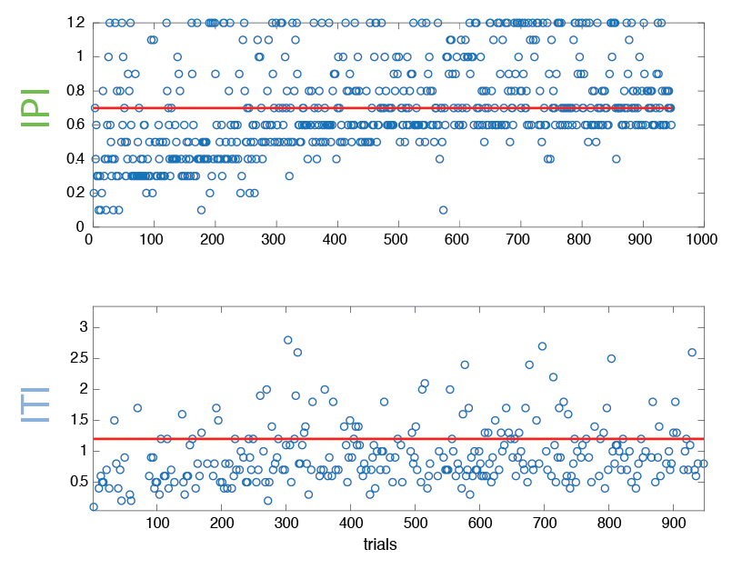
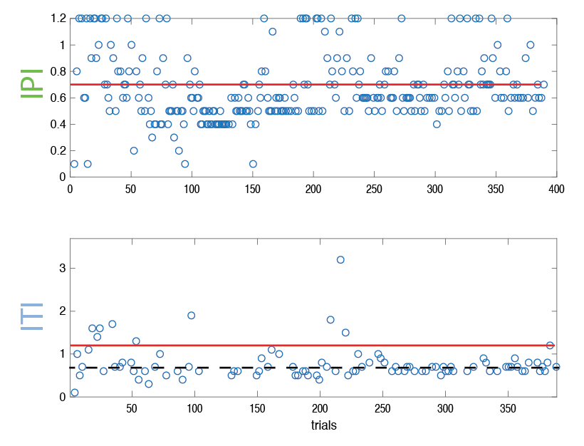
RL agents with different inferred state spaces
Agent 1: Knows ITI
Agent 2: Does not know ITI
Next steps… state discovery process (iPOMDPs; Doshi-Velez 2009); the sequence learning problem

Slide 10
today
the role of MC in state discovery
model 1.0: partially observable markov decision processes (POMDPs)
model 2.0: continuous inference over world states
the role of MC in exploration of action space
reward gradients
future directions and summary
learning over reward gradients
a surprise…!

Slide 11
today
the role of MC in state discovery
model 1.0: partially observable markov decision processes (POMDPs)
model 2.0: continuous inference over world states
the role of MC in exploration of action space
reward gradients
future directions and summary
learning over reward gradients
a surprise…!

Slide 12
things I learned and people to thank
things I learned
data is messy
thank you guys!
bence
gerald
Notes:
learned about data
- data is messy but makes it more interesting
learned a lot about myself
skeptical (too much) sometimes just need a push over the edge to get analyses done

Slide 13
today
the role of MC in state discovery
model 1.0: partially observable markov decision processes (POMDPs)
model 2.0: continuous inference over world states
the role of MC in exploration of action space
reward gradients
future directions and summary
learning over reward gradients
a surprise…!

