Slide 1
COMP90041
Lab5: Immutable Objects
Lucy Li

Slide 2
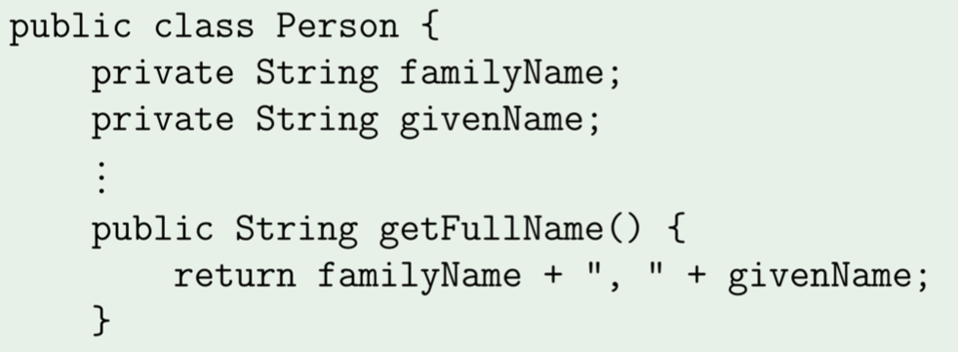
Review
Class
Class contains:
Instance variables: hold data of an object
Methods: define operations

Slide 3
Review
Class
Class is a type – can be used to declare variables that hold instances of that type
public class Test {
private Person teacher;
private Person [ ] classmates;
}

Slide 4
Review
Instance variables
Best practice: make it private and use accessor and mutators
public class Person{
private String familyName;
//accessor
public String getFamilyName(){
return this.familyName;
}
//mutator
public void setFamilyName(String newName){
this.familyName = newName;
}
}

Slide 5
Review
Instance variables (cont.)
What will happen if we have public instance variables….
For the Person class example:
Create a new object of class Person: Person a = new Person();
Change instance variable by: a.familyName = “Li”
What will happen if we have public static instance variables…
For the Person class example:
Create a new object of class Person: Person a = new Person();
Change instance variable by: a.familyName = “Li”
When other people create their own object of Person: Person b = new Person();
b.familyName will be changed as well!

Slide 6
Review
Instance variables (cont.)
Why?
Avoid privacy leaks
Restrict access to read only (do not include mutators)
Add some checks before trying to make changes to the instance variables

Slide 7
Review
Constructors:
Always have same name as class
Never specify the return type
Every class has a default constructor
Instance variables (cont.)
Initialization:
Initialize within constructors
public class Person{
private String familyName;
private String givenName;
public Person (String familyName, String givenName){
this.familyName = familyName;
this.givenName = givenName;
}
}

Slide 8
Review
Instance variables (cont.)
Initialization:
Assign value when created
public class Person{
private String familyName = “Li”;
private String givenName = “Lucy”;
}

Slide 9
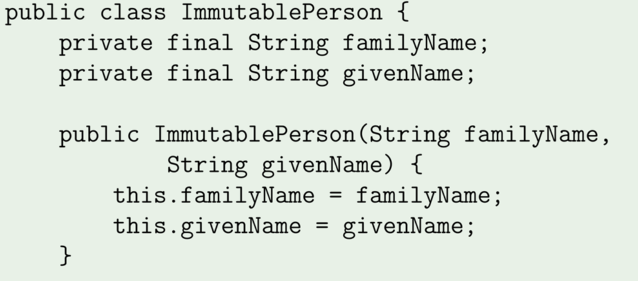
Review
Immutable objects
Def: cannot be changed once they are created
How?
No public methods that can modify the object (no mutators)
Use final keyword to instance variables

Slide 10
Review
“this” keyword
refer to the current class
public class Person{
private String familyName ;
private String givenName;
public Person (String familyName, String givenName){
this.familyName = familyName;
this.givenName = givenName;
}
}

