Slide 1
COMP90041
Lab6: Mutable Objects
Lucy Li

Slide 2
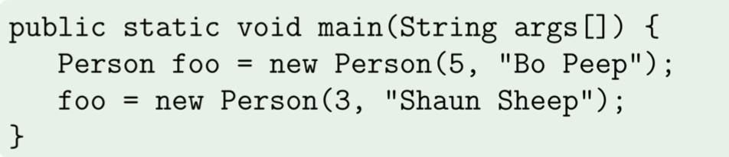
Review: reference types vs. value types (1)

Slide 3
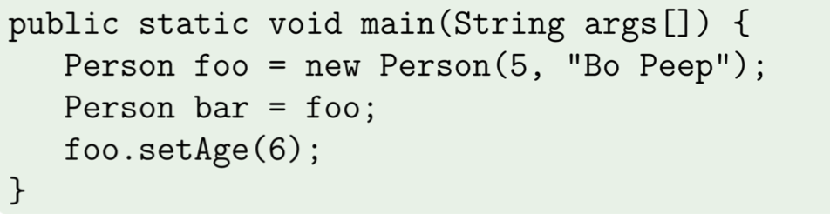
Review: reference types vs. value types (2)

Slide 4
Review: reference types vs. value types (3)
public static void main (string[ ] args){
//reference types Person A = new Person (1, “John”);
Person B = new Person (2, “Sam”);
Person B = A;
//value types
int alpha = 1;
int beta = 2;
int beta = alpha;
}

Slide 5
Review: shallow copy vs deep copy
Shallow copy:
Person A = new Person (1, “John”)
Person B = Person A
Deep copy:
Person A = new Person (1, “John”)
Person B = new Person (1, “John”)
All instance variables are the same!

Slide 6
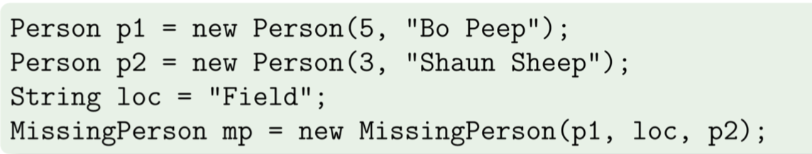
Review: privacy leak (1)

Slide 7
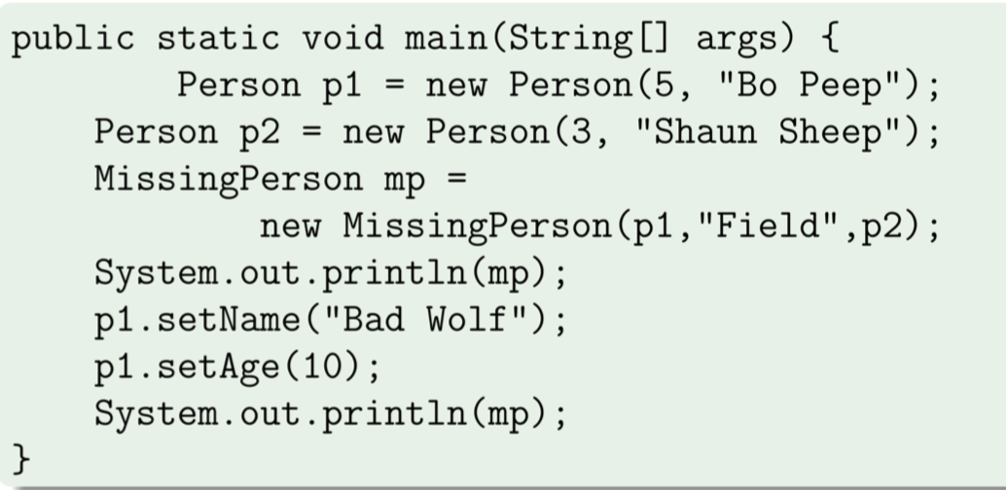
Review: privacy leak (2)
Why?

Slide 8
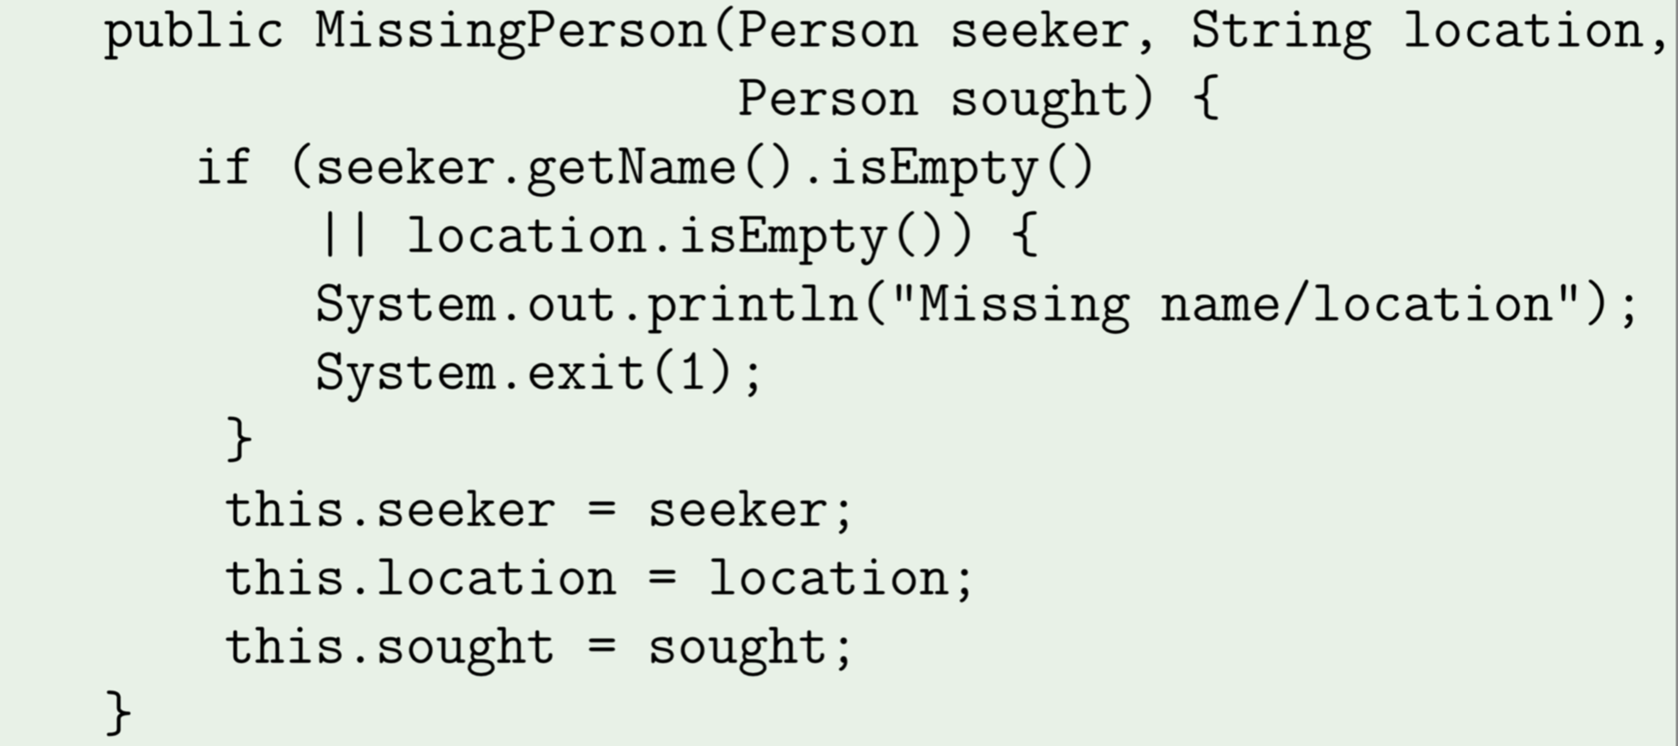
Review: privacy leak (3)
Take closely at constructors again….
All shallow copies!!

Slide 9
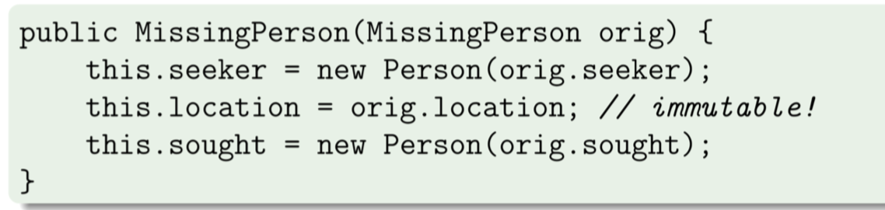
Review: copy constructor (1)

Slide 10
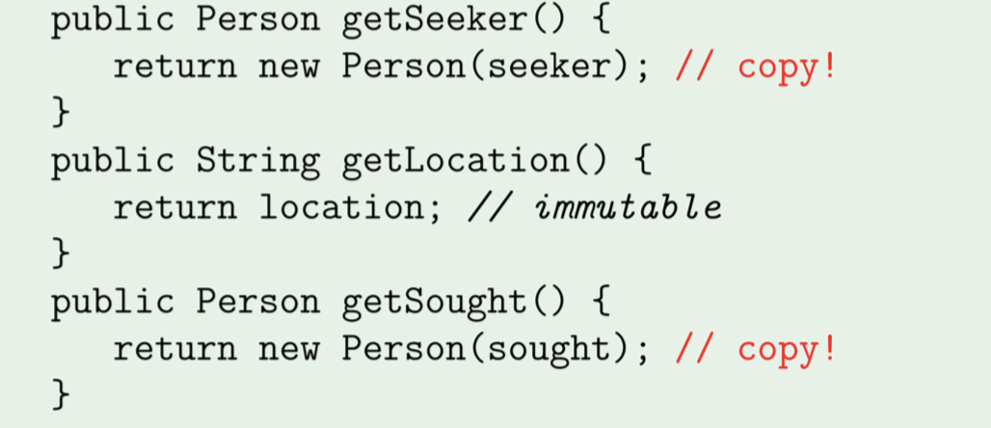
Review: copy constructor (2)

Slide 11
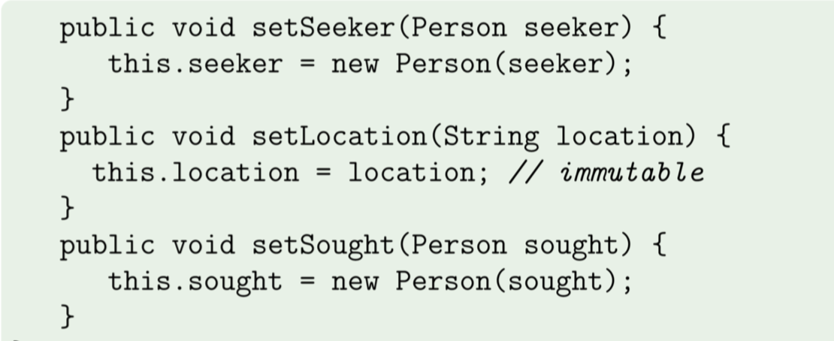
Review: copy constructor (3)

Slide 12
Review: Strings are immutable
public static void main(String args[]) {
String str = "abc";
String strCopy = str;
str = "def";
System.out.println(strCopy); // prints "abc"
}

