Slide 1
COMP90041
Lab8: Inheritance
Lucy Li

Slide 2
Review: Inheritance
The derived class (or child class) inherits all instance variables and methods of the base class (or parent class) and add its own
Except private methods and instance variables
Super keyword: reference to parent class object
super.parentInstanceVariable
super.parentMethod( )
E.g. next page

Slide 3
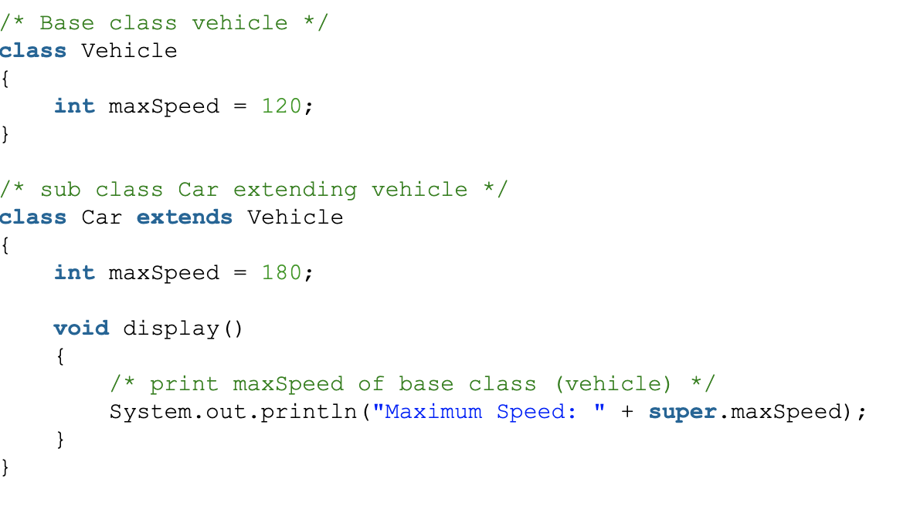

Slide 4
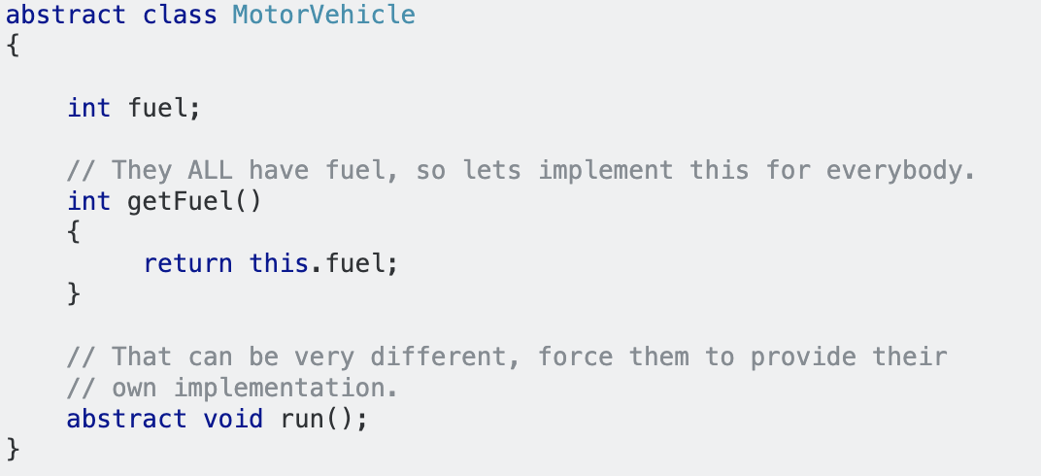
Review: Abstract data type
At least one method is abstract (or not defined)
e.g. abstract class

Slide 5
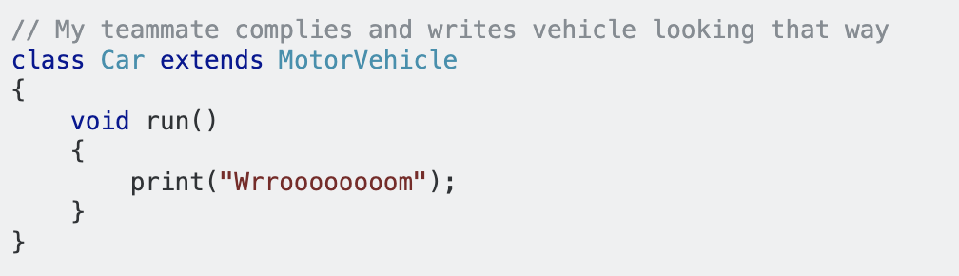
Review: Abstract data type
Implementation

Slide 6
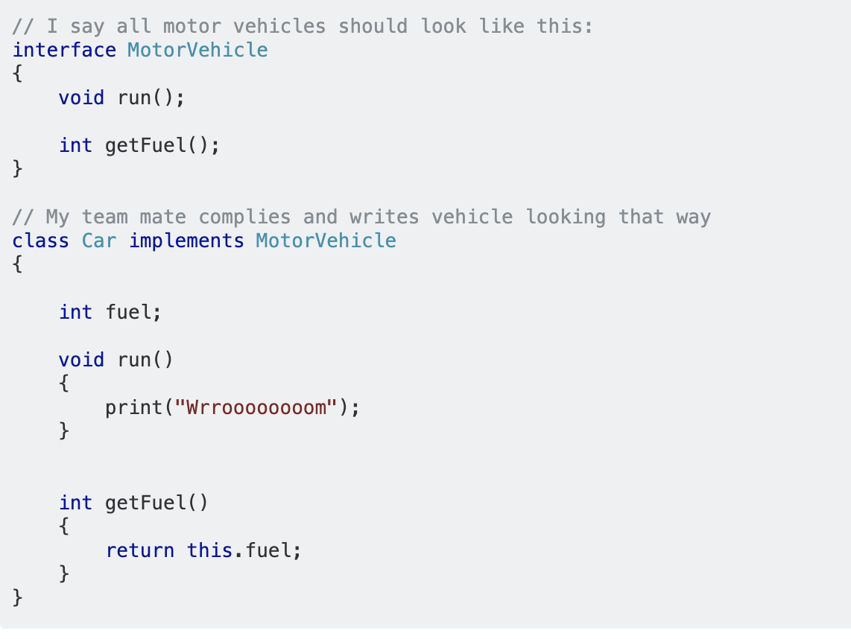
Review: ADT vs Interface
No implementation at all
A “contract” that requires all classes that implement this interface to have these methods
E.g. interface

Slide 7
Review: ADT vs interface
Implementation

Slide 8
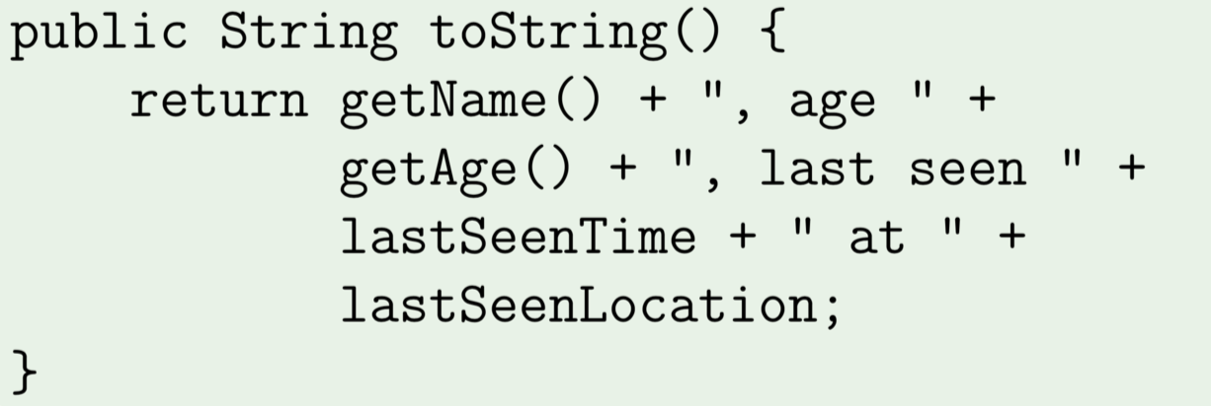
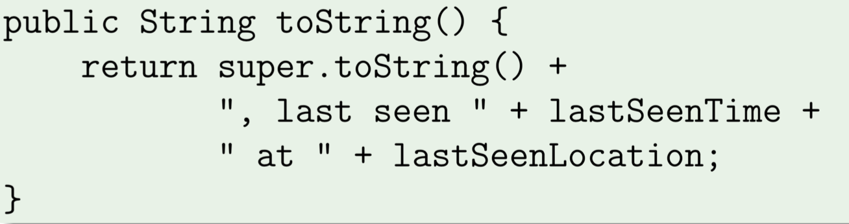
Review: Overriding
Subclass defines a method with the same signature
Parent class toString( ) method
Child class toString() method

Slide 9
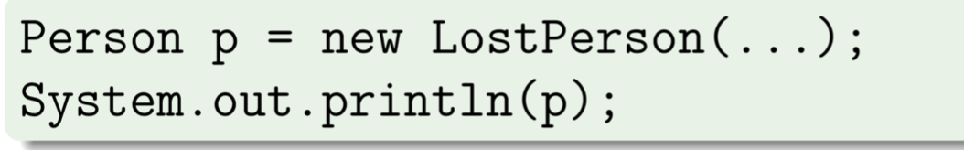
Review: Overriding
Which toString method will the following use?

Slide 10
Review: Overriding vs overloading
Overloading:
Name is the same but signature is different
Can access both methods
Can overload static methods
Overriding
Same signature as method in base class
Can only access overriding method in child class
Cannot override static methods

Slide 11
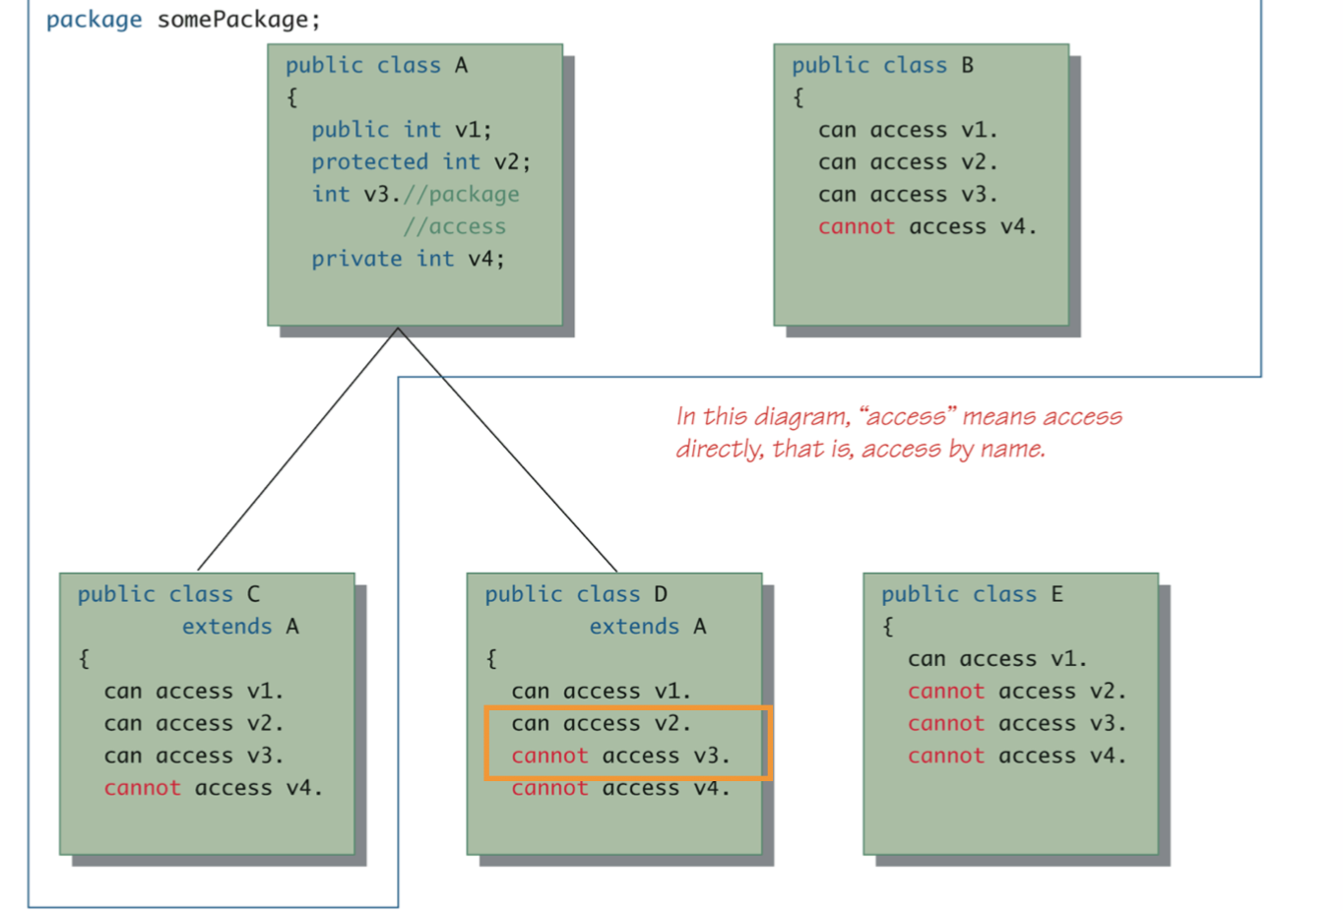
Review: Package and visibility
Private
Public
Package
Protected

