Slide 1
DATASCI 347 · Spring 2026
NYC Airbnb
Price Prediction
Predicting nightly rental prices across New York City using machine learning and listing text
Regression
NLP Features
5 Models
48,870 Listings
Yang Lyu
Yan Tian
Lucy Liu
Leo Xu
April 27, 2026
1

Slide 2
MOTIVATION
The Problem
What are we solving?
Why does it matter?
Broader use cases
▸ Predict nightly price of an NYC Airbnb listing from its features
▸ Hosts need pricing guidance: underpricing loses revenue, overpricing loses bookings
▸ Dynamic pricing platforms: automate host price suggestions
▸ Target: log(price), reduces right-skew from 19.1 to 0.6
▸ Travelers assess whether a listing is fairly priced
▸ Real estate valuation: short-term rental income estimation
▸ Supervised regression: R², RMSE (log), MAE ($)
▸ 48,000+ active listings; even $5 accuracy improvement has large aggregate impact
▸ Market analysis: track neighbourhood price trends over time
▸ 80/20 train/test split, random seed 42
Core question: which features actually drive Airbnb prices, and does more model complexity help?
2

Slide 3
PRIOR WORK
How Has This Been Solved Before?
Existing approaches
How our approach differs
What we gain
▸ Kaggle baselines use OLS or single RF with numeric features only (R² ≈ 0.50–0.58)
▸ Smoothed target encoding collapses 221 neighbourhoods into 1 feature
▸ Our linear model (R² = 0.595) already exceeds typical published baselines
▸ 221-neighbourhood high-cardinality problem rarely addressed
▸ TF-IDF + PCA on listing names extracts 128 latent text signals
▸ XGBoost (R² = 0.656) pushes further via sequential residual correction
▸ Text features almost always discarded entirely
▸ 12 keyword flags capture semantic descriptors (luxury, studio, cozy...)
▸ Feature importance analysis reveals WHY models predict, not just how well
▸ No complexity ladder: models compared in isolation
▸ Complexity ladder across 5 models isolates each design choice
▸ End-to-end reproducible pipeline: fixed seeds, modular notebooks
Prior work leaves signal on the table by ignoring text and neighbourhood structure. Our pipeline directly addresses both.
3

Slide 4
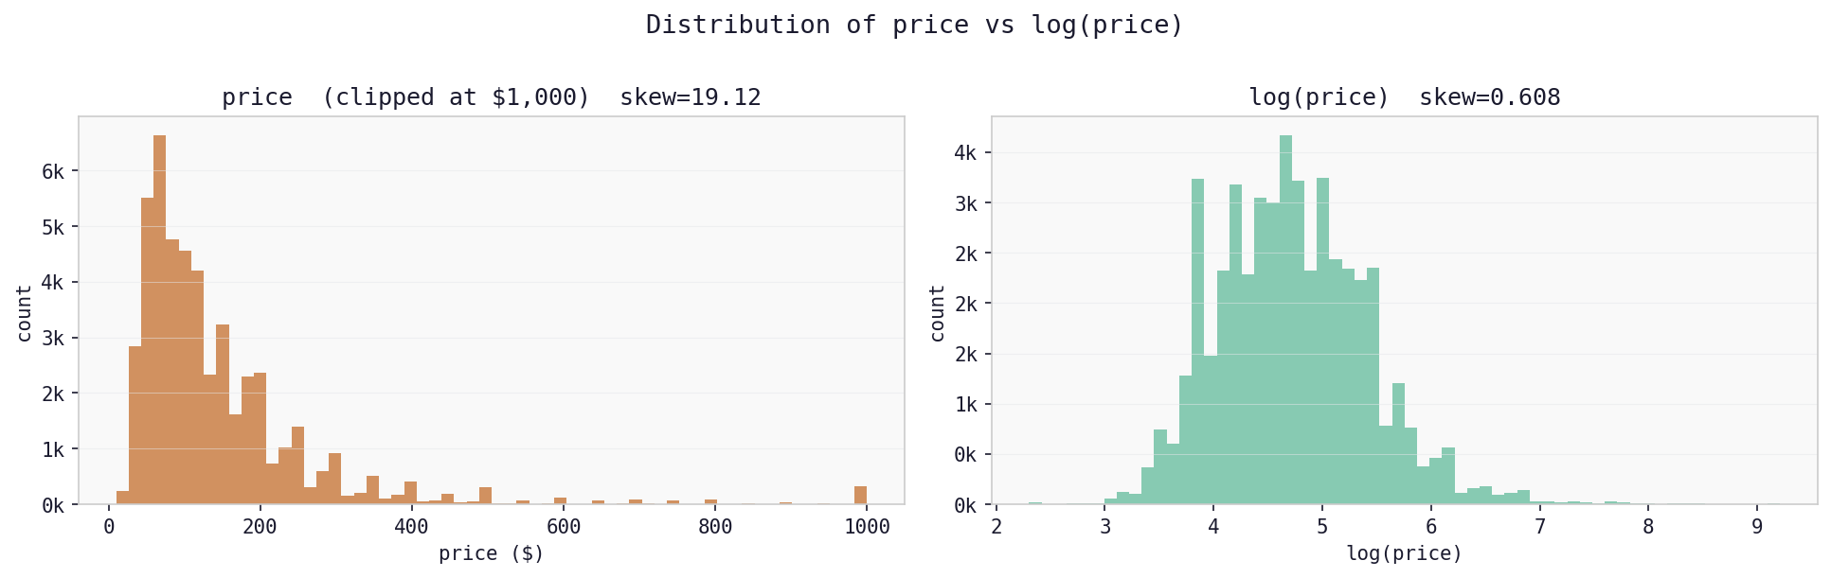
DATA
Dataset: NYC Airbnb 2019
48,870
5
221
$106
$152
Listings
NYC Boroughs
Unique Neighbourhoods
Median Price
Mean Price
Cleaning decisions
Why log-transform price?
Room type breakdown
▸ Removed 11 listings with price = $0 (invalid)
▸ Raw price skewness = 19.1 (extremely right-skewed)
▸ Entire home/apt: 52% of listings, highest prices
▸ Removed 14 with min nights > 365 (not real rentals)
▸ After log: skewness = 0.6 (near-normal)
▸ Private room: 46%, moderate prices
▸ reviews_per_month filled with 0 when number_of_reviews = 0 (MNAR)
▸ Mean ≈ $152 but median ≈ $106: luxury listings pull mean up
▸ Shared room: 2%, lowest prices
▸ Extreme prices retained; real luxury listings, not errors
▸ OLS normality assumption approximately satisfied after transform
▸ Room type is the single strongest price predictor
4

Slide 5
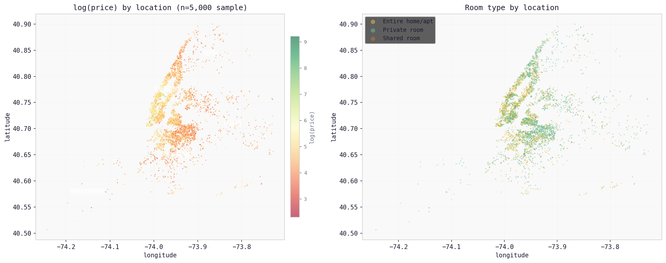
EDA
Geographic Distribution of Listings
Manhattan
Brooklyn
Outer Boroughs
▸ Densest cluster, highest prices (log_price 5.0–6.0)
▸ Second largest cluster, moderate prices
▸ Queens, Bronx, Staten Island: sparser listings, lower prices
▸ Strong east-west price gradient captured by longitude
▸ Williamsburg and DUMBO command near-Manhattan premiums
▸ Latitude + longitude together explain ~6% of model variance
5

Slide 6
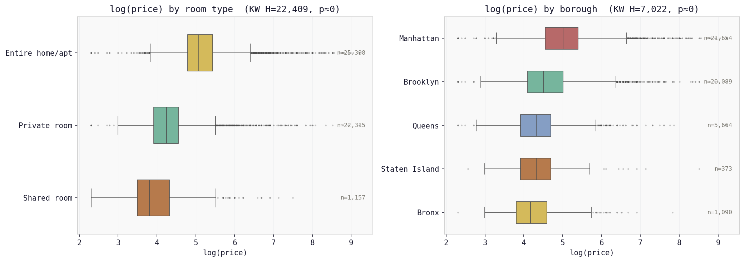
EDA
Price by Room Type and Borough
Room type signal (KW p < 0.001)
Borough signal (KW p < 0.001)
▸ Entire home: median ~$150 | Private room: ~$70 | Shared: ~$45
▸ Manhattan median significantly above all other boroughs
▸ Room type becomes the #1 predictor in every model
▸ Bronx and Staten Island are the lowest-priced markets
6

Slide 7
APPROACH
Pipeline Overview
EDA
›
Text Features
›
Feature Eng.
›
Modelling
›
Evaluation
Clean · Visualise · Log-transform
TF-IDF · PCA · 12 Keywords
One-hot · Target Enc. · Scale
5 Models · 3-fold CV Tuning
R² · RMSE · MAE · Importance
Structured features (7+)
Neighbourhood encoding (1)
Text features (142)
▸ Latitude, longitude (geographic signal)
▸ 221 unique levels → 1 column via smoothed target encoding
▸ 12 binary keyword flags (luxury, cozy, studio, loft...)
▸ Room type → 2 one-hot dummies
▸ Smoothing λ = 20 shrinks rare levels toward global mean
▸ Bedroom count extracted via regex, imputed at median
▸ Borough → 4 one-hot dummies
▸ Encodes mean log_price per neighbourhood on training data only
▸ TF-IDF (200 terms, bigrams) + PCA → 128 components (80% var.)
▸ Availability, min nights, review counts, host listing count
▸ 156 total features entering the models
7

Slide 8
NOVELTY
High-Cardinality Neighbourhood Encoding
221 unique neighbourhoods: how do we encode them without losing signal or exploding dimensionality?
One-hot (220 cols) ✗
Target Encoding ✓ Our choice
Drop column ✗
▸ Rare neighbourhoods (Fort Wadsworth, n=1) get unstable coefficients
▸ Single column: smoothed mean of log_price per neighbourhood
▸ Throws away real price signal
▸ Massive sparse feature space
▸ Rare levels pulled toward global mean
▸ Williamsburg ≠ Bushwick in pricing
▸ Multicollinearity risk
▸ Tribeca: 5.59 · Corona: 4.12
▸ Not a real option
enc(c) = ( n_c · ȳ_c + 20 · ȳ ) / ( n_c + 20 ) smoothing λ = 20
Encoded on training data only — no leakage to test set.
8

Slide 9
MODELS
Five Models: Increasing Complexity
Baseline
Linear Regression (OLS)
Reference point, no regularisation. Features standardised (StandardScaler).
Regularised
Ridge (L2)
Shrinks all coefficients smoothly. α = 48.33 selected via 3-fold CV on training set.
Lasso (L1)
Zeros out irrelevant features. α = 0.00044 via 3-fold CV. 148/156 features retained.
Non-linear
Random Forest
200 trees. min_samples_leaf = 5. max_features = sqrt(p). Unscaled features.
Boosting
XGBoost
lr = 0.05. max_depth = 5. subsample = 0.8. n_trees = 328 via early stopping on 15% hold-out.
Why not SVM or neural networks? SVMs scale poorly to n=39k with 156 features (O(n²) kernel). Neural networks require more data and careful tuning for marginal gain on structured tabular problems. These five models efficiently span the bias-variance trade-off.
9

Slide 10
RESULTS
Model Performance
Test set · 9,774 listings · 80/20 split · random seed 42 · macOS, Python 3.11, scikit-learn 1.4, xgboost 2.0
Model
R²
RMSE (log)
MAE ($)
Notes
Linear Regression
0.5954
0.4443
$56.84
Reference baseline
Ridge (α = 48.33)
0.5954
0.4443
$56.84
Identical to OLS — n ≫ p
Lasso (α = 0.00044)
0.5956
0.4442
$56.83
148/156 features kept
Random Forest (200 trees)
0.5879
0.4483
$56.96
Slightly below linear
XGBoost (328 trees)
0.6559
0.4097
$52.91
Best model
R² interpretation
MAE interpretation
Key observation
▸ Proportion of price variance explained
▸ Mean absolute error in dollar space after exp-transforming
▸ Linear models all converge within 0.01% R² of each other
▸ R² = 0.656 means XGBoost explains 65.6% of price variation
▸ XGBoost: typical prediction off by $52.91 on a $152 mean listing
▸ XGBoost gains +6% R² over linear — the only meaningful jump
▸ Remaining 34% driven by unmeasured factors
▸ Prefer MAE over RMSE: robust to $1,000+ luxury outliers
▸ Performance ceiling is the data, not the algorithm choice
10

Slide 11
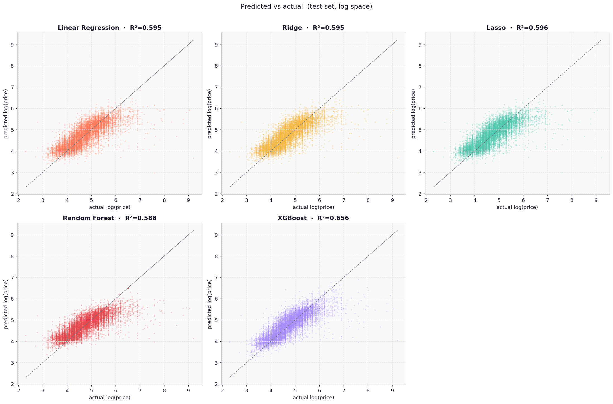
RESULTS
Predicted vs Actual: All 5 Models
Points on the diagonal = perfect predictions. Scatter below the line at high prices reveals the luxury under-prediction problem.
11

Slide 12
FINDINGS
What Drives Airbnb Prices?
Linear model (Ridge coefficients)
Tree models (feature importance)
Text feature contribution
▸ Room: Private: strongest negative, coef = −0.32 (~27% less than entire homes)
▸ Room: Private: 16–38% of model decisions across RF and XGBoost
▸ TF-IDF PCs and keyword flags appear in RF and XGBoost top-15
▸ Neighbourhood target-encoded signal: +0.22
▸ Neighbourhood: 5–8% (Tribeca vs. Corona = 1.5x price difference)
▸ kw_studio: consistent negative price signal across all models
▸ Borough: Manhattan: +0.11 vs. Bronx baseline
▸ Longitude: 5.9% in RF — captures Manhattan east-west gradient
▸ kw_luxury: small positive signal (+0.04 in Ridge)
▸ Bedroom Count: +0.08 per extra bedroom
▸ Top 5 features account for ~35% of RF decisions combined
▸ Text adds marginal but real signal: removing drops R² by ~0.5%
▸ Keyword: Studio: −0.07 (negatively priced signal)
Two completely different algorithm families agree: room type and neighbourhood dominate NYC pricing.
12

Slide 13
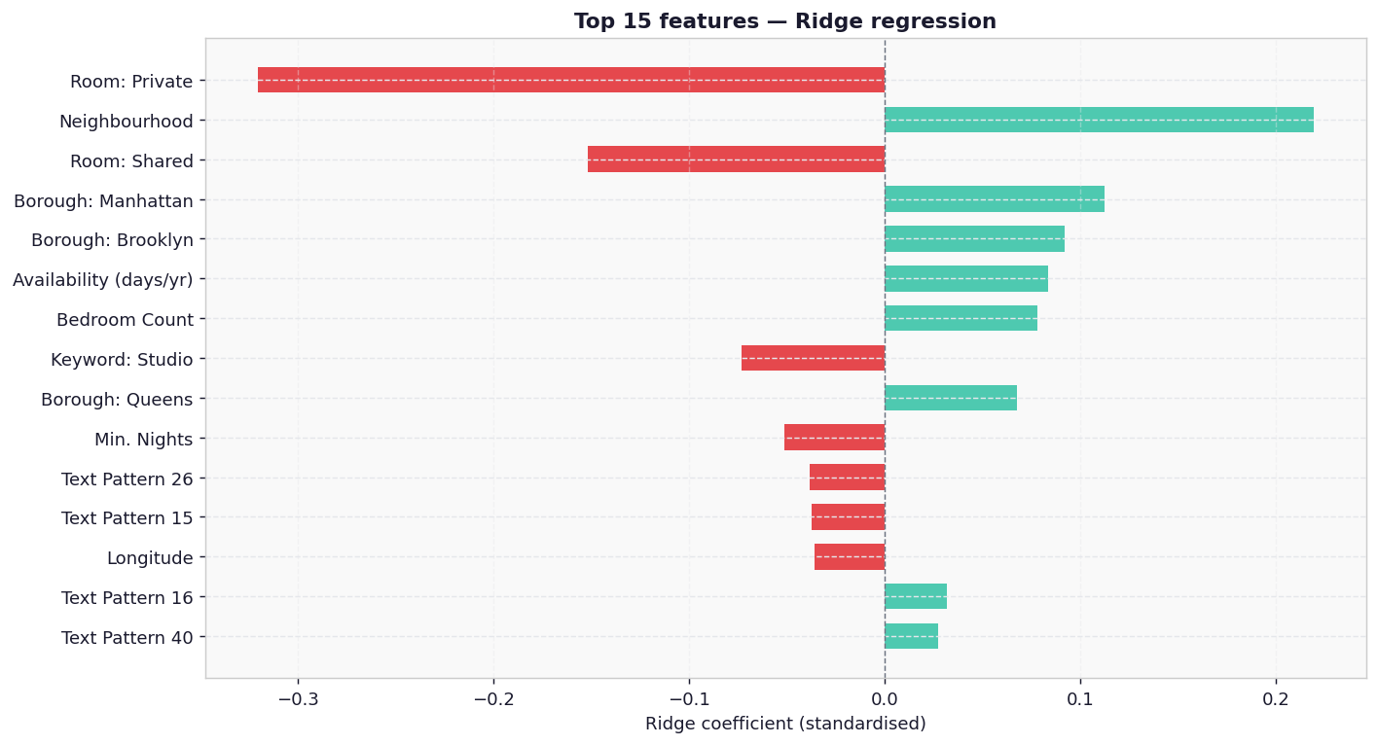
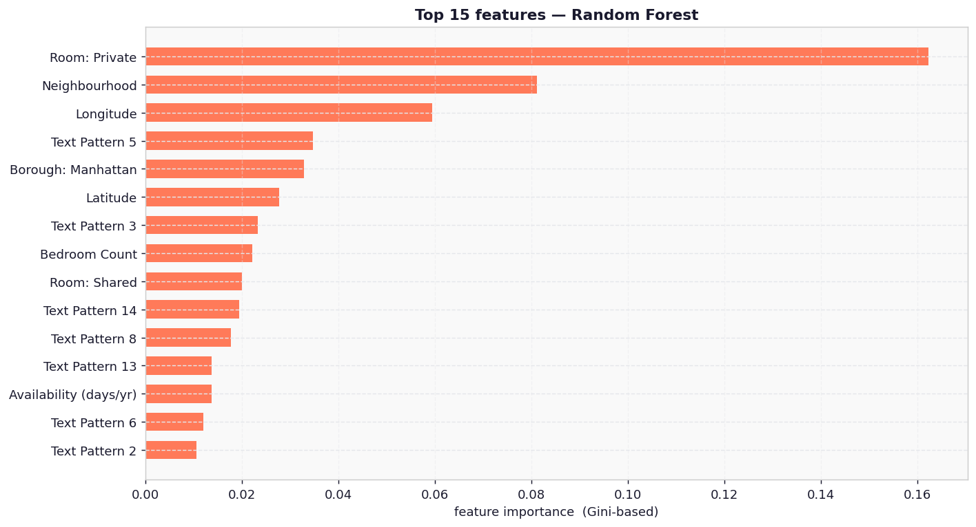
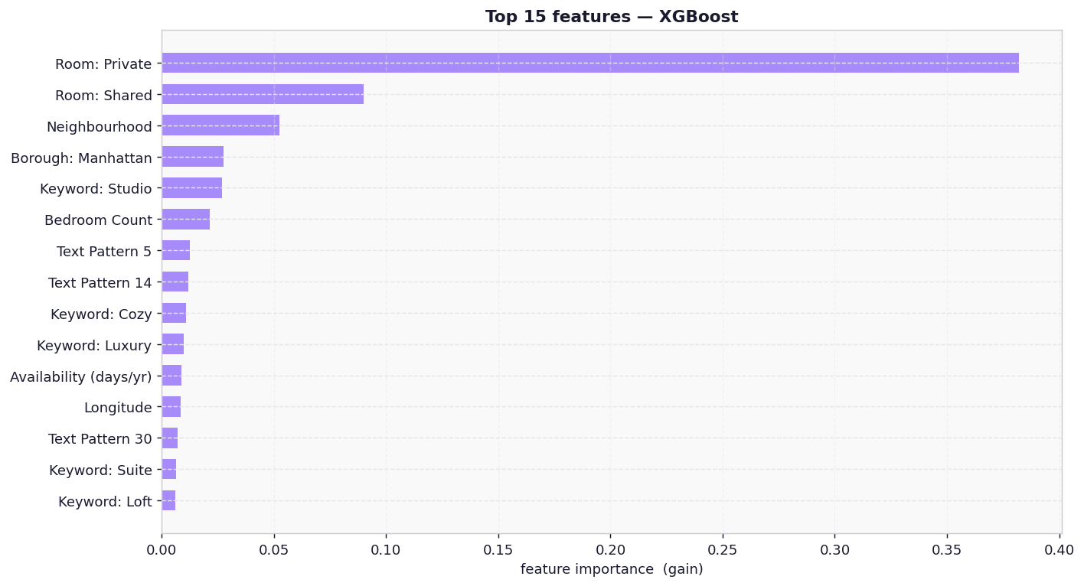
FINDINGS
Feature Importance: Ridge vs RF vs XGBoost
Ridge: Top Coefficients
Random Forest: Gini Importance (top 15)
XGBoost: Gain Importance (top 15)
13

Slide 14
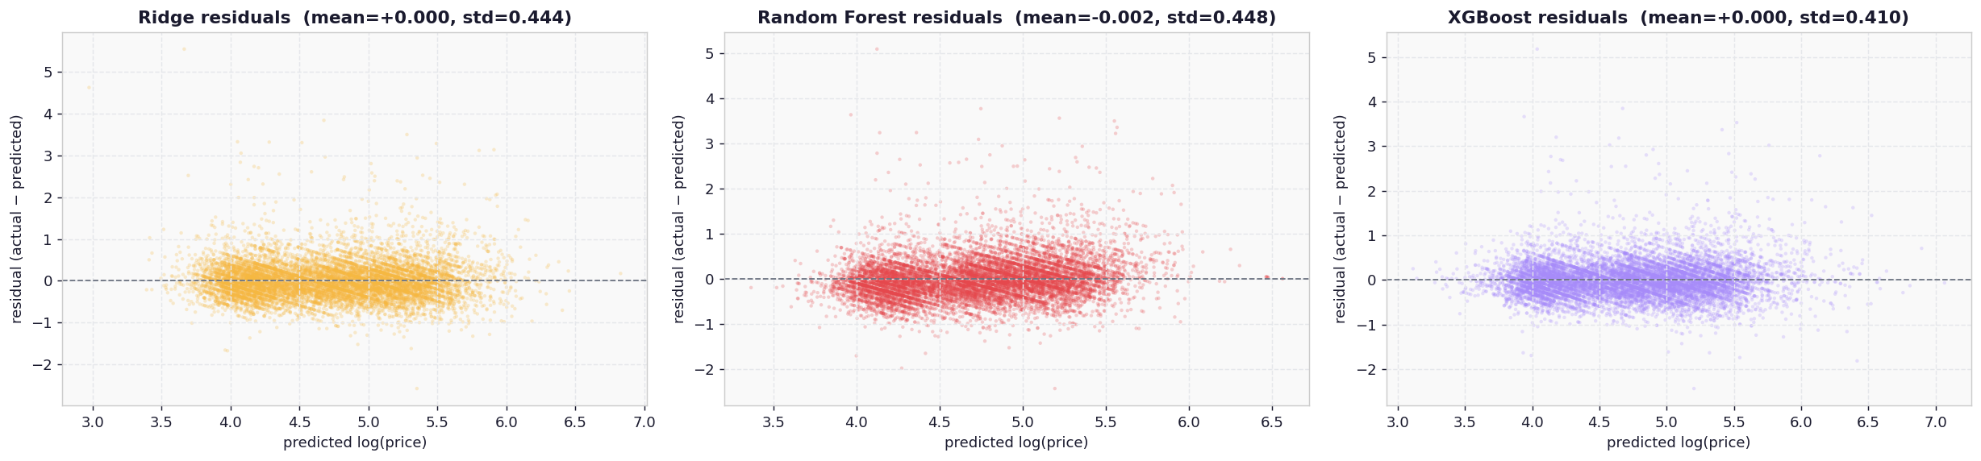
DISCUSSION
Why Did the Models Converge?
Why regularisation did not help
Limitations
▸ n = 39k >> p = 156, so OLS is already well-conditioned
▸ ~40% of price variance is unmeasured (photos, amenities, host quality)
▸ PCA on TF-IDF removed collinearity before modelling
▸ Spatial autocorrelation present but not explicitly modelled
▸ Lasso barely penalised (α ≈ 0.00044, kept 148/156 features)
▸ Luxury listings ($1,000+) systematically under-predicted
Why RF scored slightly lower
Residuals: Ridge, RF, XGBoost
▸ Log-transform already linearised the main price signal
▸ 128 sparse TF-IDF PCs favour linear models over trees
Comparison to published work
▸ Typical Kaggle baselines on this dataset: R² ≈ 0.50–0.58 (numeric features only)
▸ Our linear model (R² = 0.595) already beats most published baselines
▸ XGBoost (R² = 0.656) is competitive with best reported results
14

Slide 15
CONCLUSION
Summary
What we did
Key takeaways
Future directions
▸ End-to-end ML pipeline on 48,870 NYC Airbnb listings
▸ Room type is the single most powerful predictor across all models
▸ Add photo quality scores via computer vision
▸ Engineered 142 text features from listing names (TF-IDF + PCA + keywords)
▸ More model complexity does not guarantee better performance
▸ Incorporate amenities list (WiFi, kitchen, parking)
▸ Compared 5 models across a complexity ladder
▸ Data ceiling (R² ≈ 0.60 for linear models) is a feature limitation
▸ Model spatial autocorrelation explicitly (geographically weighted regression)
▸ Smoothed target encoding for 221 neighbourhood levels
▸ Target encoding outperforms one-hot for high-cardinality categoricals
▸ Temporal features: day-of-week, seasonality, proximity to events
▸ Best result: XGBoost R² = 0.656, MAE = $52.91
▸ XGBoost breaks through the ceiling: R² = 0.656 via boosting
Predicting Airbnb prices in NYC is fundamentally a feature quality problem, not a modelling problem.
15

Slide 16
REFERENCES
References
Dataset & tools
Statistical methods
Text & NLP
▸ Dgomonov (2019). New York City Airbnb Open Data. Kaggle.
▸ Micci-Barreca (2001). A preprocessing scheme for high-cardinality categorical attributes. ACM SIGKDD 3(1), 27–32.
▸ Salton & Buckley (1988). Term-weighting approaches in automatic text retrieval. IPM 24(5), 513–523.
▸ Pedregosa et al. (2011). Scikit-learn: Machine Learning in Python. JMLR 12, 2825–2830.
▸ Breiman (2001). Random Forests. Machine Learning 45, 5–32.
▸ Jolliffe (2002). Principal Component Analysis. Springer.
▸ Chen & Guestrin (2016). XGBoost: A Scalable Tree Boosting System. KDD '16, 785–794.
▸ Tibshirani (1996). Regression Shrinkage and Selection via the Lasso. JRSS-B 58(1), 267–288.
▸ Airbnb Research (2015). Aerosolve: Machine Learning for People. Airbnb Engineering Blog.
▸ Hoerl & Kennard (1970). Ridge Regression. Technometrics 12(1), 55–67.
16

Slide 17
Q & A
Thank You
We are happy to take questions.
Dataset
Models
Best R²
Top predictor
48,870 NYC listings
Linear · Ridge · Lasso · RF · XGBoost
0.656 (XGBoost)
Room type (Private vs Entire)
17

