Slide 1
General Target
Develope an AI-powered, context-aware language learning platform for ESL, with real-time, personalized feedback -- CALLME: Context-Aware Language Learning with Multimodal Enhancement
Challenge
Existing tools like Duolingo and ChatGPT are too generic—they don’t help users describe real, life-specific scenes or identify awkward phrasings in realistic contexts.
CALLME:
Context-Aware Language Learning

Slide 2

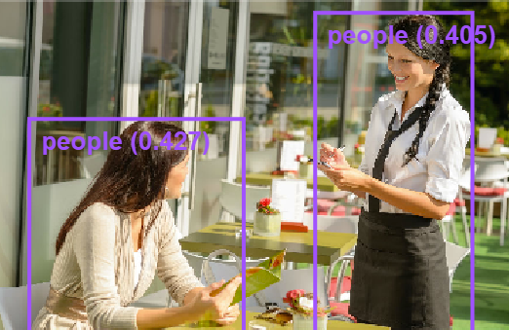

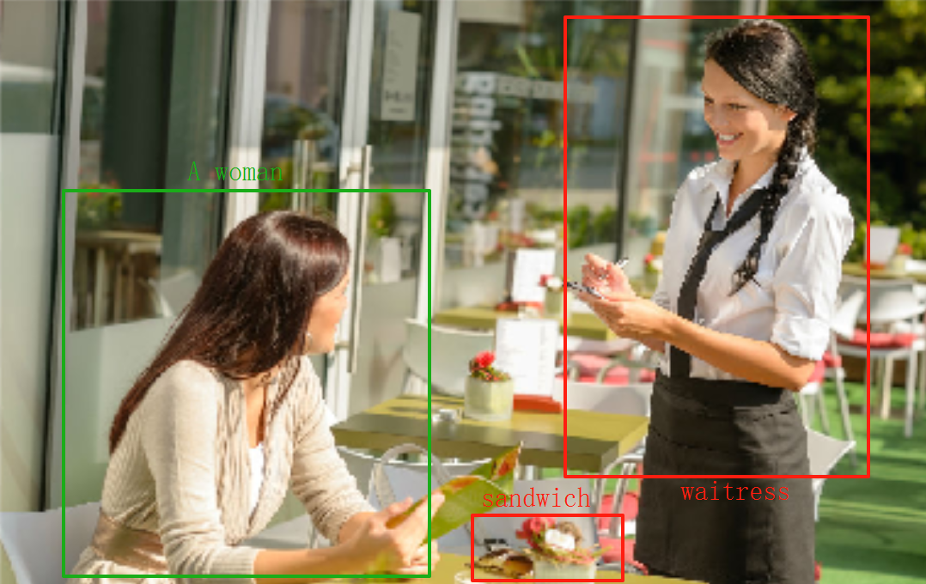


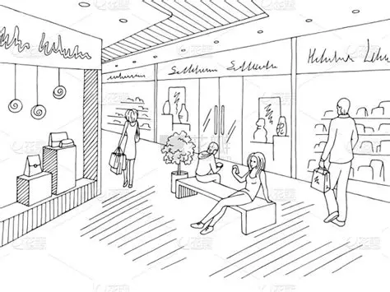












Photo Image/Video Input + Description
Computer Vision Grounding Model
Grounding Labels
MLLMs
Native Expression
Comparison Results in Image
From LLMs
Sketch + Description
Image-to-Image Model
Scenes Image
...
Entity Pairing & Matching
LLMs
Web Application with
AI-driven Feedback
From Human
Semantic Elements Extraction
Structured Data
Human Speech
Speech Processing Model
ESL Expression
Human Text
Pipeline Draft

Slide 3


Wei Ren
(video input is extension so can first try image format)
Photo Image/Video Input
Computer Vision Grounding Model
Grounding Labels
Computer Vision Grounding
Zhu Lu
Work Allocation
Sketch + Description
Image-to-Image Model
Scenes Image
Image Generation
Yifan Bao
Human Speech
Speech Processing Model
ESL Expression
Speech Recognition

Slide 4



Han Jing
Work Allocation
ESL Users
Web Application
Feedback
Web Application Development
1. These parts maybe fully completed before week-10 mid-term pre (I guess) , and after that we’ll use MLLM generate native english expression and entity extraction
2. This work distribution follows our earlier discussion and the info you shared. Maybe we can adjust it later if needed — this is just a first draft.
3. As for model part (backend), we can start from model selection, define input&output, and try the function in a small dataset this week I think.
4. As for application part(frontend), maybe can draft a web picture (also we can design it together!) and define which web tool you want to choose , can try to construct some front-end input port this week.
5. Later I’ll create a shared github repository and a sharing file/ Timeline/ Work Recordings of our group.

Slide 5
Previous Course Reference
https://huggingface.co/CS5647Team3
https://github.com/HanMeng2004/5647-DiffSinger
https://github.com/NNorahh/AudiobookGeneration_cs5647 (Their Website looks cool: https://rafaelgoulartb.github.io/audio-book-website/)
https://github.com/AnjuGopalkrishnan/pronunciation-evaluation-smc (This project is a little similar to us maybe can serve as an arch ref)
https://github.com/HongruCai/CS5647_VocalTrainingAssistant
https://github.com/Samwei1/CS5647_Text2PianoMusic/tree/master

