Slide 1
Modeling PCV7 Introduction
Lucy Li

Slide 2
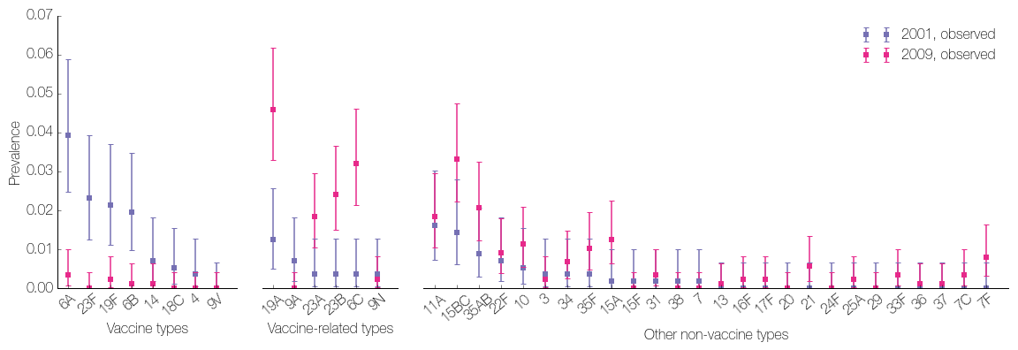
Aim: Estimating fitness before and after PCV7 introduction
Peri-PCV data is more informative of vaccine types
PCV7-era data is more informative for VRTs and non-vaccine types (NVTs) that expanded after vaccine introduction...
...particularly for NVTs that were not sampled in 2001.

Slide 3
Difficulties with fitting to both peri-PCV and PCV7-era data
More parameters to estimate (40) and data points to explain:
More quantities to fit to as more serotypes were sampled in 2009
Need to estimate reduction in fitness due to vaccination
4 of 6 vaccine-related types (VRTs) were consistently underestimated (19A, 23A, 23B, 6C)
Accounting for cross-immunity slightly improved fit
In general, model could not accommodate changes to the fitness ordering of serotypes
No closed-form likelihood expression
Need to compare model simulations to data
Stochasticity in the agent-based model
Averaging across many simulations and/or simulating larger population size

Slide 4
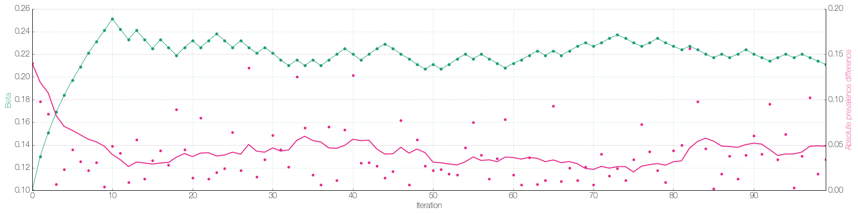
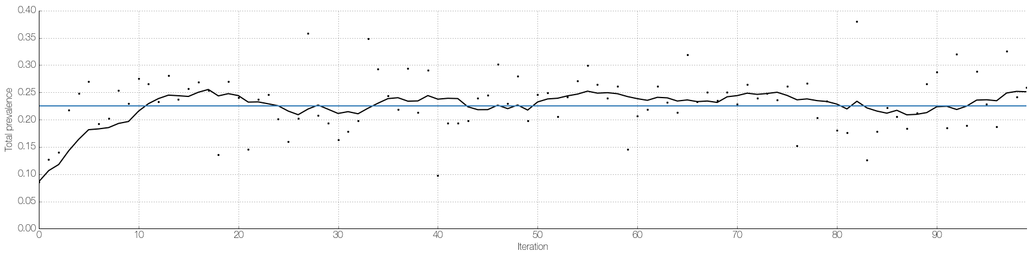
First test
PCV Modeling Update 02/2017

Slide 5
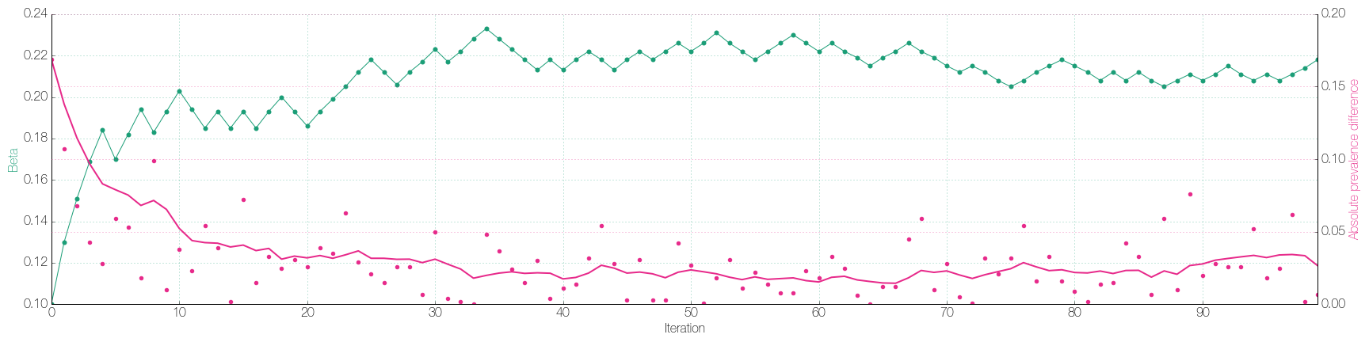
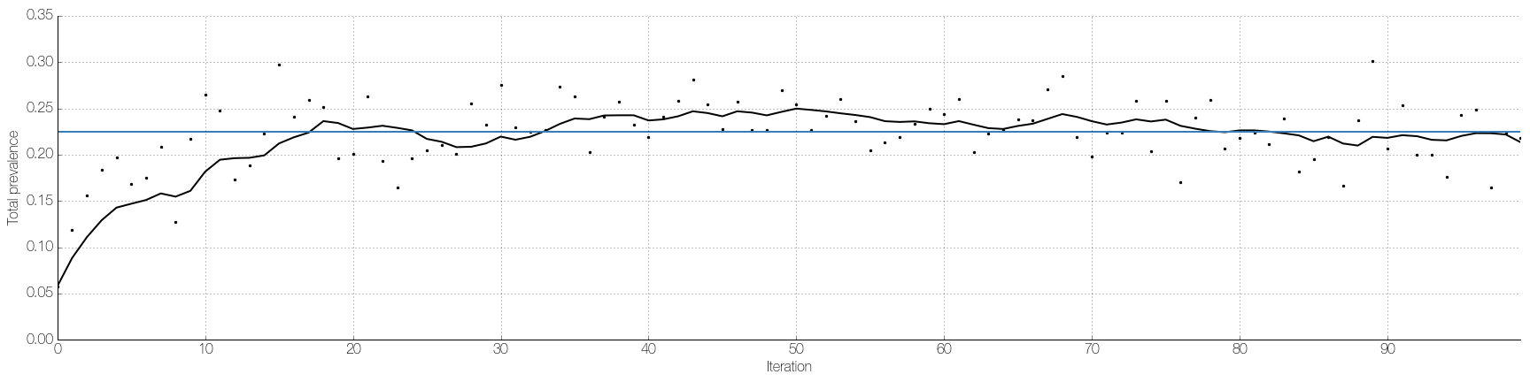
2.5x population size
PCV Modeling Update 02/2017

Slide 6
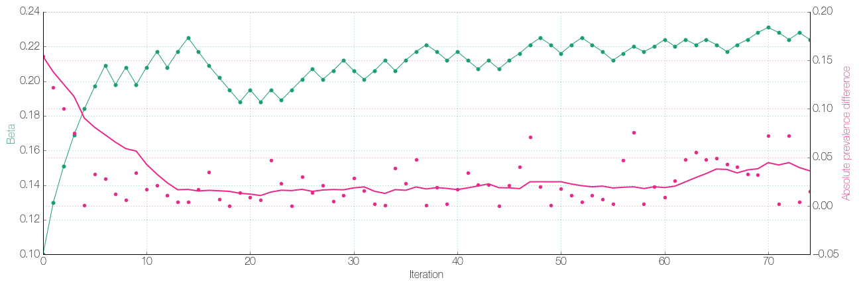
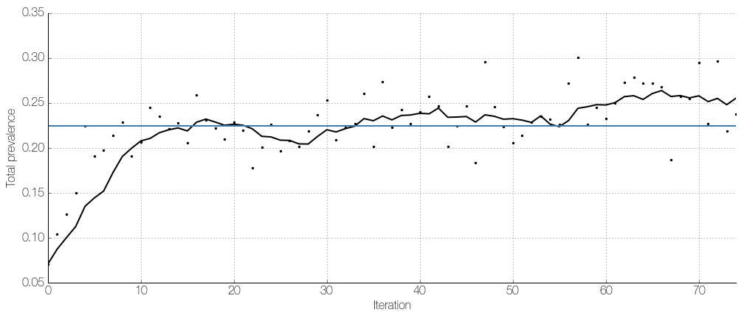
Averaging 5 simulations
PCV Modeling Update 02/2017

Slide 7
Plan
Model
Account for changes in both directions in prevalence of VRTs and NVTs
Fitting algorithm
Use peri-PCV7 data to estimate VT fitness and PCV7-era data to estimate the rest
Then fit model to both sets of data at the same time to estimate vaccine efficacy
Explore relationship between number of simulations vs simulating from larger population
Try an MCMC approach – don’t need to know beforehand which direction to tune parameters
Likelihood calculation
Instead of a distance from prevalence, calculate binomial likelihood of observing prevalence
Fit to data from more time points

Slide 9
PCV Modeling Update 02/2017
Model fitting: Before
Goal: Maximize expected likelihood of parameters given 2001 data.
observed data
+
probabilistic model
stochastic simulation
simulated prevalences
likelihood estimate
parameters
Challenges: The likelihood…
… is a function of many (40) parameters
… has no closed form
→ cannot calculate gradient
… cannot even be calculated directly
→ we only have a noisy estimate of it by running a stochastic simulation, which takes time (1-2 min.)
}
Parameter space is big.
}
Difficult to determine which direction to explore next in parameter space.

Slide 10
PCV Modeling Update 02/2017
Model fitting: Shortcuts exploited
Goal: Maximize expected likelihood of parameters given 2001 data.
observed data
+
probabilistic model
stochastic simulation
simulated prevalences
likelihood estimate
parameters
Things we had going for us:
If the simulated prevalences matched the observed prevalences, this will maximize the likelihood.
→ Focus on finding parameters that reproduce the observed prevalences (green box).
Monotonic relationship between fitness rank and prevalence.
→ Based on our current simulated prevalence, we know how to adjust the fitness rank.
Adjusting a serotype’s fitness rank does not affect prevalences of other serotypes excessively.
→ Fitness parameters can be fit in parallel.

Slide 11
PCV Modeling Update 02/2017
Model Fitting: Now
Goal: Maximize expected likelihood of parameters given 2001 and 2009 data.
observed data +
probabilistic model
stochastic simulation
simulated 2001 prevalences
likelihood estimate
parameters
simulated 2009 prevalences
Things we used to have going for us (now with complications):
If the simulated prevalences matched the observed prevalences, this will maximize the likelihood.
→ Focus on finding parameters that reproduce the observed prevalences.
The simulated prevalences now have to match the observed data at two time points.
Monotonic relationship between fitness rank and prevalence.
→ Based on our current simulated prevalence, we know how to adjust the fitness rank.
We now adjust one rank and hope it reproduces the observed prevalence at two time points.
Adjusting a serotype’s fitness rank does not affect prevalences of other serotypes excessively.
→ Fitness parameters can be fit in parallel.
Parameters to be fit now also include vaccine efficacy.

Slide 12

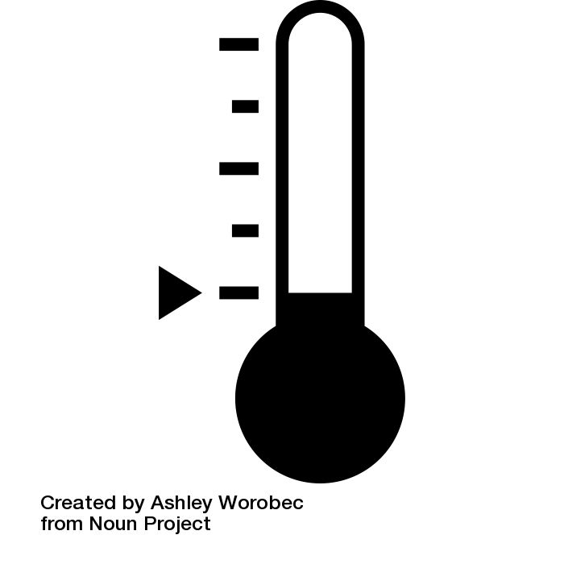
PCV Modeling Update 02/2017
Analogy
Room 2001
Before:
Target
Raise thermostat a little bit.
Room 2001
Target
Now:
Less clear what to do.
Room 2009
Target
Icons: Ashley Worobec, Sarah Tan. Noun Project. thenounproject.com

Slide 13
PCV Modeling Update 02/2017
Initial plan
Challenges and how to address them:
Difficult to determine which direction to explore next in parameter space (no analytical gradient)
Simultaneous perturbation stochastic approximation
Simultaneously perturb all parameters to estimate all components of the gradient.
(n parameters requires only 2 simulations / iteration)
However, simulations may be too noisy… If so, will try increasing population size or averaging results from multiple simulations.
Parameter space is large.
Try fitting fitness ranks in parallel, i.e. adjust each fitness rank as if it only affected the terms in the log-likelihood involving its serotype.
Adjust the fitness ranks and the vaccine efficacy on alternate iterations.

Slide 14
PCV Modeling Update 02/2017
First milestone
Try to reproduce previous results, i.e. fit only peri-PCV7 data using new algorithm
As before, use absolute prevalence error, rather than log-likelihood, to quantify how well we are doing.

Slide 15
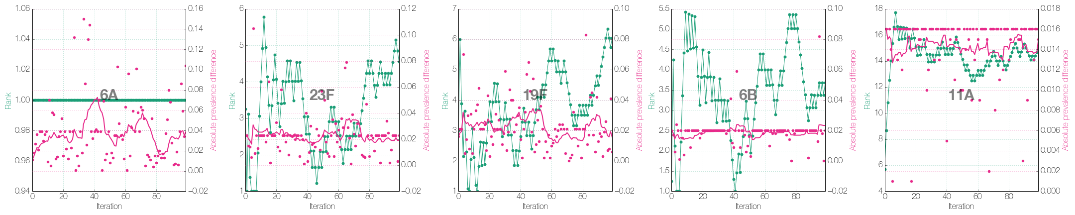
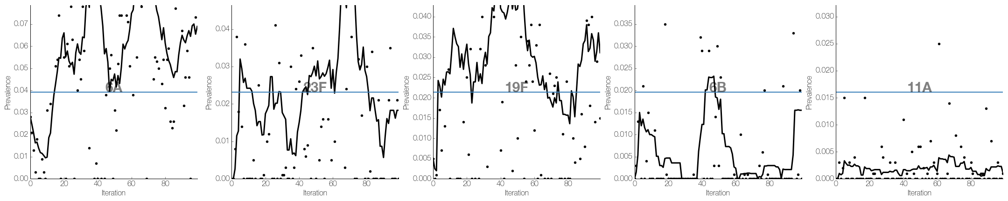

Slide 16
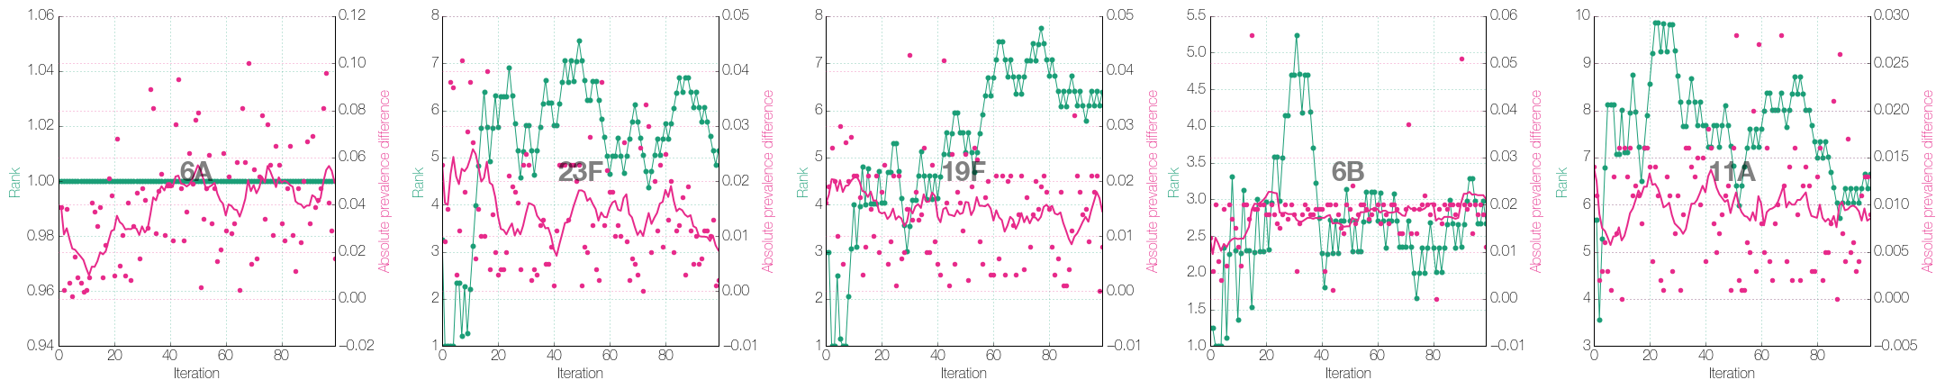
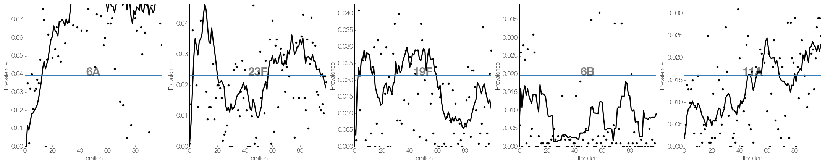
2.5x population size
PCV Modeling Update 02/2017

Slide 17
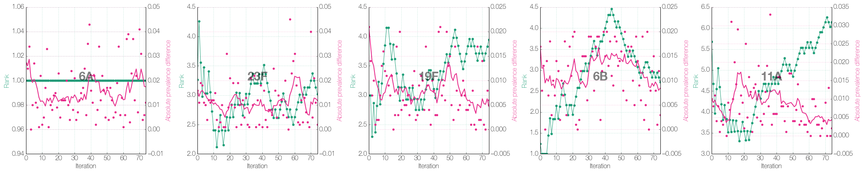
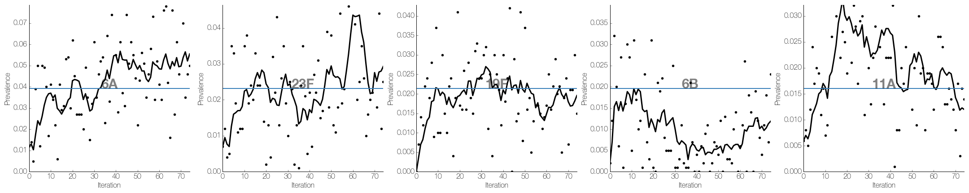
Averaging 5 simulations
PCV Modeling Update 02/2017

