Slide 1
Estimating recombination rates from bacterial genomes using Approximate Bayesian Computation (ABC) coupled with Bayesian optimization
Notes:
Work in progress!
Also I’m not a statistician

Slide 2
ABC is pretty useful
Used extensively in
Population genetics
Ecology
Epidemiology
Systems Biology
Probably other fields too, where more exact methods are mathematically/computationally intractable
Beaumont 2010
Notes:
ABC is widely used

Slide 3
Motivation for fitting parameters with ABC
Hard to
Simulate parameter values that could have given rise to data
My case: I observe DNA sequences, and I want to know recombination rates that could have produced these data (I’m studying epistasis, but it’s more meaningful to contextualize it with biologically meaningful recombination rates).
Easy to
Construct models that might plausibly describe observations
Simulate artificial datasets for given parameter values in model
Bayesian statistics provides a nice framework to address this problem
But, we’ll need a likelihood function (probability of obtaining data given parameter values), which may be difficult to calculate
Approximate Bayesian Computation (ABC)
Likelihood-free! We can simulate data instead and use simulated v. observed similarity as a proxy for a likelihood.
Beaumont 2010

Slide 4
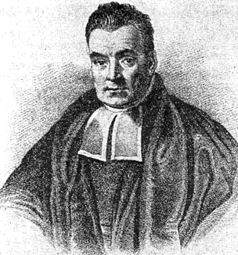
Bayes Rule
P(recombination, mutation|DNA)
P(DNA|recombination, mutation)
P(recombination, mutation)
Likelihood
Prior
Posterior
P(DNA)
Marginal Likelihood
Notes:
----- Meeting Notes (5/18/16 11:30) -----
way to figure out if parameter value is good fit, how likely is that data to be generated given that parameter value

Slide 5
ABC: “approximate” to circumvent difficulties
Problem 1: marginal likelihood too hard to compute (often involves high dimensional integral)
Solution: If likelihood can be evaluated up to normalizing constant, we can take samples from the posterior distribution even if this posterior distribution itself is unavailable using Monte Carlo methods (MCMC, IS, SMC). Here, samples are drawn relative to their likelihoods
Problem 2: likelihood function becomes hard to define/compute (esp. with complicated models)
Solution: Simulate data samples from your model given a parameter, calculate difference between simulated and observed, discrepancy likelihood, reject if too great
Algorithm:
Repeat until N points accepted
1.) Draw θ_{i} ~ P(θ)
2.) Simulate d_{i} ~ P(d|θ_{i})
3a.) Reject θ_{i} if d_{i} ≠ D_{obs} (discrete data)
3b.) Reject θ_{i} if f(d_{i}, D_{obs}) > ε (continuous data)
These are sampled from P(θ|D_{obs})
3a.) is Not-Approximate Bayesian computation, 3.) is ABC
With these N points from the distribution P(θ|D_{obs}), we can compute summaries (mode, mean, credible intervals etc.)
Notes:
Draw histogram using example of coin toss
-observed data is 5 heads, 5 tails
-prior graph: flat prior of P(heads)
-posterior graph: unimodal around 0.5, because when we draw from the prior and flip our coin 10 times, these values in the middle are more likely going to result in 5heads,5tails

Slide 6
ABC: “approximate” to circumvent difficulties
Problem 3: the previous example works if data are of low dimension
Solution: use summary statistics instead
Algorithm:
Repeat until N points accepted
1.) Draw θ_{i} ~ P(θ)
2.) Simulate d_{i} ~ P(d|θ_{i})
3.) Reject θ_{i} if f( S(d_{i}), S(D_{obs}) ) > ε
But choose your summaries wisely!!!
Although information is lost when summarizing data (mapping high-dimensional data to fewer dimensions), with enough of these low dimensional summaries we may capture much of the original information
Sufficient statistic – captures all the information for parameter of interest, original sample provides no additional information (examples: sample mean sufficient for mean (μ) of a normal distribution, number of variable positions sufficient for population mutation rate)

Slide 7
ABC: “approximate” to circumvent difficulties
If simulating data is very quick, this next problem doesn’t apply
Problem 4: lots of simulations get rejected during step
3.) Reject θ_{i} if f( S(d_{i}), S(D_{obs}) ) > ε
especially for small ε
Inference less accurate for large ε
large parameter spaces
Most of which produces simulated data that looks nothing like observed
use of many summaries
i.e. if ε = 0.1, Prob(10 summaries pass threshold) << Prob(1 summary passes threshold)
Intuition: for 2 datasets (simulated/observed), the more dimensions you compare between them the more differences you’ll potentially find
This is especially problematic if step 2.) Simulate d_{i} ~ P(d|θ_{i}) is computationally costly!
Solution: Don’t know but will find out, pretty sure they involve MCMC, IS, SMC
Gutmann and Corander 2015 propose Bayesian optimization

Slide 8
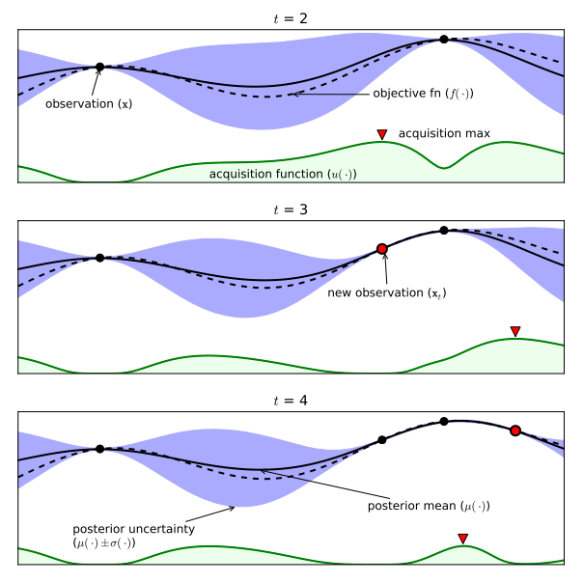
Bayesian optimization: good for finding extrema of objective functions that are expensive to evaluate
Obj. func. example: similarity b/t simulated and observed datasets
True objective function
Gaussian Process approx. of objective function
Acquisition function
The acquisition is high where the GP predicts a high objective (exploitation) and where the prediction uncertainty is high (exploration)—areas with both attributes are sampled first
Note that the area on the far left remains unsampled, as while it has high uncertainty, it is (correctly) predicted to offer little improvement over the highest observation.
Notes:
Here is our probabilistic model of this objective function, obtained using a special type of regression called a Gaussian Process Regression. When we want to predict potentially noisy outcomes of an independent variable, regression is a natural choice. We could use a linear regression model, or a quadratic or cubic etc. but a GPR is an even finer approach.
A GP is an extension of the multivariate Gaussian distribution to an infinite-dimension stochastic process for which any finite combination of dimensions will be a Gaussian distribution
It’s useful to intuitively think of a GP as analogous to a function, but instead of returning a scalar f(x) for an arbitrary x, it returns the mean and variance of a normal distribution, so instead of being a random variable it’s more like a “random function”
The black line is the mean of the GPR regression, and the blue shaded region is plus/minus the variance. Here, observations are noise free, so this is why the variance collapses at particular observations (I’m pretty sure).
Bayesian optimization uses an acquisition function to determine the next location to sample. The role of the acquisition function is to guide the search for the optimum. Typically, acquisition functions are defined such that high acquisition corresponds to potentially high values of the objective function, whether because the prediction is high, the uncertainty is great, or both.

Slide 9
Bayesian optimization: good for finding extrema of objective functions that are expensive to evaluate
Obj. func. example: similarity b/t simulated and observed datasets
True objective function
Gaussian Process approx. of objective function
Acquisition function
Variance function:
Notes:
The variance function is very important, and a very popular choice is this squared exponential function, where the variance increases as a function of distance

Slide 10
Different types of acquisition functions
Dotted red line = true objective function
Pure exploitation
Exploitation + exploration
Upper confidence bound criteria (bottom) :
UCB(x) = u(x) + kσ(x)
makes sure to explore potentially promising areas before focusing on global maximum
Notes:
The dotted red line represents the true objective function, and the blue line is the GPR mean, shaded blue is the variance.
First acquisition function is pure exploitation, new points that offer even an infinitesimal improvement, but with high certainty, will be chosen over potentially larger gains that have less certainty,
The rest of the time, we would sample around this optimum, accurately characterizing it. For other parts of parameter space, GPR of objective isn’t as accurate (i.e. on left of t=6), but it’s expensive/pointless to accurately characterize uninteresting/low likelihood areas

Slide 11
Bayesian optimization: good for finding extrema of objective functions that are expensive to evaluate
Notes:
Sobol sequence

Slide 12
3 Parameters I want to infer:
Mutation rate
Recombination Rate
Recombination tract length
Length of DNA donor gives to recipient (Geometrically distributed)
Simulation of parameter grid and calculation of discrepancy (below) shows:
Summary statistics I’ve chosen are informative
Discrepancy is relatively smooth
Unimodal?
= “true” value
= “true” value
= “true” value
high
high
small
Mut. rate
Rec. rate
Tract
length
low
low
large
low
Rec. rate
high
large
Tract length
small
low
Mut. rate
high
Notes:
Here, I simulated a dataset with parameter values I designated as true (black star), and then simulated datasets with parameter values plus or minus an order of magnitude, and each time I calculated the discrepancy between simulated and “observed” or the truth.
These figure show several useful pieces of information:
-discrepancy between simulated and observed data (which will be our “objective function” to model) is smooth: similarl parameter values have similar discrepancies
-surfaces are largely unimodal, although they don’t need to be this avoids discussion of local optima
-my summary statistics are informative

Slide 13
Summary of inference framework
Bayesian optimization
Simulate as many times as feasible, exploring parameter space via acquisition function, calculating discrepancy between simulated and observed data each time
Use these discrepancies and a Gaussian Process Regression to construct a probabilistic model for the discrepancy between simulated and observed data
Why? b/c discrepancy Likelihood
ABC
Follow typical ABC framework
Algorithm:
Repeat until N points accepted
1.) Draw θ_{i} ~ P(θ)
2.) Simulate d_{i} ~ P(d|θ_{i})
2.) Simulate discrepancy from GPR!
3.) Reject θ_{i} if f( S(d_{i}), S(D_{obs}) ) > ε
4.) Repeat using Sequential Monte Carlo sampler
Very fast!
*Just finished parallelizing, submitting many jobs per acquisition

