Slide 1
How do casual riders and annual members use Cyclistic differently?
A year of bike-share data, and three ways to grow memberships
Google Data Analytics Capstone · Case Study 1
Notes:
Introduce yourself and the question from Lily Moreno.

Slide 2
Ask
The question we were asked
Business task: understand how annual members and casual riders use Cyclistic bikes differently, to design a campaign that converts casual riders into members.
Stakeholders: Lily Moreno (director of marketing), marketing analytics team, executive team.
Metrics: share of rides, ride length (median), weekday vs weekend, time of day, seasonality, stations, round trips.
Data: Divvy trip data, Nov 2025 – Oct 2026 (Motivate International Inc.). 6.13M cleaned rides.
Notes:
Finance found annual members are much more profitable, so marketing wants to convert casual riders. My part is question 1.

Slide 3
Prepare & Process
Data: 6.29M trips over 12 months, 6.13M after cleaning
Source: Divvy trip data (Motivate International Inc.), Nov 2025 – Oct 2026, 12 monthly CSV files.
Cleaning in SQL (DuckDB): removed 35 duplicates, 159k rides under 1 minute, 5k over 24 hours, 13 test-station rides and 108 rides outside the window (2.6% in total).
Added ride length, day of week, hour, month and round-trip flag.
Limitations
• No rider IDs: rides, not people
• No prices or revenue
• 19.8% of rides have no station name (mostly e-bikes)
Data: Divvy trip data, Nov 2025 – Oct 2026 (Motivate International Inc.). 6.13M cleaned rides.
Notes:
Public Divvy data under the Divvy Data License Agreement. No rider IDs, so everything is about rides, not people.

Slide 4
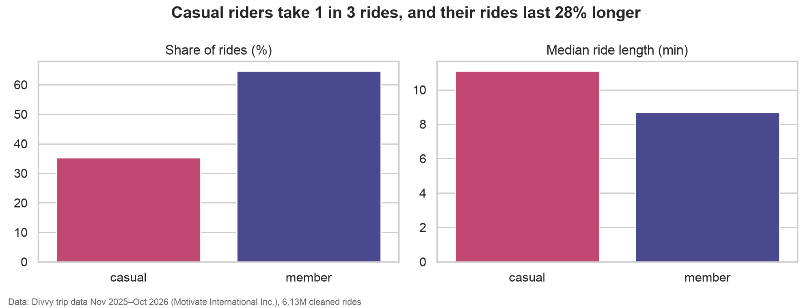
Finding 1
Casual riders take 1 in 3 rides, and their rides last 28% longer
Data: Divvy trip data, Nov 2025 – Oct 2026 (Motivate International Inc.). 6.13M cleaned rides.
Notes:
35.3% of rides. Median 11.1 vs 8.7 minutes; 13.2% of casual rides are over 30 minutes vs 5.4% for members. Medians, because ride length is heavily right-skewed.

Slide 5
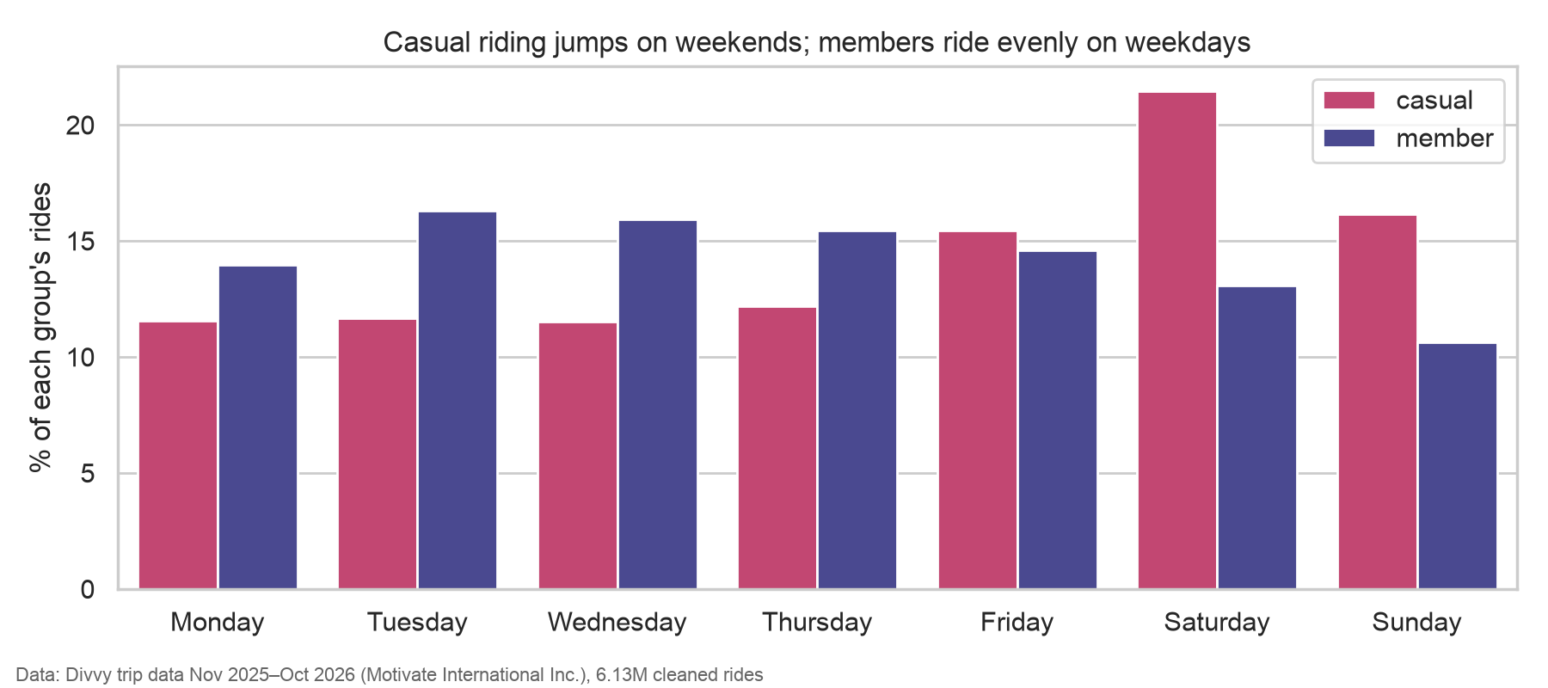
Finding 2
Casual riding jumps on weekends
Data: Divvy trip data, Nov 2025 – Oct 2026 (Motivate International Inc.). 6.13M cleaned rides.
Notes:
37.6% of casual rides fall on Saturday or Sunday (Saturday alone 21.5%) vs 23.7% for members, whose rides are spread evenly across weekdays.

Slide 6
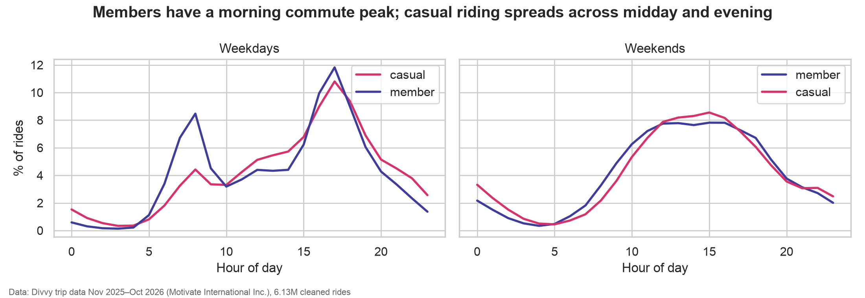
Finding 3
Members commute; casual riding spreads across the day
Data: Divvy trip data, Nov 2025 – Oct 2026 (Motivate International Inc.). 6.13M cleaned rides.
Notes:
Both groups peak at 17:00 on weekdays, but members also peak at 07:00–08:59 (15.2% of their weekday rides vs 7.7%). On weekends both curves look alike.

Slide 7
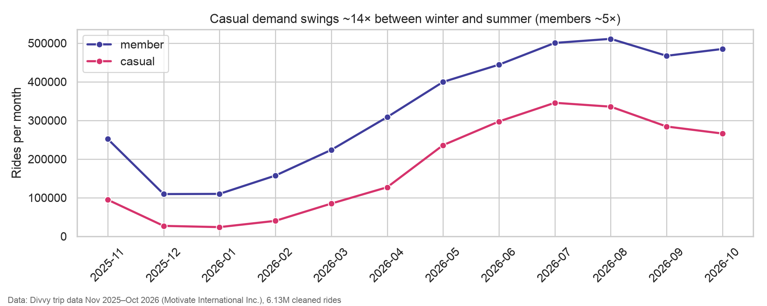
Finding 4
Casual demand swings about 14× between winter and summer
Data: Divvy trip data, Nov 2025 – Oct 2026 (Motivate International Inc.). 6.13M cleaned rides.
Notes:
Peak month / quietest month: 14.5× for casual, 4.7× for members. Casual share goes from 17.9% in January to 40.8% in July; 69% of casual rides happen May–September.

Slide 8
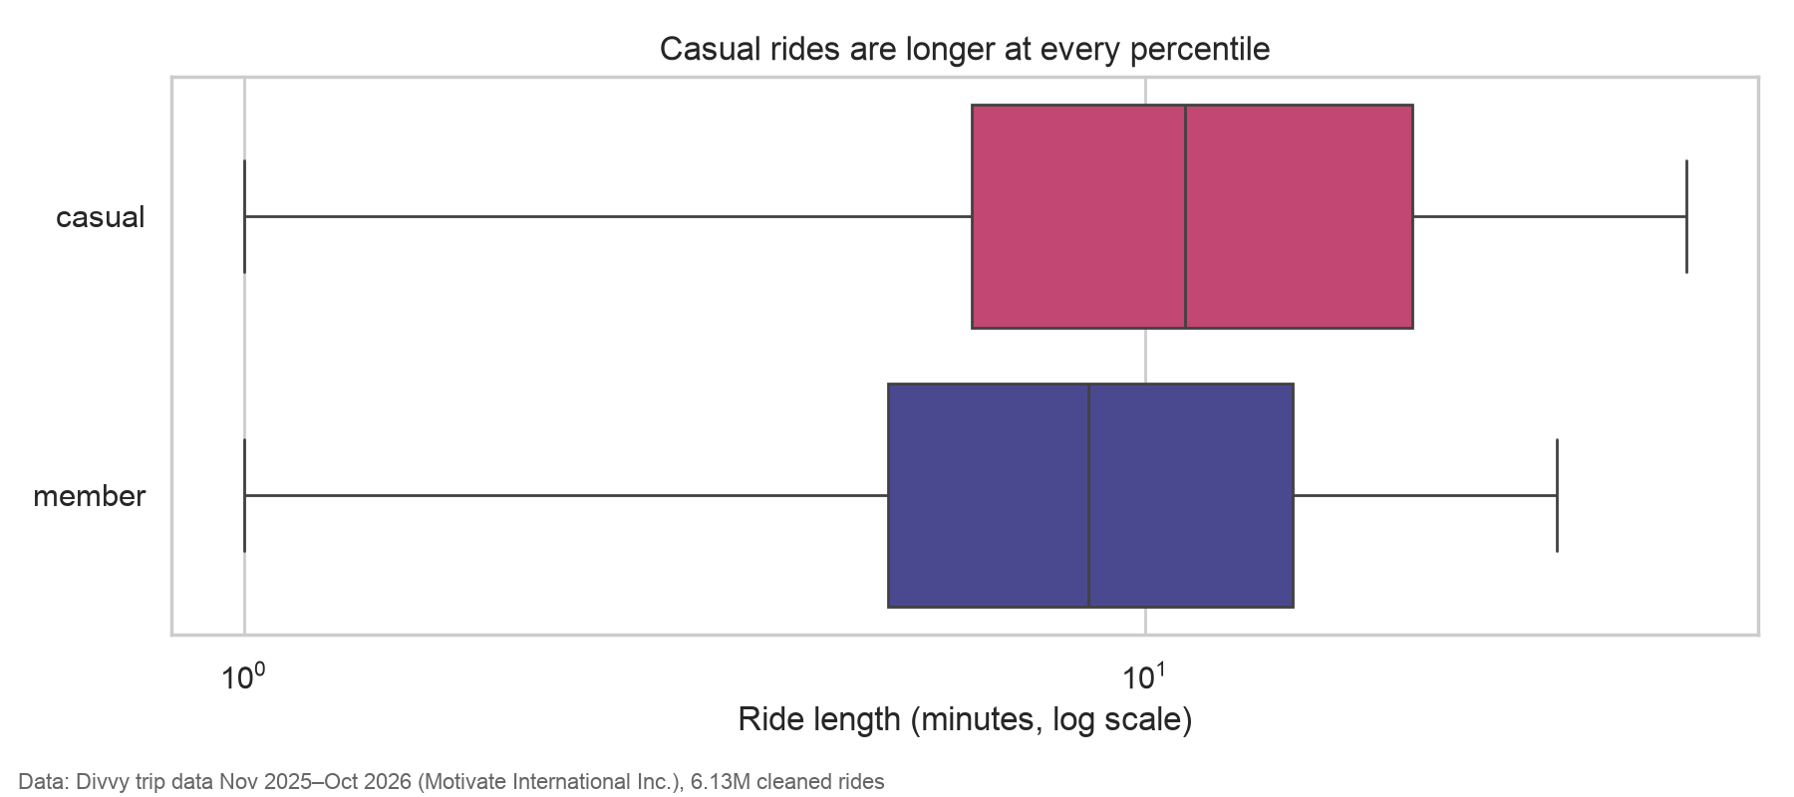
Finding 5
Casual rides are longer at every percentile
Data: Divvy trip data, Nov 2025 – Oct 2026 (Motivate International Inc.). 6.13M cleaned rides.
Notes:
90th percentile 35.4 vs 23.4 minutes. Box plot on a log scale from a 200,000-ride random sample; outliers hidden.

Slide 9
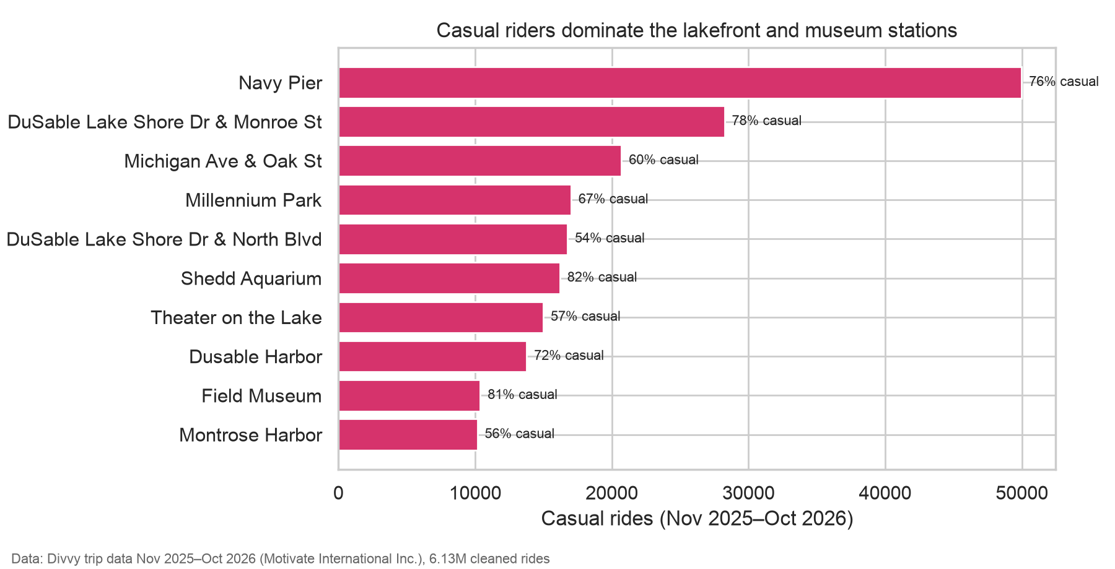
Finding 6
The lakefront and museums are casual territory
Data: Divvy trip data, Nov 2025 – Oct 2026 (Motivate International Inc.). 6.13M cleaned rides.
Notes:
Casual riders make 76–82% of rides at Navy Pier, Shedd Aquarium, Field Museum and DuSable Lake Shore Dr & Monroe St. Round trips: 7.4% of casual rides vs 2.2% (rides with known stations).

Slide 10
Finding 7
A quarter of casual rides already look like commutes
25.1% of casual rides (≈540,000) happen on weekdays at commute hours.
Members: 38.5%. These casual riders already behave like members, but pay per ride.
Data: Divvy trip data, Nov 2025 – Oct 2026 (Motivate International Inc.). 6.13M cleaned rides.
Notes:
Weekday rides at 07:00–09:59 or 16:00–18:59. About 540k casual rides. These riders are the easiest to convert.

Slide 11
Act
Three ways to turn casual riders into members
1. Summer weekend membership: a seasonal or weekend plan promoted May–September, upgradable to annual (findings 1, 3, 5).
2. Lakefront campaign in peak season: geo-targeted ads, in-app messages and dock QR codes at Navy Pier, Shedd Aquarium, Field Museum, Millennium Park, DuSable Lake Shore Dr; weekends 12:00–18:00 (finding 6).
3. Convert commuter-like casual riders: "you already ride like a member" with a savings calculator for weekday commute-hour riders (findings 2, 4, 7).
Data: Divvy trip data, Nov 2025 – Oct 2026 (Motivate International Inc.). 6.13M cleaned rides.
Notes:
Each recommendation is tied to findings. Pricing for the savings messages must come from finance.

Slide 12
Further work
Next steps
Join anonymised account data to count riders and measure conversion.
Get current prices to quantify savings in the campaign messages.
Add weather and event data to separate tourism from regular use.
A/B test the three offers in summer 2027 and track membership sign-ups.
Data: Divvy trip data, Nov 2025 – Oct 2026 (Motivate International Inc.). 6.13M cleaned rides.
Notes:
Ask for anonymised account data to measure conversion; A/B test the offers.

