Slide 1
Causal Capability Platform
Capability → Project Cases → Shared Tools & Methods
Causal
Capabilities
Project
Cases
Shared
Lego Modules

Slide 2
Causal Capability Platform — Conceptual Map
Shared causal “Lego modules” can be assembled across capabilities and project cases
Row 1
Causal
Capabilities
Incremental
Impact
Did it work?
Root Cause &
Business Drivers
Why did KPI move?
Demand Shift &
Choice Behavior
What behavior shifted?
Pathway /
Mediation
How did it work?
Effect
Heterogeneity
Where / for whom?
Decision
Optimization
What should we do next?
Example project cases can span multiple capabilities
Product Launch Measurement
impact + demand shift + decision
Sales Growth Decomposition / MVM
root cause + pathway
Campaign / Coupon Incrementality
impact + heterogeneity + optimization
Row 2
Project
Cases
Traffic Decline / Anomaly Diagnosis
root cause + demand shift
Menu / Category Demand Shift
choice behavior + mediation
Customer / Store Targeting & Rollout
heterogeneity + decision optimization
Reusable causal method modules — shared across all capabilities and cases
Causal Design
Intake
Experimentation
A/B · geo · switchback
Quasi-Experiments
DiD · synthetic control
Matching / Weighting
PSM · IPW · DR
DAG / SCM
causal structure
Mediation / Pathway
direct · indirect
Row 3
Shared Tools
& Methods
Causal ML / Uplift
CATE · causal forest
Root Cause
& anomaly attribution
Demand Migration
substitution · halo
What-if
Simulation
Policy
Optimization
Validation
refutation · sensitivity
Effect Store
impact library
Guardrails
spillover · long-term
Reporting / API
decision layer

Slide 3
Causal Capability Platform — Conceptual Map
Incremental Impact
Did the action truly create lift?
Business Drivers
& Root Cause
What drove KPIs to move or cause anomalies?
Demand/Segment Shift
What demand behavior shifted?
Effect
Heterogeneity
Where, when, for whom did/will it work
Pathway /
Mediation
Through what mechanism did the effect happen (direct/indirect)
Decision
Optimization
What should we do next?
Causal
Capabilities
DIAL
MVM
Next Best Offer
McDonald’s Project
Cases
CLV
Serum
(New product / campaign launch)
Sales Forecasting
Causal Design
Intake
Panel Models
Fixed Effects · Random Effects · Mundlak
Bayesian Causal Inference
Causal ML / Uplift
CATE · causal forest
Mediation / Pathway
direct · indirect
What-if
Simulation
Shared Tools
& Methods
Reusable causal method modules, shared across all capabilities and cases
Experimentation
A/B · geo · switchback
Root Cause
& anomaly attribution
Demand Migration
cannibalization · halo
Policy
Optimization
Quasi-Experiments
DiD · matching · synthetic control
SHAP / Shapley Attribution
Guardrails
spillover · long-term
Validation
refutation · sensitivity
Reporting / API
decision layer

Slide 5
Causal Capability Platform — Conceptual Map
Incremental Impact
Did the action truly create lift?
Business Drivers
& Root Cause
What drove KPIs to move or cause anomalies?
Demand/Segment Shift
What demand behavior shifted?
Effect
Heterogeneity
Where, when, for whom did/will it work
Pathway /
Mediation
Through what mechanism did the effect happen (direct/indirect)
Decision
Optimization
What should we do next?
Causal
Capabilities
DIAL
MVM
Next Best Offer
Buyer Flow Analysis
Project
Cases
CLV
Serum
(New product / campaign launch)
Sales Forecasting
Causal Design Intake
Counterfactual · Covariate · Baseline
Panel Models
Fixed Effects · Random Effects · Mundlak
Demand Migration
cannibalization · halo · carry over
Causal ML / Uplift
CATE · Causal Forest · Double ML
DAG / structural causal modeling
Bayesian Network
What-if
Simulation
Experimentation
A/B · geo · switchback
SHAP / Shapley Attribution
Guardrails
spillover · long-term
Structural Causal Model (SCM)
Policy
Optimization
Shared Tools
& Methods
Reusable causal method modules, shared across all capabilities and cases
Quasi-Experiments
DiD · matching · synthetic control ·
Regression Discontinuity Design / RDD ·
Bayesian Structural Time Series
Bayesian Causal Modeling
priors · uncertainty · hierarchical pooling
Validation
refutation · sensitivity
Instrument Variables
Governance
Playbook
Covariate Adjustment
regression controls · treatment indicator

Slide 6
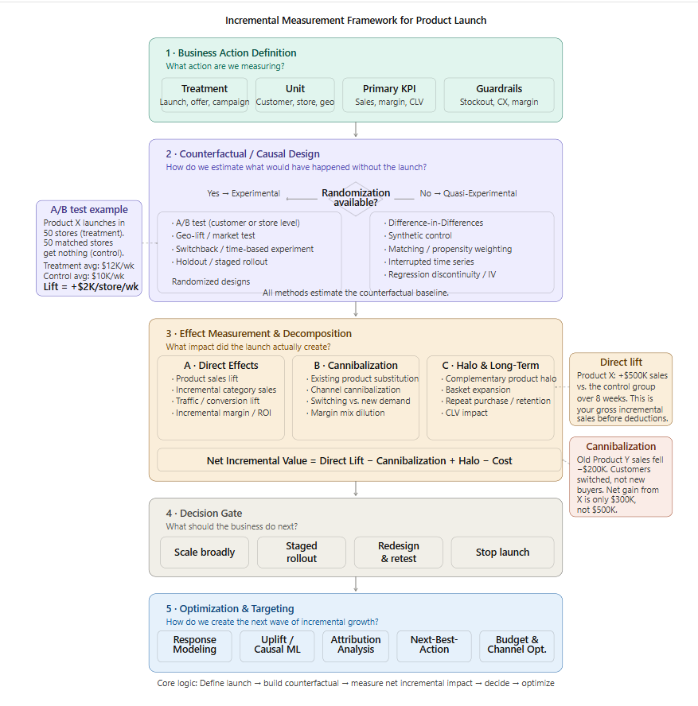

Was the new product/feature successful?
How were new product top-line KPIs?
Did Product X create incremental sales?
Did it cannibalize existing products?
Did it create Halo effect?
How should we scale the launch more broadly?
Panel fixed-effects regression can be used for causal driver analysis by comparing changes within the same restaurant and controlling for measured confounding factors. However, because those feature changes occur naturally and may be driven by unobserved business conditions, the causal interpretation depends heavily on modeling assumptions. A/B testing provides a cleaner counterfactual through random assignment, while DiD provides a more explicit counterfactual through a defined treatment event and a comparison group.
Response Modeling: predicts likely buyers
Uplift / Causal ML: predicts incremental responders
Attribution Analysis: identifies influential touchpoints
Next-Best-Action: recommends the best next intervention
Budget & Channel Opt.: allocates investment for maximum incremental return
Who is likely to purchase Product X?
Who will buy because of the offer / launch exposure?
Which channels or touchpoints influenced the purchase journey?
What is the best next intervention for each customer?
Which channels, segments, or markets deserve more investment?
Expected Incremental Profit = Uplift × Margin − Offer Cost−Cannibalization Risk
Notes:
Expected Incremental Profit=Uplift×Margin−Offer Cost−Cannibalization Risk

Slide 7
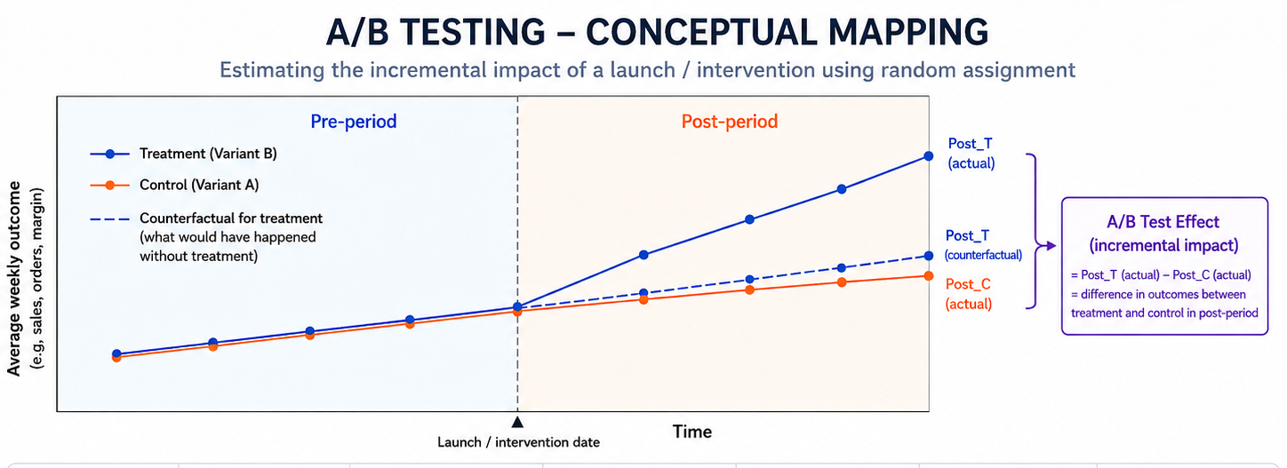
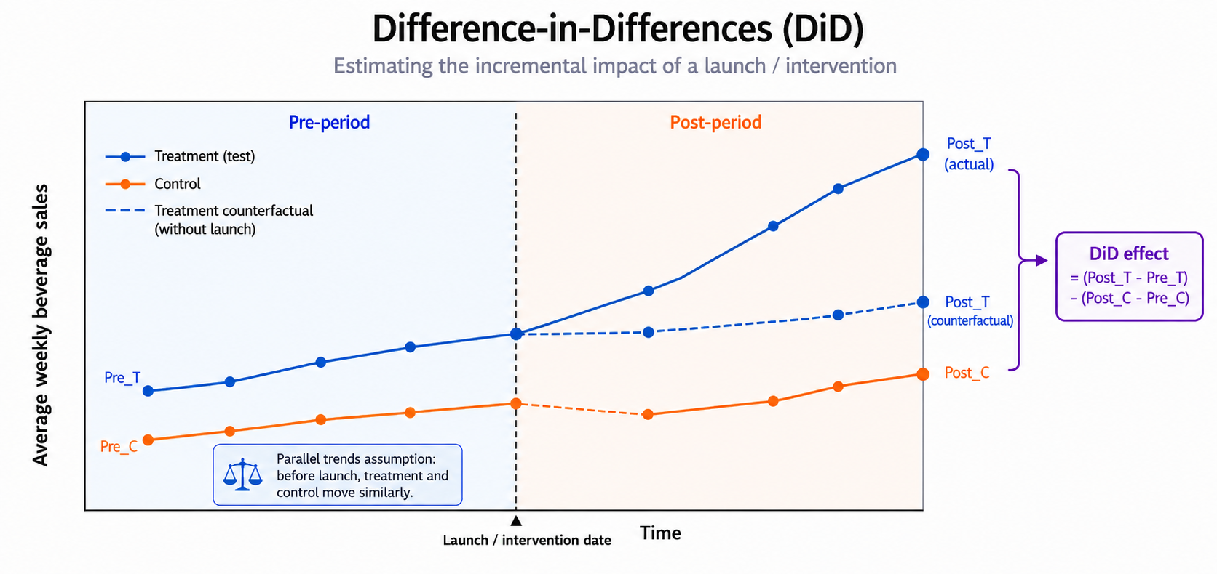

Slide 8
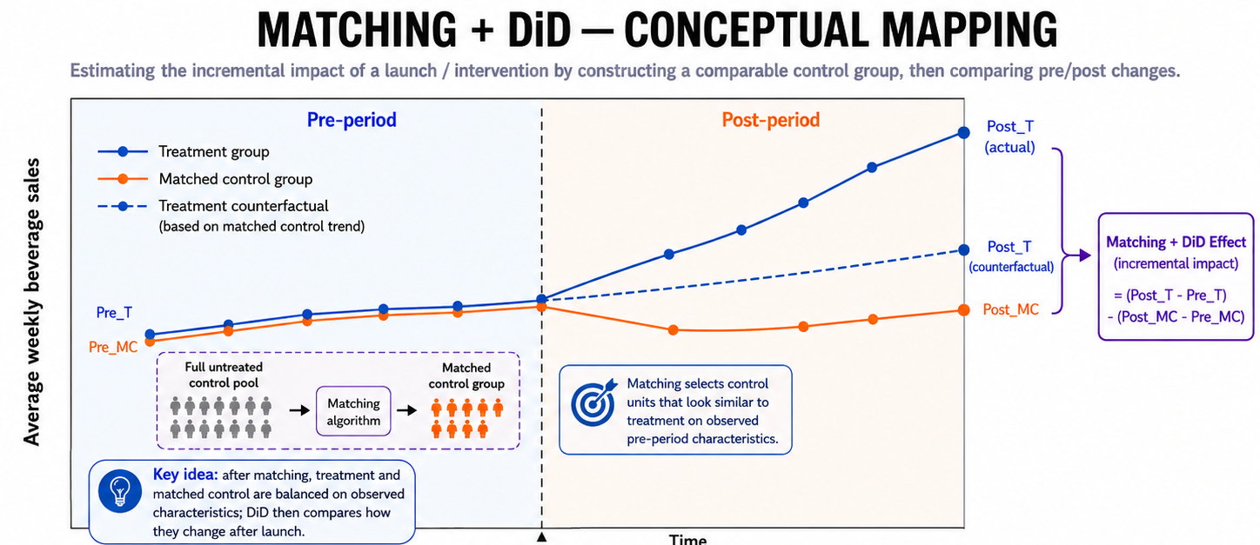
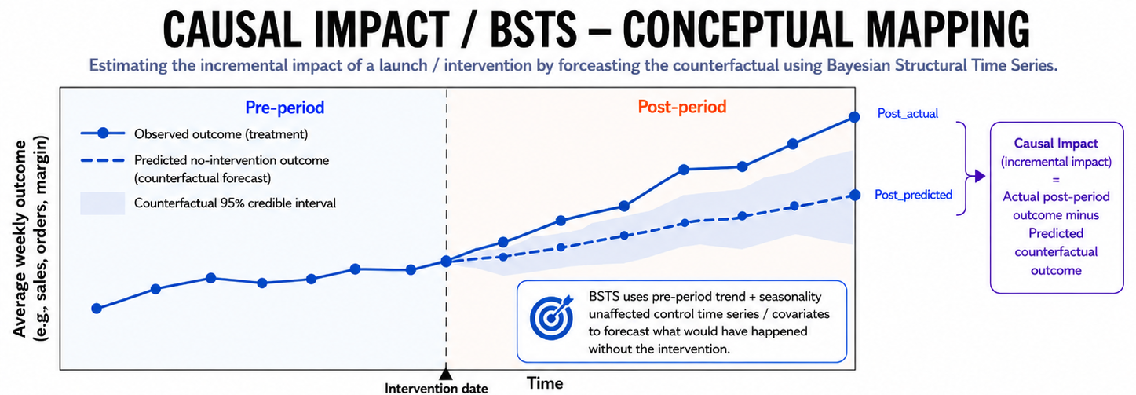

Slide 9
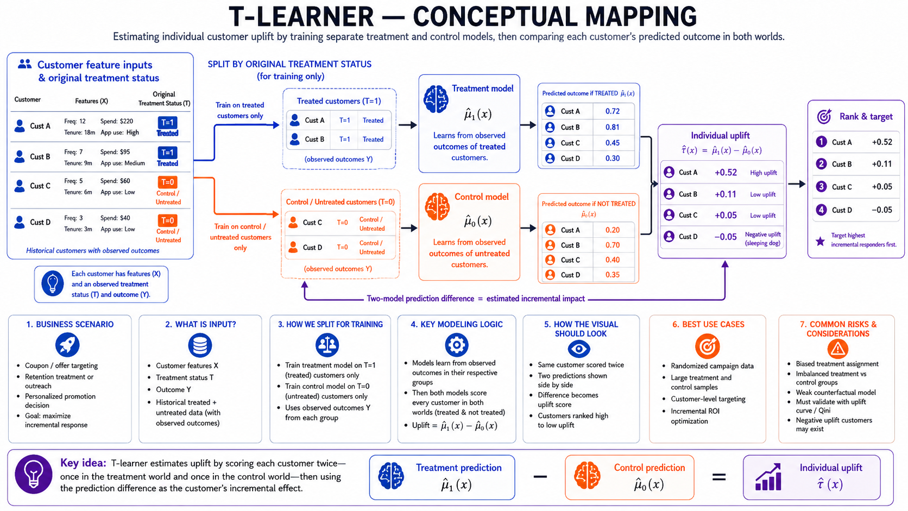

Slide 10
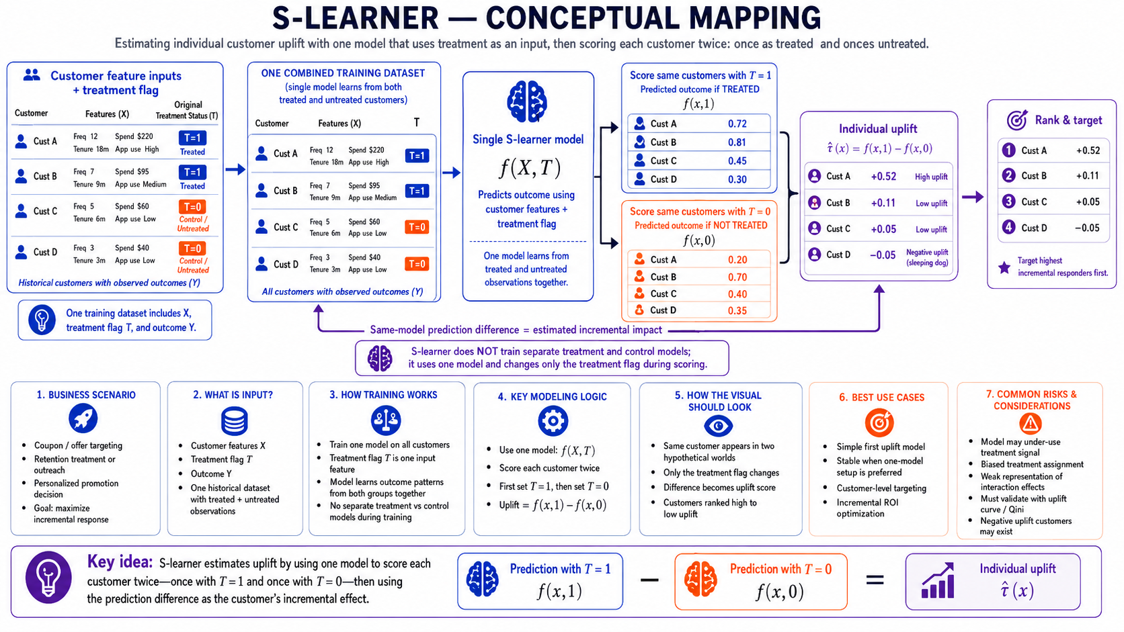

Slide 11
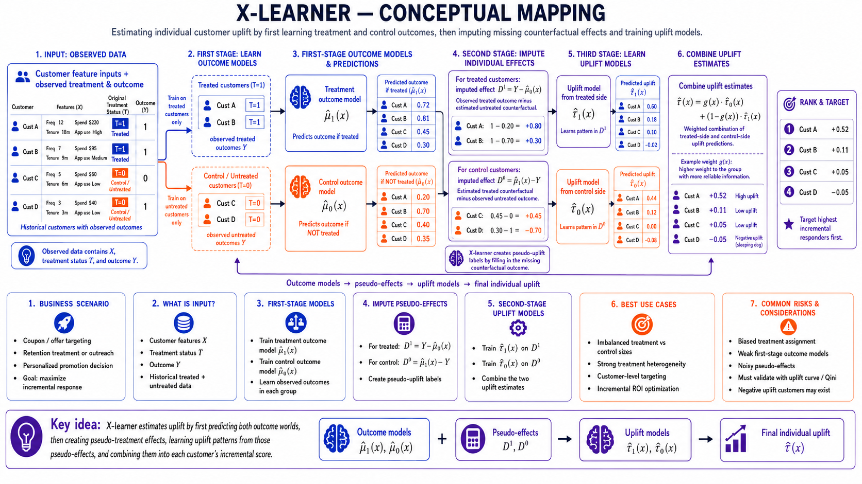

Slide 12
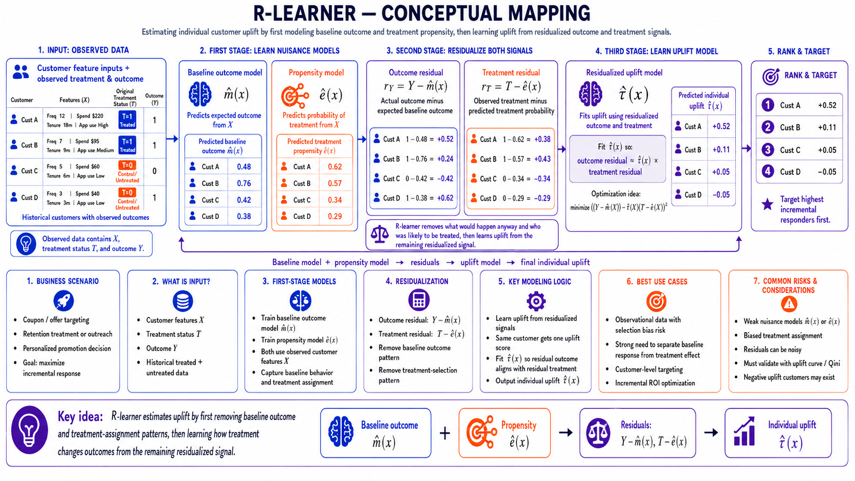

Slide 13
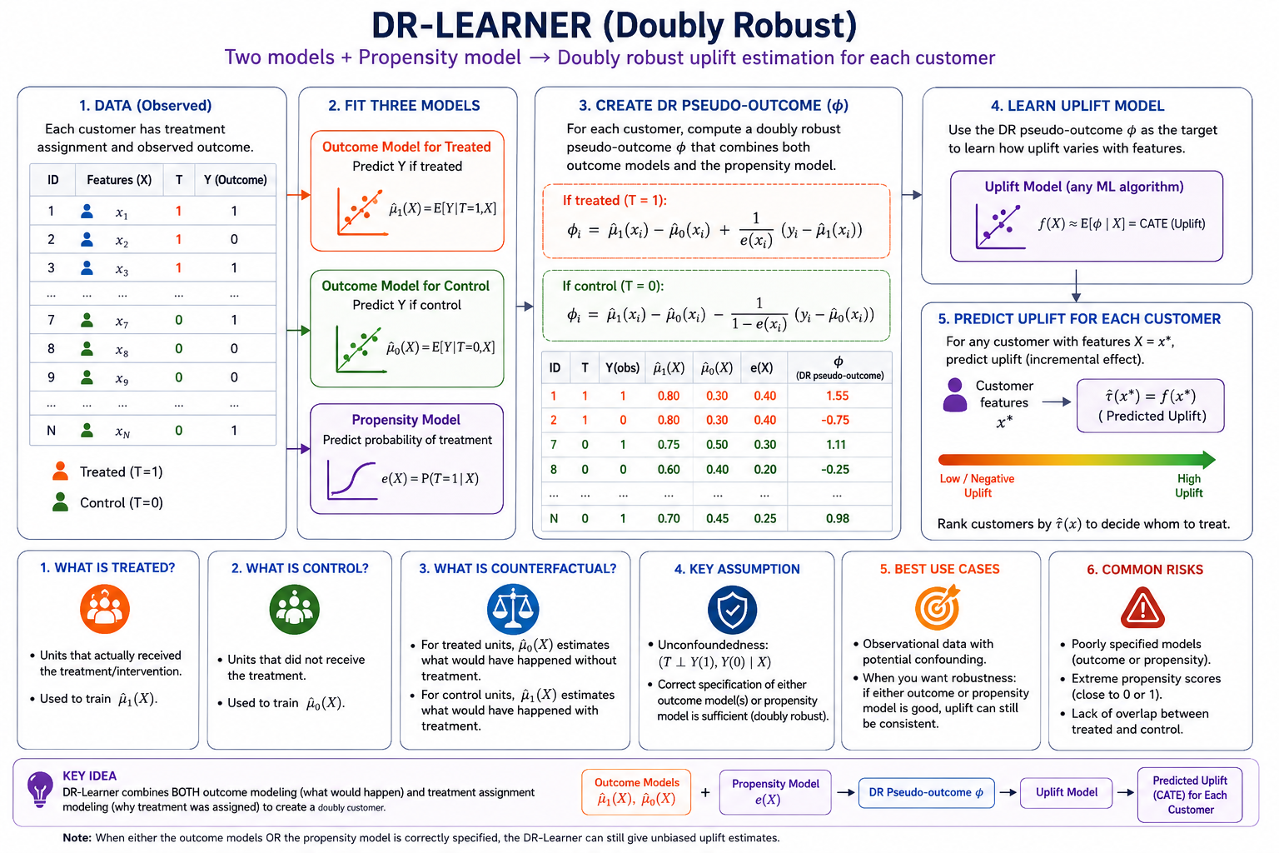
DR pseudo outcome=Base uplift+Observed error correction weighted by treatment probability

Slide 14
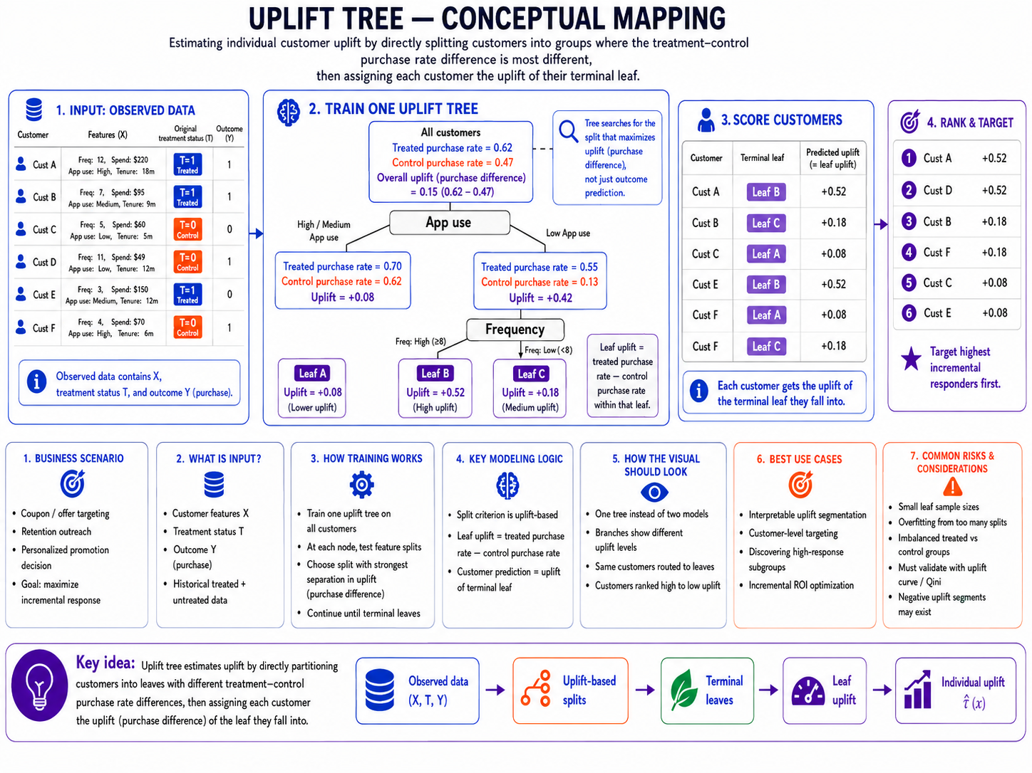

Slide 15
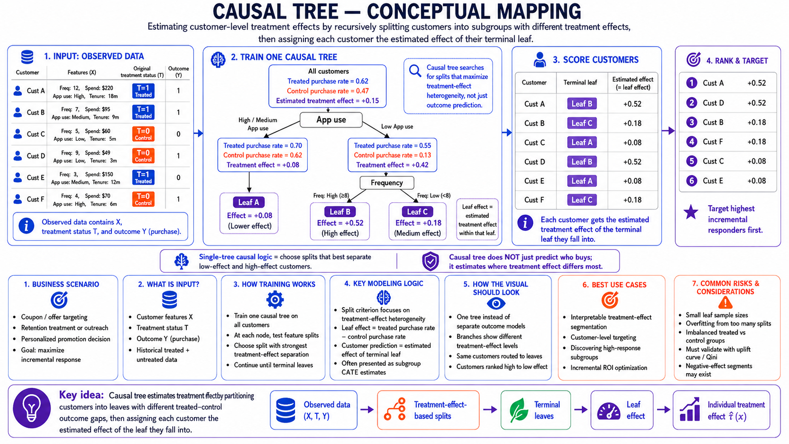

Slide 16
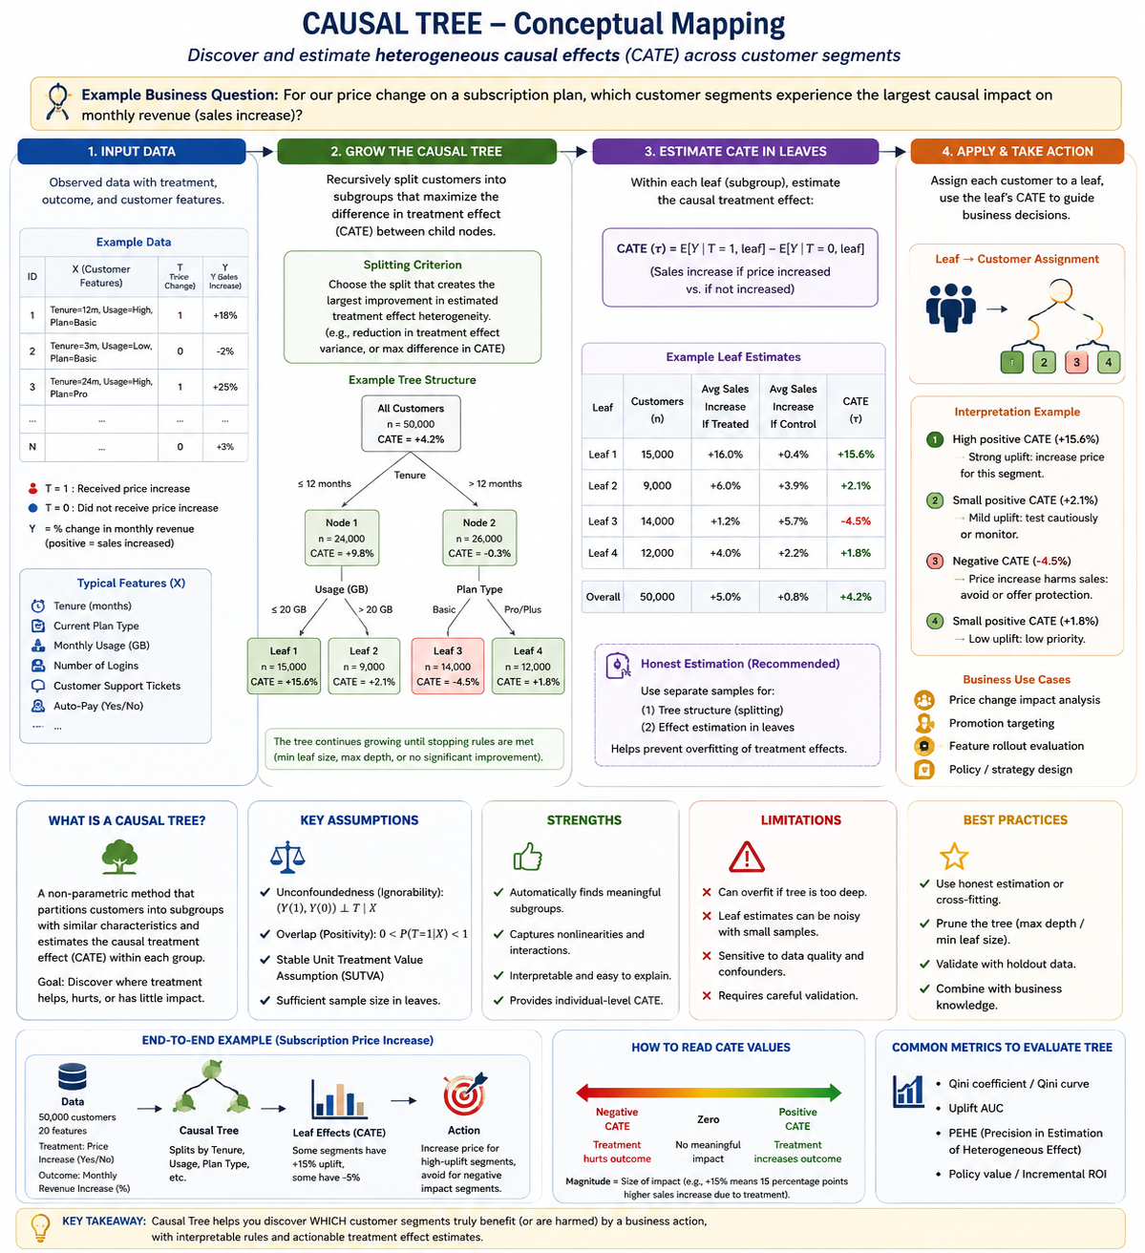

Slide 17
