Slide 1
GC Decomposition – Protected Base + Growth Movement Waterfall
Foundation / BAU
Foundation Movement
External Context
Counterfactual weak foundation base → protected BAU base → actual foundation movement → external context → commercial actions → gap / residual → actual outcome
Commercial Actions
Enablement / Bottleneck
Gap / Residual
1. Counterfactual Weak Foundation Base
2. Foundation Protection / BAU Base
3. Foundation Movement vs BAU / LY
4. External Context
5. Commercial / Campaign Actions
6. Enablement / Bottleneck
7. Gap / Residual
GC (Millions)
+8M
+3M
+4M
-5M
+12M
350M
-9M
-2M
+5M
+2M
+9M
+3M
333M
+1M
330M
+2M
+1M
-3M
-2M
-1M
+10M
+3M
+6M
-8M
+8M
-4M
+0M
-3M
310M
2024 Actual GC (reference)
Weak Foundation
Speed / Ops
Supply / Availability
Technology Reliability
CSAT / CX
People / Hours
Loyalty Base
Protected BAU Base
Speed Change
Supply Change
Tech Change
CSAT Change
Hours Change
Loyalty Change
Weather
Macro
Competition
Calendar / Footprint
Pricing
Promo / Value
Media
LTO / Menu
Digital / CRM
Foundation Enablement
Bottleneck Drag
Known Data Gap
Residual
2025 Actual GC
Counterfactual scenario
Reference only
+23M protected GC Maintains base vs degraded foundation
+2M net foundation movement Actual changes vs BAU / LY
-15M external context Weather, macro, competition
+42M commercial movement Pricing, promo, media, LTO, digital
-1M net enablement Readiness lift less bottleneck
-11M gap / residual Still not fully measured
Method note: foundation domains appear twice with different meanings — (1) protected base / avoided loss versus degraded counterfactual, and (2) actual movement versus BAU or last year. Values shown are illustrative placeholders.
Counterfactual base is a scenario, not last year actual. 2024 actual is shown only as reference.

Slide 2
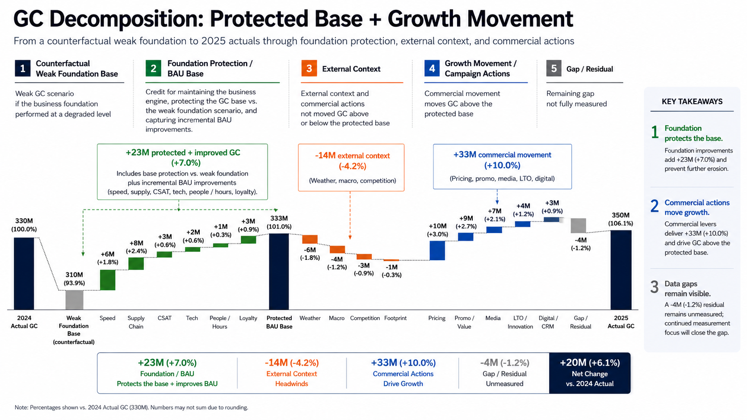

Slide 3
GC Decomposition: Protected Base + Growth Movement
From a counterfactual weak foundation to 2025 actuals through foundation protection, external context, and commercial actions
1
Counterfactual Weak Foundation Base
2
Foundation Protection / BAU Base
3
External Context
4
Growth Movement / Campaign Actions
5
Gap / Residual
Weak GC scenario if the business foundation performed at a degraded level
Credit for maintaining the business engine, protecting the GC base, and capturing incremental BAU improvements.
External context not controlled by the business moves GC above or below base
Commercial movement moves GC above the protected base
Remaining gap not fully measured
KEY TAKEAWAYS
+23M protected + improved GC (+7.0%)
Includes base protection vs. weak foundation plus incremental BAU improvements (speed, supply, CSAT, tech, people / hours, loyalty).
-14M external context (-4.2%)
(Weather, macro, competition)
+35M commercial movement (+10.6%)
(Pricing, promo, media, LTO, digital)
1
Foundation protects the base.
Adds +23M (+7.0%) and prevents erosion.
+6M (+1.8%)
+3M (+0.9%)
-4M (-1.2%)
350M (106.1%)
+7M (+2.1%)
2
Commercial actions move growth.
333M (100.9%)
+9M (+2.7%)
330M (100.0%)
+2M (+0.6%)
+1M (+0.3%)
+3M (+0.9%)
-6M (-1.8%)
+10M (+3.0%)
Delivers +35M (+10.6%) above the protected base.
+8M (+2.4%)
+3M (+0.9%)
-4M (-1.2%)
-3M (-0.9%)
+6M (+1.8%)
-1M (-0.3%)
310M (93.9%)
3
Data gaps remain visible.
-4M (-1.2%) remains unmeasured; close with better data capture.
2024 Actual GC
Weak Foundation Base (counterfactual)
Speed
Supply Chain
CSAT
Tech
People / Hours
Loyalty
Protected BAU Base
Weather
Macro
Competition
Footprint
Pricing
Promo / Value
Media
LTO / Innovation
Digital / CRM
Gap / Residual
2025 Actual GC
+23M (+7.0%)
-14M (-4.2%)
+35M (+10.6%)
-4M (-1.2%)
+20M (+6.1%)
Foundation / BAU Protects base / improves BAU
External Context Headwinds
Commercial Actions Drive Growth
Gap / Residual Unmeasured
Net Change vs. 2024 Actual
Note: Percentages shown vs. 2024 Actual GC (330M). Numbers may not sum due to rounding.

Slide 4
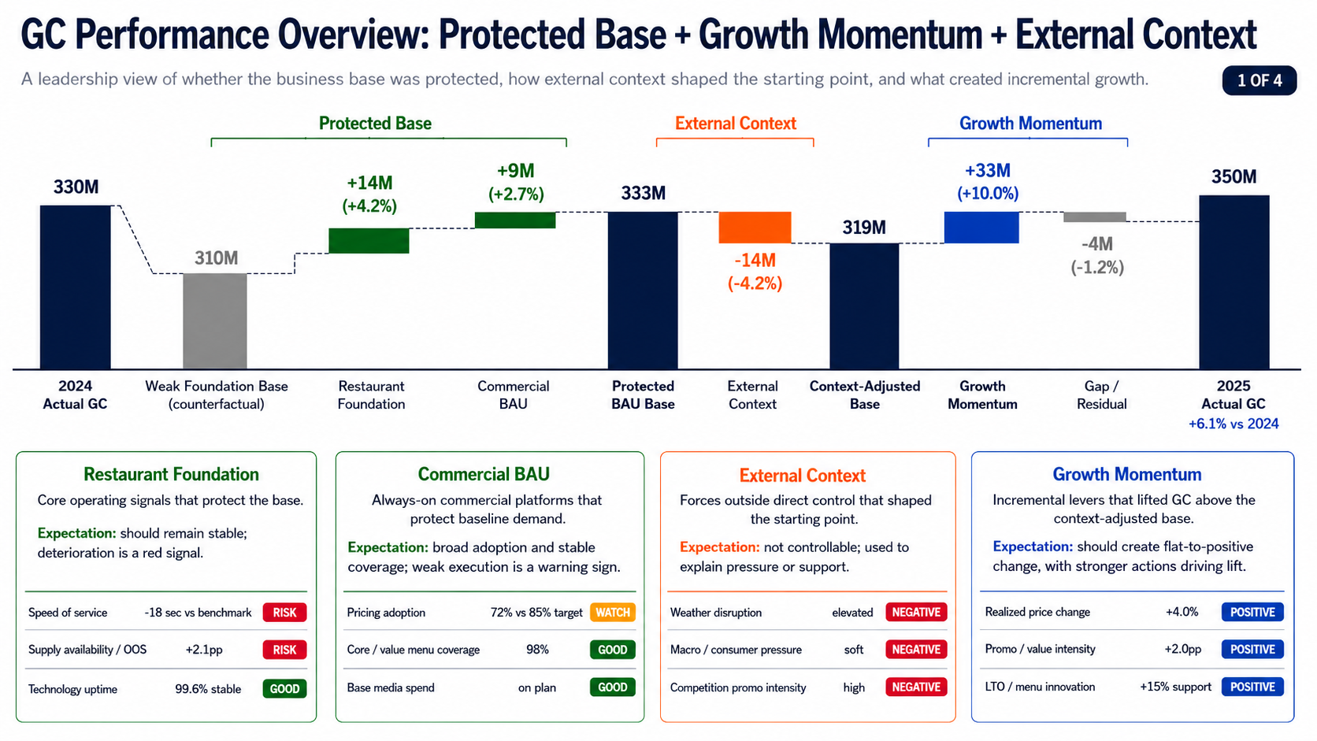

Slide 5
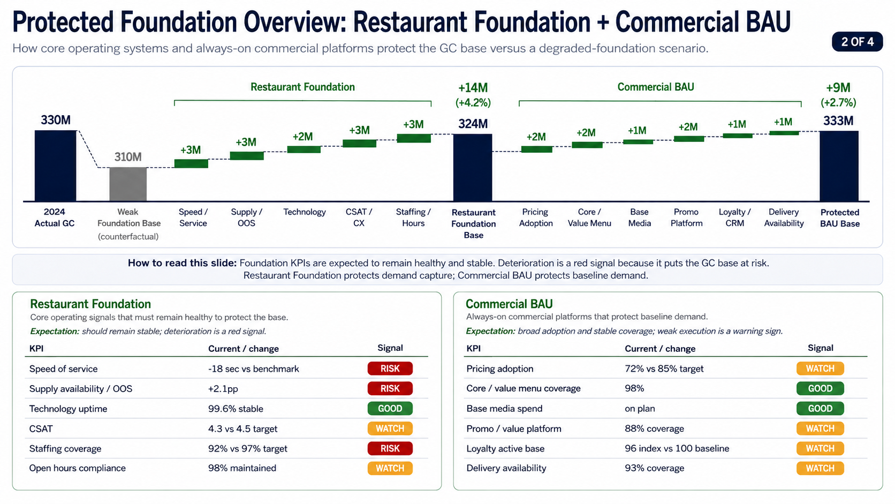

Slide 6
GC Performance Overview: Protected Base + Growth Momentum + External Context
1 OF 4
A leadership view of whether the business base was protected, how external context shaped the starting point, and what created incremental growth.
Protected Base
External Context
Growth Momentum
333M
+33M
(+10.0%)
330M
350M
+14M
(+4.2%)
+9M
(+2.7%)
319M
-4M
(-1.2%)
310M
-14M
(-4.2%)
2024
Actual GC
Weak Foundation Base
(counterfactual)
Restaurant
Foundation
Commercial
BAU
Protected
BAU Base
External
Context
Context-Adjusted
Base
Growth
Momentum
Gap /
Residual
2025
Actual GC
+6.1% vs 2024
Restaurant Foundation
Commercial BAU
External Context
Growth Momentum
Core operating signals that must
remain healthy to protect the base.
Always-on commercial platforms that
protect baseline demand.
Forces outside direct control that shaped
the starting point.
Incremental levers that lifted GC above
the context-adjusted base.
Expectation: should remain stable;
deterioration is a red signal.
Expectation: broad adoption and stable
coverage; weak execution is a warning sign.
Expectation: not controllable; used to
explain pressure or support.
Expectation: should create flat-to-positive
change, with stronger actions driving lift.
Speed of service
+18 sec vs target
RISK
Pricing adoption
72% vs 85% target
WATCH
Weather disruption
elevated
NEGATIVE
Realized price change
+4.0%
POSITIVE
Supply availability / OOS
+2.1pp
RISK
Core / value menu coverage
98%
GOOD
Macro / consumer pressure
soft
NEGATIVE
Promo / value intensity
+2.0pp
POSITIVE
Technology uptime
99.6% stable
GOOD
Base media spend
on plan
GOOD
Competition promo intensity
high
NEGATIVE
LTO / menu innovation
+15% support
POSITIVE
Note: Illustrative values; percentages shown vs. 2024 Actual GC.

Slide 7
Protected Foundation Overview: Restaurant Foundation + Commercial BAU
2 OF 4
How core operating systems and always-on commercial platforms protect the GC base versus a degraded-foundation scenario.
Restaurant Foundation
+14M
(+4.2%)
Commercial BAU
+1M
+1M
+9M
(+2.7%)
+2M
+1M
+2M
333M
330M
+3M
324M
+2M
+2M
+3M
+3M
+3M
310M
2024
Actual GC
Weak
Foundation Base
(counterfactual)
Speed /
Service
Supply /
OOS
Technology
CSAT /
CX
Staffing /
Hours
Restaurant
Foundation
Base
Pricing
Adoption
Core /
Value Menu
Base
Media
Promo
Platform
Loyalty /
CRM
Delivery
Availability
Protected
BAU Base
How to read this slide:
Foundation KPIs are expected to remain healthy and stable. Deterioration is a red signal because it puts the GC base at risk.
Restaurant Foundation protects demand capture; Commercial BAU protects baseline demand.
Restaurant Foundation
Commercial BAU
Core operating signals that must remain healthy to protect the base.
Always-on commercial platforms that protect baseline demand.
Expectation:
should remain stable; deterioration is a red signal.
Expectation:
broad adoption and stable coverage; weak execution is a warning sign.
KPI
Current / change
Signal
KPI
Current / change
Signal
Speed of service
-18 sec vs benchmark
RISK
Pricing adoption
72% vs 85% target
WATCH
Supply availability / OOS
+2.1pp
RISK
Core / value menu coverage
98%
GOOD
Technology uptime
99.6% stable
GOOD
Base media spend
on plan
GOOD
CSAT
4.3 vs 4.5 target
WATCH
Promo / value platform
88% coverage
WATCH
Staffing coverage
92% vs 97% target
RISK
Loyalty active base
96 index vs 100 baseline
WATCH
Open hours compliance
98% maintained
WATCH
Delivery availability
93% coverage
WATCH
Note: Illustrative values; percentages shown vs. 2024 Actual GC. Status labels highlight standout KPIs only.

Slide 8
External Context Overview: Conditions Shaping Performance
4 OF 4
Factors outside direct control can lower or raise the context-adjusted base before incremental growth levers are evaluated.
EXTERNAL CONTEXT DRIVERS
Impact on GC (Millions)
333M
-14M (-4.2%)
-6M (-1.8%)
319M
external context
-4M (-1.2%)
0M (0.0%)
-3M (-0.9%)
-1M (-0.3%)
Protected BAU Base
Weather
Macro / Consumer
Competition
Industry / Category
Footprint / Calendar
Context-Adjusted Base
How to read this slide: External context is outside direct control; it calibrates the starting point after protected base and helps set realistic expectations for growth momentum.
EXTERNAL CONTEXT DETAIL — standout signals only
Area
Example KPI
Current / change
Benchmark
Implication
Signal
Weather
Severe weather days / mobility disruption
Elevated
Normal
Mobility pressure
NEGATIVE
Macro / Consumer
Consumer confidence, inflation pressure
Soft
Neutral
Traffic pressure
NEGATIVE
Competition
Competitor promo intensity / price gap
High
Average
Share pressure
NEGATIVE
Industry / Category
QSR traffic trend
Flat / down
Positive
Category headwind
WATCH
Footprint / Calendar
Comparable day mix, closures, calendar shift
Stable
Stable
Neutral
NEUTRAL
Local Events
Market disruptions, events, strikes, local demand shocks
Selective
Normal
Localized impact
WATCH
Note: External context separates uncontrollable headwinds/tailwinds from internal execution and helps calibrate targets and narrative.

Slide 9
Growth Momentum Overview: Signals That Create Incremental GC
3 OF 4
These signals are expected to create incremental lift and explain why GC moved above or below the protected base.
+33M commercial movement (+10.0%)
Illustrative example
KEY TAKEAWAYS
Growth Momentum Drivers
Growth momentum is about change, not just stable health.
Promo / Value
LTO / Menu Innovation
Digital / CRM
Operations Improvement
Supply Improvement
1
Pricing
Media
Delivery
Contribution (M)
+10M
+9M
+7M
+4M
+3M
+2M
-1M
-1M
Commercial levers such as pricing, media, promo, LTO, digital, and delivery should create lift.
(+3.0%)
(+2.7%)
(+2.1%)
(+1.2%)
(+0.9%)
(+0.6%)
(-0.3%)
(-0.3%)
2
Driver
KPI
YoY Change
Expected Role
Comment
Pricing
Effective price
+4%
Drive pricing realization
Affordability must be monitored
Promo / Value
Discount depth
+2pp
Drive volume and traffic
Balance lift with margin impact
Some operational or supply changes may help or constrain momentum.
Media
Media spend ROI
+10%
Drive awareness and traffic
Focus on efficient channels
3
LTO / Menu Innovation
LTO sales contribution
+15%
Drive trial and incremental sales
Sustain novelty and relevance
Digital / CRM
Active members
+8%
Increase engagement and frequency
Grow and retain active base
Delivery
Delivery sales mix
+1pp
Expand accessible demand
Manage profitability and fees
Operations Improvement
Restaurant margin
+1%
Unlock margin to reinvest
Efficiency gains may vary
Positive movement is expected here; weak or negative movement signals lost incremental opportunity.
Supply Improvement
COGS per unit
-1%
Lower cost to support margin
Commodity and supplier driven

Slide 10
MVM Technical Architecture (Phase 2)
Protected Base
External Context
Growth Momentum
Restaurant Foundation
Commercial BAU
Weather
Macro
Competition
Industry
Pricing
Promo
Media
Menu
/ LTO
Loyalty
Delivery
Speed
Supply
Pricing
Menu
Tech
CSAT
Media
Promo
Crew
Loyalty
Delivery
Data & Feature Tables
Feature Store
Topline KPIs + Features
Training datasets
Speed:
R2P, OEPE
P90 service time
Supply:
OOS
Tech:
Uptime
CSAT:
OSAT, sentiment
Crew:
OSAT
Coverage
Pricing:
Adoption rate
Menu:
Core / Value items
Media:
Base spend
…
3-year restaurant weekly historical performance
Evidence Pathway
Yes → Prior-Informed Path
Prior evidence exists?
No → Causal Estimation Path
Granular Domain Drill-Downs
Evidence
&
Business
Knowledge Repositories
Prior Repository
Panel / Regression Analysis
Experiment Repository
Causal Inference Capability
Explains which sub-components drive domain-level contribution for traceability
Business Domain Alignment
Quasi-Experiment / Matching
QBR / Historical Analysis
Sensitivity / Scenario Analysis
Menu
Premium | Value | Core | LTO
Business domain teams need to agree on the attribution estimation
Industry Reference
Pricing
Premium | Value | Core | LTO
Prior-Informed Estimate
New Domain Estimate
Menu
RGM
Media
Base Media | Campaign | Channel
Marketing
Ops
Stand-alone Domain Estimate Outputs
Speed
Service Time | Restaurants | Hours
Technology
People
impact estimate + uncertainty + confidence + data quality + owner validation
Competition
Price | Promo | Share of Voice
Supply Chain
Finance
Speed
Supply
Tech
CSAT
Crew
Weather
Macro
Competition
Industry
Delivery
Pricing
Menu
Media
Promo
Loyalty
Delivery
Pricing
Promo
Media
Menu
/ LTO
Loyalty
Integrated MVM & Reconciliation
ML training -> Aligns all domains, fits monthly / quarterly / yearly training data, confidence + uncertainty
Final Outputs
Waterfall Output
Domain Drill-Downs
Confidence
Uncertainty
Results Alignment

Slide 11
MVM Technical Architecture (Phase 2)
Gap
Protected Base
External Context
External Context
Growth Momentum
Restaurant Foundation
Commercial BAU
Weather
Macro
Competition
Industry
Pricing
Promo
Media
Menu
/ LTO
Loyalty
Delivery
Speed
Supply
Pricing
Menu
Tech
CSAT
Media
Promo
Crew
Loyalty
Delivery
Data & Feature Tables
Feature Store
Topline KPIs + Features
Training datasets
Speed:
R2P, OEPE
P90 service time
Supply:
OOS
Tech:
Uptime
CSAT:
OSAT, sentiment
Crew:
OSAT
Coverage
Pricing:
Adoption rate
Menu:
Core / Value items
Media:
Base spend
…
3-year restaurant weekly historical performance
Evidence Pathway
Yes → Prior-Informed Path
Prior evidence exists?
No → Causal Estimation Path
Granular Domain Drill-Downs
Evidence
&
Business
Knowledge Repositories
Prior Repository
Panel / Regression Analysis
Experiment Repository
Causal Inference Capability
Explains which sub-components drive domain-level contribution for traceability
Business Domain Alignment
Quasi-Experiment / Matching
QBR / Historical Analysis
Sensitivity / Scenario Analysis
Menu
Premium | Value | Core | LTO
Business domain teams need to agree on the attribution estimation
Industry Reference
Pricing
Premium | Value | Core | LTO
Prior-Informed Estimate
New Domain Estimate
Menu
RGM
Media
Base Media | Campaign | Channel
Marketing
Ops
Stand-alone Domain Estimate Outputs
Speed
Service Time | Restaurants | Hours
Technology
People
impact estimate + uncertainty + confidence + data quality + owner validation
Competition
Price | Promo | Share of Voice
Supply Chain
Finance
Speed
Supply
Tech
CSAT
Crew
Weather
Macro
Competition
Industry
Delivery
Pricing
Menu
Media
Promo
Loyalty
Delivery
Pricing
Promo
Media
Menu
/ LTO
Loyalty
Integrated MVM & Reconciliation
ML training -> Aligns all domains, fits monthly / quarterly / yearly training data, confidence + uncertainty
Final Outputs
Waterfall Output
Domain Drill-Downs
Confidence
Uncertainty
Results Alignment

