Slide 1
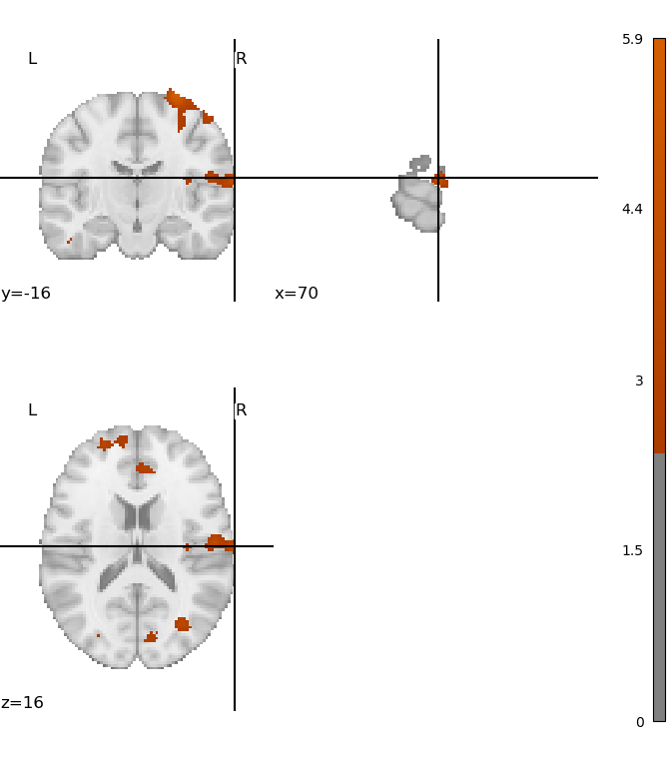
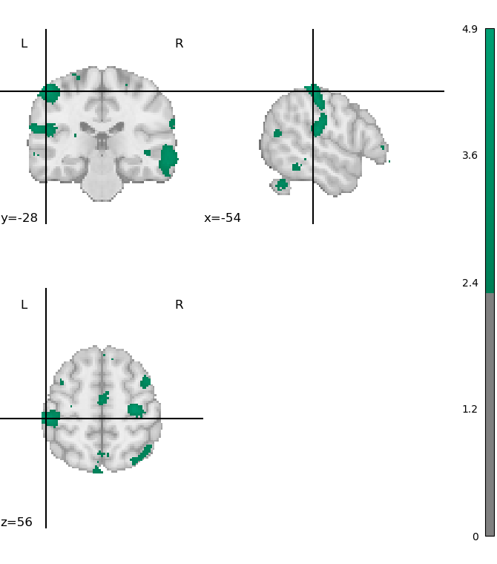
A.
B.
Notes:
1st level localizer: A. left vs. baseline; B: right vs. baseline

Slide 2
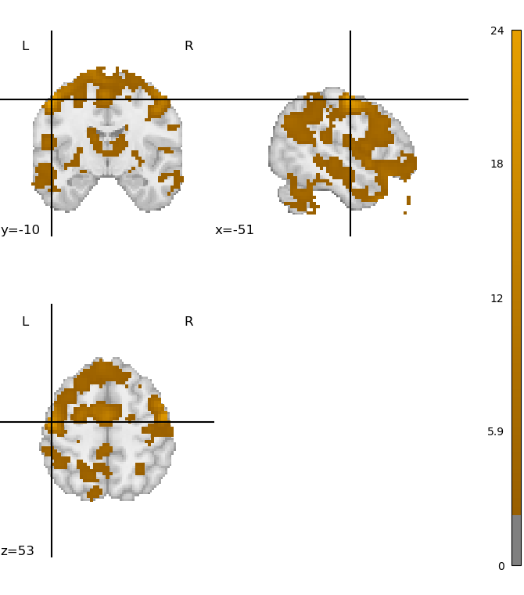
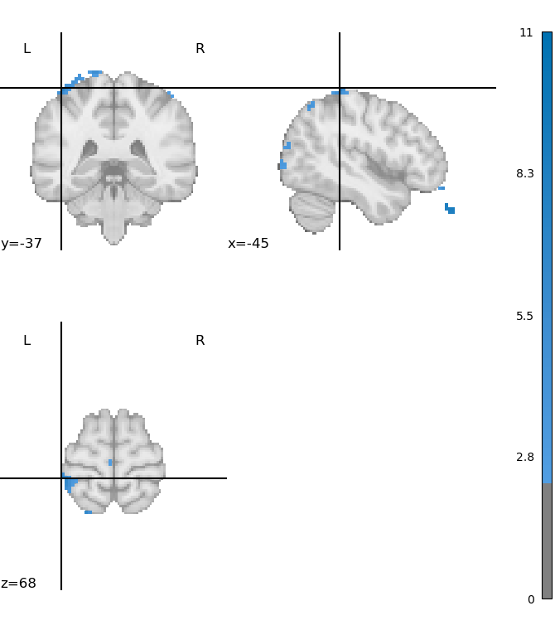
A.
B.
Notes:
1st level phases: A. alt vs. sim; B: sim vs. alt

Slide 3

Notes:
1st level switch

Slide 4
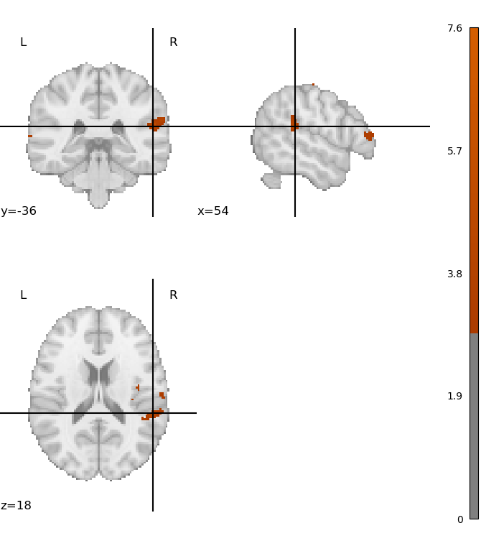
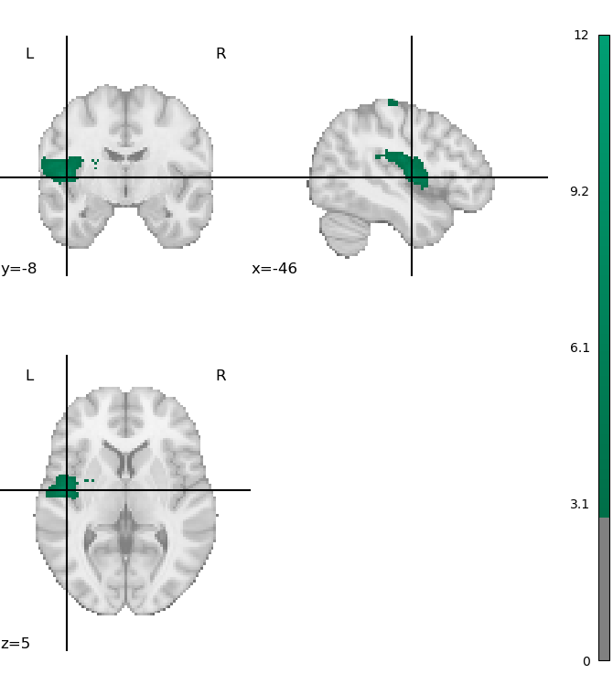
A.
B.
Notes:
2nd level localizer: A. left vs. baseline; B: right vs. baseline

Slide 5
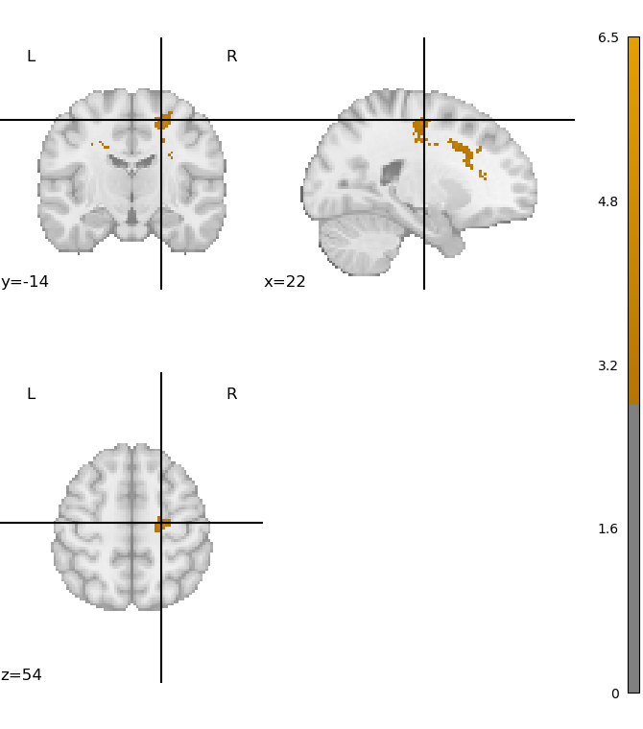
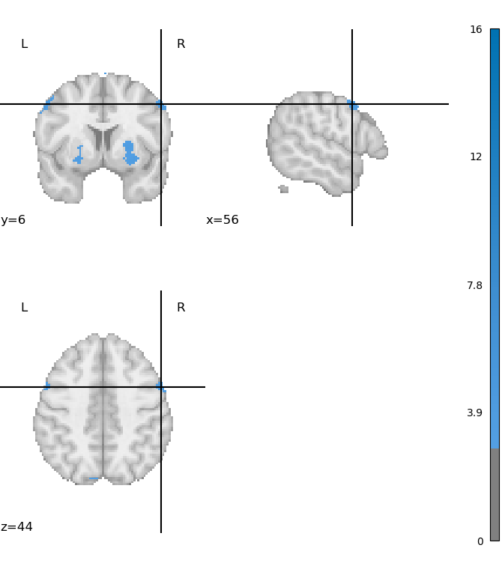
A.
B.
Notes:
2nd level phases: A. alt vs. sim; B: sim vs. alt

Slide 6

Notes:
2nd level switch

