Slide 1

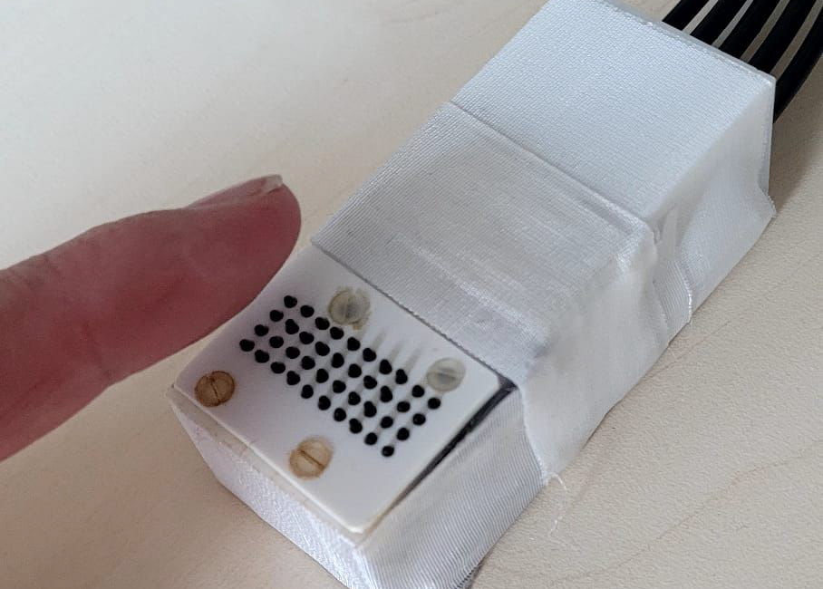
A.
behavioral assessment of perceptual switch
inside fMRI
Screening & SetUp
MRI Localizer, Fieldmapping & T1
Run 1
Run 2
Run 3
Run 4
Run 5
Run 6
Run 7: Functional Localizer
Question-naires
~ 10 min
~ 10 min
6 min
6 min
6 min
6 min
6 min
6 min
6 min
~ 5 min
B.
C.
D.
alternating
time
time
x
x
TD
…
simultaneous
TR
400 ms
+
400 ms
+
i_{L}(t)
i_{R}(t)
L
R
L
R
ALT
SIM
400 ms
high intensity
400 ms
low intensity

