Slide 1
Chemical Atlas
Andrew Barry & Olwenn Martin, Lucy Sabin
With Sahra Gibbon, Onya McClausland, Mark Miondownik
Supported by the UCL grand Challenges Initiative on climate chane

Slide 2
Background
Growth of research on chemicals in social sciences, humanities and arts since 2000s (e.g. Murphy, ‘Chemical Regime of Living’, Environmental History, 2008). See also Landecker, Sawyer, Hepler-Smith
The idea of Chemical Geography (2017) https://www.ucl.ac.uk/anthropocene/sites/anthropocene/files/andrew_barry_manifesto_for_a_chemical_geography.pdf
Chemical Exposures reading group UCL Anthropocene 2020-25, leading to a workshop in 2022, and publication of Gibbon, Glazer, Sabin, Barry (eds.) Chemical Exposures: Toxicity in the Anthropocene https://www.ucl.ac.uk/anthropocene/projects-and-seminars/research-groups/chemical-exposures-workshop-call-papers
The Chemical Atlas project 2024-25

Slide 3
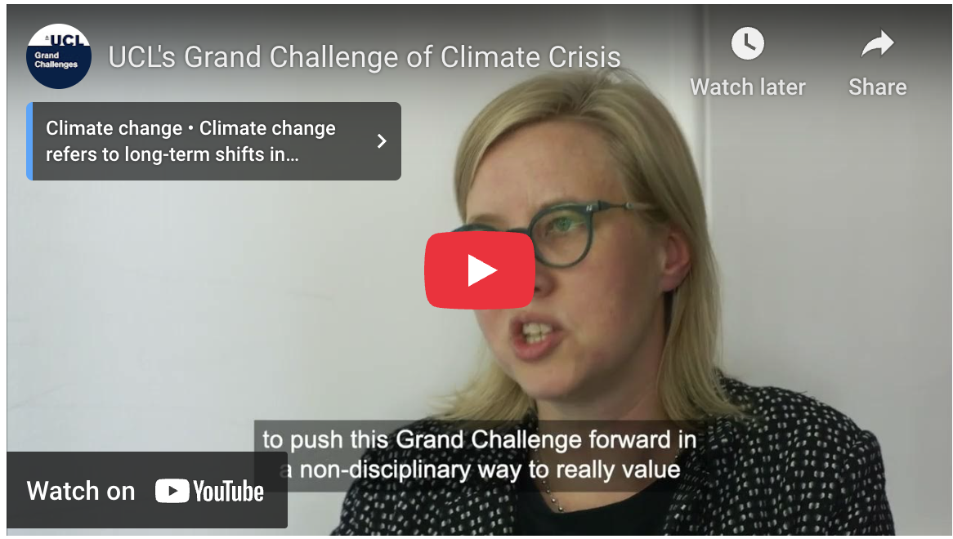
Chemical Atlas
The Project
The ambition of this project is to create the first iteration of online multimedia platform which will begin to map a complex field to which many disciplines can and should contribute. The atlas cannot be comprehensive – the range of pollutants and spatio-temporal scales at which they operate is too wide. Rather the aspiration of the chemical atlas project will be cross-disciplinary – to show how mapping chemical pollution demands the combined contributions of ethnographers, legal scholars, natural scientists, artists, and citizen scientists. The map will not just include cartographic representations (e.g. maps of air quality data, fossil fuel and mineral extraction), but also ethnographic descriptions, and audio-visual material.
https://www.ucl.ac.uk/grand-challenges/themes/climate-crisis

Slide 4
The Chemical Crisis
The Chemical Crisis
The UN Environment Programme has proposed the formation of a panel on chemical pollution that would sit alongside the existing panels on climate change (IPCC) and biodiversity loss (IPBES). Yet, while the chemical panel will exist in parallel to the IPCC, the climate crisis intersects with what we might call the chemical crisis in four ways:
The extraction of carbon, whether in the form of coal or oil, has provided the feedstock for the chemical as well as the fossil fuel industries. The economy and politics of fossil fuels and petrochemicals have been and remain entangled. The shift away from oil as a source of fuel has contributed to an increase in the production of plastics by oil producers and to the large-scale mining of Lithium, for example, both with major environmental impacts.
The chemical sector is energy intensive and is the third largest industry subsector for CO2 emissions (IEA 2024). Yet it has hitherto not received the attention devoted, for example, to transportation or domestic heating.

Slide 5
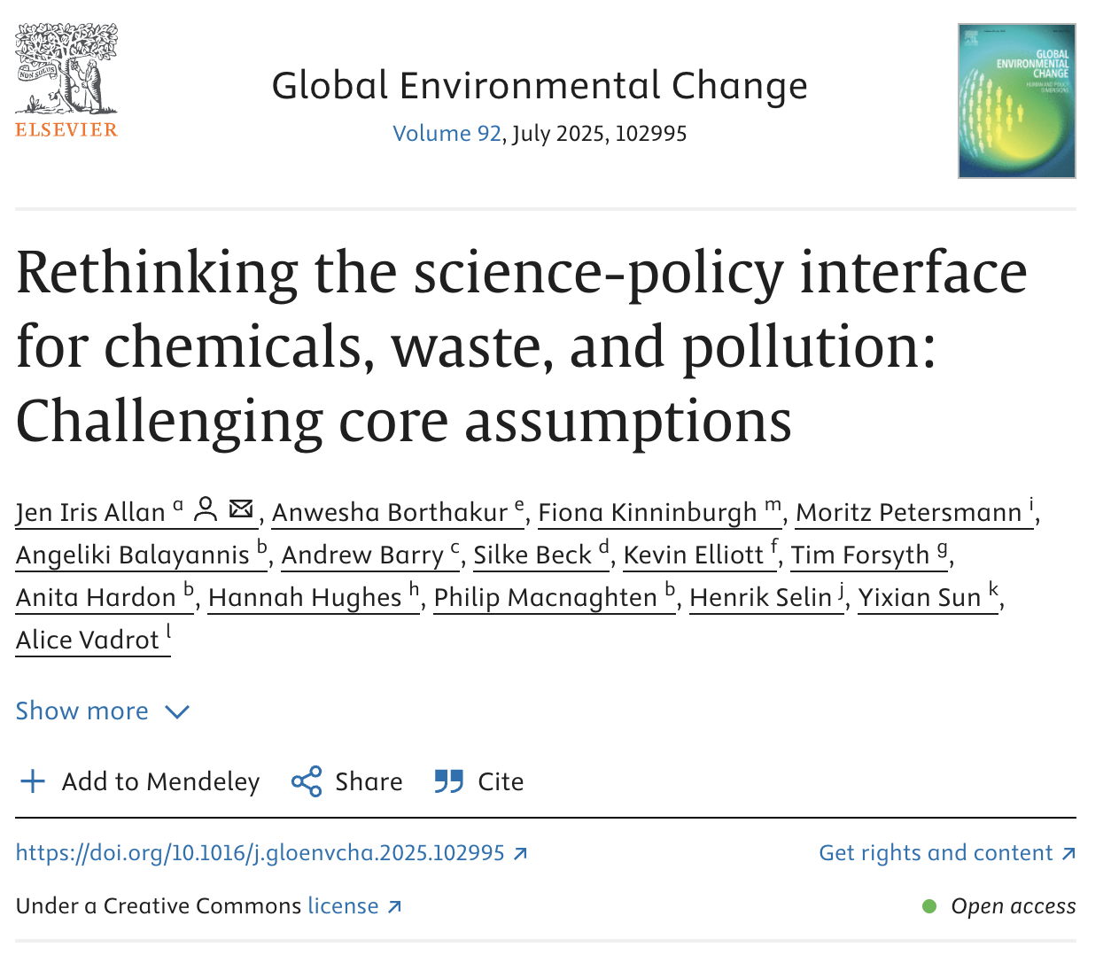
The production of fossil fuels continues to have pervasive impact on the chemical composition of the planet. Indeed, geo and environmental chemists have played a critical role in climate change research, tracing the changing chemical composition of the oceans, atmosphere, and soil over time.
Institutionally, some have proposed that the chemical panel should imitate the institutional form of the IPCC. The question of the relation between climate change and chemical pollution has geopolitical implications.

Slide 6
Impacts
Impacts & Assessment
This project envisions two overlapping groups of stakeholders, who will benefit from the atlas as a resource for research, teaching, policy making and knowledge exchange. First, those involved in the creation of the atlas and its content, encompassing the team at UCL, our external collaborators, contributing authors, the website designer, and the post- and undergraduate participants who will be instrumental in providing critical feedback. Moreover, subsequent focus groups will foster novel understandings and generate cross-disciplinary networks. Second, NGOs and interested members of the public as well as researchers and students will benefit from its open source content.

Slide 7
Both the method and the medium of the chemical atlas are inherently impactful, and lead to the following forms of assessment:
The method of co-designing the atlas entails an ongoing process of impact assessment as a core part of the creative research process from the outset.
The feedback on the atlas itself during the prototype tests will allow us to iteratively improve this interface and thus assess and maximise its impact.
The impact of the published atlas will be tangible in terms of both qualitative feedback and the quantitative feedback generated by website analytics.
The range of international contributions, including contributions from NGOs and institutions in the Global South, will be manifest in the atlas.
The project will create a first iteration of the atlas. Applications will be made over the course of the project to support further iterations and assessed by relevant funding bodies (e.g. the RSC and Royal Society).

Slide 8
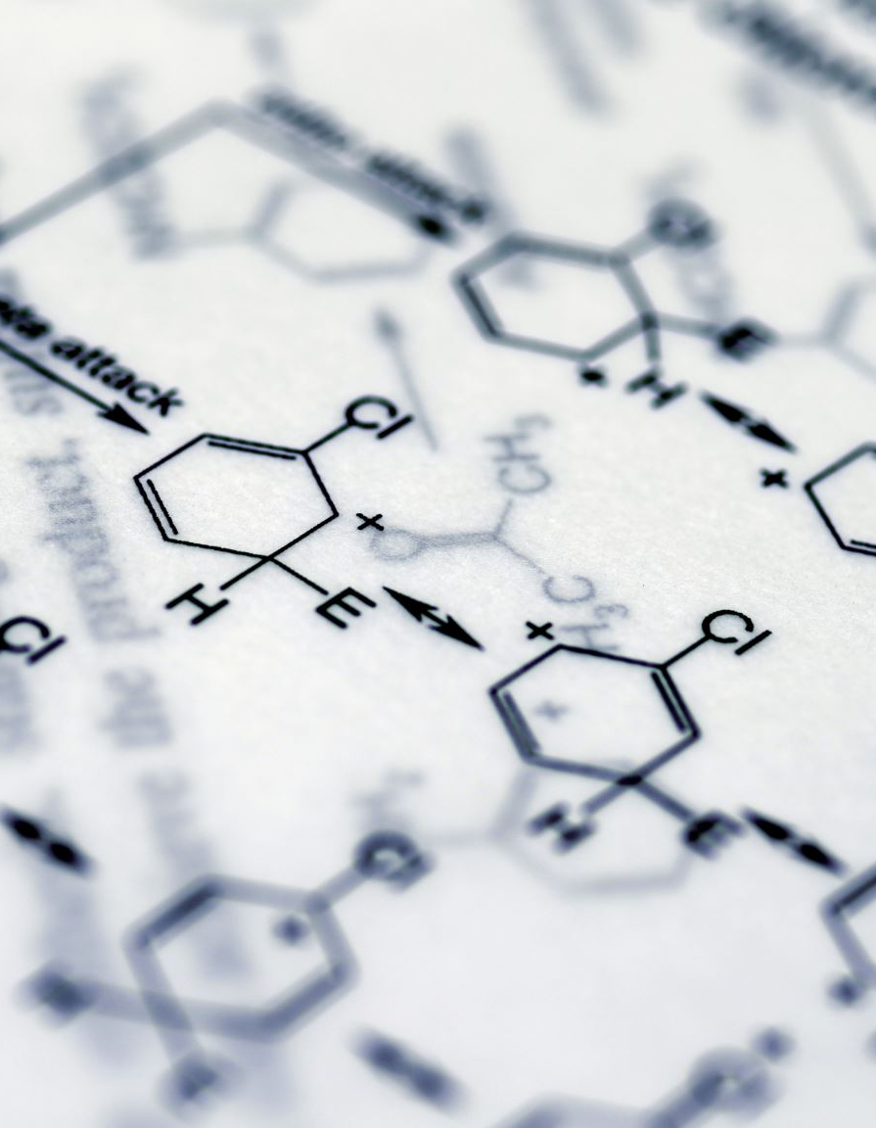
Questions for the workshop
How can we develop an inter or cross disciplinary project on chemicals?
What is a chemical? What is the atlas about?
What might a chemical atlas look like? What form should it take? What other examples of atlas might provide good models?

Slide 9
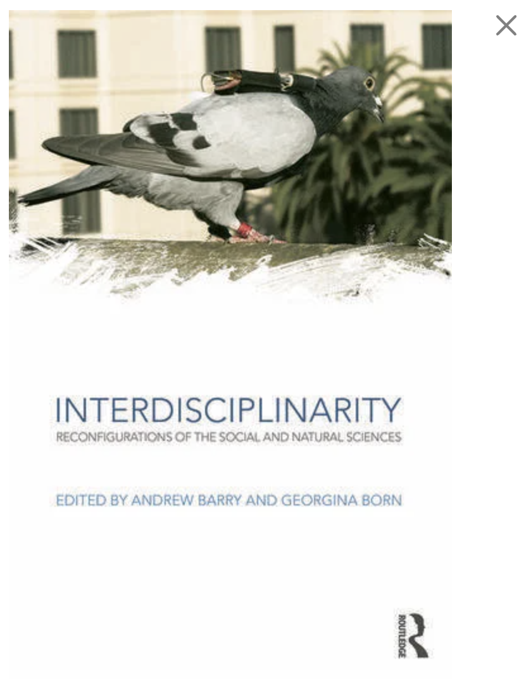
Interdisciplinarity: Some publications
Interdisciplinarity:
Barry, Born and Weszkalnys, ‘Logics of interdisciplinarity’, Economy and Society (2008)
Barry and Born (eds) Interdisciplinarity: Reconfigurations of the Natural and Social Sciences (2013)
Interdisciplinary art-science practices:
Barry and Born, ‘Art-science: from public understanding to public experiment’, Journal of Cultural Economy, 3(1), 2010
Interdiscplinarity in music, new media, computer software:
Born, Rationalizing Culture: IRCAM, Boulez, and the Institutionalization of the Musical Avant-Garde (1995)

Slide 10
Disciplines and Interdisciplines
All disciplines are ‘interdisciplinary’
e.g. engineering [management, sociology, physics]; architecture [cultural theory, civil engineering]; law [sociology]; geography [geosciences, history] etc.
So we shouldn’t oppose the bounded unity of disciplines to the openness of interdisciplines
But disciplines are interdisciplinary in different ways, in different circumstances, institutions and national contexts – excluding, or incorporating and translating other disciplines
And interdisciplines can become ‘disciplinary’, with departments, degrees, mechanisms of closure, sub-disciplinary fields etc…..the question of interdisciplinarity is institutional as much as conceptual
And there are broader divisions between the natural and social sciences….
See A Barry and G Born, Interdisciplinarity: Reconfigurations of the Social and Natural Sciences, London: Routledge, 2013

Slide 11
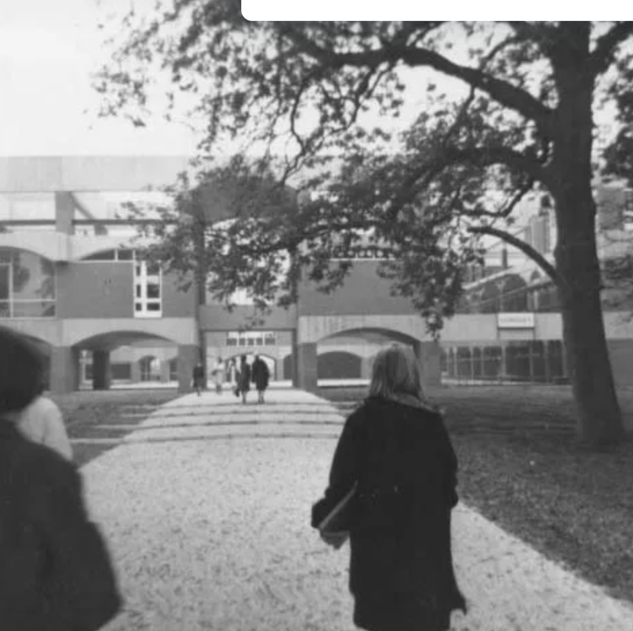
Interdisciplinary problems
Interdisciplinarity has been expected to address shifting and evolving problems:
e.g.
1950s-60s – Snow/Leavis/Zuckerman, cybernetics, the interdisciplinary university, ‘transdisciplinarity’ (1970)
2000s-2010s – public accountability and engagement, innovation and use, nanotechnology, sustainability studies, interdisciplinary art and music practices, risk and uncertainty
Today??

Slide 12
Modes of Interdisciplinarity
1. Additive-Synthesis mode:
Examples? Earth System Science, Quantum Chemistry, biochemistry, Political Ecology, Historical Sociology?
2. Subordination service mode:
Examples? Ethnography in industry, computer music research, some forms of ‘art-science’,,digital humanities (?), ELSI research (?)
3. Agonistic-antagonistic mode:
Interdisciplinary research that implies a critical distance or break from previous forms of disciplinary research
Examples?: cybernetics, molecular biology, literary theory, science and technology studies, art-science, ‘more-than-human’ geography, medical humanities, trans or anti-disciplinary research.

Slide 13
Logics of interdisciplinarity: prevalent rationales or orientations
1 Logic of accountability: Nowotny et al > Public Understanding of Science paradigm – public consultation, stakeholder engagement, citizen juries etc
2 Logic of innovation: industrial and/or technological innovation to fuel economic growth, creative economy, knowledge transfer etc
3 Logic of ontology: privileged relation to the agonistic-antagonistic mode (and transdisciplinarity) –
Notes:
1) Logic of Accountability: both governmental ‘top-down’ and democratising, participatory ‘bottom-up’ versions –
both ‘instruments of legitimation, defending against the possibility of public criticism, or enabling legislative guidelines to be met’ and
eg social sci in env & climate change research: ‘offers inventive ways of engaging lay knowledges and publics in scientific debate through such practices as deliberative mapping and participatory integrated assessment’ –
eg Oko Institut – founded 1977 to provide scientific evidence to buttress protests led by civic action groups in southwestern Germany
2) Logic of Innovation: leads to development of novel instruments, objects, practices or policies –
eg ethnography in IT industry: ‘connects businesses to “unarticulated desires” of customers… offers techniques through which businesses can transform their knowledge of and engagement with those micro-spaces of social life, replete with social and cultural difference, to which they previously did not have access’ > ethnographer-designer collaborations, development of prototypes, fine-tuning of product designs…
3) Logic of Ontology: towards a relational concept of subject-object –
‘ethnography may be employed to achieve a transformation of the ontological imagination of the firm, towards a conception of the intentional-industrial object as a socio-cultural-technical assemblage’
… and 3 logics entangled in each field: eg art-sci – 1) ‘PUS’, making sci accessible to publics (accountability), 2) development of novel hybrid art-organisms, assemblages and events (innovation), and 3) legacy of conceptual art > art reconceived as research / public intervention / event

Slide 14
Histories and situations
Interdisciplinarity: Reconfigurations of the Social and Natural Sciences was an intervention in a debate in science policy and social theory
But the situation has changed, and takes geographically and disciplinary specific forms:
Intensification of computerization, and growth of big data, social media
Indigenous knowledges
Urgency of environmental problems
Intensification of geopolitical competition
Growth of commercial research and citizen science

Slide 15
Art-science study (2006-7): 2 sites – UK and US
UK: funding schemes - Arts Council England, Wellcome Trust, Gulbenkian initiatives, project-based, short-term, commissioned
US: university based, eg of University of California, at 3 levels –
UCI (University of California, Irvine), founded 1965 as US model of the interdisciplinary university (along with UCSD, UC Santa Cruz)
Arts, Computation and Engineering (ACE) Masters Program: pedagogical experiment in forming interdisciplinary (arts-sci/tech) subjects suspended between 3 UCI Schools: Arts, Information and Computer Science, Engineering, (Biosciences pending in 2006)
ACE Faculty: individual art-scientists – focus on Beatriz da Costa (1974-2012): robotics, public artist, activist (Preemptive Media, Critical Art Ensemble …)

Slide 16
 | (UK) science-art programmes | (US) university-based art-science (eg UCI)
Institutional form | Commissioning model – WT, ACE, Gulbenkian > Term ‘science-art’ stable Unsustained, less funding, fragmentary, individualist | (Fragile) university base, salaried + research grants > Term ‘art-sci’ unstable, in flux Sustained funding, training ACE suspended betw 3 schools
Logics | Accountability: PUS > public engagement + Innovation: experimental, art as research (+ weak Ontology…) | Innovation: UCI industry links; res. advances both science & art + Ontology: incubates new inter-discipline, -languages, -subjects
Mode of interdisciplinarity / division of labour | Continuing div of labour: short collaboration, inter-lang model Subordination: art serves sci (but sci serves art in projects) | Transcends div of labour: interdisc in 1 person, sustained collaborations Agonistic/antag: ontological shift proposed for art, science, IT
Evaluation | Project funds, less pressure: ACE innovative anthrop model Leach: collaboration, new contexts, as value creation | Sustained funds pose acute evaluation problems: tenure promotion etc Unresolved 1 yr post crisis review
Lateral connections | Confined, limited: less developed networks, less consolidation, atomised | Profuse, proliferating: space of multiple connections local (UC DARnet), national, international..
Genealogies: nature and depth | Less developed geneals at intersection of a) PUS, and b) conceptual art | Pronounced, ramifying, multiple geneals: conceptual art, art & technology, computation/AI, cybernetics, biotech, etc…

Slide 17
Genealogies of Art-Science: ACE’s pedagogy
Computation/bio sciences & technologies
Phenomenological critique of AI (Dreyfus) -
embodiment,
situatedness >
- biologically-based intelligent robotics (Brooks)
- automatic design & evolvable robots
- A. Life: self-reproducing cellular automata
- emergence: creative artificial organisms
- artificial cultures
- genetic langs for mating, competition & evolution of virtual creatures
- expressive AI as interactive art…
British cybernetics
Biological computing
(Stafford Beer
Gordon Pask) -
self-organisation, dynamic equilibrium, analog-digital & live/human-non-human assemblages…
Biology of cognition (Maturana and Varela) - autopoiesis
Critical & feminist STS
Evelyn Fox Keller
Donna Haraway
Emily Martin
Andrew Pickering
Sarah Kember…
Linguistic
Art & Language...
Conceptual art
Muybridge
Duchamp
Tinguely
Cage, Fluxus
Social-Political
Hans Haacke
APG
Gustav Metzger
Adbusters
RTMark
CAE
Preemptive Media
Beatriz da Costa
‘Pidgeon Blog’
Technological
Nam June Paik
EAT/Billy Kluver
Jack Burnham
Laurie Anderson
Jim Pomeroy
Roy Ascott
Perry Hoberman
Stelarc
Eduardo Kac
Oron Catts
Victoria Vesna
Robert Nideffer
Simon Penny –
interactive agency in robotic/
installation artworks: ‘aesthetics of behaviour’
Garnet Hertz ‘Roachbot’
Art & technology/ studio-labs
Weimar Bauhaus
Black Mountain College
Bell Labs
EVL, U. Illinois
IRCAM
Ars Electronica
MIT Media Lab
Banff Centre
Canon ArtLab Tokyo
Xerox PARC’s
Symbiotica
PAIR
ZKM
Late C19th
Early C20th
Mid C20th
1970s
1980s
1990s
HCI/ CSCW:
phenomenology
+ EM
(Paul Dourish) -
embodied interaction >
tangible computing, ubiquitous comp., social computing
(> ethnography / IT…)

Slide 18
Ontological politics – from conceptual art to art-science
Conceptualism’s commitment to a distinctive ontology of art: originating in 1960s critique of formalist modernism > questions art as object, site, and social relations: each targeted for transformation by distinctive lineages of conceptual / post-conceptual practice
Conceptualism can be grasped via series of negations:
1) of primacy of visual forms > multimedia performances
2) negation of art’s commodity form > installation & site-specific work
3) negation of art’s ‘autonomy’ > politics of everyday life through interventions in media and publicity, art allied to political movements, politics of art as institution, art that foregrounds social relations…
> Art-science can be allied to an ontological shift / transition which, proffered by conceptual art, predates it
UK science-art publicly downplays, Rockefeller absents, ontological shift
Whereas US/ACE’s art-science interrogates the very categories of art, technology, agency, life, the human

Slide 19
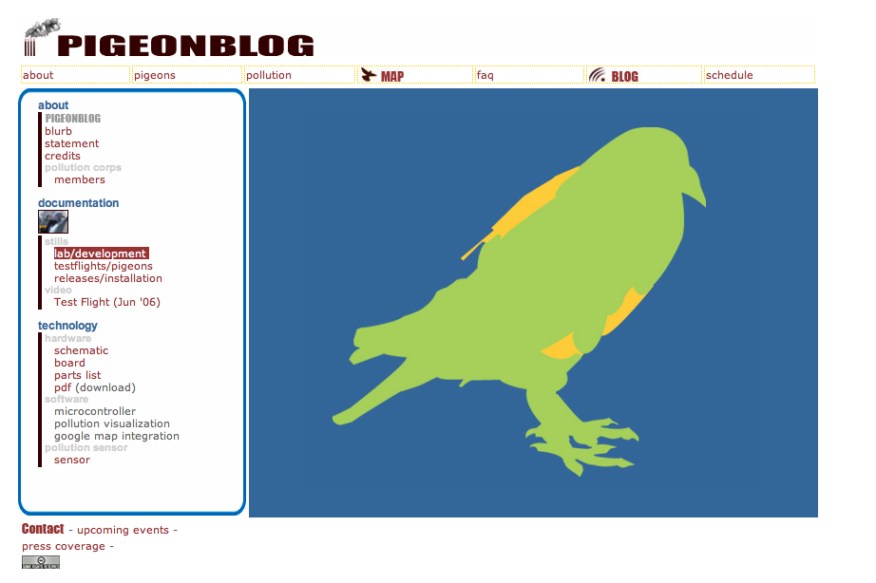
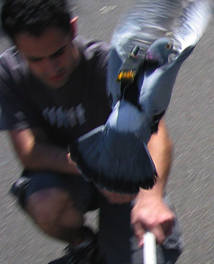
Pigeonblog by Beatriz da Costa

Slide 20
PigeonBlog and the logic of ontology
PigeonBlog thus combines artistic, scientific, social and political value:
Online blog and educational program involved local people in monitoring air pollutants, mobilising those most affected by pollution
Beatriz’s and our case: PigeonBlog’s enacts a logic of ontology: rather than present ready-made science to the public, PigeonBlog generates a new scientific practice, reconfiguring air quality not as a property of air but as a relation between pollution and those most affected by it
> Relational knowledge of air pollution dvpd via reflexive engagement between participants who are both the subjects & objects of knowledge, and who engage in its co-production, so that the knowledge produced also changes to take account of race and class, inequality and injustice
But PigeonBlog also transforms and multiplies art to encompass scientific and social research, website, installation, performance event, scientific papers, and social relations between art-scientist and affected publics

Slide 21
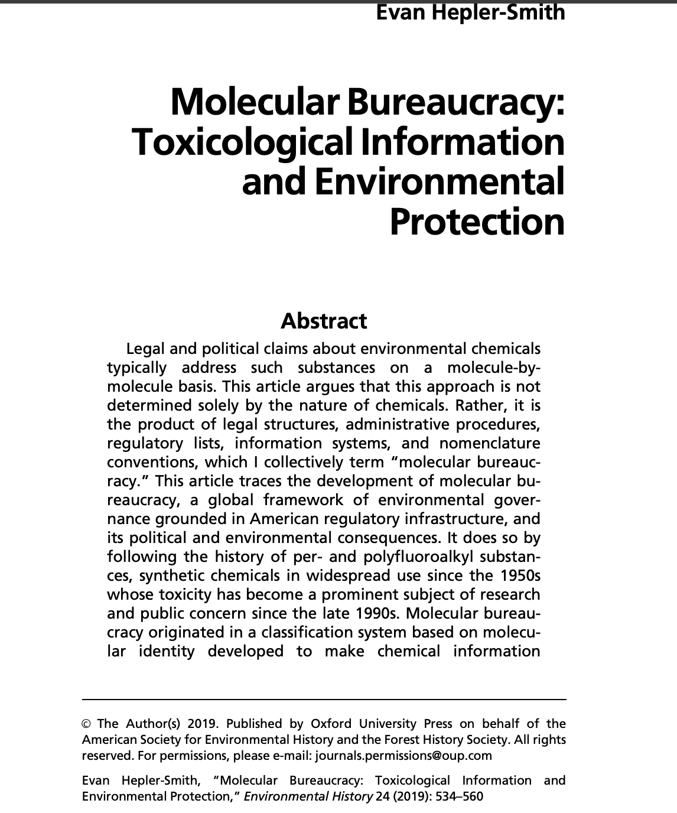
‘The Molecular Bureaucracy’ of chemistry
Popular (and natural and social scientific) accounts of chemicals often focus on individual chemicals conceived of as molecules or elements (e.g. S0_{x}, ‘rare earth’ elements, C02 )
How can chemicals be conceived differently? – in relation to
See e.g. Bensaude-Vincent and Stengers, The History of Chemistry (1996), Bensaude-Vincent, Faut-il avoir peur de la chemie? (2005), Hepler-Smith, ‘Molecular Bureaucracy’ (2019)

Slide 22
What is a chemical?
No single answers, Question of how different disciplines, fields, interdisciplines:
Conceive of their chemicals and the world (e.g. as parts of systems, as isolated agents, as relational etc.)
Construct, transform, invent or trace chemicals (eg. through purification, abstraction, modelling, collaboration, ethnography, political action, performance)
Supplement the existence of their objects (entangling them in devices, data bases, information and atlases)
Chemicals have become increasingly supplemented and co-exist with information about their properties, performance and toxicity
See Barry (2005), ‘Pharmaceutical Matters: the invention of informed materials’ Theory, Culture and Society

Slide 23
What is a chemical atlas?
This is the problem we will address for the rest of the workshop, and how we might design one….

