Slide 1
A Distributed Object Store for Meteorological and Climate Data
Simon Smart, Tiago Quintino, Baudouin Raoult
ECMWF
simon.smart@ecmwf.int

Slide 2
Motivation

Slide 3
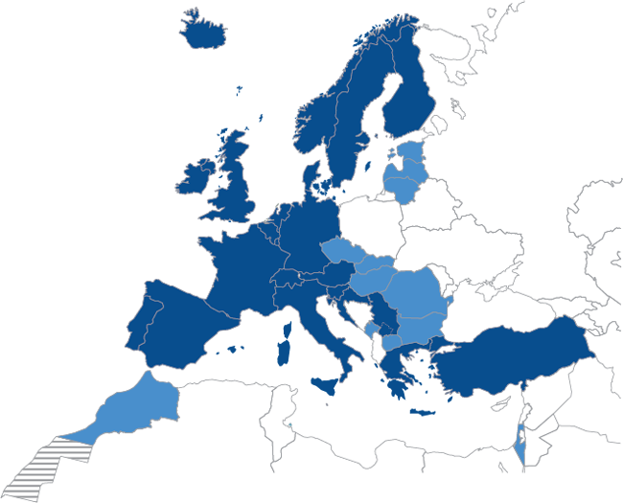
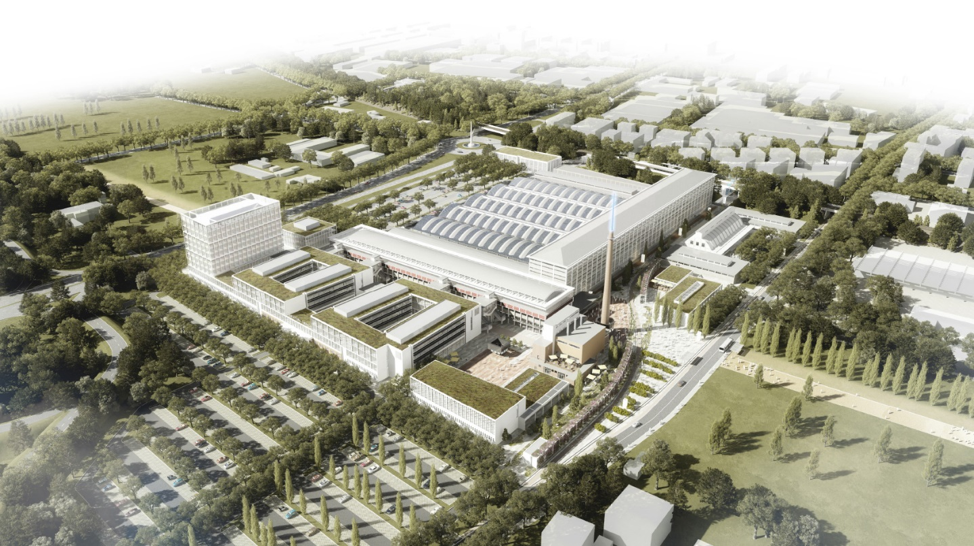
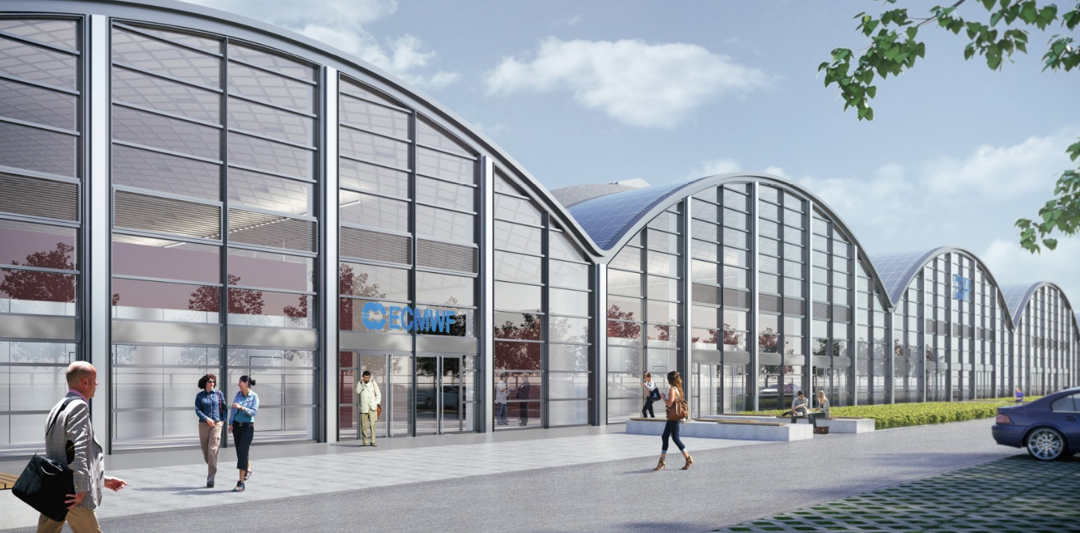
ECMWF’s Forecasting Systems
What do we do?
Operations – Time Critical
HRES 0-10 day, 00Z+12Z
O1280 (9km) 137 levels
ENS 0-15 day, 00Z+12Z
O640 (18km) 91 levels
ENS extended 16-46 day, twice weekly
O320 (36km) 91 levels
BC 06Z and 18Z
hourly post-processing 0-5 days
Research – Non Time Critical
Experiments to improving our models
Reforecasts, Climate reanalysis, etc

Slide 4
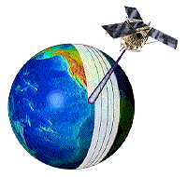

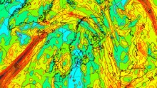
ECMWF’s (Simplified) Operational Workflow
Data Workflow
Post-process data for client products
Post-process for statistics and data analysis
Perpetual archival of generated data sets
Global
Observations
Acquisition
IFS
Model
Product
Generation
Product
Dissemination
Obs
Fields
Member
States
&
Customers
Products
MARS
Perpetual Archive
Notes:
Add more complex version???
Make case for task parallelism?

Slide 5
ECMWF’s Production Workflow
IFS
Model
Product
Generation
ECPDS
Member
States
&
Customers
Raw Output
Fields
42TiB Read (70%)
Products
FDB
PDB
Parallel Filesystem
Storage (Lustre)
Time critical path
6.6M grid points
137 levels
904M values, per variable
18M fields
MARS
Perpetual Archive

Slide 6
(Simplified) Storage view of workflow
Acquisition
Product
Dissemination
Observations
Member
States
&
Customers
Lustre
IFS
Model
MARS
Product Generation
Perpetual Archive

Slide 7
History and Future of Resolution Upgrades
Resolution | Grid size | Grid Points | Field Size (in memory)
T319 | 62.5 km | 204 k | 1.6 MB
T511 | 39 km | 524 k | 4 MB
T799 | 25 km | 1.2 M | 9.6 MB
T1279 | 16 km | 2.1 M | 16.8 MB
Tco1279 | 9 km | 6.6 M | 50.4 MB
Tco1999 | 5 km | 16.1 M | 122.6 MB
Tco3999 | 2.5 km | 64 M | 490 MB
Tco7999 | 1.25 km | 256 M | 1909 MB

Slide 8
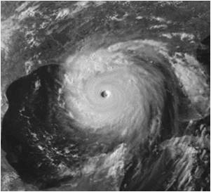
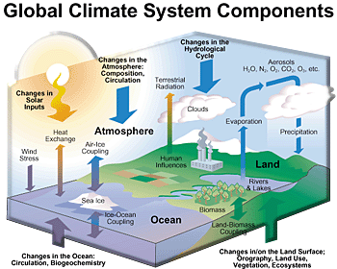




Multiple dimensions
➔Reliability
Ensembles
➔Range
Model complexity
Traditional weather science domain
Traditional climate science domain
➔Accuracy
Model resolution
Today: it needs high-resolution, ‘Earth system’ model ensembles to perform at all scales!

Slide 9
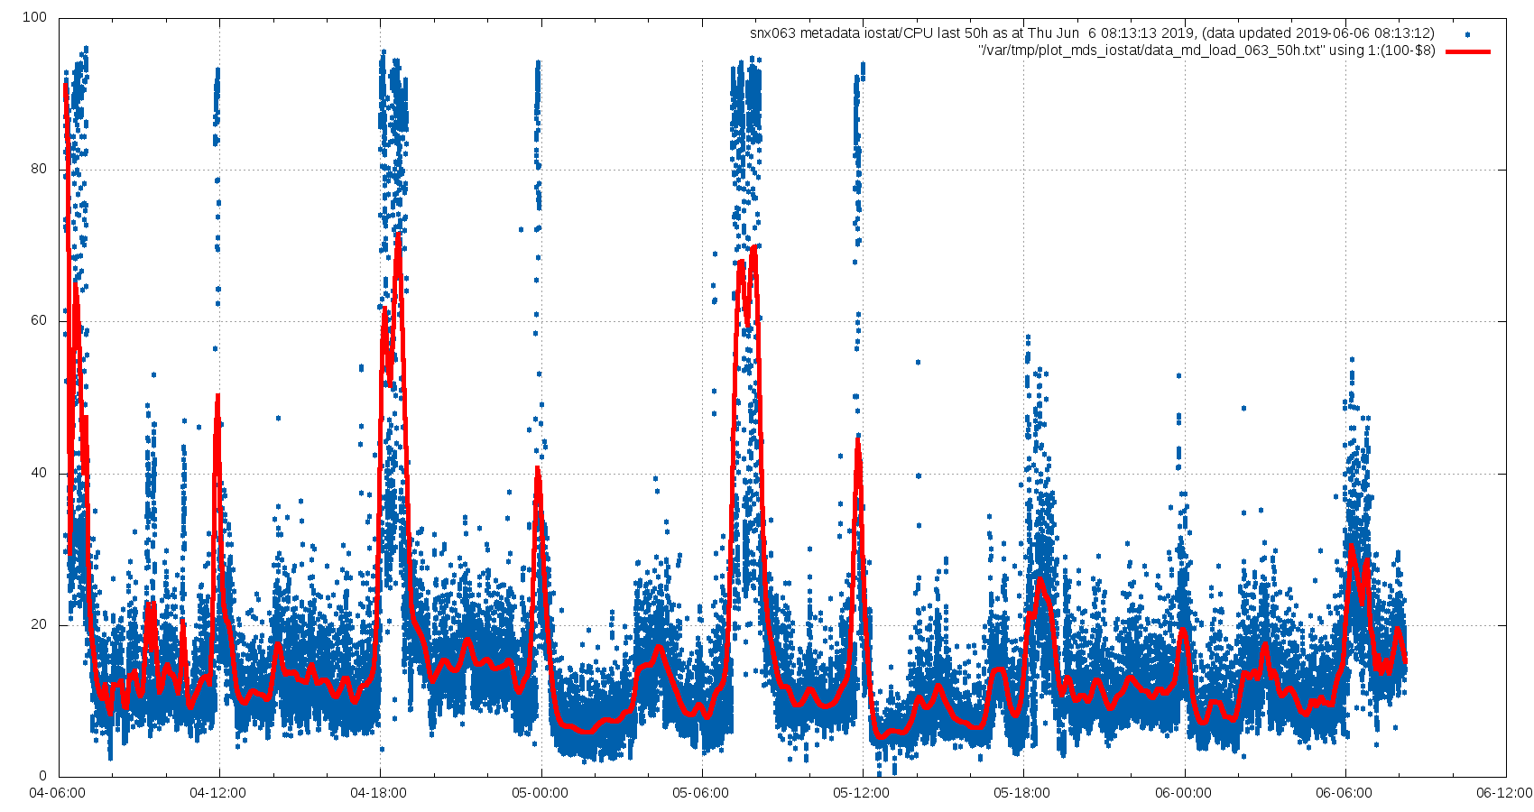
Impact of Metadata Optimisation

Slide 10
Effects of Product Generation
 | Model | Model + I/O | Model + I/O + PGen
Nodes | 2440 | 2776 | 2926
Run time [s] | 5765 | 6749 | 7260
Relative | - | + 17% | + 26%
Broadwell nodes 2x18 cores
Cray XC40 Aries interconnect
Lustre FS IOR 90GiB/s

Slide 11
Approach

Slide 12
So, Why a Domain Specific Object Store?
Flexibility
Many new technologies (H/W and S/W) coming to market
Existing system is tied to POSIX
Consistency
Data is presented in the same manner to applications
Access is through semantically meaningful metadata

Slide 13
MARS Language
RETRIEVE,
CLASS = OD,
TYPE = FC,
LEVTYPE = PL,
EXPVER = 0001,
STREAM = OPER,
PARAM = Z/T,
TIME = 1200,
LEVELIST = 1000/500,
DATE = 20160517,
STEP = 12/24/36
RETRIEVE,
CLASS = RD,
TYPE = FC,
LEVTYPE = PL,
EXPVER = ABCD,
STREAM = OPER,
PARAM = Z/T,
TIME = 1200,
LEVELIST = 1000/500,
DATE = 20160517,
STEP = 12/24/36
Unique and semantic way to describe all ECMWF data
Notes:
If this all sounds to neat, and good to be true, that is because it is
Requires data curation, and careful management of schemas.

Slide 14
Semantics
ACID – Transactional.
archive() blocks until data handed over
flush() blocks until data is visible
Visible data is immutable
Data can be masked

Slide 15
Work already done

Slide 16
FDB (version 5)
Model
Model
…
Model
Domain specific (NWP) object store
Transactional, No synchronization, No MPI
Key-value store
Keys are scientific meta-data (MARS Metadata)
Values are byte streams (GRIB)
MARS
Metadata
+
Fields
FDB
Support for multiple back-ends:
POSIX file-system (currently on Lustre)
DCPMMs using pmdk library
Could explore others:
Intel DAOS, Cray DataWarp, MERO, etc.
Supports wild card searches, ranges, data conversion, etc…
PMDK
OStore
POSIX
param=temperature/humidity,
levels=all,
steps=0/240/by/3
date=01011999/to/31122015,

Slide 17
Into operations…
% fdb-stats class=od,date=20190612,expver=0001
Summary:
========
Number of databases : 58
Fields : 83,747,723
Size of fields : 104,493,002,498,506 (95.0358 Tbytes)
Duplicated fields : 1,316,502
Size of duplicates : 2,668,035,857,106 (2.42656 Tbytes)
Reacheable fields : 82,431,221
Reachable size : 101,824,966,641,400 (92.6093 Tbytes)
Databases : 58
TOC records : 89,329
Size of TOC files : 191,427,584 (182.56 Mbytes)
Size of schemas files : 949,228 (926.98 Kbytes)
TOC records : 89,329
Owned data files : 89,271
Size of owned data files : 104,506,303,059,882 (95.0479 Tbytes)
Index files : 89,271
Size of index files : 13,677,232,128 (12.7379 Gbytes)
Size of TOC files : 191,427,584 (182.56 Mbytes)
Total owned size : 104,520,172,668,822 (95.0605 Tbytes)
Total size : 104,520,172,668,822 (95.0605 Tbytes)

Slide 18
FDB in Time-Critical Operations
FDB5 into time-critical operations on Tuesday 11th June!

Slide 19
New Developments

Slide 20
Front-ends and API
Metadata:
CLASS = OD,
TYPE = FC,
LEVTYPE = PL,
EXPVER = 0001,
STREAM = OPER,
PARAM = 130,
TIME = 1200,
LEVELIST = 500,
DATE = 20190614,
STEP = 12
Determines where the data is stored …
Run-time configurable
Implement data collocation policies
Manage data pools
Implements a simple interface:
archive(Metadata key, void* data, size_t length);
retrieve(Metadata key, void* data, size_t& length);
flush();

Slide 21
FDB5 Data Routing
Meta-data controlled routing
Fully asynchronous I/O
Remote access TCP/IP
Select
Distribution
Remote
Storage backend Multiple hosts
IFS
Model
class=od
class=rd

Slide 22
Capability vs Capacity
HPC
Select sub-pools for sinking IO
Model
Storage servers
Model
Model
Model
Control proximity (physical and network)
Disks, SSDs, NVDIMMS, …

Slide 23
Archiving Data
Client
Server
1. Archive
Starts threads to:
Receive data
Archive data
archive()
Control
Push data onto queue
2. Acknowledge
Data
Push data onto queue
Pop data off queue.
3. Data blobs
Pop data off queue. Forward to API
archive()
4. Flush
Wait until all archives complete
flush()
Control
flush()
5. Acknowledge

Slide 24
Results

Slide 25
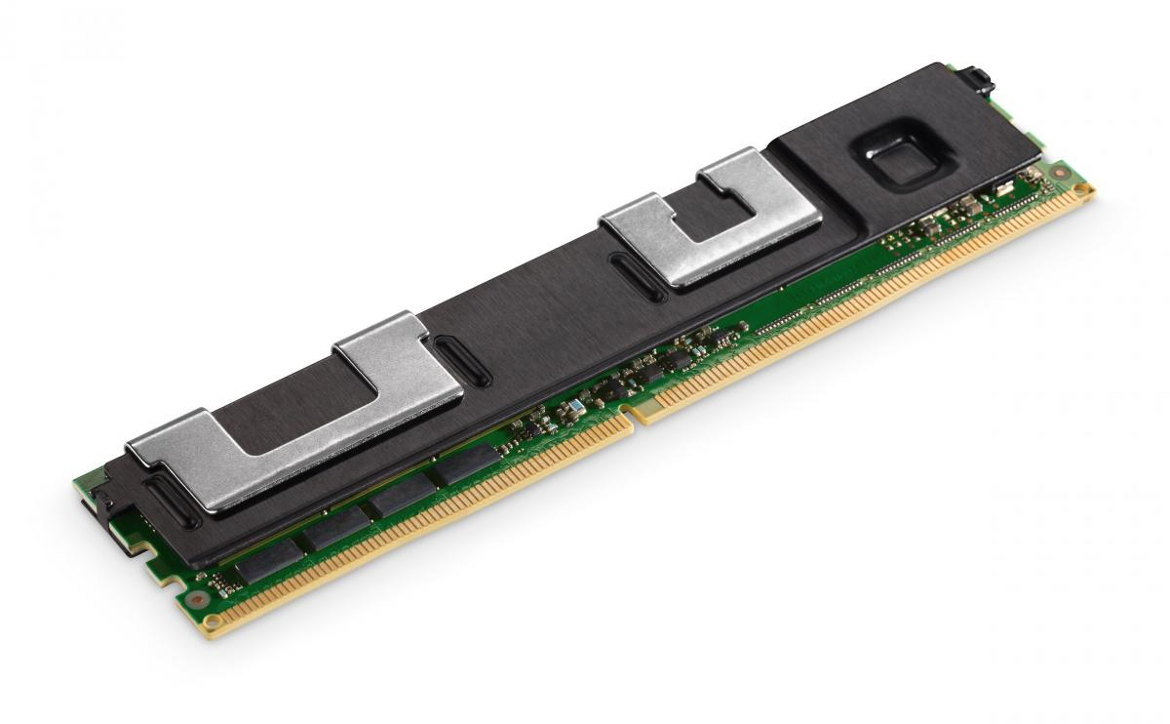
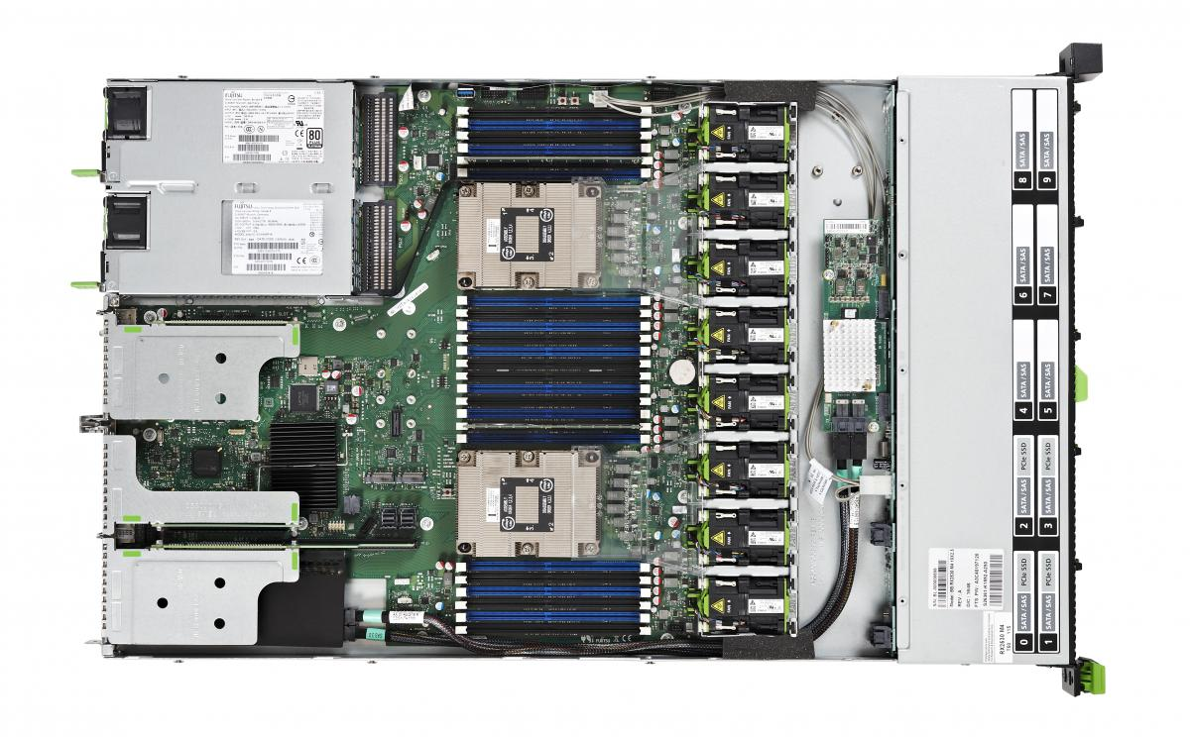
NextGenIO Prototype
Read all @ www.nextgenio.eu
Development of an HPC node by with Intel 3D Xpoint
Dual-CPU Intel® Xeon® SP nodes
OmniPath network
192GB DRAM
3TiB of NVRAM DIMMs
Prototype system
34 compute nodes
Hosted @ EPCC, Edinburgh

Slide 26
Data Flow Schematic
All I/O operations are asynchronous, so computation can continue
Distributed to all servers using a Distributed Hash, so no synchronisation needed
Node 1
Node 2
Node 3
Node 4
IFS I/O
Producer
IFS I/O
Producer
IFS I/O
Producer
IFS I/O
Producer
FDB
Server
FDB
Server
FDB
Server
FDB
Server
Monitor
Monitor
Monitor
Monitor
NVRAM
NVRAM
NVRAM
NVRAM
NVRAM
NVRAM
NVRAM
NVRAM

Slide 27
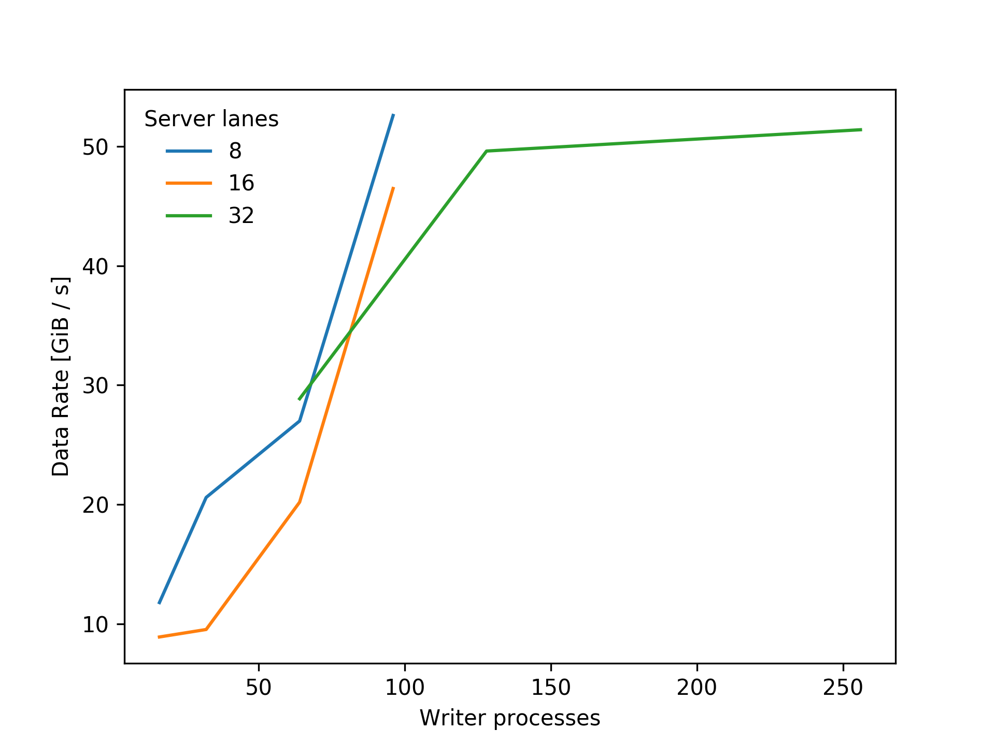
FDB5 Remote Performance

Slide 28
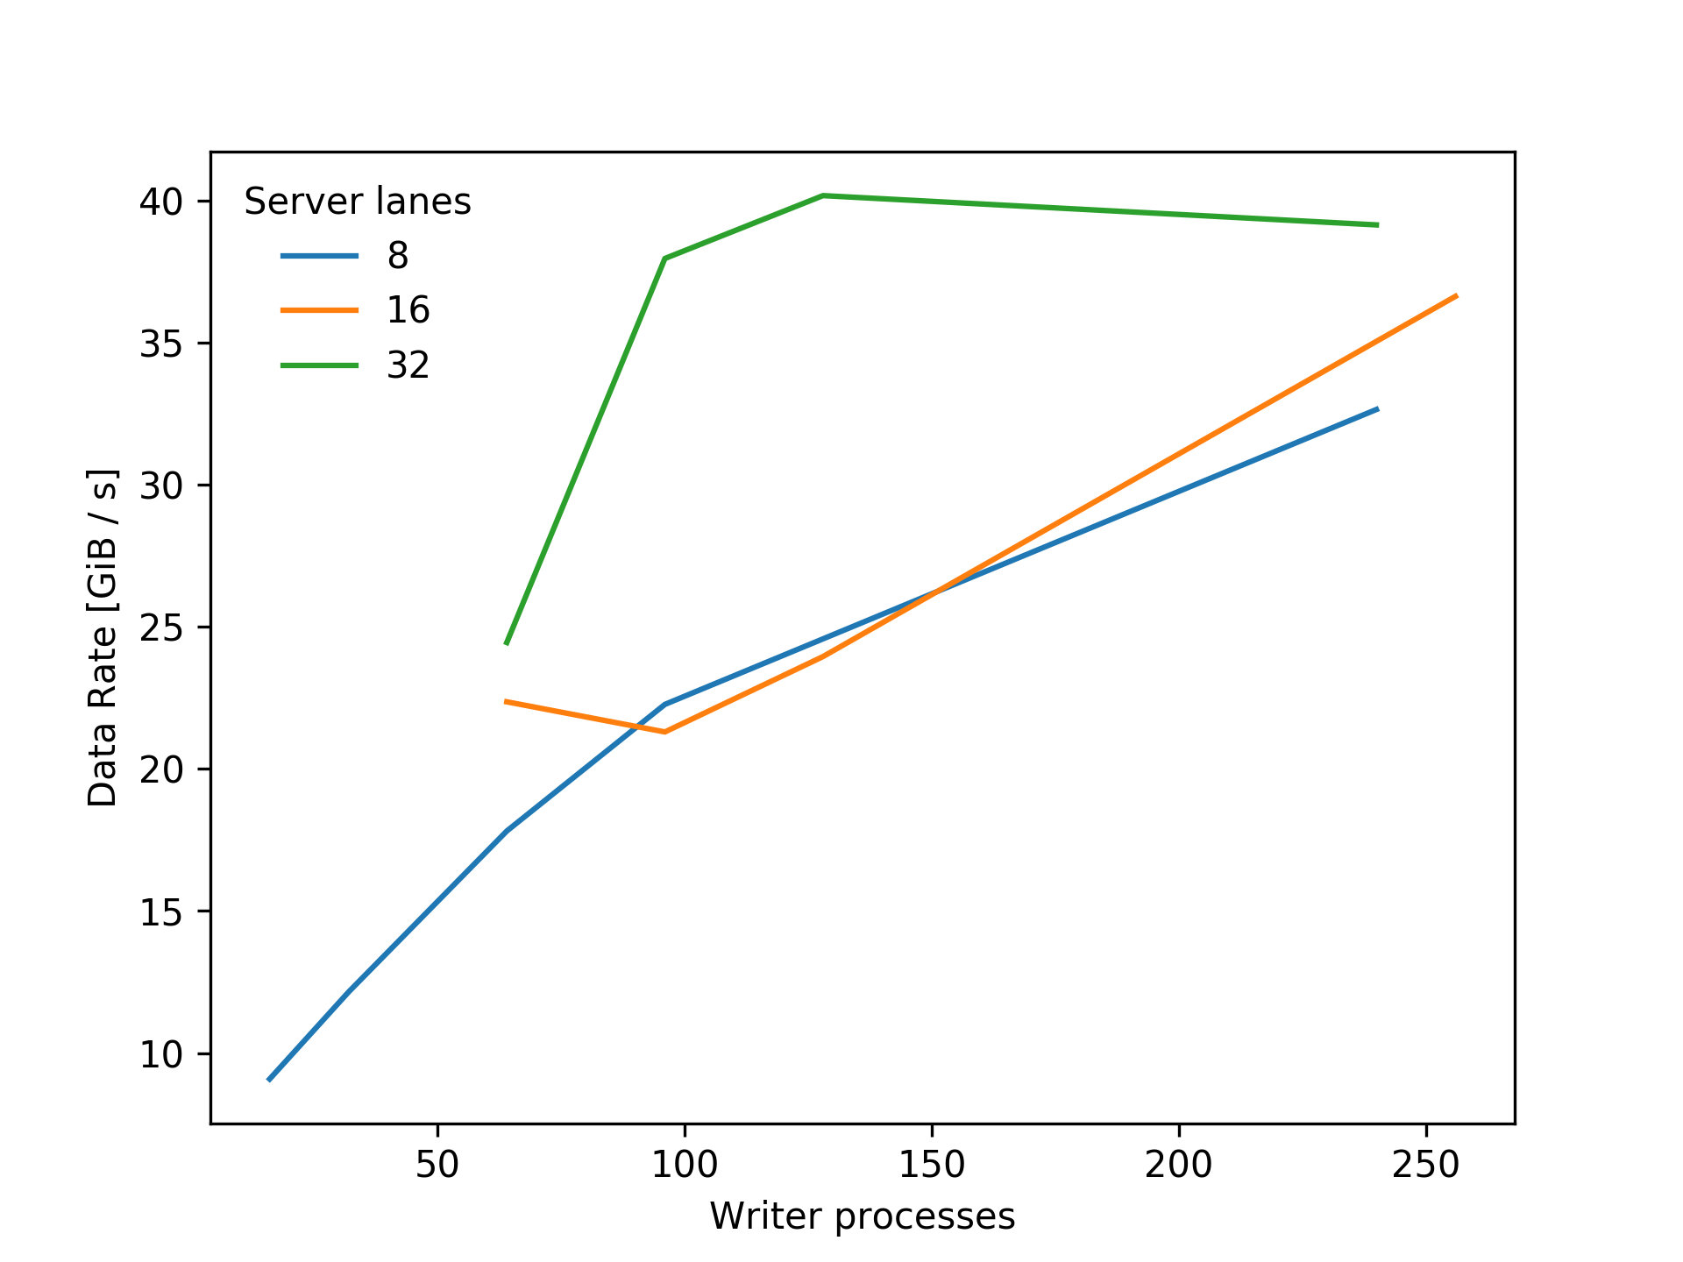
FDB5 Remote Performance (DCPMMs)

Slide 29
Running the forecast model
 | Model + I/O | Model + I/O + PGen
Run time (Lustre) [s] | 1793 | 1928
Run time (Distributed) [s] | 1610 | 1599
NextGenIO prototype. 32 nodes
Intel OmniPath2 interconnect
6 ensemble members

Slide 30
The Future

Slide 31
ODB Store
IFS
ifsobs
ODB Store
Pre-processing
Archive
MARS
HDD
Tape
Notes:
Ifsobs makes it easier to switch backends, allows us to read and write odb2 files, while still using ODB1 in-memory

Slide 32
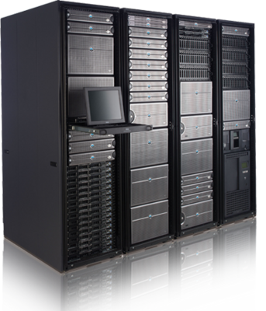
Novel Data Flows – Data Centric Computing
Cloud
Producer
Consumer
Bring users to the data
Use data while it is hot
Access using scientifically meaningful metadata
Archive
NVRAM (?)
Data Hypercubes
MARS
PFS
HDD
Tape

Slide 33
Data Centre Migration to Bologna
FDB servers
MARS archive
Bologna
HDD
Tape
Shinfield

Slide 34

Messages To Take Home
Domain-specific APIs give powerful tools:
Domain specific semantics
Consistent, science-oriented access
Separation of concerns
ECMWF has retooled its operation I/O with FDB5
Non-Volatile memory and other novel storage devices and hierarchies are coming
NEXTGenIO has received funding from the European Union’s Horizon 2020 Research and Innovation programme
under Grant Agreement no. 671951

