Slide 1
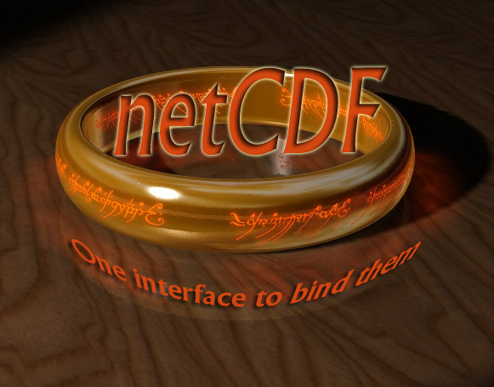
Reading NetCDF Files in Matlab and analyzing the data.
By,
Harish Sangireddy

Slide 2
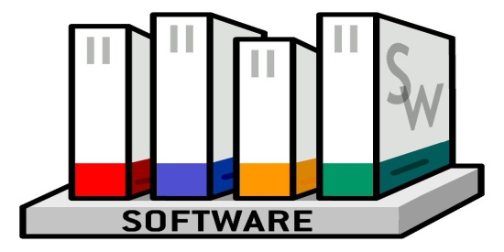
What is NetCDF?
Set of software libraries,
Machine independent data format,
That supports creation, access and sharing of array oriented scientific data.
NetCDF was developed and is maintained by UNIDATA part of the University Corporation for Atmospheric Research (UCAR) Office of Programs (UOP).
UNIDATA
NETWORK COMMON DATA FORM.

Slide 3




Why should I care about NetCDF?
Most commonly used format in the oceanographic and atmospheric science for observational data and numerical modeling.
Some of the institutions using NetCDF
The National Center for Atmospheric Research(NCAR)
University Corporation for Atmospheric Research(UCAR)
NOAA’s Climate Diagnostics Center (CDC)
LosAlamos National Laboratory
NASA
US Air Force and Navy
Atmospheric Research in Australia
Australian Defense
UK Hydrographic Office.
NATO
……

Slide 4
NetCDF Data Model
A NetCDF dataset contains
Dimensions
(for example, time, latitude, longitude, or height.)
Variables
(represents an array of values of the same type, which store the bulk data.)
Attributes
(are used to store data about the data ,ancillary data or metadata.)
height
Time
Longitude
Latitude

Slide 5
How is data stored in NetCDF?
NetCDF mynetcdf {
dimensions:
X=4;
Y=4:
Time=UNLIMITED;
variables:
float X(X);
float(Y);
int Time(Time);
float Temperature(time,X,Y);
data:
X=10,20,30,40;
Y=110,120,130,140;
Time=31,59,90;
}

Slide 6
How is data stored in NetCDF?
NetCDF mynetcdf {
dimensions:
X=4;
Y=4:
Time=UNLIMITED;
variables:
float X(X);
float(Y);
int Time(Time);
float Temperature(time,X,Y);
data:
X=10,20,30,40;
Y=110,120,130,140;
Time=31,59,90;
Temperature=
111,211,311,411;
}

Slide 7
How is data stored in NetCDF?
NetCDF mynetcdf {
dimensions:
X=4;
Y=4:
Time=UNLIMITED;
variables:
float X(X);
float(Y);
int Time(Time);
float Temperature(time,X,Y);
data:
X=10,20,30,40;
Y=110,120,130,140;
Time=31,59,90;
Temperature=
111,211,311,411,121,221,321,421;
131,133,343,345,567,566,346;
131,133,343,345,567,566,344;
131,133,345,345,567,566,347;
131,133,346,345,567,566,348;
131,133,347,345,567,566,349;
131,133,348,345,567,566,340
}

Slide 8
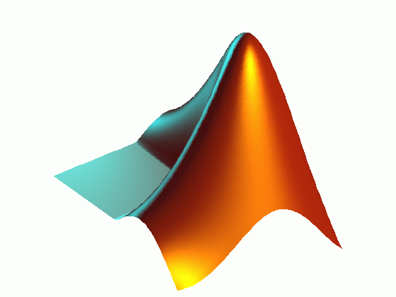
NetCDF and Matlab
Matlab
Matlab is an integrated technical computing language
It has built in support for reading and writing NetCDF data.
Provides access to more than 30 functions in the NetCDF interface.
The functions are implemented as a package called NetCDF.
For Example to call the NetCDF library routine used to open existing NetCDF files, we the following MATLAB syntax:
ncid = netcdf.open( ncfile, mode );

Slide 9
NetCDF Data Sources
I am using the Earth System Research Laboratory Physical Sciences Divisions Data Center for the downloading climate and weather Data in NetCDF format. https://www.esrl.noaa.gov/psd/data

Slide 10
Reading NetCDF data in Matlab
The first Matlab file read_netcdf.m will read the NetCDF files from a specific location in your disk.
Create Matlab variables to store the data in a multidimensional array
I then use the second Matlab file animate.m to create a movie file in avi format.
The avi file shows how the variables change over a given time period.

Slide 11
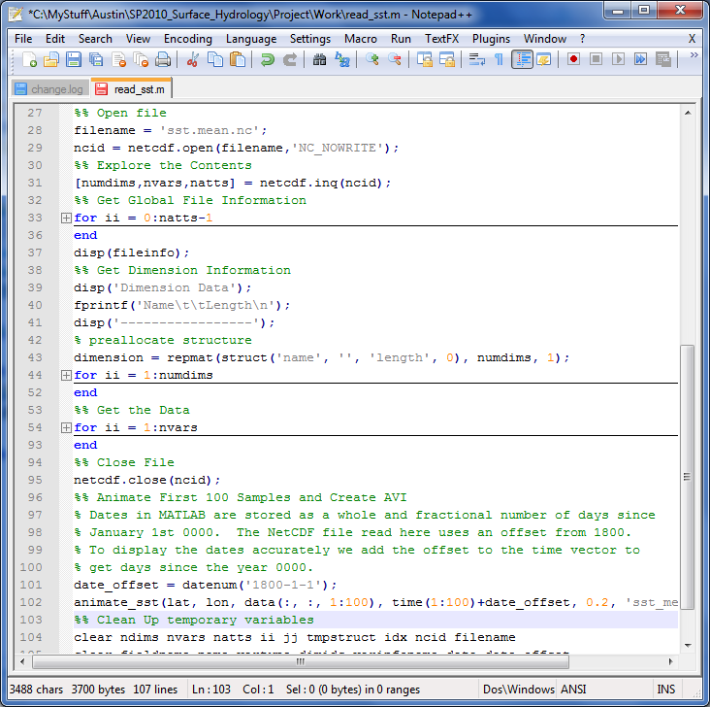
READ_NetCDF.m

Slide 12
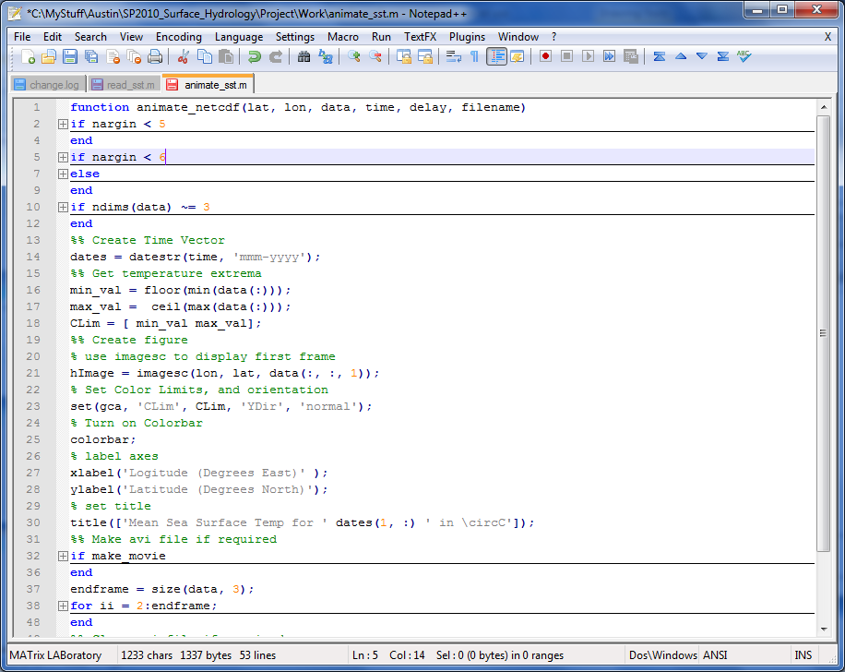
Animate_NetCDF.m

Slide 13
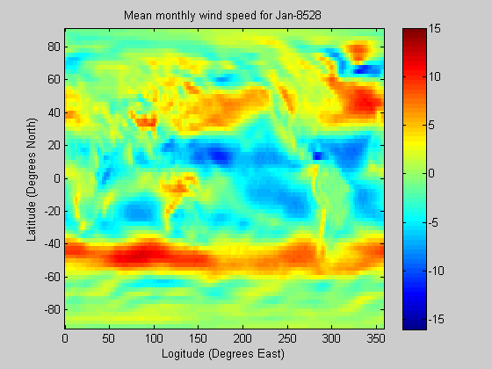
Data Analysis (mean monthly wind speed)

Slide 14
Wind Facts clearly Visible
Doldrums: The Doldrums are an area of low pressure occurring where the trade winds meet along the equator.
Roaring forties: Another set of famous winds are known as the Roaring Forties. These are very strong westerly winds which blow almost continuously in the southern hemisphere. These fierce winds are found at a latitude of 40º - hence their name!
The average wind speed in northern hemisphere is less than that in southern hemisphere.

Slide 15
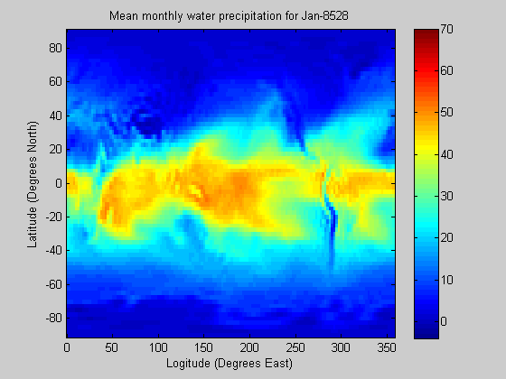
Data Analysis (mean monthly precipitation)

Slide 16
Facts about Precipitation
The mean precipitation around the equator and ITCZ is higher than any other hemisphere. It almost remains the same all around the year.
Seasonal shift in the precipitation pattern is clearly visible.
The mean precipitation in the southern hemisphere is very less when compared to those in Northern Hemisphere.

Slide 17
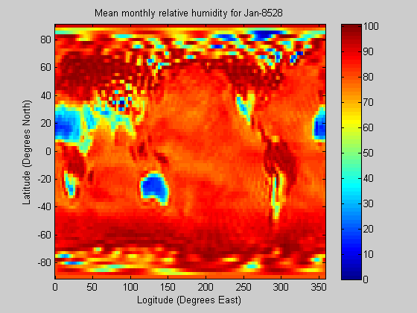
Data Analysis(mean monthly relative humidity)

Slide 18
Relative Humidity
The relative humidity is very high over oceans. Quite Obvious!
The relative humidity over the Asian and subtropical countries is low. A clear difference in range of humidity can be seen over Australia.
Amazingly the relative humidity levels in US remains on the higher side all around the year. This could be attributed to the average wind speed over the continent.

Slide 19
Conclusion
The NetCDF are great for storage and data transfer over network. It is free and open Source. Supported by UNIDATA, and used a lot in the world of climatology.
But!
They need more space and a lot of network bandwidth.
NetCDF is a binary file, it increases computer performance but reduces human readability.

Slide 20
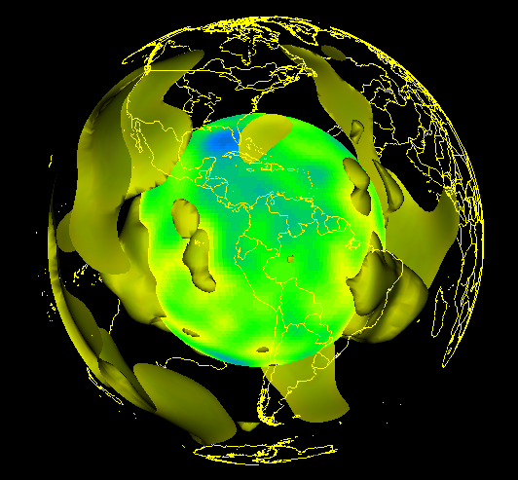
QUESTIONS
QUESTIONS

