Slide 1
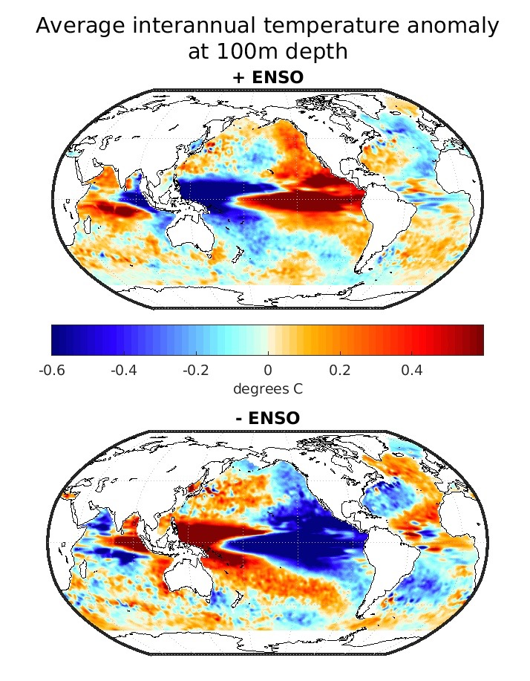

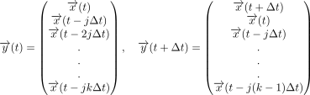

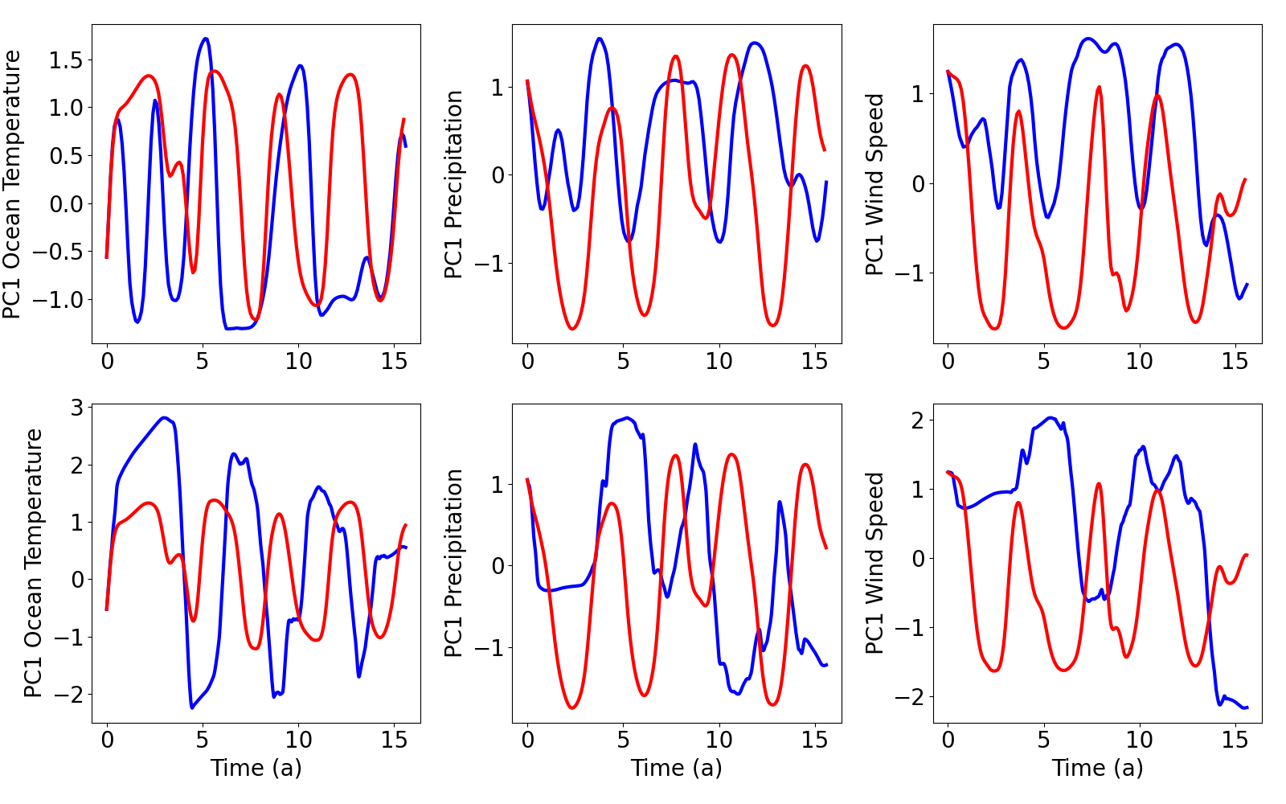
SST
Precipitation
Wind speed
Smooth
Sample
Interpolate
Predict future ENSO trends using ML models
POD
Neural network
Neural-DDE
In Neural-ODE
framework
Assume problem of this form
Neural-DDE
-Precipitation, wind speed, and SST are necessary
-Multiple timescales are important for this problem
-DDE with an ODE framework!
Neural-ODE

