Slide 1


GRE镇考机经词串讲班（上）
主讲：张巍
微信公众号：张巍老师

Slide 2

串讲PPT下载，GRE资料下载
公众号：张巍老师

Slide 3
acerbic
韦氏释义：expressing harsh or sharp criticism in a clever way

Slide 4
acerbic
-aci, -acu, -acri 尖，酸，锐利
acrid 刻薄的，辛辣的
acumen 敏锐
acute 敏锐的
acid 酸的
acidic 酸性的
acrimonious 刻薄的

Slide 5
尖酸刻薄
bitter
astringent
harsh
pungent（抨击他）
piquant（批判他）
mordant（妈蛋的）
sarcastic
satiric
acrimonious
cutting

Slide 6
acrimonious
sanctimonious
韦氏释义: pretending to be morally better than other people

Slide 7
GRE真题
Despite a tendency to be overtly _____, her poetry does not consist solely of pious sentiments: it often sparks the imagination and provides lively entertainment.
A. preachy
B. querulous
C. insincere
D. sanctimonious
E. plaintive
F. disingenuous

Slide 8
GRE真题
Despite a tendency to be overtly _____, her poetry does not consist solely of pious sentiments: it often sparks the imagination and provides lively entertainment.
A. preachy（爱讲道的）
B. querulous（易怒的）
C. insincere（不真诚的）
D. sanctimonious（假装虔诚的）
E. plaintive（悲哀的）
F. disingenuous（不真诚的）
答案：AD

Slide 9
adulation
韦氏释义: excessive or slavish admiration or flattery

Slide 10
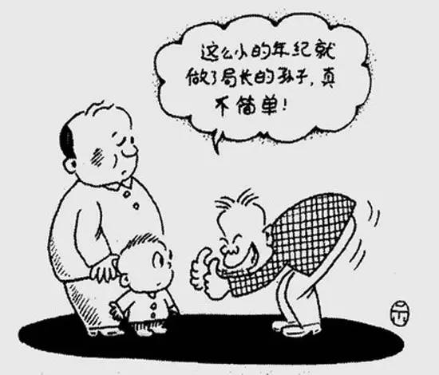
谄媚，拍马屁
adulation-adulate
flattery-flatter（服了，头）
sycophancy-sycophantic（三个粉丝）
fawn（幼鹿）
toady-toad（癞蛤蟆）

Slide 11
GRE真题
While early biographies of Florence Nightingale tended to be quite _____, Lytton Strachey’s irreverent 1918 essay about her ushered in a new era, making it acceptable, even fashionable, to criticize her.
A. unsympathetic
B. sycophantic
C. unsentimental
D. censorious
E. pedantic

Slide 12
GRE真题
While early biographies of Florence Nightingale tended to be quite _____, Lytton Strachey’s irreverent 1918 essay about her ushered in a new era, making it acceptable, even fashionable, to criticize her.
A. unsympathetic（不同情的）
B. sycophantic（谄媚的）
C. unsentimental（不动感情的）
D. censorious（爱挑剔的）
E. pedantic（迂腐的）
答案：B

Slide 13
anachronistic（ anachronism ）
韦氏释义：
(1)out of date or old-fashioned 􁬦􀷸􁌱
(2)something that is mistakenly placed in a time where it does not belong in a story, movie, etc. 􀷸􀕤􁲙􁧏􁌱

Slide 14
-ana 错误，分开
anachronistic 时代错误的
analogy 类比
analysis 分析
anatomy 解剖

Slide 15
-chron=time 时间
chronic 慢性的，长期的
chronology 年代学，年表
chronicle 编年史，记录
synchronize 使同步
anachronistic 时代错误的

Slide 16

过时的
anachronistic
old-fashioned
outmoded
antediluvian
obsolete
antiquated
archaic
superannuated

Slide 17
-anti和-ante区别

Slide 18

-ann, -enn=year 年
annual 年度的，每年的
anniversary 纪念日
annuity 养老金
perennial 常年的

Slide 19
GRE真题
Up to the 1970s, histories of science tended to be (i)_____ not least in their focus on discoveries and theories that could be read as anticipating later scientific orthodoxies, rather than on those deemed (ii)_____ in their own periods. Historians of science are now routinely far more sensitive on such scores.
Blank(i) | Blank(ii)
A anachronistic | D major
B convoluted | E fallacious
C undogmatic | F inessential

Slide 20
GRE真题
Up to the 1970s, histories of science tended to be (i)_____ not least in their focus on discoveries and theories that could be read as anticipating later scientific orthodoxies, rather than on those deemed (ii)_____ in their own periods. Historians of science are now routinely far more sensitive on such scores.
Blank(i) | Blank(ii)
A anachronistic（超前的） | D major（重大的，主要的）
B convoluted（复杂的） | E fallacious（有错误的）
C undogmatic（非教条的） | F inessential（不重要的）
答案：AD

Slide 21
augment
韦氏释义:
(1) to increase the size or amount of (something)
(2) to add something to (something) in order to improve or complete it
argument

Slide 22
banal
韦氏释义: boring or ordinary: not interesting

Slide 23
陈腐，非原创
banal
cliché
insipid
trite
hackneyed
platitude
bromide
humdrum
pedestrian
stereotyped
vapid

Slide 24
-ped=foot 脚
impede 阻碍
expedite 加速
pedal 脚踏板
peddle 沿街叫卖
pedestrian 行人
pedicure 足疗

Slide 25
-ped=child 孩子
pedology 儿科学
pedant 迂腐的教师
pediatrist 儿科以上
pedogogy 教育学

Slide 26

创新，先锋
innovative
avant-garde
original
cutting-edge
pioneering
experimental
vanguard

Slide 27
belie
韦氏释义:
(1) to give a false idea of (something)
(2) to show (something) to be false or wrong

Slide 28
同义词
第一类: disguise, conceal, misrepresent, veil
第二类: disprove, contradict, contravene, repudiate

Slide 29
capricious
韦氏释义: changing often and quickly

Slide 30
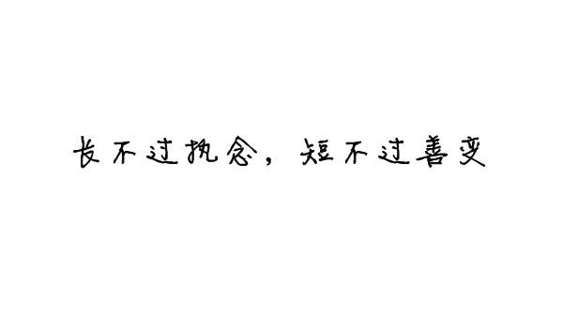
善变
unpredictable
impulsive
inconstant
fickle
mercurial
mutable
volatile
unstable
unsteady
freakish-freak
erratic
whimsical-whim

Slide 31
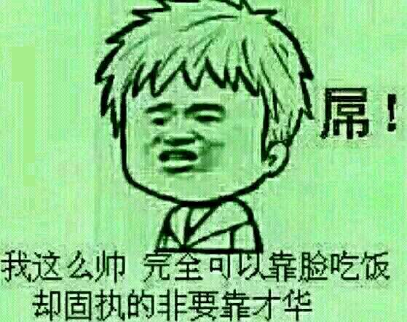
不变—固执
不变
stable
steadfast
steady
enduring
固执
unyielding
obdurate
adamant
implacable
obstinate
uncompromising

Slide 32

chimera
韦氏释义: something that exists only in the imagination and is not possible in reality

Slide 33
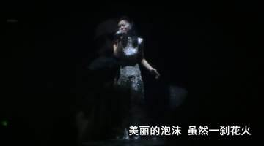
假
chimera
illusion
bubble
delusion
fancy
mirage

Slide 34

游戏里的GRE词汇
taunt 嘲讽
venom 毒素
remnant 残余的
serpent 蛇，狡猾的人
fury 愤怒，复仇女神
feeble 无力的
phantom 幻影，错觉的
prophet 先知
acolyte 寺僧

Slide 35

游戏里的GRE词汇
ensnare 诱入陷阱
annihilate 歼灭
rabid 猛烈的
guise 伪装
maelstrom 大漩涡
siege 包围
devour 吞食
dire 可怕的，悲惨的
void 虚空

Slide 36
circumspect
韦氏释义: thinking carefully about possible risks before doing or saying something
discreet
discrete
discretion

Slide 37
-circum 四周
circumscribe 限制
circumlocution 话多
circumference 周长 perimeter
circumnavigate 环球航行
circumstance 环境
circumvent 回避

Slide 38
-spect 看
aspect 方面，样子
expect 期望
inspect 检查
perspective 看法，观点
retrospect 回顾
suspect 怀疑
spectacle 眼镜
spectator 观众

Slide 39
clandestine
韦氏释义: done in a private place or way

Slide 40
秘密的，偷偷的
clandestine
secret
surreptitious
furtive
private
underground

Slide 41
compromise
韦氏释义:
(1) settlement of differences by arbitration or by consent reached by mutual concessions
(2) to damage or weaken (something)

Slide 42
GRE真题
The government has no choice but to (i)_____ the incessant demands for land reform, and yet any governmental action that initiated land reform without requisite attention to agrarian reform would (ii)_____ the overall goal of economic modernization.
Blank(i) | Blank(ii)
A anticipate | D delineate
B heed | E condone
C silence | F compromise

Slide 43
GRE真题
The government has no choice but to (i)_____ the incessant demands for land reform, and yet any governmental action that initiated land reform without requisite attention to agrarian reform would (ii)_____ the overall goal of economic modernization.
Blank(i) | Blank(ii)
A anticipate（期望） | D delineate（描述）
B heed（留意） | E condone（原谅）
C silence（沉默） | F compromise（削弱）
答案：BF

Slide 44
conundrum
韦氏释义: a confusing or difficult problem

Slide 45
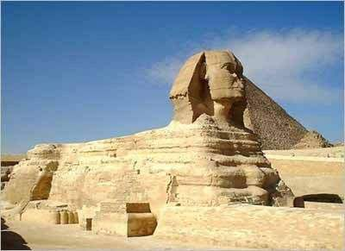
谜
conundrum
mystery
enigma
puzzle
riddle
sphinx
可难琢磨！

Slide 46
daunting
韦氏释义: tending to make people afraid or less confident

Slide 47
几大姑
haunt 经常出没，闹鬼
flaunt 炫耀
taunt 嘲讽
vaunt 吹牛
daunt 使气馁

Slide 48
GRE真题
My grandma has a strong belief in all things _____: she insists, for example, that the house in which she lived as a child was haunted.
A. clamorous
B. invidious
C. numinous
D. empirical
E. sonorous

Slide 49
GRE真题
My grandma has a strong belief in all things _____: she insists, for example, that the house in which she lived as a child was haunted.
A. clamorous（吵闹的）
B. invidious（诽谤的）
C. numinous（神秘的，超自然的）
D. empirical（经验主义的）
E. sonorous（响亮的）
答案：C

Slide 50
deliberate
韦氏释义:
(1) done or said on purpose
(2) done or decided after careful thought
(3) to think about or discuss something very carefully in order to make a decision

Slide 51
先做题，再讲词
Investors are grateful that the attorney general has stepped in to pursue inquiries into misfeasance in the financial markets, given that the regulators officially charged with policing the industry have been _____.
A. diffident
B. meticulous
C. straightforward
D. implacable
E. tenacious

Slide 52
先做题，再讲词
Investors are grateful that the attorney general has stepped in to pursue inquiries into misfeasance in the financial markets, given that the regulators officially charged with policing the industry have been _____.
A. diffident（不自信的，犹豫不决的）
B. meticulous（极其仔细的）
C. straightforward（直接的）
D. implacable（难以平息的）
E. tenacious（固执的）
答案：A

Slide 53
diffident
韦氏释义:
(1) lacking confidence
(2) hesitant in acting or speaking through lack of self-confidence

Slide 54

-fid 信任，忠心
fidelity 忠心
confidential 保密的
perfidy 不忠诚
infidel 异教徒

Slide 55
disingenuous
韦氏释义: not truly honest or sincere
ingenuous 天真的，坦白的
ingenious 灵巧的，机灵的

Slide 56
empirical
韦氏释义: based on testing or experience

Slide 57
ephemeral
韦氏释义: lasting a very short time

Slide 58
短暂
ephemeral
transient
transitory
momentary
evanescent
fleeting
instantaneous

Slide 59
instantaneous
spontaneous
simultaneous

Slide 60
持久
enduring
eternal (external)
everlasting
lasting
immortal
permanent
perpetual (perpetuate/perpetrate)

Slide 61
GRE真题
In Japanese aesthetics, especially but not only in Noh, beauty contains the idea of _____: beauty must have an air of evanescence, the intimation of its own demise.
A. transience
B. symmetry
C. decay
D. simplicity
E. balance
F. deterioration

Slide 62
GRE真题
In Japanese aesthetics, especially but not only in Noh, beauty contains the idea of _____: beauty must have an air of evanescence, the intimation of its own demise.
A. transience（短暂）
B. symmetry（对称）
C. decay（衰退）
D. simplicity（简单）
E. balance（平衡）
F. deterioration（衰落）
答案：CF

Slide 63
exculpate:
韦氏释义: to clear from alleged fault or guilt
vindicate
韦氏释义: to free from allegation or blame

Slide 64
GRE真题
Some ethicists worry that a deeper understanding of the brain may be tantamount to _____; if we discover that free will is an illusion of neural circuitry, how will we hold people responsible for their actions?
A. vindication
B. proscription
C. ministration
D. valediction
E. exculpation

Slide 65
GRE真题
Some ethicists worry that a deeper understanding of the brain may be tantamount to _____; if we discover that free will is an illusion of neural circuitry, how will we hold people responsible for their actions?
A. vindication（证明清白）
B. proscription（禁止）
C. ministration（援助）
D. valediction（告别词）
E. exculpation（开脱罪行）
答案：E

Slide 66

founder
韦氏释义:
(1) one that founds or establishes
(2) to experience failure
(3) to fill with water and sink

Slide 67
hodgepodge
韦氏释义: a mixture of different things

Slide 68
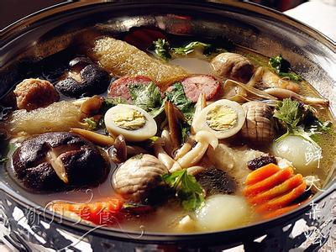
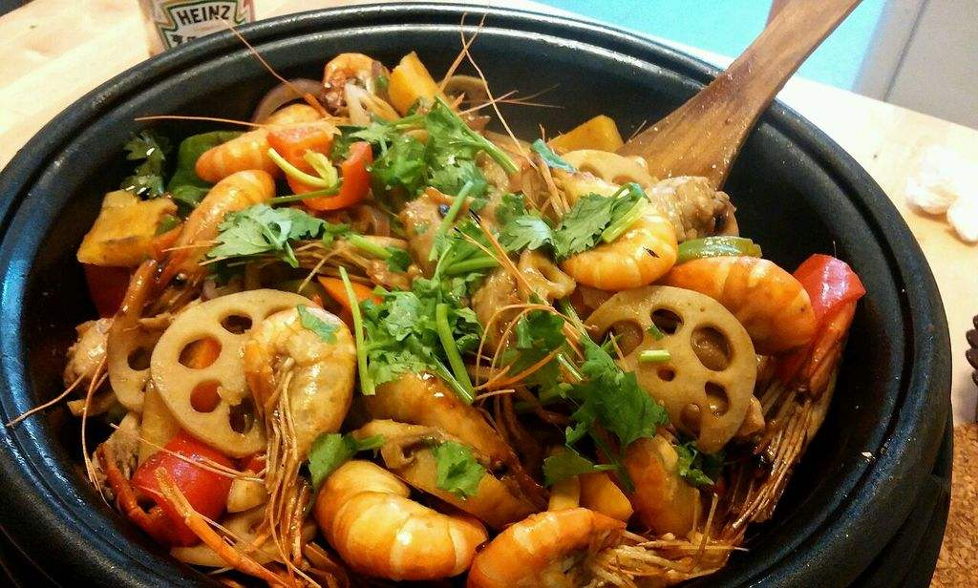
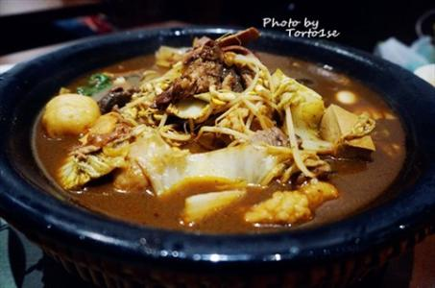
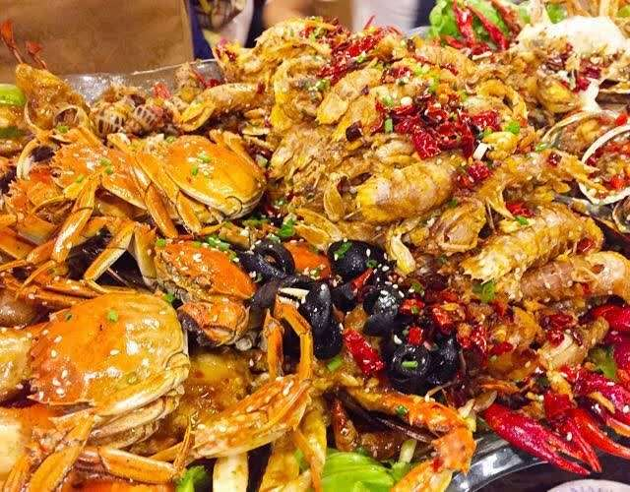
大杂烩
hodgepodge
hotchpotch
pastiche
patchwork
jumble
welter
medley
motley
montage

Slide 69
impassioned
韦氏释义: showing of feeling very strong emotions
impassive
passive
dispassionate
compassion

Slide 70
GRE真题
It’s a sign of John Dramani Mahama’s maturity as a writer that he is willing to consider his country’s future so _____: his memoir is appealingly honest, given to clear-eyed assessments rather than exaggerated accounts of achievements.
A. cheerfully
B. dispassionately
C. insightfully
D. evocatively
E. analytically
F. blithely

Slide 71
GRE真题
It’s a sign of John Dramani Mahama’s maturity as a writer that he is willing to consider his country’s future so _____: his memoir is appealingly honest, given to clear-eyed assessments rather than exaggerated accounts of achievements.
A. cheerfully（开心地）
B. dispassionately（冷静客观地）
C. insightfully（有见解地）
D. evocatively（启发地）
E. analytically（冷静分析地）
F. blithely（快活地）

Slide 72
串讲PPT下载，GRE资料下载
公众号：张巍老师

Slide 73
考满分GRE课程介绍
All In One课程
考前冲刺班

