Slide 1

Customer Segmentation and Churn Rate Prediction for Bank

Slide 2
Data
https://www.kaggle.com/datasets/sakshigoyal7/credit-card-customers

Slide 3
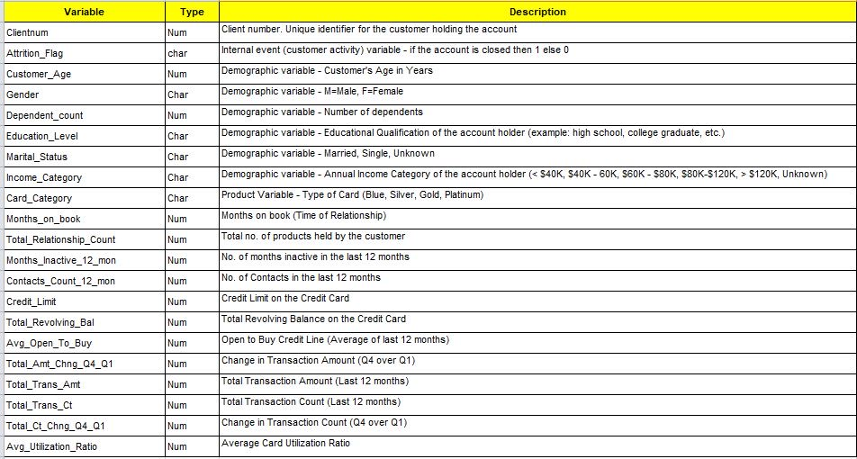

Slide 4
EDA

Slide 5
total rovelving /credit limit= ratio

Slide 6
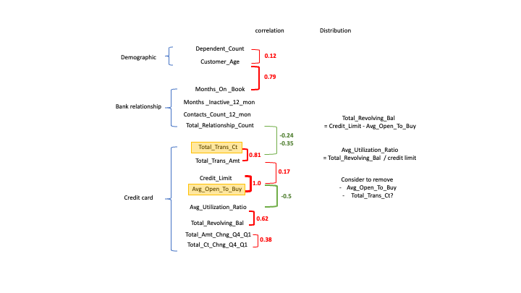

Slide 7
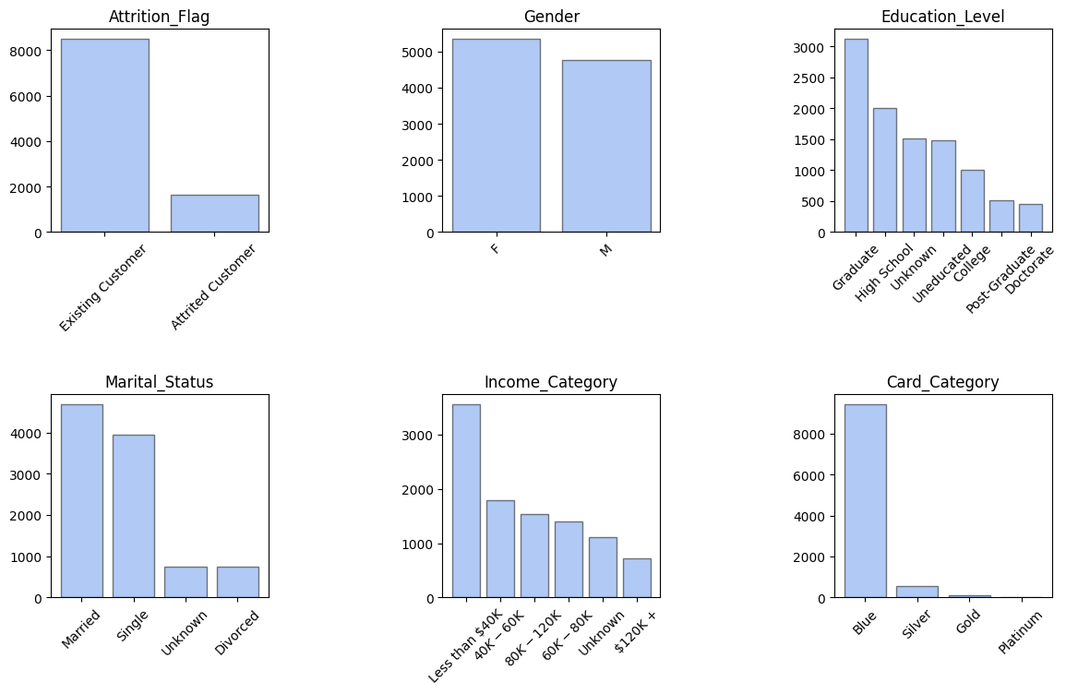

Slide 8
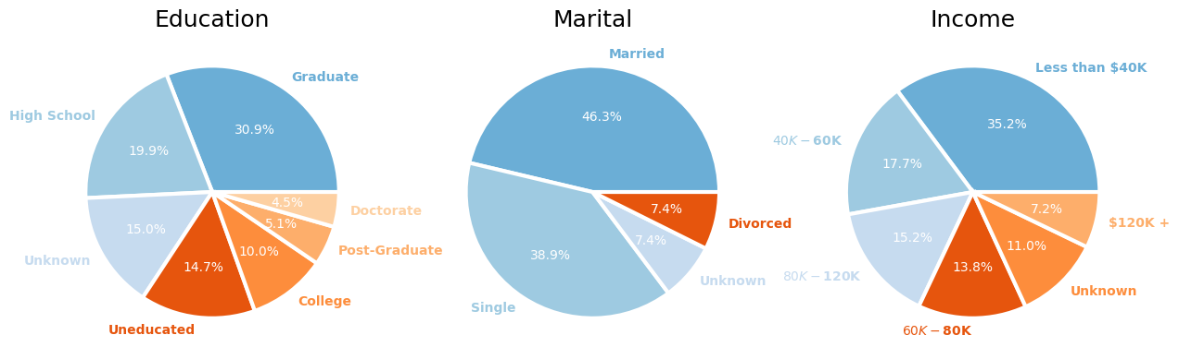

Slide 9
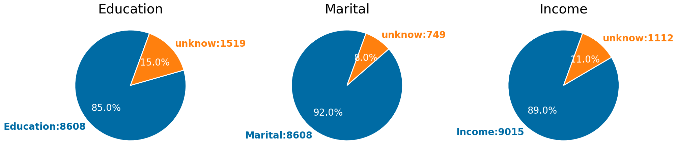

Slide 10
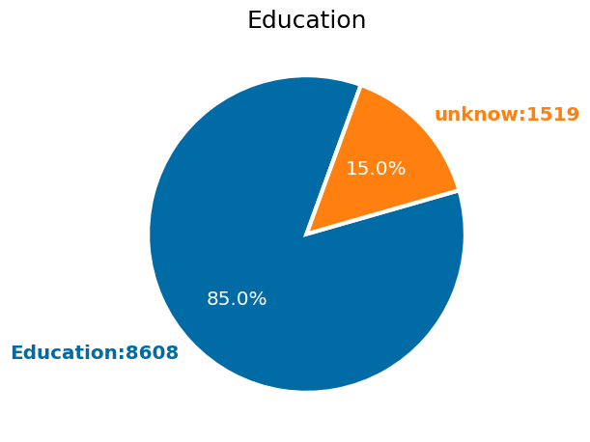
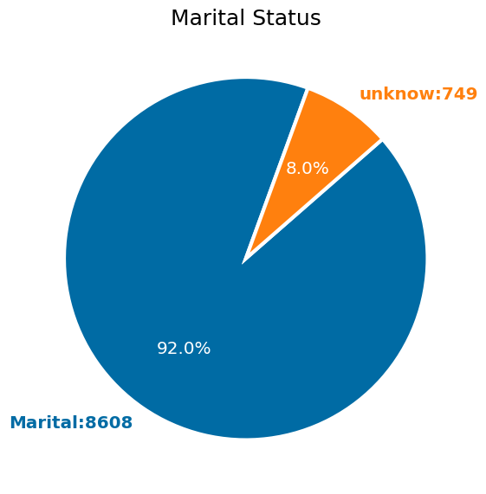
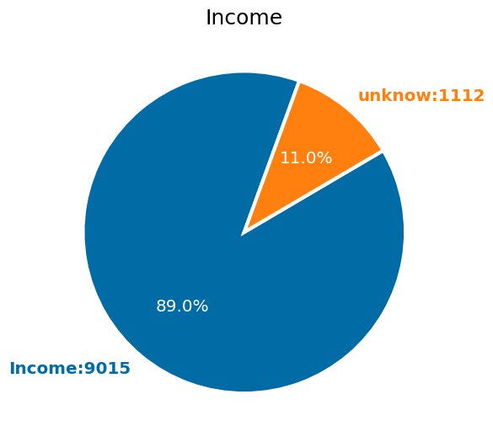
* imbalance data (Attrited Customer 16.00%)
* Unknown data (Education_Level, Marital_Status, Income_Category)
* Blue Card almost entire data sets
https://www.kaggle.com/code/nnttch/bankchurners-eda-smote-statsmodels#Customer-Profile

Slide 11
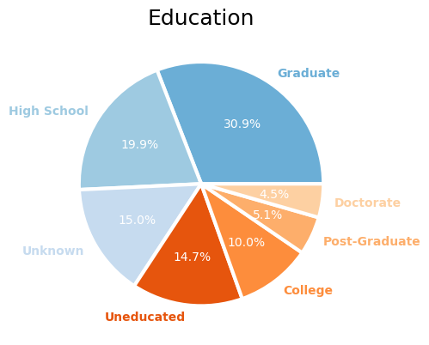
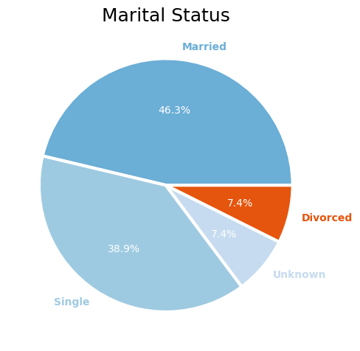
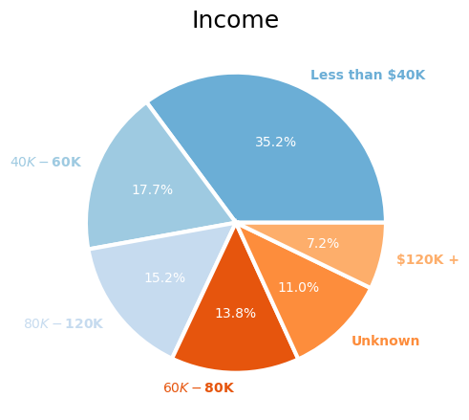

Slide 12
