Slide 1


Ottawa Titans
Smart Resume Analyzer & Job Recommendation System
TEAM: OTTAWA TITANS | STACK: FASTAPI, STREAMLIT, MONGODB, SPACY, SCIKIT-LEARN

Slide 2

Problem & Impact
ADDRESSING THE CHALLENGES OF MANUAL SCREENING
Manual Screening
Bias Risks
Recruiters often sift through thousands of resumes, which leads to a process that is not only slow but also inconsistent, making it difficult to find qualified candidates efficiently.
As recruitment scales, the risk of bias increases, particularly in manual screening. Unconscious biases can affect hiring decisions, resulting in missed opportunities for strong candidates.

Slide 3
Objectives of the System
Resume Parsing
Extract essential entities from uploaded resumes efficiently.
Resume Scoring
Evaluate resumes against job descriptions for ATS compatibility.
Candidate Storage
Manage candidates' profiles in a structured MongoDB database.

Slide 4
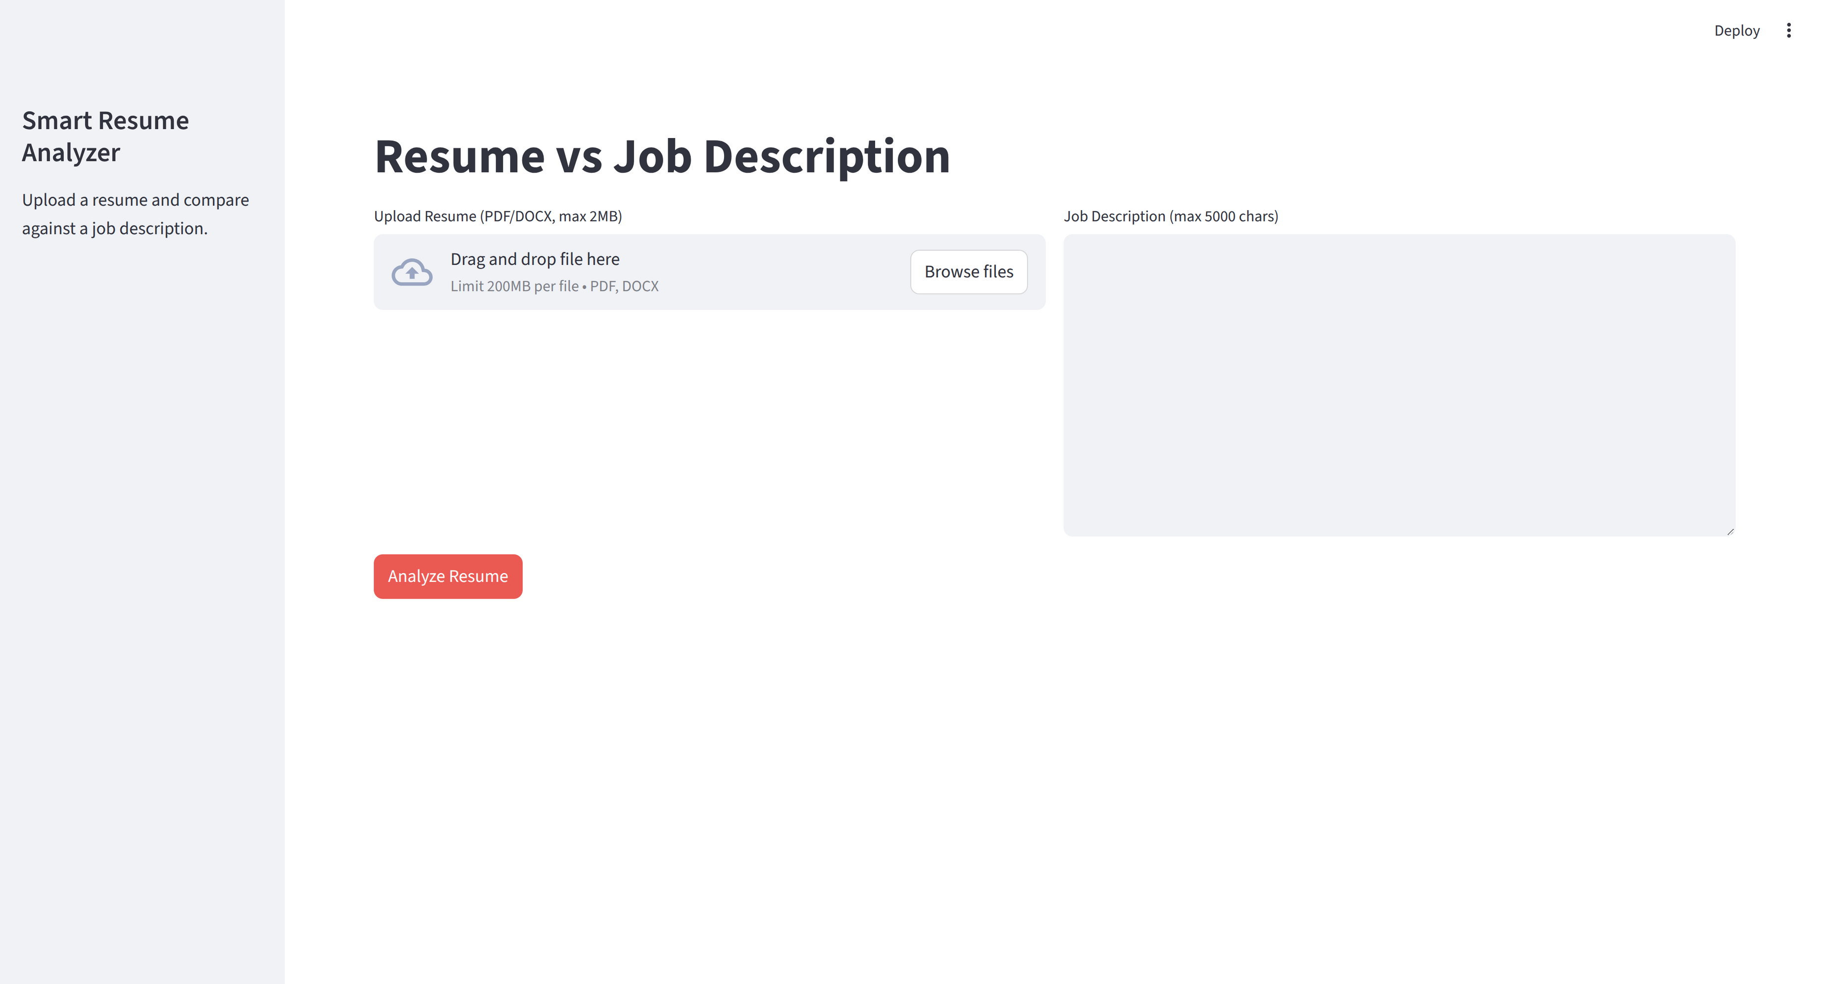
User Flow
  Upload resume (PDF/DOCX, ≤2MB) → Paste JD (≤5000 chars) → Analyze
  Show compatibility %, matched/missing skills, role recommendations
  Store candidate profile in MongoDB

Slide 5

System Architecture
  Streamlit UI → FastAPI backend → MongoDB
  NLP/ML: spaCy for NER, TF-IDF + Cosine Similarity for scoring
  Seeded role benchmarks (10 common tech roles) for recommendations

Slide 6

Data Model Overview
Candidates
Stores essential details like name and skills, name, resume_text, parsed_at
Jobs
Contains roles and their ideal skill sets.
Seed Jobs
Auto-inserts data on application startup.

Slide 7
ATS Scoring Approach
AN OVERVIEW OF SCORING LOGIC APPLIED
Hard-skill emphasis + boosting
Normalization + vectors
Transparency
Programming languages, tools, cloud/data stack; detected hard skills are injected/weighted before vectorizing.
Lowercase/whitespace cleanup, then TF-IDF on resume/JD; compare with cosine similarity; High Match if score ≥ 0.7.
Surface matched vs. missing hard skills alongside the score.

Slide 8
Features & Constraints
ESSENTIAL CAPABILITIES AND LIMITATIONS OVERVIEW
Inputs/limits
Results
Reliability
PDF/DOCX parsing (PyPDF2/docx), file size capped at 2MB; JD length capped at 5000 chars (client + server)
Matched vs. missing skills tagging; top-10 seeded role recommendations from seed_jobs.json
DB errors return 503 gracefully; startup job seeding is non-blocking if Mongo is unavailable.

Slide 9
Demo Plan Overview
Start
Initiate Mongo, FastAPI, and Streamlit services.
Upload Resume
Users can upload resume files for analysis.
View Results
Analyze compatibility, skills differences, and recommendations.

Slide 10
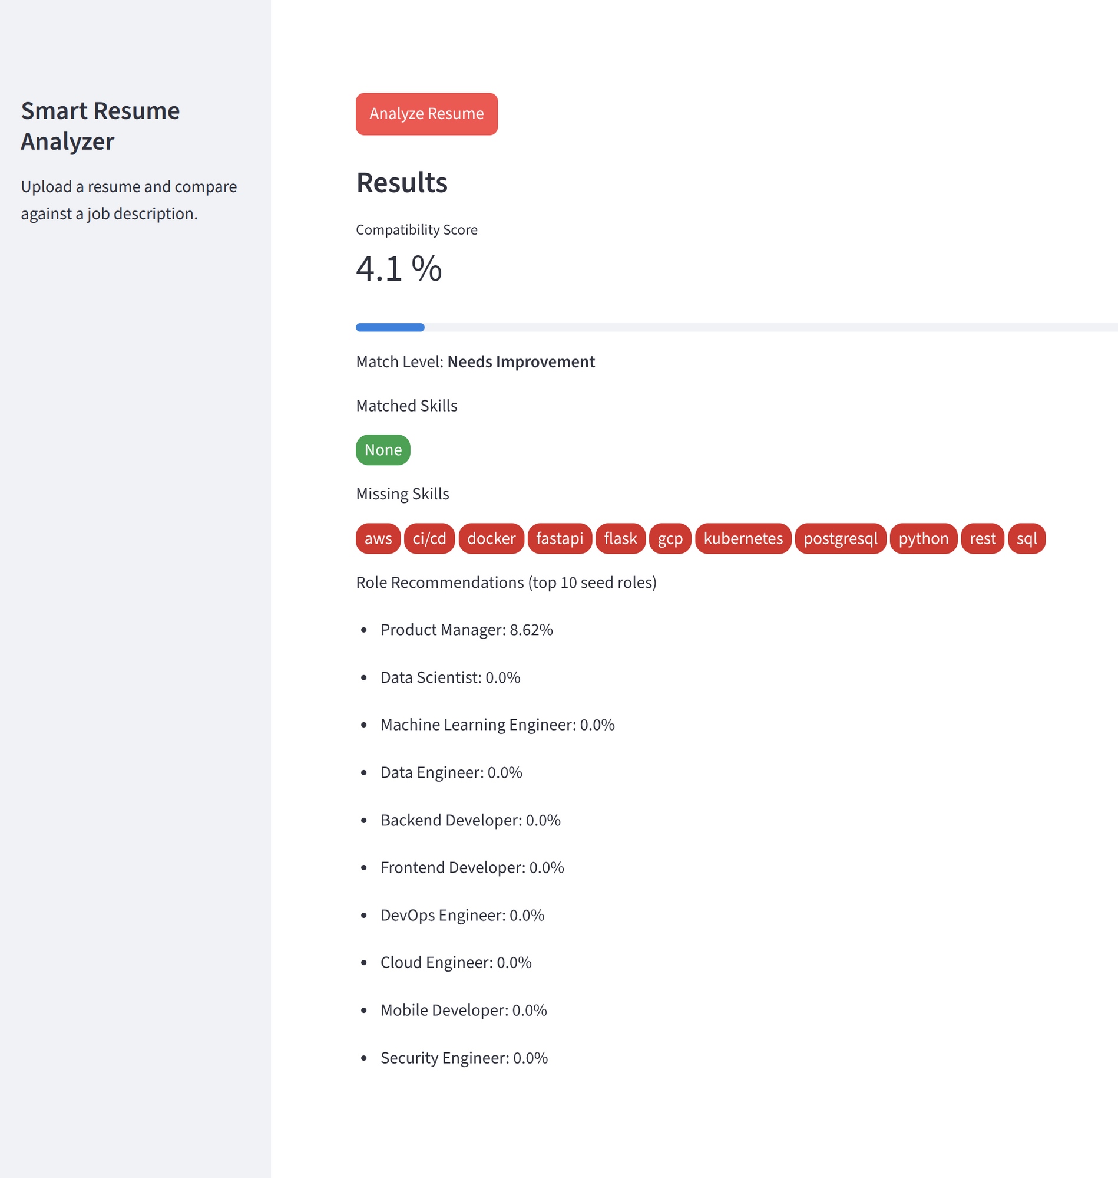
Results
INSIGHTS
01
Upload
The upload flow is designed for simplicity, allowing users to easily submit their resumes in various formats while receiving immediate feedback.
02
Analysis
The analysis metrics view provides users with essential insights, highlighting compatibility scores and skills differences against job descriptions.

Slide 11
Limitations and Future Enhancements
Current gaps
Basic spaCy NER for names/emails; rule-based hard-skill list; no experience/recency/tenure weighting; no embeddings.
Future
Richer skill ontology + semantic embeddings for softer/implicit skills; add recency/tenure weighting in scoring; role-specific weight tuning.
Ops/admin
CRUD for jobs/skills to manage benchmarks without code changes.

Slide 12
Thank You!

