Slide 1






Two Approaches for Register-based Population Size Estimation: Individual-level and Population-level
${\text{Lucy} \text{Brown}}^{1}$: lyb3@kent.ac.uk
$${\text{Eleni} \text{Matechou}}^{2}$$
$${\text{Bruno} \text{Santos}}^{3}$$
$${\text{Eleonora} \text{Mussino}}^{4}$$
1 University of Kent, UK
2 Queen Mary University of London, UK
3 Universidade de Lisboa, Portugal
4 Stockholm University, Sweden

Slide 2

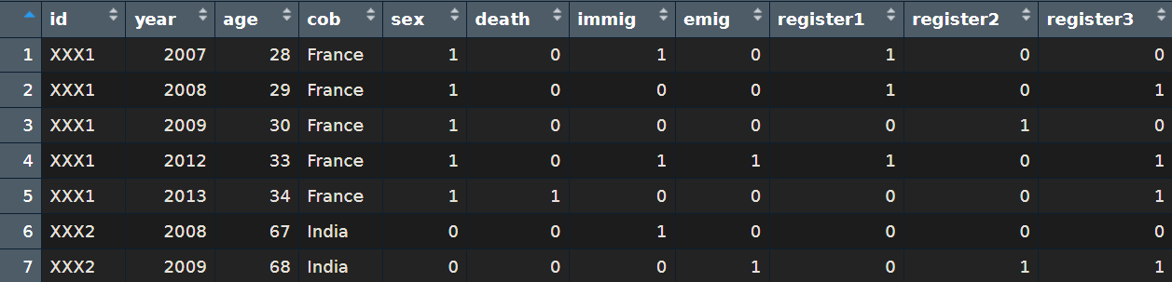

Administrative Register Data
An arbitrary number of registers
Provided by a national statistics agency (e.g. Statistics Sweden – SCB, or Statistics Norway - SSB)
Emigration, Immigration and Death records
All foreign-born residents who first entered the country as adults during the study years
(e.g. for Sweden 2003-2016,
or for Norway 2007-2023)
Covariates (treated as categorical)
Age
Country of birth
Sex
Time since first entry

Slide 3

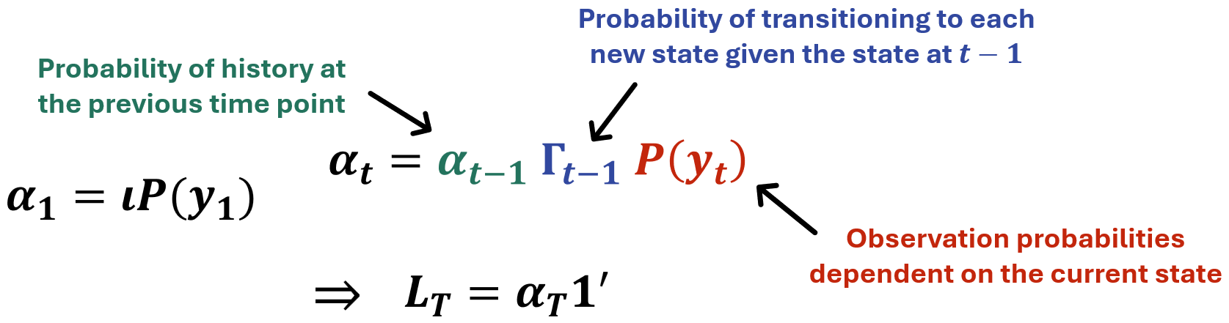

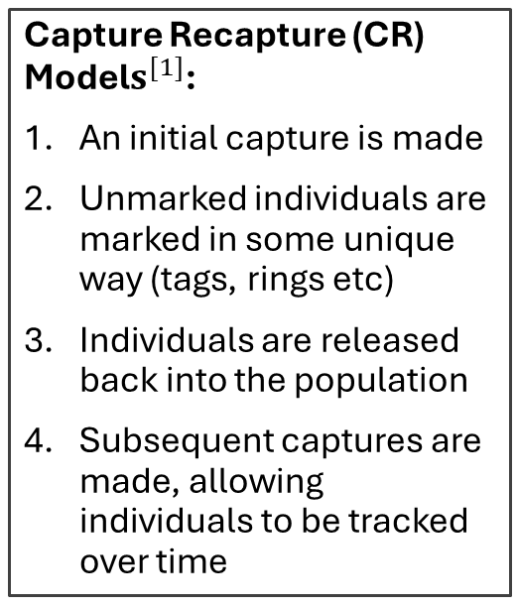
Capture-Recapture & HMM Formulation
Capture Recapture (CR) Model$s^{[1]}$:
An initial capture is made
Unmarked individuals are marked in some unique way (tags, rings etc)
Individuals are released back into the population
Subsequent captures are made, allowing individuals to be tracked over time
CR models are commonly used in ecology to estimate population size for wild animals
An individual’s true state is unobservable (latent)
Hidden Markov model (HMM) formulation marginalises over the latent state to calculate the marginal likelihood
This iterative method is very efficient and allows latent states to be inferred
$$δ P(y_{1})$$
[1] Kenneth H. Pollock. Capture-recapture models. Journal of the American Statistical Association, 95(449):293–296, 2000. ISSN 01621459, 1537274X. URLhttp://www.jstor.org/stable/2669550

Slide 4
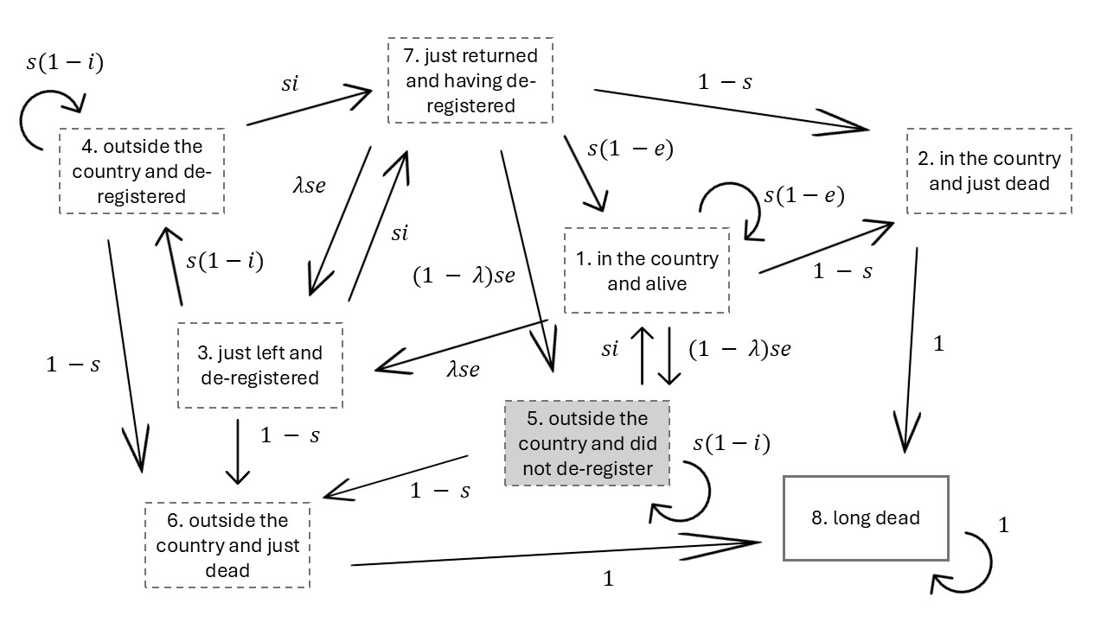
e = emigration
i = (re-)immigration
λ = de-registering
s = survival

Slide 5





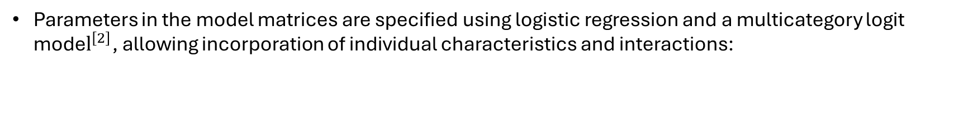
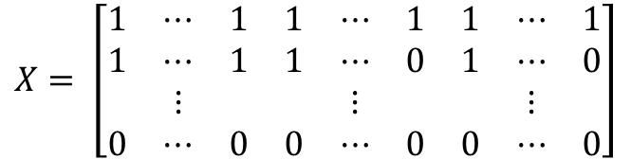
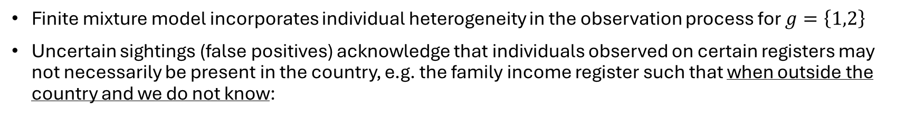
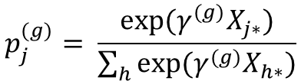

Model Specification
[2] A. Agresti. An introduction to categorical data analysis. John Wiley & Sons, 2nd edition, 2007.
Parameters in the model matrices are specified using logistic regression and a multicategory logit mode$l^{\left[2\right]}$, allowing incorporation of individual characteristics and interactions:
$$logit\left(θ\right)=β_{0}+β_{1}C_{1}+β_{2}C_{2}+ …$$
$$X= \left[\begin{matrix}1 & ⋯ & 1 & 1 & ⋯ & 1 & 1 & ⋯ & 1 \\ 1 & ⋯ & 1 & 1 & ⋯ & 0 & 1 & ⋯ & 0 \\ & ⋮ & & & ⋮ & & & ⋮ & \\ 0 & ⋯ & 0 & 0 & ⋯ & 0 & 0 & ⋯ & 0\end{matrix}\right]$$
$$p_{j}^{(g)}= \frac{exp⁡(γ^{(g)}X_{j∗})}{\sum_{h}{exp⁡(γ^{(g)}X_{h∗})}}$$
Individual- and time-dependent covariates C
Registers
Covariates
Interactions
Finite mixture model incorporates individual heterogeneity in the observation process for $g=\left\{1,2\right\}$
Uncertain sightings (false positives) acknowledge that individuals observed on certain registers may not necessarily be present in the country, e.g. the family income register such that when outside the country and we do not know:
P(observed on family income register only) = $ε$
P(unobserved) = $1 − ε$
5

Slide 6
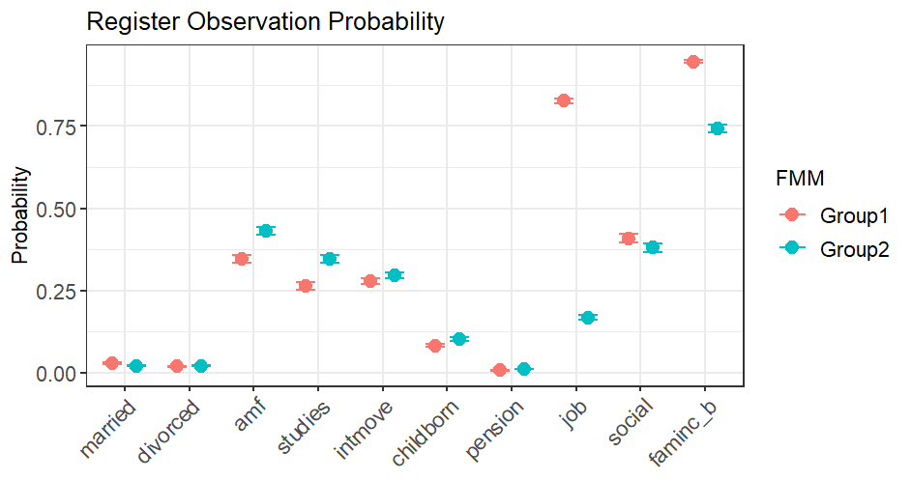
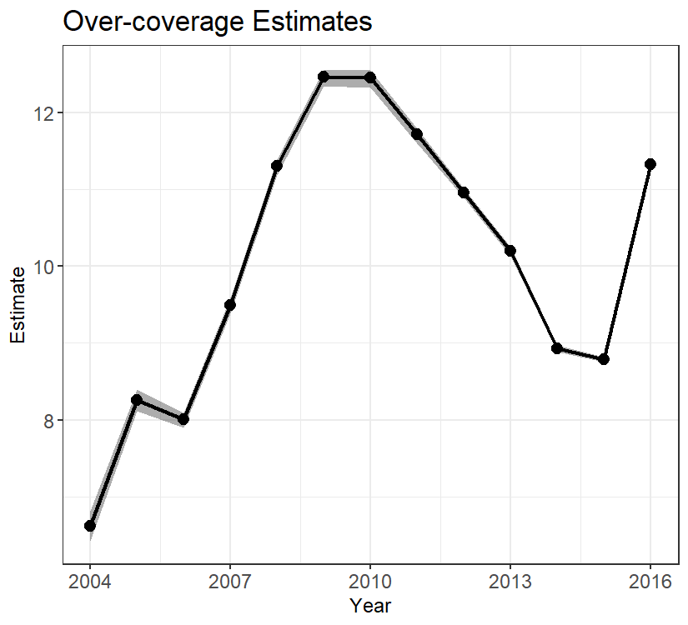
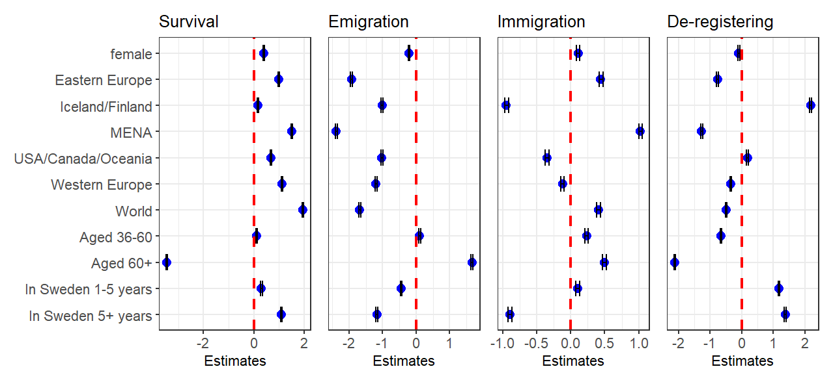
Baseline:
Survival: 0.996 (0.995, 0.996)
Emigration: 0.481 (0.475, 0.487)
Re-immigration: 0.084 (0.082, 0.086)
De-registration: 0.529 (0.522, 0.536)

Slide 7

Benefits:
Incredibly detailed results for each group of individuals
Able to follow individuals every year they are present during the study, determining which state they are in (using the Viterbi Algorithm)
Improvement on previous models
Limitations:
We had near unlimited access to a high-performance computing cluster BIANCA at Uppsala University, allowing huge computational capacity and effectively perfect parallelisation. Realistically, access to similar resources is limited
Propose a population-level model

Slide 8

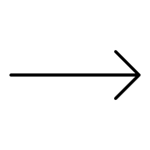



Overview of Population-level Model
new arrivals
known immigration
unknown immigration
new arrivals
new arrivals
$$N_{1}$$
$$N_{2}$$
$$N_{3}$$
known emigration
unknown emigration
known emigration
unknown emigration
death
death

Slide 9
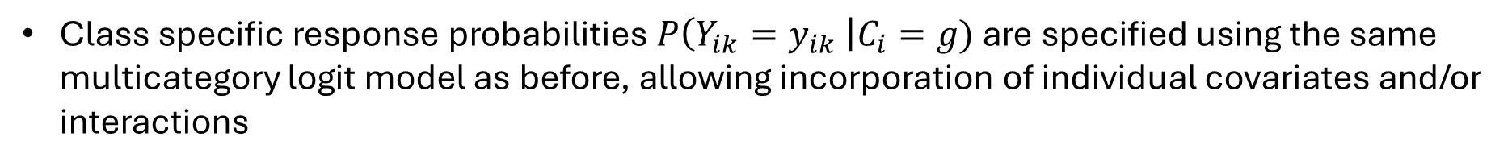
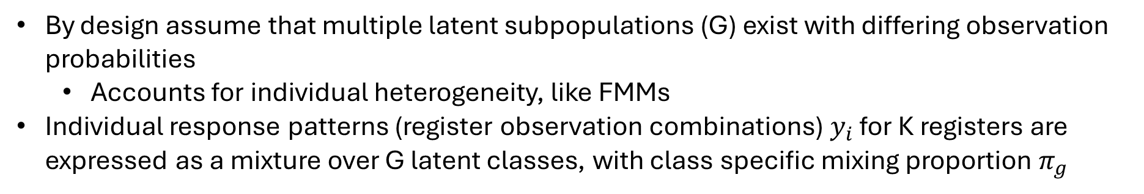
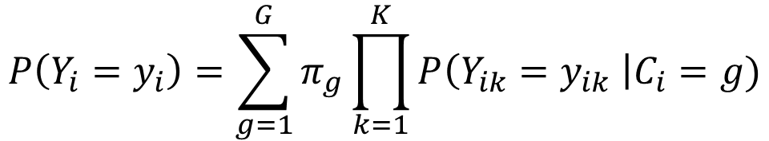

Latent Class Model$s^{[3]}$
[3] Mariano Porcu and Francesca Giambona. Introduction to latent class analysis with applications. The Journal of Early Adolescence, 37(1):129–158, 2017. doi: 10.1177/0272431616648452.
By design assume that multiple latent subpopulations (G) exist with differing observation probabilities
  Accounts for individual heterogeneity, like FMMs
Individual response patterns (register observation combinations) $y_{i}$ for K registers are expressed as a mixture over G latent classes, with class specific mixing proportion $π_{g}$
$$P\left(Y_{i}=y_{i}\right)=\sum_{g=1}^{G}{π_{g}\prod_{k=1}^{K}{P\left(Y_{ik}=y_{ik} \right|C_{i}=g)}}$$
Class specific response probabilities $P\left(Y_{ik}=y_{ik} \right|C_{i}=g)$ are specified using the same multicategory logit model as before, allowing incorporation of individual covariates and/or interactions

Slide 10




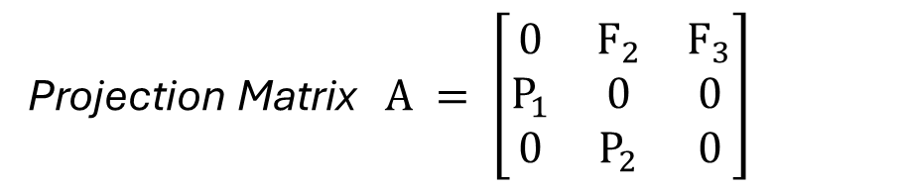
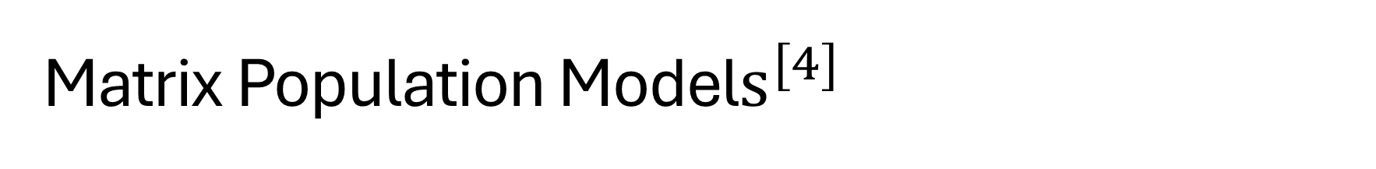

Matrix Population Model$s^{[4]}$
[4] Hal Caswell. Matrix population models: construction, analysis, and interpretation. Sinauer Associates, Inc, 2nd edition, 2001.
A class of population models that utilise matrix algebra
Applications in estimation and projection of populations in both ecology and demography
Similar to HMM formulation of CR, but on a population-level with counts in each state
$$F_{3}$$
$$\underline{n}\left(t+1\right)=A\underline{n}\left(t\right)$$
$$F_{2}$$
Projection Matrix $A = \left[\begin{matrix}0 & F_{2} & F_{3} \\ P_{1} & 0 & 0 \\ 0 & P_{2} & 0\end{matrix}\right]$
1
2
3
$$P_{1}$$
$$P_{2}$$
Counts in each stage (geographical location and/or covariate stage) are observed, allowing transition probabilities to be estimated
Covariate combinations are considered separately and transition between stages allowed

Slide 11
Current Work
Currently can fit LCM to each year then plug estimates into the MPM
  LCM: fitted to each covariate group separately, estimates population size, allowing an estimate of the number of overcovered individuals each year
  MPM: fitted to all years to estimate life event probabilities (survival, emigration, re-immigration and de-registration) for each covariate group, using states
    Present in the country
    Dead
    Outside the country and de-registered
    Overcovered (outside country but didn’t de-register)
Goal: combine models and optimise jointly

Slide 12


Thank you for your attention!
Email: lyb3@kent.ac.uk

Slide 13
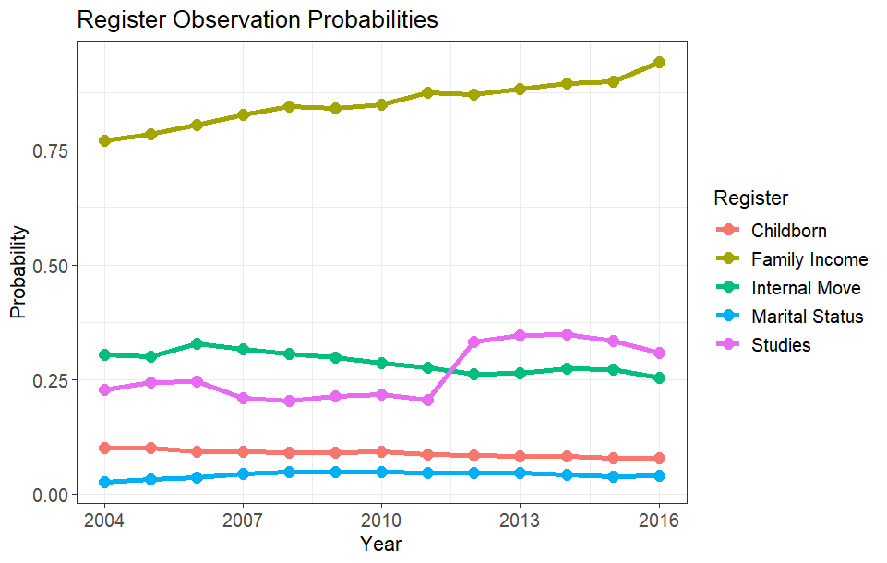
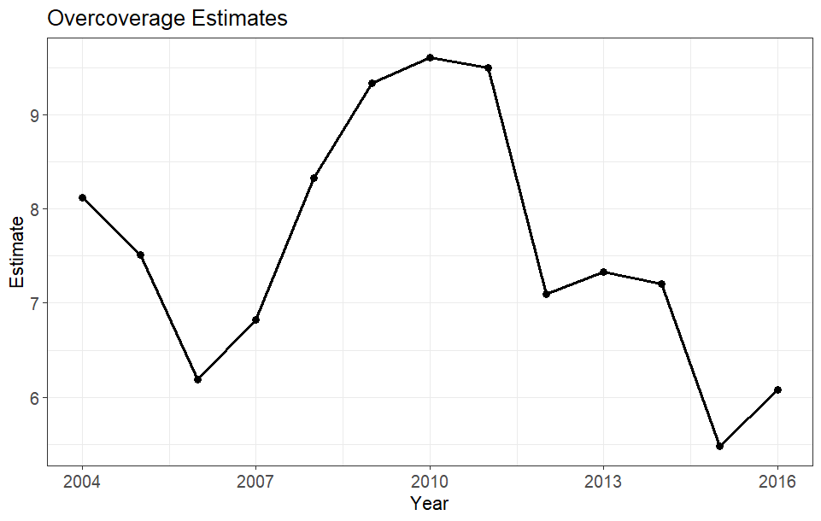
Life Event Probabilities:
Survival: 0.99862
Emigration: 0.11450
Re-immigration: 0.23231
De-registration: 0.79870
Note: these are only preliminary estimates
Different registers are used
No covariates are incorporated
Only 1 latent class is considered (no FMM equivalent)
Uncertain sightings are not considered

