Slide 1

Oriental Horizon Hotel Business
Review Intelligence for
Hotel Revenue Management
Fine-tuned deep-learning models that turn guest reviews into room-pricing signals
ISOM5240 Group Project · Group 6 · Ou Zhiyong (A0018498R) · Zhang Ludan (A0309855R)
Notes:
[Ou Zhiyong] Hello everyone. We are Ou Zhiyong and Zhang Ludan from Group 6, and our project is called Review Intelligence for Hotel Revenue Management. We built it for Oriental Horizon Hotel Business, the hotel company one of us works for. In the next ten minutes we will show how two fine-tuned deep-learning models turn guest reviews into signals that help the hotel set its room prices.

Slide 2


The pricing system cannot read reviews
Our revenue management system (RMS) only uses numbers — but guests write words
What the RMS uses today
What it misses
Occupancy and booking pace
Competitor room rates
Seasonality and events
Thousands of free-text guest reviews
Is our reputation strong enough to charge more than competitors?
Are our guests mostly business or leisure travellers?
All numeric — easy for a model to use.
Two questions a revenue manager cannot answer by reading every review.
2
Notes:
[Ou Zhiyong] Oriental Horizon prices its rooms with a revenue management system. The system works with numbers: occupancy, booking pace, competitor rates and seasonality. But guest reviews also tell us what guests are willing to pay, and they are written in free text, so the system ignores them. A revenue manager would like to answer two questions: first, is our reputation strong enough to charge more than our competitors? Second, are our guests mostly business or leisure travellers, because the two groups react very differently to price. Nobody can read thousands of reviews by hand, so we used deep learning.

Slide 3
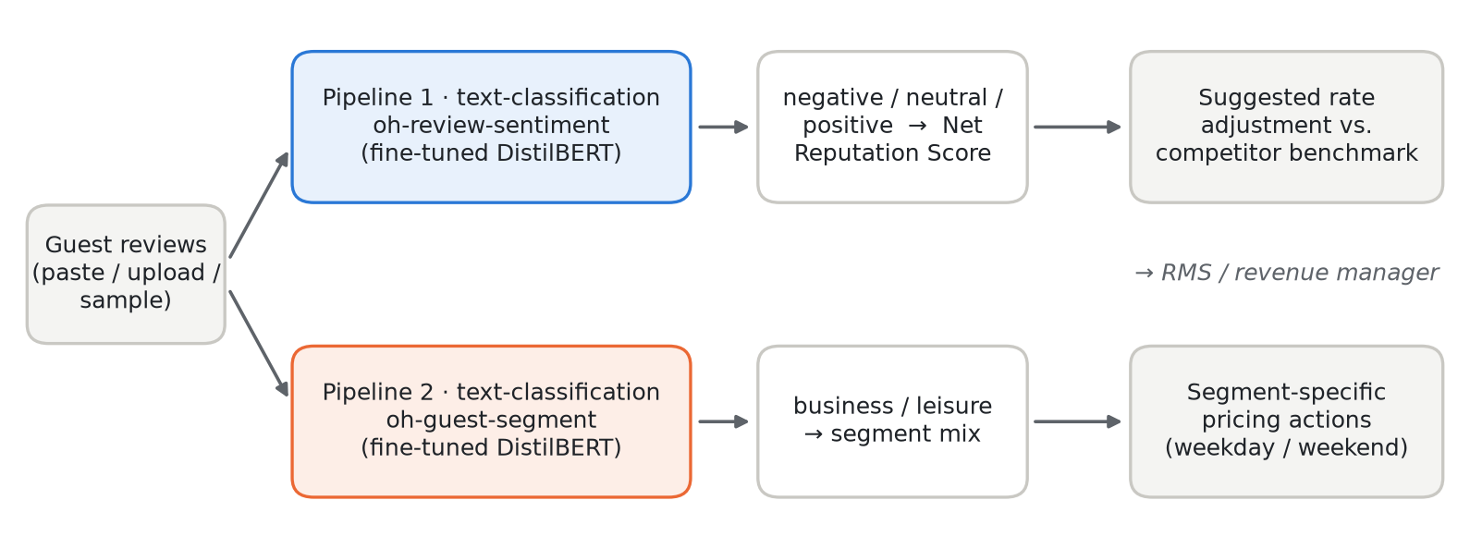
Our solution: two fine-tuned pipelines
Objective: turn guest reviews into a reputation signal and a demand-mix signal for the RMS
Net Reputation Score = % positive − % negative reviews. Each 10 points above competitors → +1% on the base rate (capped at ±5%).
3
Notes:
[Ou Zhiyong] Our solution has two Hugging Face text-classification pipelines. Pipeline one reads each review and labels it negative, neutral or positive. From these labels we compute a Net Reputation Score, which is the share of positive reviews minus the share of negative reviews. If our score is above the competitors' score, the app suggests a small price premium of one percent for every ten points, capped at five percent. Pipeline two labels each review as written by a business or a leisure guest. The segment mix tells the revenue manager which pricing actions to use, for example weekday rates for business guests and weekend packages for leisure guests.

Slide 4


Data: 515,000 real reviews, labelled for free
Public Booking.com reviews (Kaggle) as a stand-in for confidential hotel data
515K
45,000
30,000
Booking.com reviews of European hotels
balanced reviews for the sentiment model
balanced reviews for the guest-segment model
Labels come from the data itself
Pre-processing
Score < 5.5 → negative · 6.5–7.9 → neutral · ≥ 9.0 → positive
Trip tag “Business trip” → business · “Leisure trip” → leisure
Ambiguous scores in between are left out
Join the “liked” and “disliked” parts into one review
Remove placeholders, empty and duplicate reviews
15,000 reviews per label · split 80 / 10 / 10
4
Notes:
[Ou Zhiyong] Our hotel's own reviews are confidential, so we used a public dataset of 515,000 Booking.com reviews from European hotels as a stand-in. The nice thing is that the labels already exist in the data. The reviewer score gives the sentiment: below 5.5 is negative, 6.5 to 7.9 is neutral, and 9 or above is positive. We left out the scores in between because they are ambiguous. The trip tags tell us whether the guest was on a business or a leisure trip. We joined the liked and disliked parts of each review, removed placeholders and duplicates, and drew a balanced sample of 15,000 reviews per label. That gives 45,000 reviews for sentiment and 30,000 for the guest segment, split 80, 10 and 10 percent into training, validation and test sets.

Slide 5


Models: small, fast, fine-tuned on hotel reviews
Each student fine-tuned one model; both compared two Hugging Face candidates
Fine-tuning set-up
Student 1 · Sentiment
Student 2 · Guest segment
Google Colab, free T4 GPU
New classification head on a pre-trained encoder
2 epochs · learning rate 3e-5 · batch 32 · max 256 tokens
Best epoch kept by validation macro-F1
Small distilled models → fast enough on Streamlit's CPU
No large language models, as the course recommends
negative / neutral / positive
Final model: oh-review-sentiment
business / leisure
Final model: oh-guest-segment
Candidate (Hugging Face) | Size | Role
distilbert-base-uncased | 67M | Fine-tuned · selected
distilroberta-base | 82M | Fine-tuned · compared
nlptown bert-base-multilingual-sentiment | 167M | Baseline, no training
facebook/bart-large-mnli | 407M | Baseline, zero-shot
5
Notes:
[Ou Zhiyong] Each of us fine-tuned one model. I, Zhiyong, fine-tuned the sentiment model, and Ludan fine-tuned the guest-segment model. For both tasks we compared two small pre-trained models from Hugging Face, DistilBERT and DistilRoBERTa. They are distilled versions of BERT, so they keep most of BERT's accuracy but are fast enough to run on Streamlit's CPU. We also tested two larger models without any fine-tuning as baselines. Training ran on a free Colab GPU: two epochs, learning rate 3e-5, batch size 32 and a maximum of 256 tokens per review. We kept the epoch with the best validation macro-F1. I will now hand over to Ludan for the results.

Slide 6


We improved the models in two rounds
The first segment model failed — we changed the question, not just the model
Round 1: three segments
Business / couple / family reached only 55.8%: one family review in three was read as “couple”, because most reviews never say who the guest travelled with.
Round 2: what we changed
Business vs. leisure — the core split in hotel revenue management
2.5× more training data
6
Notes:
[Zhang Ludan] Thank you. We did not get here on the first try. In round one we used 6,000 reviews per label and three guest segments: business, couple and family. The sentiment model reached 72.7 percent, but the segment model reached only 55.8 percent. One family review in three was mistaken for a couple, because most reviews never mention who the guest travelled with. So in round two we changed the question: business versus leisure, which is also the most important split in hotel revenue management. We also used two and a half times more data. Sentiment accuracy rose to 75 percent, and the segment model reached 72 percent.

Slide 7
Fine-tuning beats ready-made models
Experiment 1 — model selection on 4,500 / 3,000 held-out test reviews (accuracy and CPU runtime)
+12
+17
points: sentiment
(62.8% → 75.0%)
points: guest segment
(55.4% → 72.1%)
20×
≈
faster than zero-shot BART on CPU (83 ms vs 1.7 s)
DistilBERT and DistilRoBERTa tied (≤ 0.9 pts) → smaller model chosen
7
Notes:
[Zhang Ludan] Our first experiment compares the models on held-out test reviews: 4,500 for sentiment and 3,000 for the segment. Fine-tuning made a big difference. For sentiment, accuracy went from 62.8 percent with a ready-made model to 75 percent with our model, a gain of 12 points. For the guest segment, the zero-shot BART model reached only 55 percent, and our model reached 72 percent, a gain of 17 points. Our model is also about 20 times faster on a CPU. The two fine-tuned candidates were practically tied, within one point, so following our rule we chose the smaller DistilBERT model.

Slide 8
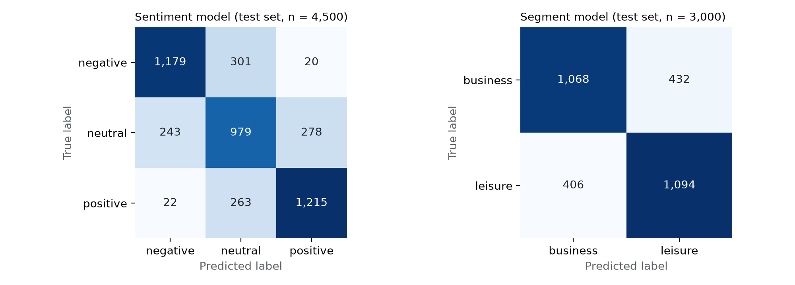

Where the models make mistakes
Confusion matrices on the test sets
Why the signal is still reliable
Positive and negative are confused in only 1.4% of reviews
Most errors are one step away: neutral vs. its neighbours
Segment errors are balanced (432 vs. 406), so no bias towards one group
Remaining errors are mostly reviews that do not say why the guest travelled, e.g. “Room was comfortable and location was good.”
8
Notes:
[Zhang Ludan] Here we look at where the models go wrong. On the left, the sentiment model: almost all errors are one step away, for example neutral versus positive. Positive and negative are confused in only 1.4 percent of reviews, so the reputation score is reliable. On the right, the segment model: errors are balanced in both directions, so it does not favour business or leisure. Many remaining errors are reviews that simply do not say why the guest travelled, like "Room was comfortable and location was good." Even a human could not tell.

Slide 9
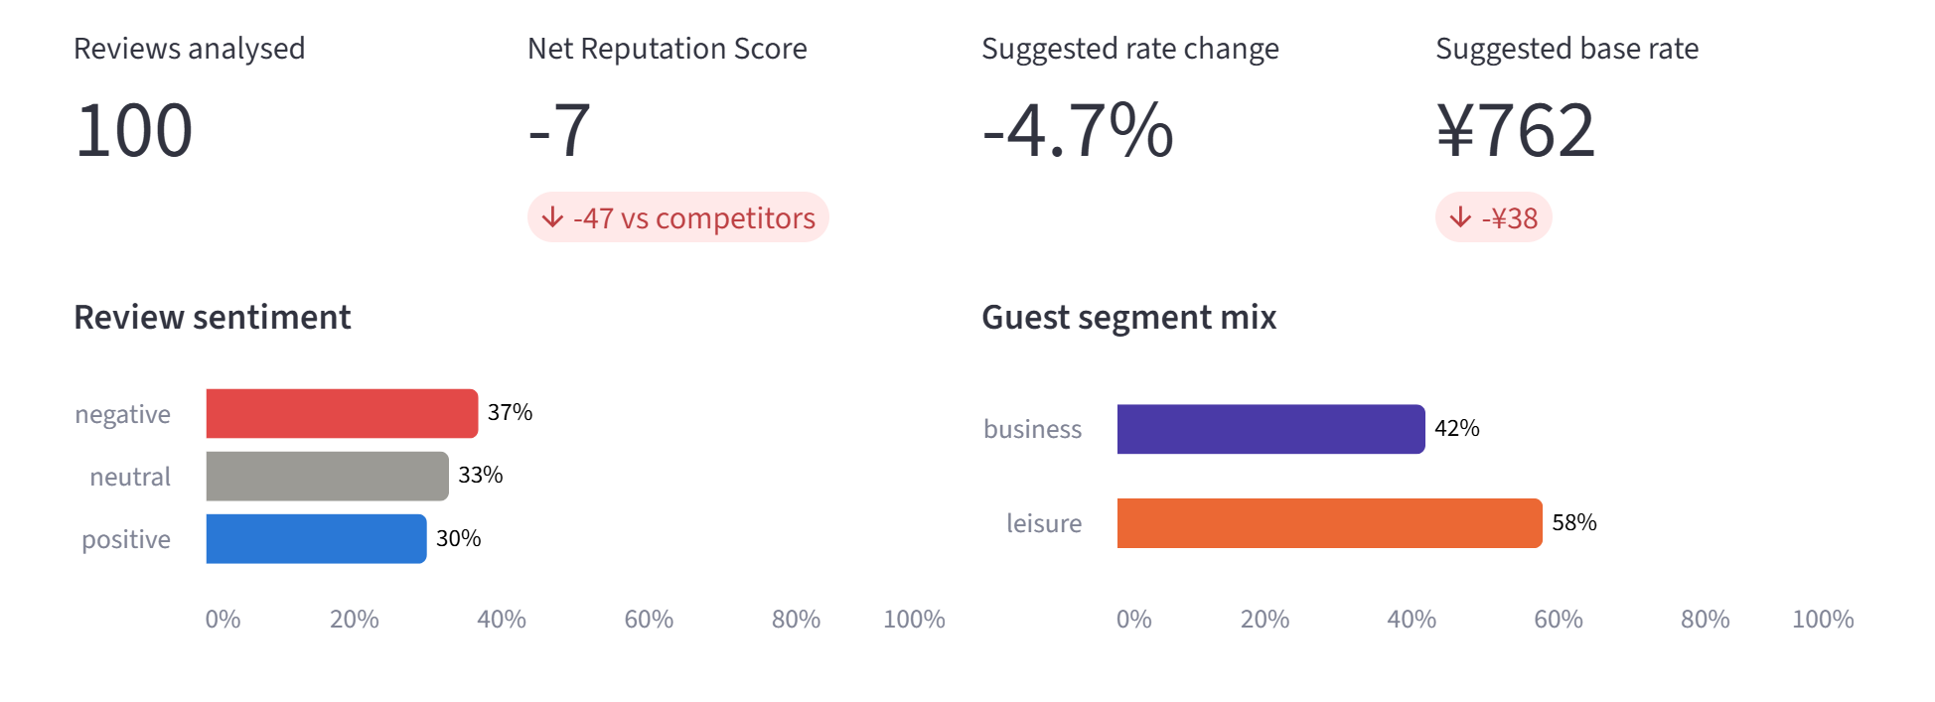
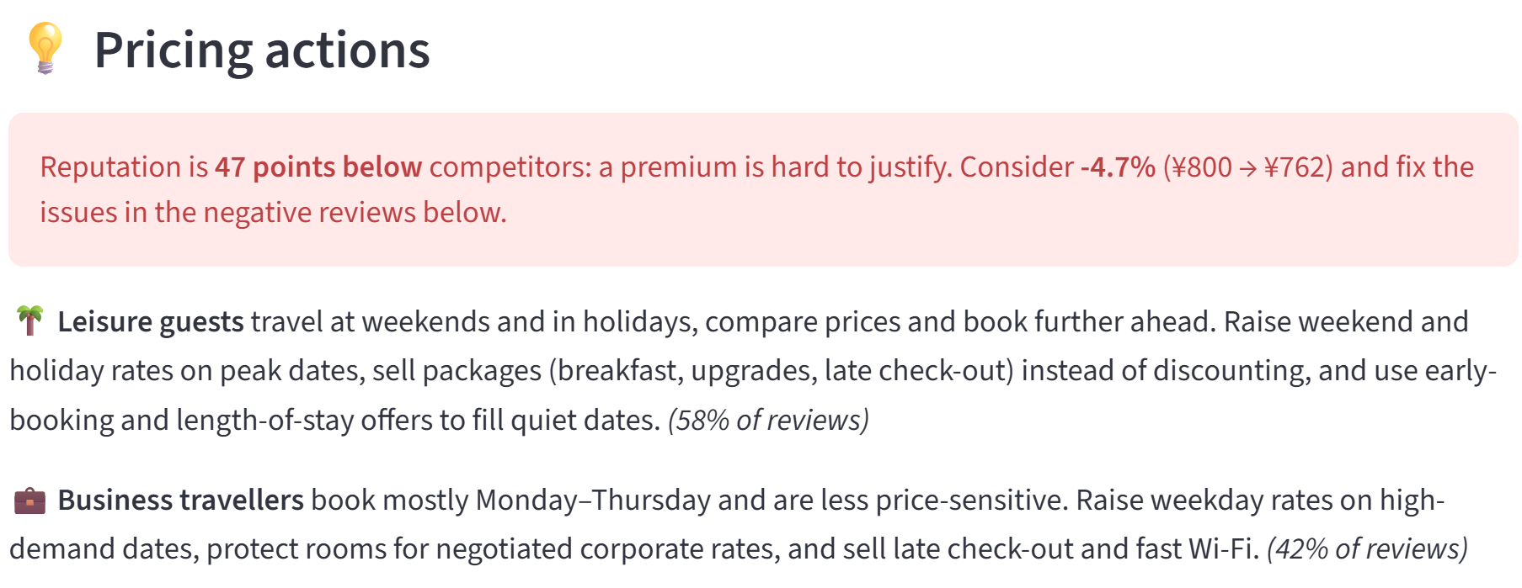
The app: from reviews to a price suggestion
oriental-horizon-review.streamlit.app
1
Paste, upload or sample reviews
2
Both pipelines classify every review
3
Reputation score vs. competitors → suggested rate
4
Segment mix → pricing actions
5
Download results; check accuracy live
9
Notes:
[Zhang Ludan] This is our app on Streamlit Cloud. The revenue manager pastes reviews, uploads a file, or takes a random sample. Both pipelines classify every review in a few seconds. The app then shows the Net Reputation Score compared with competitors, a suggested rate change, and the new base rate. In this example we used test reviews, which are balanced on purpose, so the score is low and the app suggests a small discount. Below, the pricing actions explain what to do for each guest segment, for example weekday rates for business travellers and packages instead of discounts for leisure guests. Results can be downloaded for the pricing system.

Slide 10
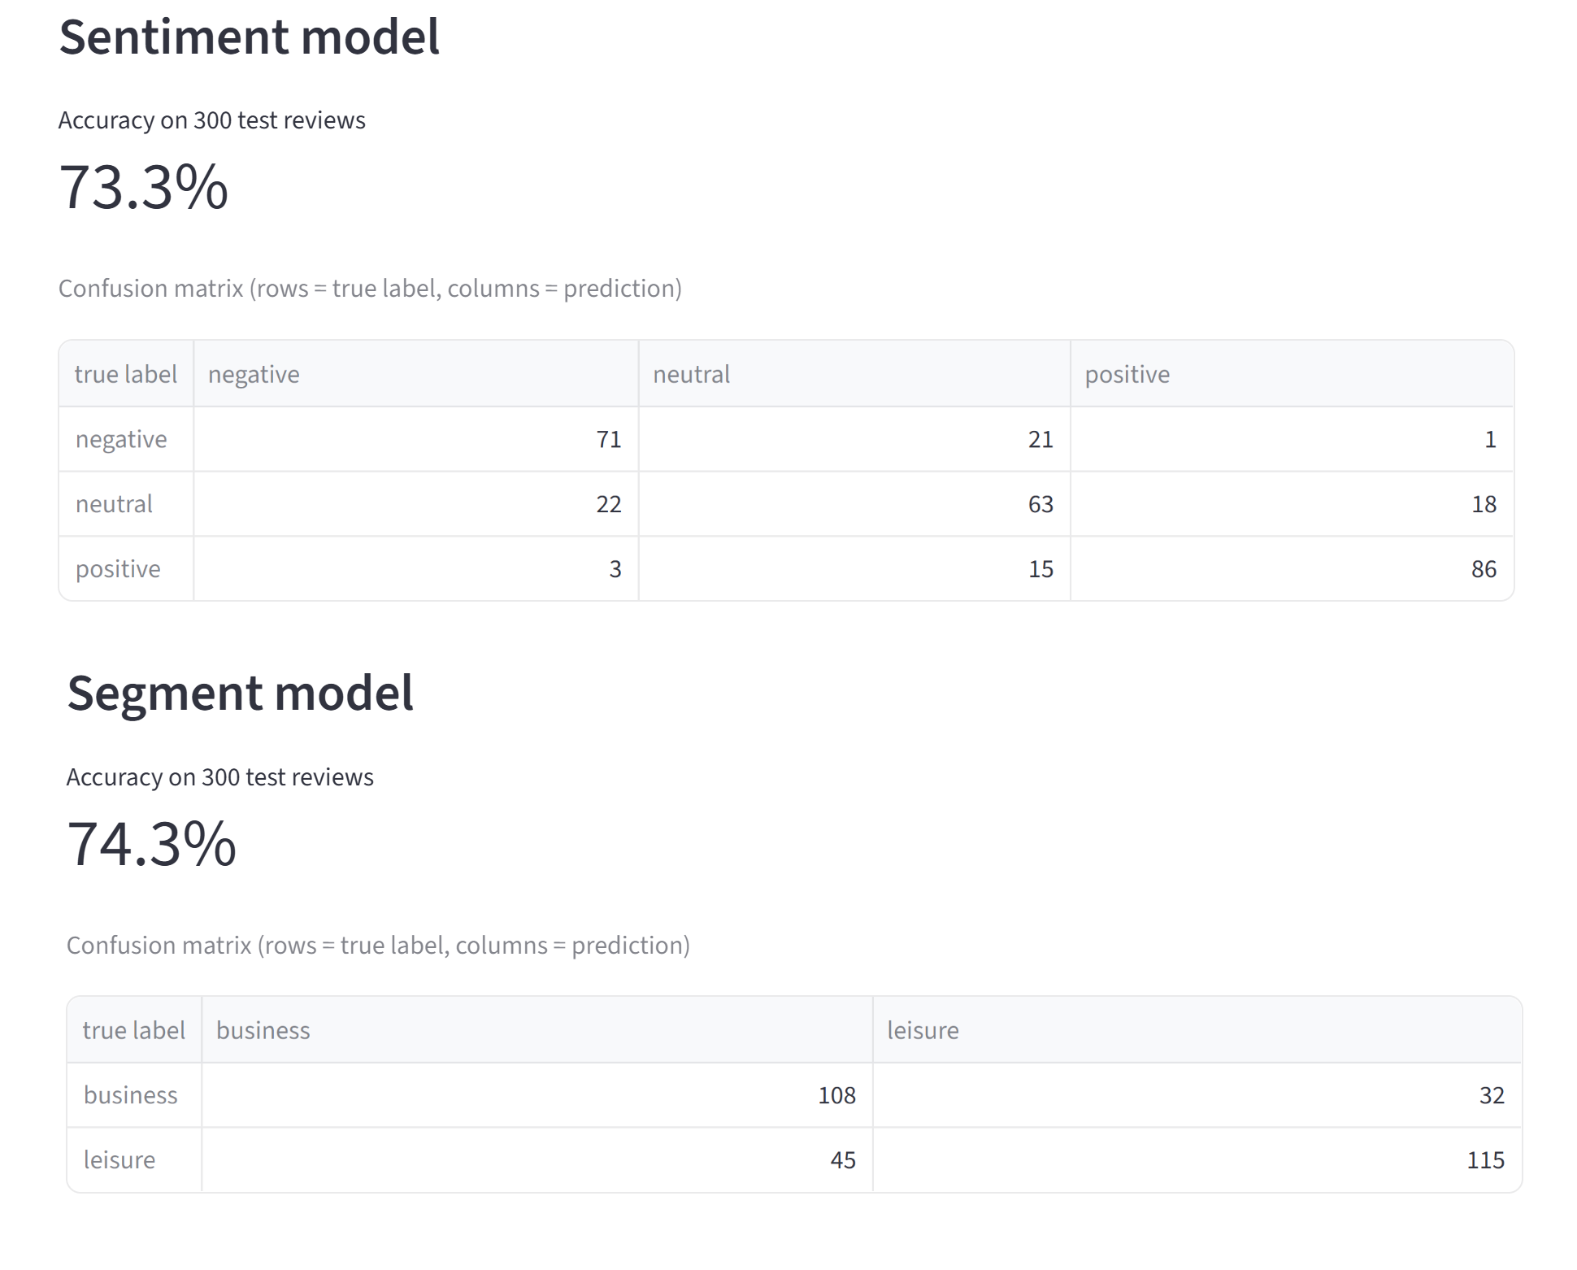

Experiment 2: the deployed app is just as accurate
Accuracy check run live on Streamlit Cloud — 300 test reviews per model (seed 42)
73.3%
74.3%
sentiment accuracy on Streamlit Cloud
guest-segment accuracy on Streamlit Cloud
Exactly the same as in Notebook 03
Same 300 reviews, same results in Colab and in the app
Proves the app runs the models our notebooks produced
Within the ±5-point sampling margin of the full test sets
10
Notes:
[Zhang Ludan] Our second experiment measures the accuracy of the deployed app. The app has an accuracy-check tab that runs both models on 300 labelled test reviews directly on Streamlit Cloud. Sentiment reached 73.3 percent and the guest segment 74.3 percent. These are exactly the same numbers we got in our Colab notebook with the same reviews, which proves the app runs the same models our notebooks produced. They are also within the normal sampling margin of the full test results.

Slide 11


How Oriental Horizon can use it
From a class project to a weekly input for the pricing system
Collect weekly
Feed the RMS
Keep humans in control
Retrain on our data
Monitor
Reviews from booking channels for our hotel and 3–5 competitors
Reputation index vs. competitors + business/leisure mix by day of week
Revenue manager approves changes within the agreed ±5% cap
Label our own (often Chinese) reviews; fine-tune a multilingual model
Quarterly accuracy check; compare suggestions with RevPAR
Limitation: trained on English reviews of European hotels, with labels taken from scores and tags, so some labels are noisy.
11
Notes:
[Zhang Ludan] How can Oriental Horizon use this? First, collect reviews every week from our booking channels, for our hotel and three to five competitors. Second, feed the pricing system two indicators: a reputation index compared with competitors, and the business-leisure mix by day of week. Third, keep the revenue manager in control: changes stay within the five percent cap and are approved by a person. Fourth, retrain the models on our own reviews, many of which are in Chinese, using a multilingual model and the same notebooks. Finally, check accuracy every quarter and compare the suggestions with revenue per available room. One limitation: our models were trained on English reviews of European hotels, and some labels are noisy.

Slide 12
Conclusion
75%
sentiment accuracy, with positive and negative almost never confused (1.4%)
72%
business vs. leisure accuracy, good enough to estimate the segment mix
+12 / +17
accuracy points from fine-tuning vs. ready-made models, at a fraction of the runtime
App: oriental-horizon-review.streamlit.app
Models: huggingface.co/ludanzhang54/oh-review-sentiment · oh-guest-segment
Thank you — questions welcome!
Notes:
[Zhang Ludan] To conclude: our sentiment model reaches 75 percent accuracy and almost never confuses positive with negative reviews, so it gives a reliable reputation signal. Our segment model reaches 72 percent, which is good enough to estimate the business-leisure mix across many reviews. Fine-tuning added 12 and 17 accuracy points compared with ready-made models, and runs much faster. Together they turn guest reviews into inputs Oriental Horizon's pricing system can use. The app and models are online at the links shown. Thank you, and we are happy to take questions.

