Slide 1
实习总结 （Internship Summary)
赵路达

Slide 2

项目(Projects)
LegoNet Gradient Checker
Parametric Linear Rectifier Unit(ReLU/PreLU) Implementation on LegoNet + Experiments on 100y click-Data dataset
LegoClassifyNet Implementation + Experiments on MNIST dataset
LegoNet Visualizer

Slide 3

Gradient Checker

Slide 4
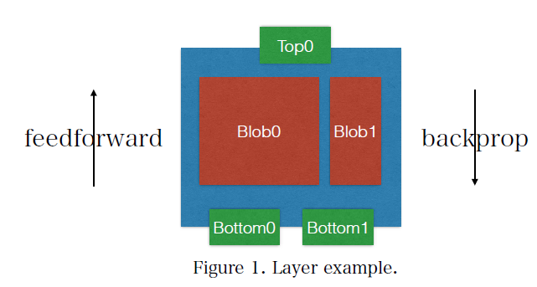

Background
LegoNet DNN Framework
Forward Feed calculates scores from first Layer to last
Back-propagation updates gradients from last Layer to first
However, backpropagation code can be tricky to get right

Slide 5
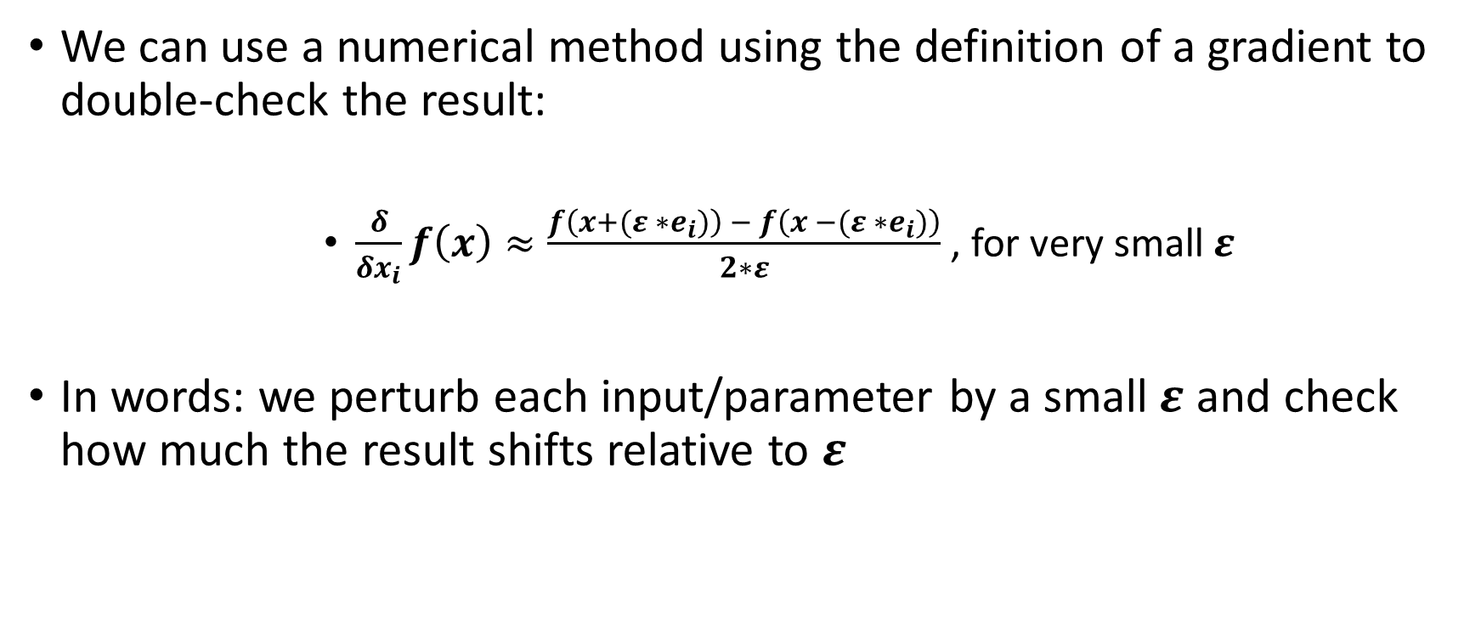
We can use a numerical method using the definition of a gradient to double-check the result:
$\frac{δ}{δx_{i}}f\left(x\right)≈\frac{f\left(x+(ε ∗e_{i})\right) − f\left(x −(ε ∗e_{i})\right)}{2∗ε}$ , for very small$ε$
In words: we perturb each input/parameter by a small$ε$ and check how much the result shifts relative to $ε$

Slide 6
Prints Report
Outputs vectors
Norm function
Yes!
No
Numerical Gradients
Verification
Gradients from backprop
Inputs
Parameters

Slide 7
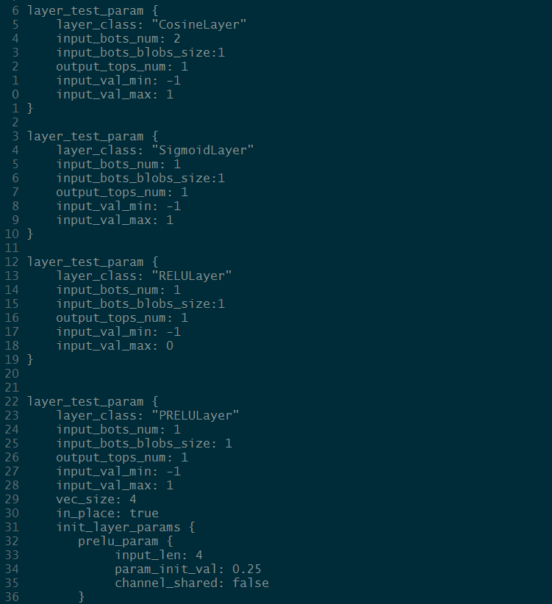
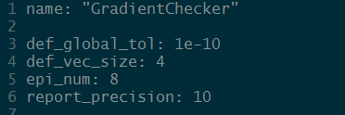
Configurable Testing
Each tested Layer, with tolerance, input ranges, and other parameters are listed in prototxt format

Slide 8
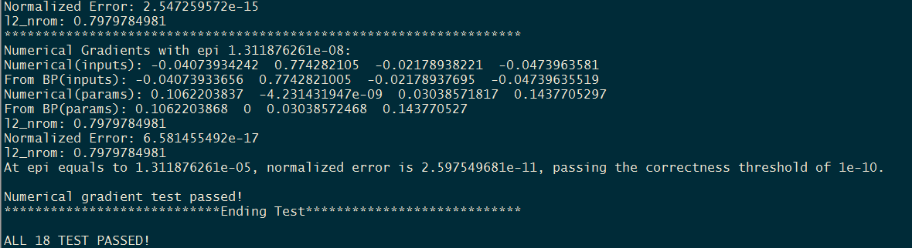
Detailed Analysis
One script will automatically run all tests and prints out detailed results in order to aid debugging

Slide 9
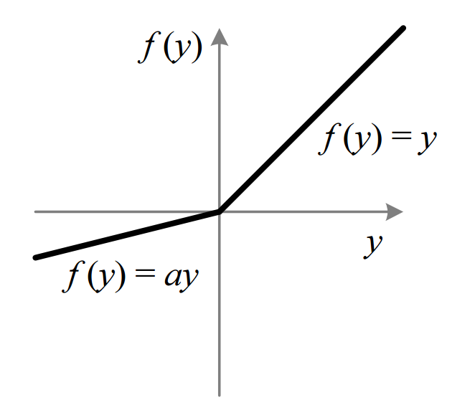
Parametric Linear Rectifier Unit(PReLU), Implementation + Experimentation

Slide 10
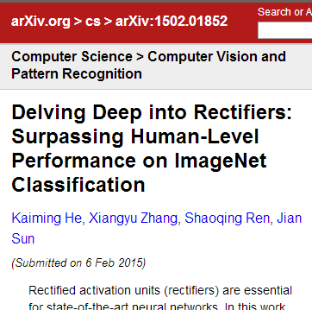
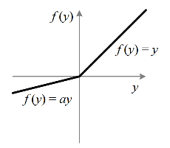
Motivation + Hypothesis
ReLU Activation Units widely used in Deep Learning due to desirable non-linearity properties
PReLU an improvement over ReLU by providing train-able parameter to adjust non-linearity
Has shown significant results(ImageNet)
Question: NLP?

Slide 11




Implementation
LegoNet: modular design, relative easy to add new Layer classes
ReLU Layer
Feed-Forward:
Backpropagation:
Inputs:
PReLU Layer
Feed-Forward:
Backpropagation:
PReLU params:
Inputs:

Slide 12
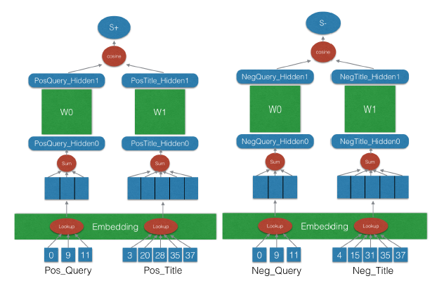
Experiments
Context: 2-hidden layer Simnet DNN used for similarity rankings between query-title pairs
Baseline: 2-hidden layer w/ softsign acti. function

Slide 13
Goals
Compare ReLU, PReLU speed + accuracy improvement to baseline softsign acti. function
Investigate effect of PReLU parameter a’s learning rate
Test effectiveness of PReLU non-linear initialization proposed in paper vs. current default initialization(Xavier initialization)
Investigate network structures using ReLU with possible sparse output representations

Slide 14
ReLU, PReLU, compared to baseline
Conclusion: ReLU Layer Networks obtained worse results than baseline, Similar results for PReLU Networks, but more works are needed
Future Directions: More in-depth comparisons, including more tuning of PReLU Networks

Slide 15
Initialization Comparison
Conclusion: PReLU non-linear initialization performed worse than default init.
Possible Explanation: init. proposed for extremely deep CNNs used in image processing, may not be applicable here
Future Direction: Investigate other type of initializations

Slide 16
PReLU learning rates
Still running…

Slide 17
Sparse Outputs Network with ReLU
Conclusion: unbalanced structures works significantly better than balanced versions, but still suffers an accuracy penalty compared to baseline
Future Direction: further testing with ReLU additions to network. Perhaps LR is too low?

Slide 18
Experimentation is hard!
First experience with doing research + experimentation on large-scale dataset
Many challenges: debugging difficulties, lack of exp. in multi-thread, accidentially rm-ing directories…
However, many learnings: working with big datasets, how to devise good experiments, lots and lots of shell scripts…etc. etc.

Slide 19
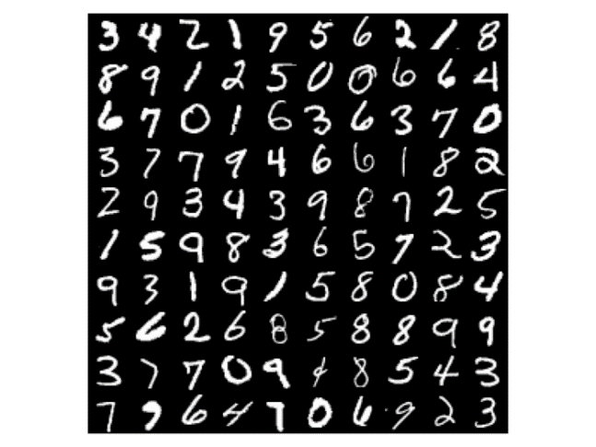
LegoClassifyNet: Experiments with MNIST

Slide 20
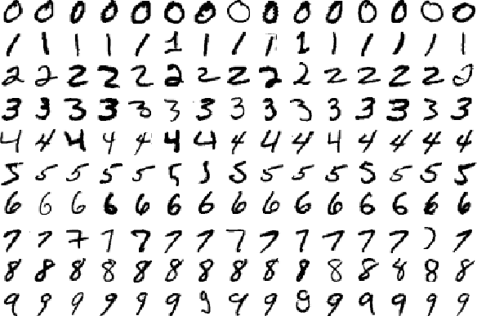

MNIST Dataset
open-source dataset of handwritten digits from 0-9, widely used as benchmark in Deep Learning
Small, easy and fast to train & debug
Investigated PReLU/ReLU effectiveness in classification task
Achieved over 98% testing set accuracy with 2-hidden layer NNs with PReLU units, matching most publicly published results

Slide 21
MNIST Experiments, #1
Conclusion: ReLU/PReLU show improvement over other non-linear functions in MNIST classification task, contrary to click-data experiments
PReLU convergence rate slightly faster, with similar result on 2-hidden layer NN

Slide 22
MNIST Experiments, #2
Conclusion: bigger PReLU param learning rates leads to faster convergence on MNIST dataset
Future direction: more investigations of param a’s effect on NN learning rate + accuracy

Slide 23
MNIST Experiments, #3
Conclusion: PReLU non-linear init. No significant effect compared to baseline. This matches result on click-data experiments

Slide 24
MNIST Experiments, #4
Conclusion: additional hidden layers seem to improve accuracy, but result is not significant
Future direction: testing even deeper NNs with other structures

Slide 25
MNIST Experiments, #5
Conclusion: a values increase from 1st PReLU Layer forward
Corresponds to steep non-linearity in the first layer, followed by strictly decreasing non-linearity in the following layers
Future direction: More investigation into a values in various contexts

Slide 26
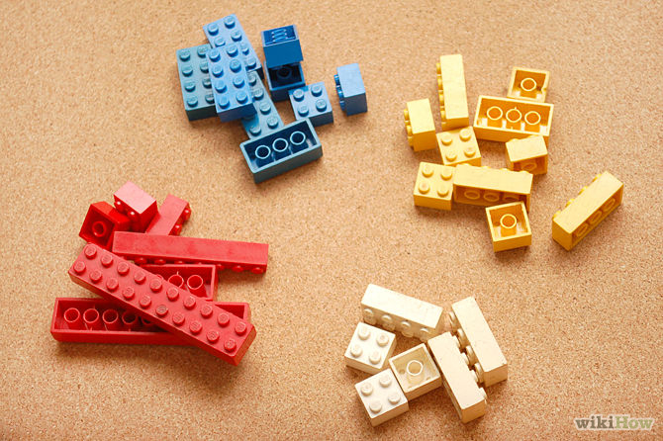
LegoClassifyNet
Generalized code used for MNIST classification to meet further needs for classification on LegoNet
Implemented LegoClassifyNet, LegoClassifyTestNet classes
Implemented new classify.cpp tool
Wrote wiki tutorial for working with MNIST with this framework, designed for first-time users

Slide 27

Network Visualizer

Slide 28

Graph Visualization
Complex LegoNet configuration files – prototxts – need visualization
Converts LegoNet prototxt format into renderable .dot texts
Built in pure JS – directly embeddable into any webpage
Utilizes open-source JS parsing + rendering libraries
Viz.js
pbparser.js
Google Image API(first version)

Slide 29
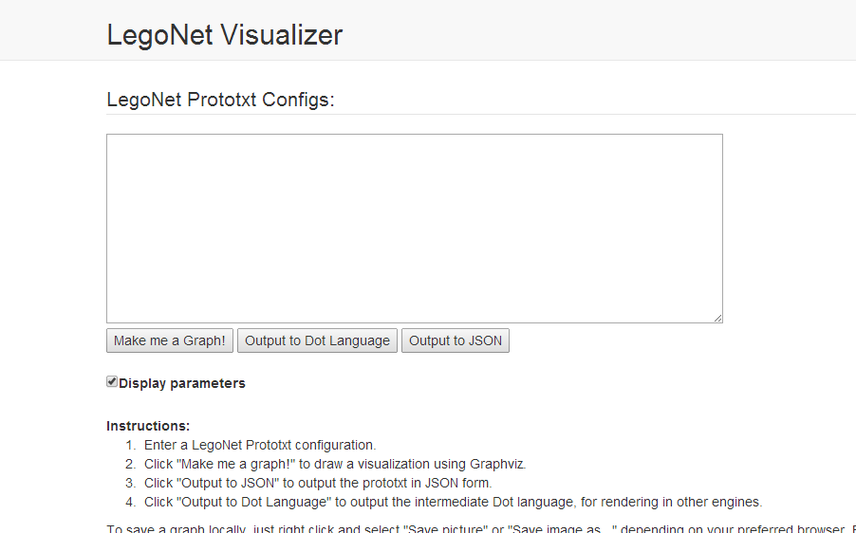

Slide 30
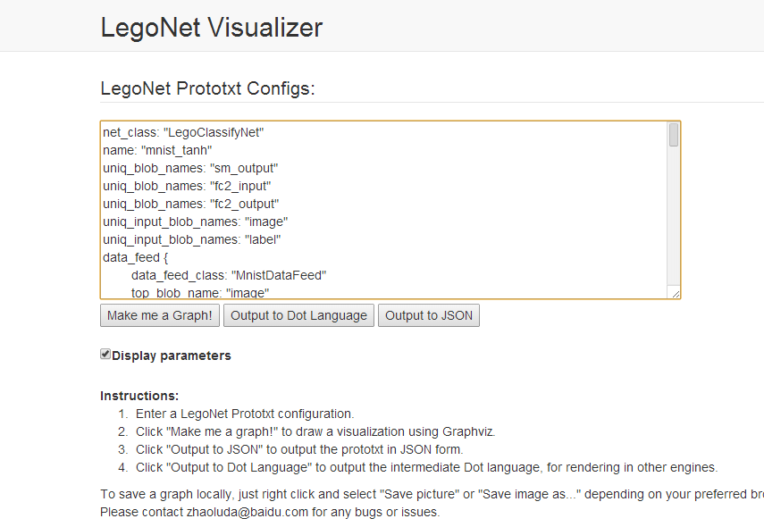

Slide 31
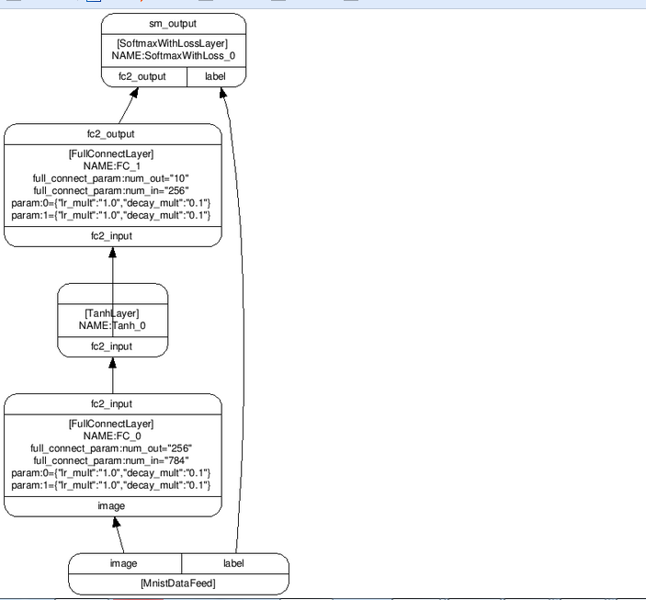
Output

Slide 32

Luda 在百度

Slide 33
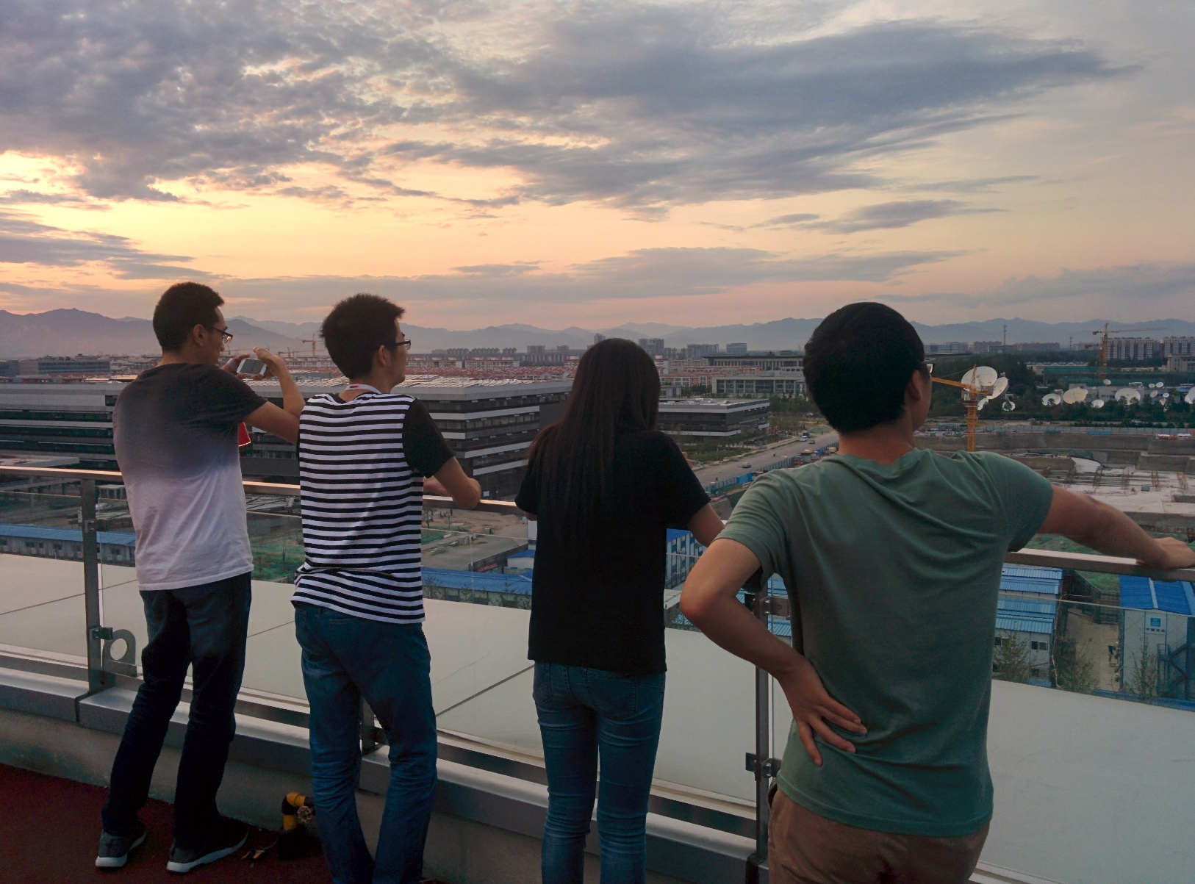



Slide 34
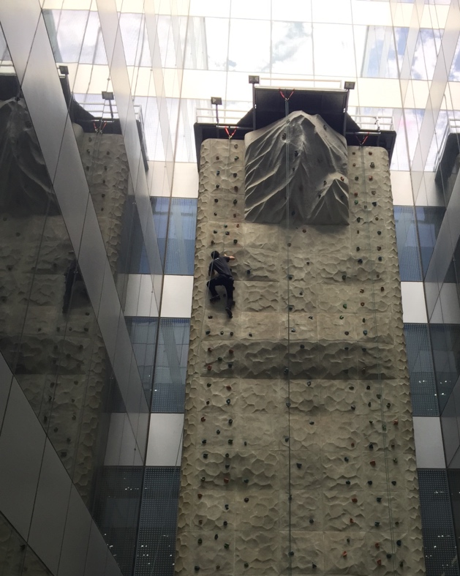
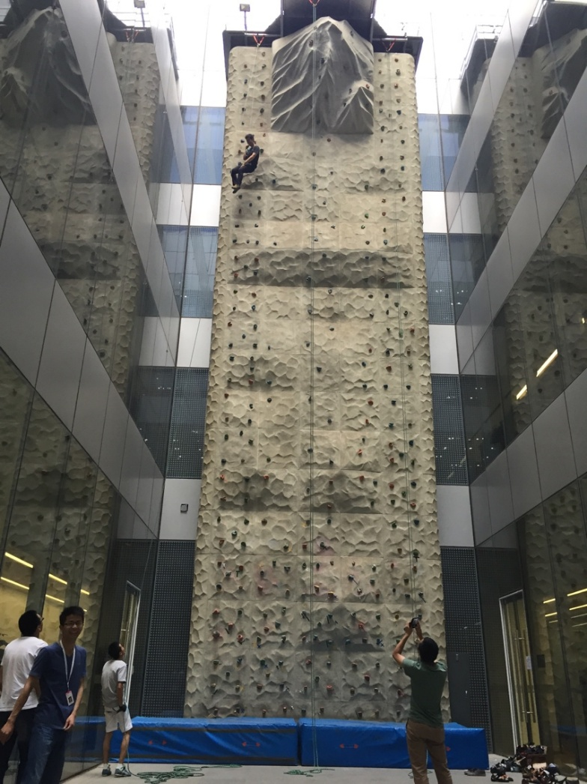

Slide 35
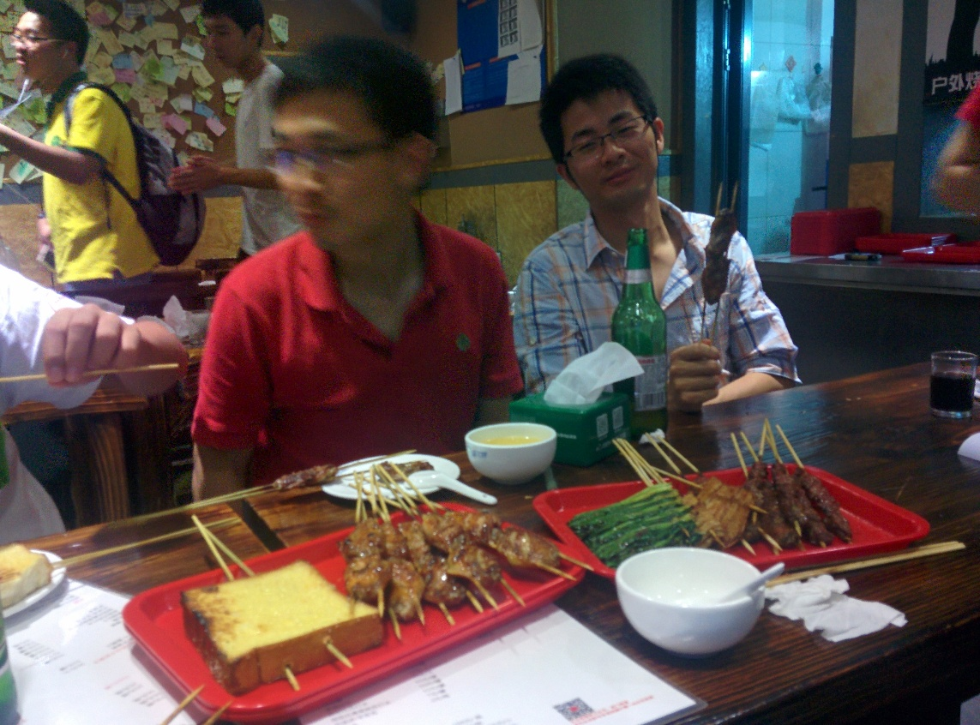
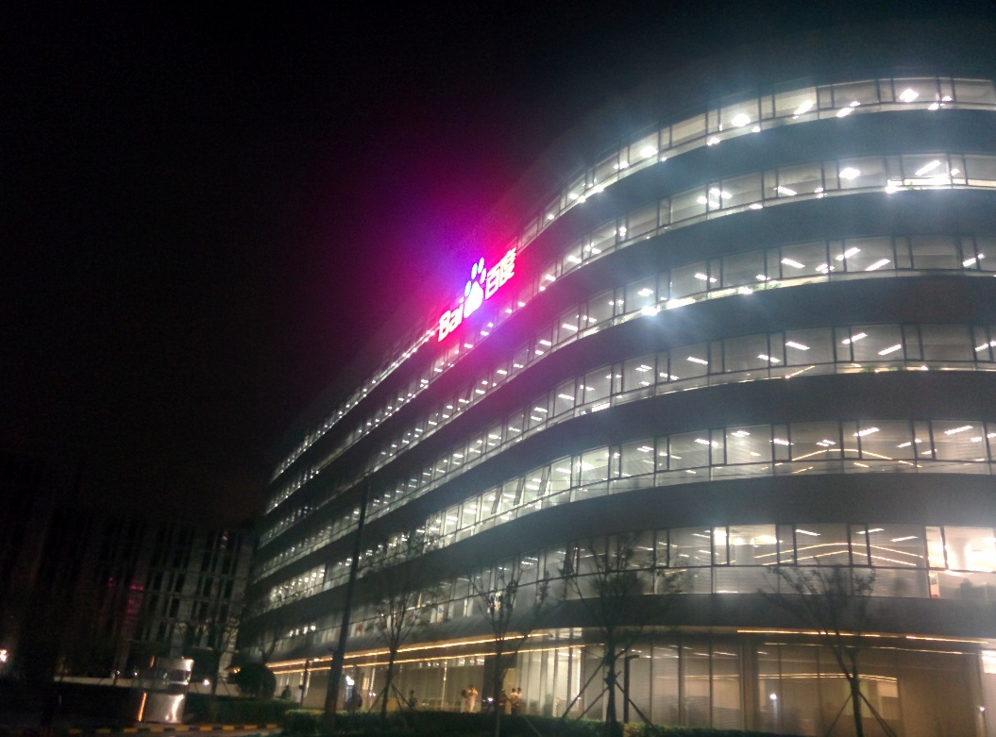

Slide 36
感谢
指导人： 董大祥
LegoNet 小组
整个 NLP-SC 团队

