Slide 1
ZeroVM package manager/bundler
Muharem Hrnjadovic
Rackspace International
@al_maisan

Slide 2
what's this about?
binary package (zar):
  ZeroVM application/executable
  library
  Runtime/binary
zpm geared towards application devs
zars can live anywhere
Initial focus on Python

Slide 3
features
Start new zar project
Bundle/unbundle zars
Publish zar to registry
List/search zars in registry
Manage zar dependencies (transitive)
Checksum/sign zars

Slide 4
What do we need?
Workspace specification
zar specification
zvsh support
Zebra support
zpm implementation

Slide 5
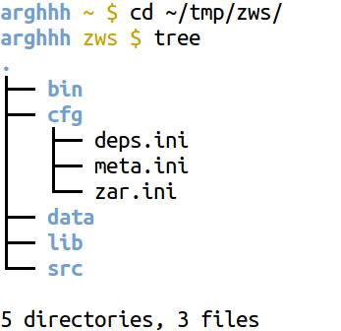
workspace specification

Slide 6
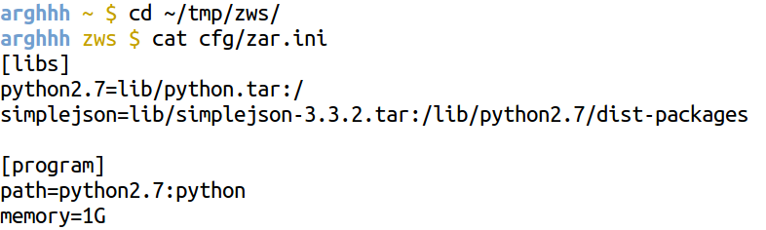
zar.ini

Slide 7
zar metadata
Name
Version
Summary
Description
Keywords
Home-page
Author-email
License
Classifier
Metadata-Version
http://www.python.org/dev/peps/pep-0314/

Slide 8
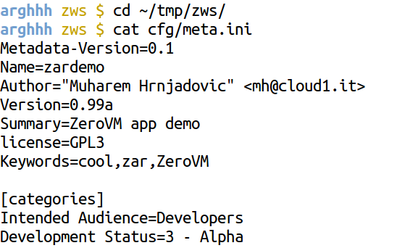
metadata example

Slide 9
zar specification
tar archive of (selected portions) of the workspace
complete!
zars are always checksum'ed/signed
when uploaded to the registry
  zars are resigned with registry key

Slide 10
zpm --new
[--type app|lib|bin]
create workspace
populate with config templates

Slide 11
zpm --bundle
Produces signed binary package + zctl file
{name}-{version}.zar
{name}-{version}.zctl (checksums etc.)
src/ directory
  will be included by default
  can be omitted on demand

Slide 12
zpm --push
Publish zar to registry
Developer needs to register with registry beforehand
  Name, email, gpg key fingerprint

Slide 13
zpm --unbundle
Make sure checksum/signature is valid
Unpack the zar into a workspace

Slide 14
python cases
No dependencies
Pure python dependencies
Dependencies with C libs

Slide 15
How does it work?
Get/build any dependencies needed (with pip)
Tell zpm what should be bundled up (zar.ini)
  Python code → tar files
  static libs (*.a files) → relink python binary
Later: ready packaged libs/binaries from the registry
Relinking binaries: always ship all the *.o and *.a files

Slide 16


