Slide 1

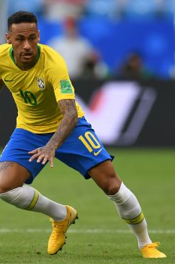



ETL Project: FIFA 2018 Team Analysis
Gretchen Anderson, Ludmilla Garcia, Ashish Kumar, Richard Lee, Jamal and Charles

Slide 2
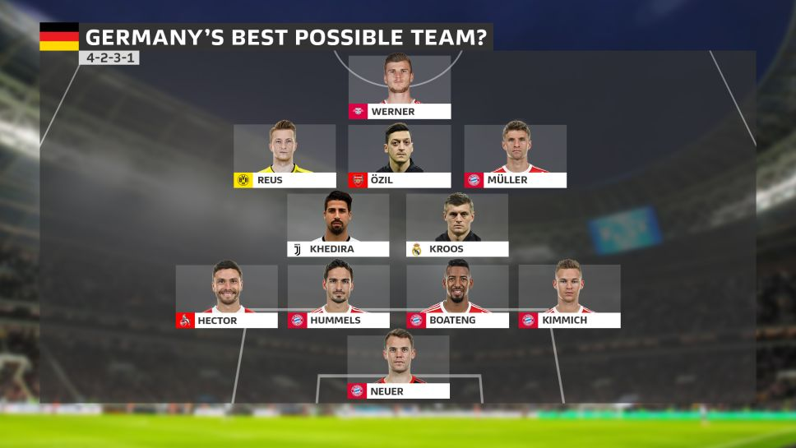
Project Proposal
Calculate the Players overall score of each team and compare it to the number of team’s wins in FIFA.
Sources : Kaggle.com
1) FIFA 2018 world cup results
2) Complete Dataset of all Players
3) World Cup 2018 Players

Slide 3

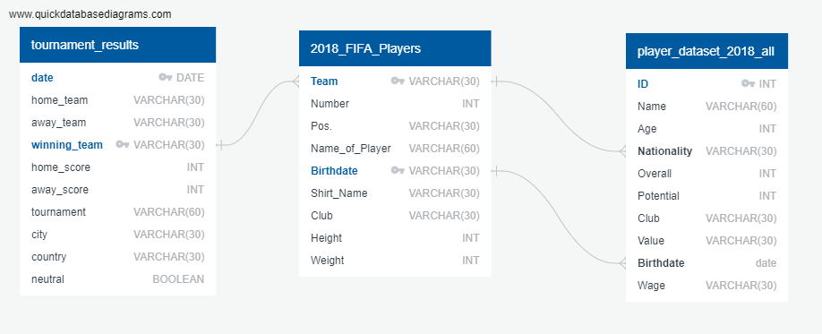
Data Modeling

Slide 4
Steps Involved- ETL Process
Importing the data into Pandas from 3 csv files
Data Cleaning
Selecting only the players that played for the world cup with their overall scores
Calculating the number of wins for each country
Merging the two datasets with final dataset resulting in nation with their players score and number of wins.

Slide 5
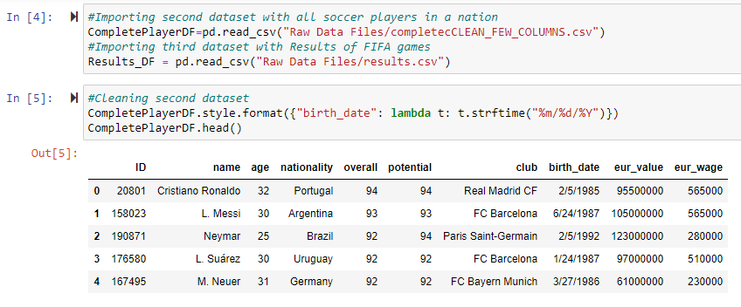
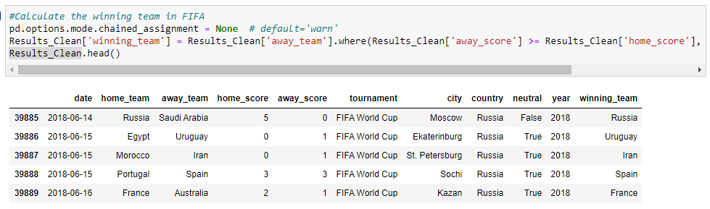

Slide 6
Data Cleaning
Selecting just the fields required for our analysis
Picking 2018 as the year for information on players overall score
Changing the Birth date format so its consistent
Removing duplicates if any
Changing column titles for consistency
Replacing country names such as “IR Iran” to “Iran”

Slide 7
Merging Data
Performed left join between WC_Player and CompletePlayer on nationality and birthdate. Now we have the world cup players and their performance score.
Group by players based on their nationality and add their score.
The resulting dataset is joined with our FIFA dataset which has number of wins by country.

Slide 8
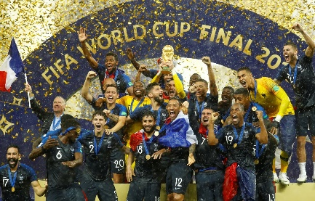
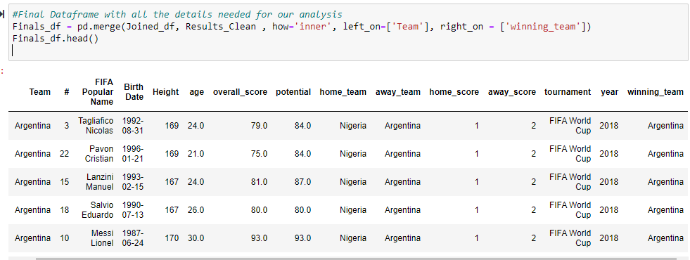
Final Dataset

Slide 9
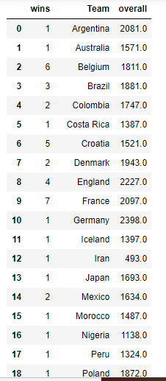
Analysis

Slide 10
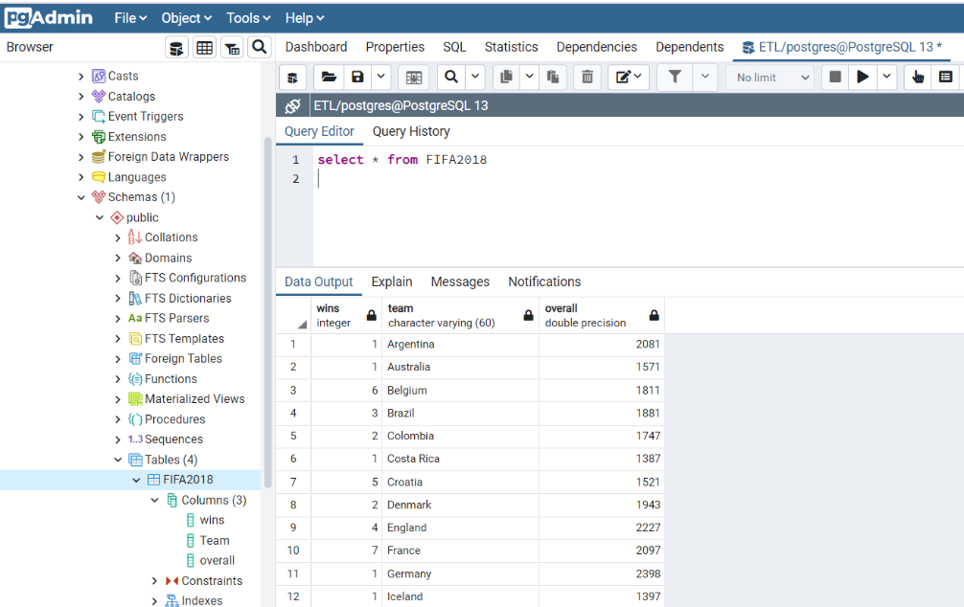
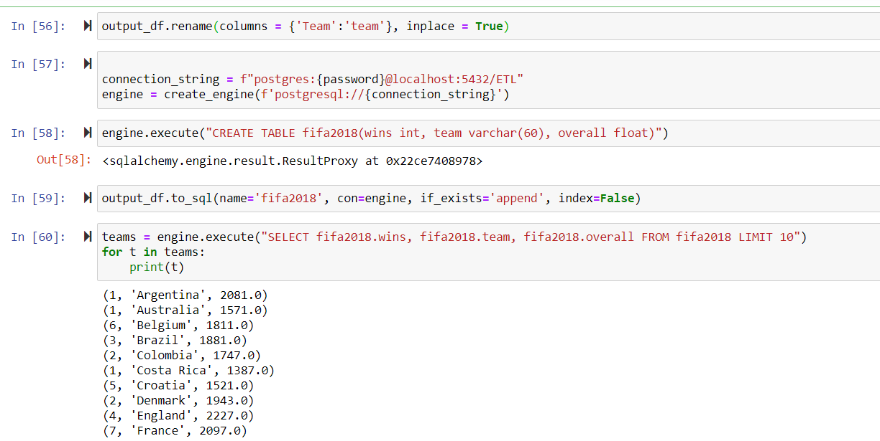
Loading into PostgresSQL

Slide 11
Challenges
Formatting player names to match
Splitting the ‘name_of_player’ column in the 2018_Fifa_players table into first, middle, and last name
Realized this was too difficult, moved on to joining based on birthdate. Some players had special characters in their name which were present in one data source but not the other.
Not all players were found in all datasets
Joining by nationality and birthdate was not unique so we had to drop few countries from our analysis

