Slide 1






Social Media Usage and Its Impact on Society

Slide 2

Social Media and Mental Health
It is believed that social media can cause anxiety and depression.
How much of an impact does social media have in a society?
(Getty Images)
Notes:
-social media is proved to cause anxiety and depression in society

Slide 3
Decompose the Ask
Are the negative impacts of social media leading people to commit suicide?
Is there a correlation between suicide rate and media usage?
What metrics can we use to measure social media?
Which social media platforms are the most representative? Considerations?
Who?
Focus?
United States
Demographic breakdown
Age, gender, generation

Slide 4



Identify Data Sources
https://www.kaggle.com/datasets
https://ourworldindata.org/
https://sproutsocial.com/insights/new-social-media-demographics

Slide 5
Define Strategy and Metrics
Strategy:
Start with a high-level overview
Drill down to find answers to our questions
Metrics:
Social media usage metrics
Average monthly users per year
Suicide rate
Suicides per 100K Population
Society
Narrow down to gender, age group and country

Slide 6
Build Data Retrieval Plan
Kaggle
Found a CSV file of suicide rate for 101 Countries from 1995 to 2016. The table included demographic data.
OurWorldinData
Website has a CSV file that showed average monthly users for 19 different social media sites per year from 2002 – 2019.

Slide 7
Retrieve Plan
Utilize pandas to save and manipulate data
Utilize Python to select representative data
Use Matplotlibs to plot information
Pull information about suicide rates by country and demographics to analyze
Social media Usage- pull number users by platform and clean

Slide 8

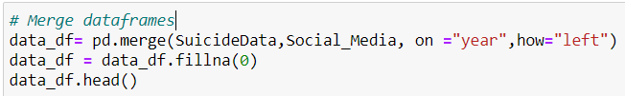
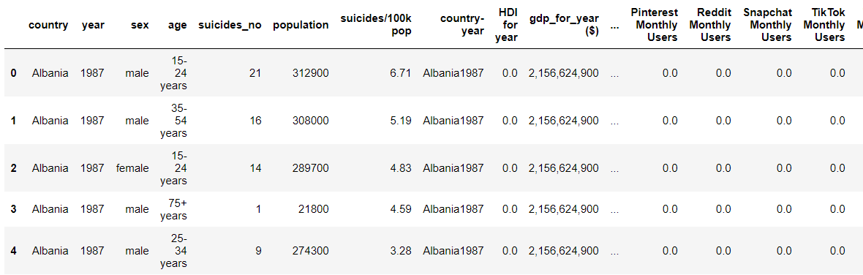
Assemble and clean data
Notes:
Table has more columns that are not shown

Slide 9
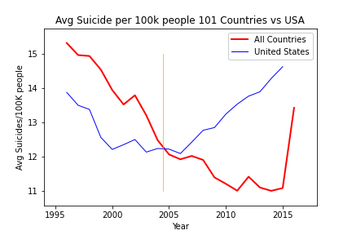





Analyze for Trends
Suicides trend was going down for the United States and other (101)Countries from 1995 up to mid 2004. The United States made a turn and started trending upwards while other countries kept their downward trend.
What happened?
Social Media Timeline
Facebook Started
YouTube
Twitter
Facebook Popular
2004
2005
2006
2008
2010

Slide 10
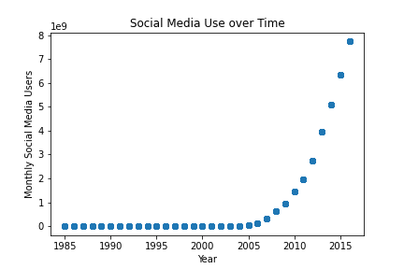
Analyze for Trends
Social media use increased exponentially starting around 2009.

Slide 11
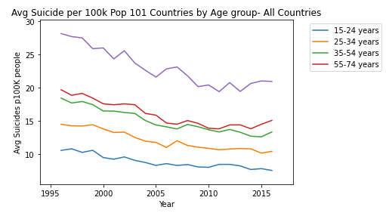
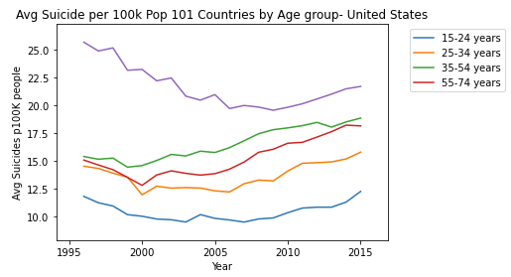
Analyze for Trends
Suicide /100k people by Age Group. Comparing United States with other Countries.

Slide 12
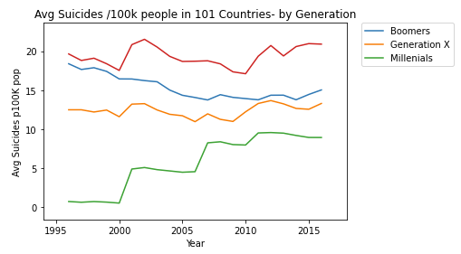
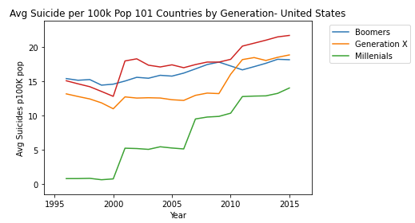
Analyze for Trends
Suicide /100k people by Generation. Comparing United States with other Countries.
Generation | Oldest Age | Youngest | Age in 2005
 | Today* | Age Today*
The Silent Generation | 75 | 95 | (80 ,60)
Boomers | 56 | 74 | (59 ,41)
Gen X | 41 | 55 | (40 ,26)
Millennials | 26 | 40 | (25 ,11)

Slide 13
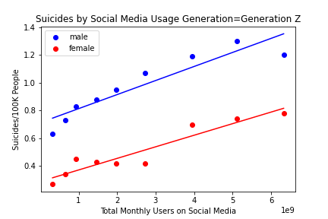
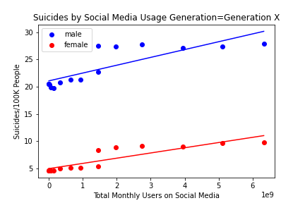
Analyze for Trends
Excluding everything prior to the start of our social media data, Generation Z and Generation X showed the highest correlation factors.
Generation Z
Correlation:
Male = 0.93
Female = 0.95
R-squared
Male = 0.86
Female = 0.9
Generation X
Correlation:
Male = 0.83
Female = 0.88
R-squared
Male = 0.69
Female = 0.78

Slide 14
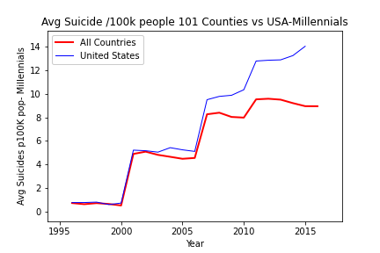
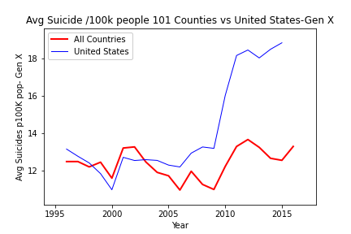
Analyze for Trends
Millennials and Gen X- United States Vs All Countries

Slide 15
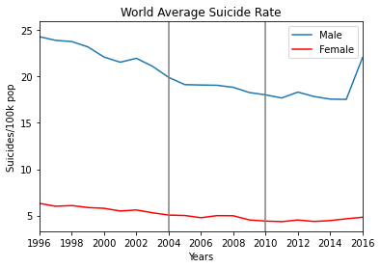
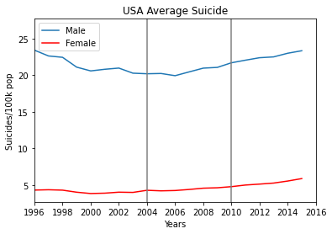
Analyze for Trends
Average Suicide Rate for the World and the USA based on Gender.

Slide 16
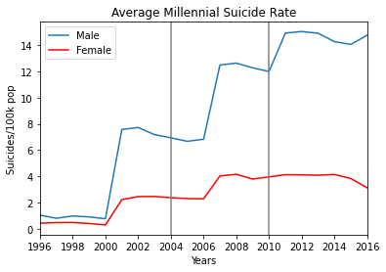
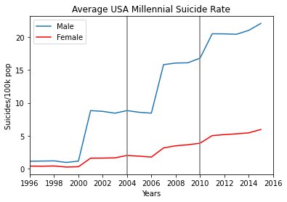
Analyze for Trends
Breakdown of Millennial data based on gender.

Slide 17
Acknowledge Limitations
Even though there may be a correlation in the data, there are many other factors that impact Suicide rates in a society that is not part of the scope in this project.
Gen z Data-
We did not include this generation because there is very limited data for it. Which could be misleading

Slide 18
Conclusions
There are numerous psychological studies that link social media with anxiety and depression. However, with the information presented in this project the effects of social media might be taking a fatal toll in the United States
While other countries suicide rates are trending down, the United States is going up since the introduction of Social Media. And based on our data it may be increasing at an even greater rate for younger generations.
Suicides in males are more prevalent than in females, access to social media might be a factor.
The correlation coefficient analysis of the two main variables supports our hypothesis, that social media is leading to a higher number of suicides in the United States.

