Slide 1
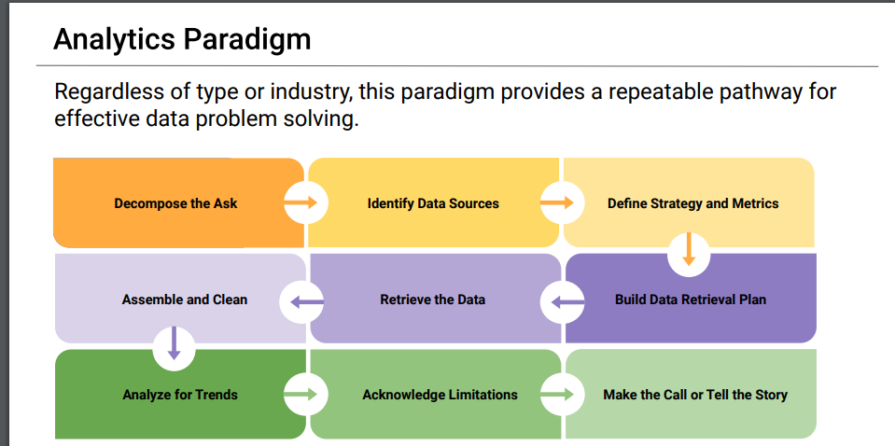

Slide 2

Social Media Usage impact in Society

Slide 3

Sad face -
(Getty Images)
Notes:
-social media is proved to cause anxiety and depression in society

Slide 4
Decompose the Ask
Step 1
Is the negative impact of social media leading people to commit suicide?
Is there a correlation between suicide rate and media usage
What can be a Social Media usage metric?
Which are the more representative Social Media platform? Should be consider just one platform or all
Who is Society?
Which countries seem to show higher impact by social media?
United States
Is it different by group age/generation?
Is it different by gender?

Slide 5



Identify Data Sources
Step 2
Data Sources available
https://www.kaggle.com/datasets
https://ourworldindata.org/
https://sproutsocial.com/insights/new-social-media-demographics

Slide 6
Define Strategy and Metrics
Step 3
Blueprint
Strategy: high level ->drill down to find answers to our questions
Metrics:
Social Media usage metrics: average monthly users per year
Suicide Rate
Society: Narrow down to gender, age group and Country

Slide 7
Build Data Retrieval Plan
Step 4
Kaggle. Found a CSV file of suicide rate for 101 Countries from 1985 to 2016. The table includes some demographics data.
OurWorldData website had statistics about media users by year.

Slide 8
Retrieve Plan
Utilize pandas to save and manipulate data
Utilize Python to select representative data
Use Matplotlibs to plot information
Pull information about suicide rates by country and demographics to analyze
Social media Usage- pull number users by platform and clean
Step 5

Slide 9

Assemble and clean data
Step

Slide 10
Analyze for Trends
Step

Slide 11
Analyze for Trends
Step

Slide 12
Acknowledge Limitations
Step

Slide 13
Conclusions
Step

