Slide 1
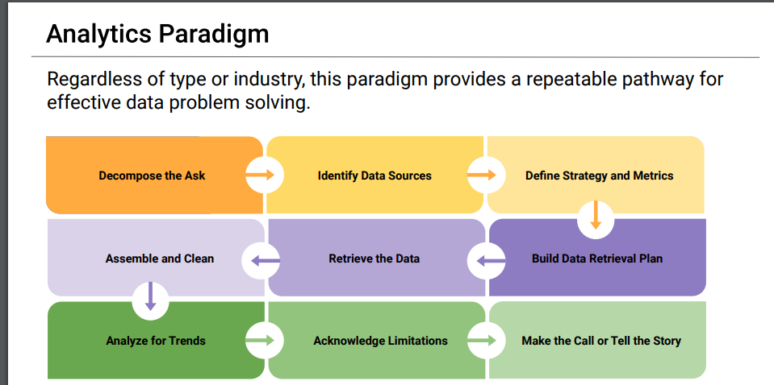

Slide 2


Social Media Usage impact in Society

Slide 3
Decompose the Ask
Step 1
What can be a Social Media usage metric?-users
Which are the more representative Social Media platform? Should be consider just one platform or all
Which variable can be used to prove impact in society
Who is Society?
Which countries seem to show higher impact by social media? R square between users and suicide rate
Is it different by group age?
Is it different by gender?

Slide 4



Identify Data Sources
Step 2
Data Sources available
https://www.kaggle.com/datasets
https://ourworldindata.org/
https://sproutsocial.com/insights/new-social-media-demographics

Slide 5
Define Strategy and Metrics
Step 3
Blueprint of target
Social Media usage metrics: number of users
Social Media Platform: Most popular to avoid duplicative data??? Or all together
Variable that can be link to usage of Social Media: Suicide Rate
Society: Narrow Countries based on correlation to Suicide Rate data (r-square)

Slide 6
Build Data Retrieval Plan
Step 4
Social Media usage metrics: users
Social Media Platform: Most popular to avoid duplicative data??? Or all together
Variable that can be link to usage of Social Media: Suicide Rate
Society: Narrow Countries based on correlation to Suicide Rate data (r-square)
Drill down to demographics: Gender and age group

Slide 7
Retrieve Plan
Jupyter
Utilize pandas to save and manipulate data
Utilize Python to select representative data
Use Matplotlibs to plot information
Countries
Pull information about suicide rates by country and calculate r2 to select representative countries to analyze
Social media Usage- pull number users by platform and clean
Step 5

Slide 8
Assemble and clean data
Step

Slide 9
Analyze for Trends
Step

Slide 10
Analyze for Trends
Step

Slide 11
Acknowledge Limitations
Step

Slide 12
Conclusions
Step

