Slide 1
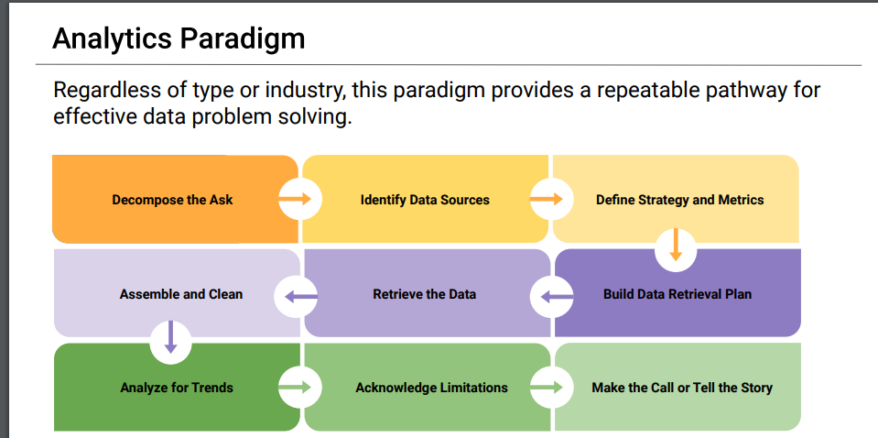

Slide 2






Social Media Usage and Its Impact on Society

Slide 3

Social Media and Mental Health
It is proven that social media can cause anxiety and depression.
How much of an impact does social media have on society?
(Getty Images)
Notes:
-social media is proved to cause anxiety and depression in society

Slide 4
Decompose the Ask
Is the negative impact of social media leading people to commit suicide?
Is there a correlation between suicide rate and media usage?
What can be a Social Media usage metric?
Which are the more representative social media platform? Should be consider just one platform or multiple platforms?
Who is Society?
Which countries seem to show higher impact by social media?
United States
Is it different by group age/generation?
Is it different by gender?

Slide 5



Identify Data Sources
https://www.kaggle.com/datasets
https://ourworldindata.org/
https://sproutsocial.com/insights/new-social-media-demographics

Slide 6
Define Strategy and Metrics
Strategy:
Start with a high-level overview
Drill down to find answers to our questions
Metrics:
Social media usage metrics
Average monthly users per year
Suicide rate
Suicides per 100K Population
Society
Narrow down to gender, age group and country

Slide 7
Build Data Retrieval Plan
Kaggle
Found a CSV file of suicide rate for 101 Countries from 1985 to 2016. The table includes some demographics data.
OurWorldData
Website had a CSV file that showed average monthly users for 19 different social media sites per year from 2002 – 2019.

Slide 8
Retrieve Plan
Utilize pandas to save and manipulate data
Utilize Python to select representative data
Use Matplotlibs to plot information
Pull information about suicide rates by country and demographics to analyze
Social media Usage- pull number users by platform and clean

Slide 9

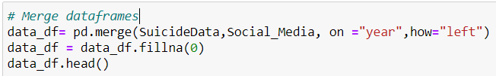
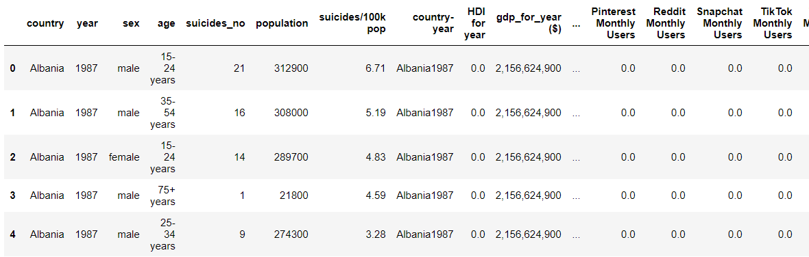
Assemble and clean data
Notes:
Table has more columns that are not shown

Slide 10
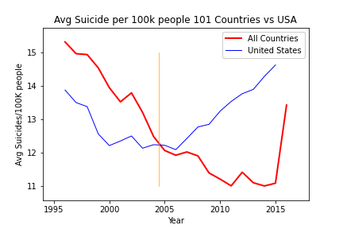





Analyze for Trends
Suicides trend was going down for United States and other Countries (101) from 1995 up to mid 2004, when United States made a turn and trend started going up while other countries kept their down trending numbers.
What happened?
Social Media Timeline
Facebook Started
YouTube
Twitter
Facebook Popular
2004
2005
2006
2008
2010

Slide 11
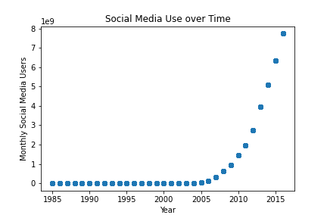
Analyze for Trends
Social media use increased exponentially starting around 2016.

Slide 12
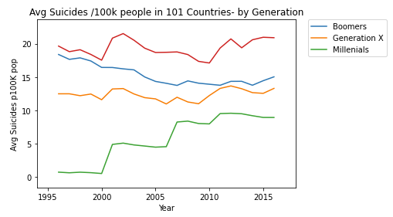
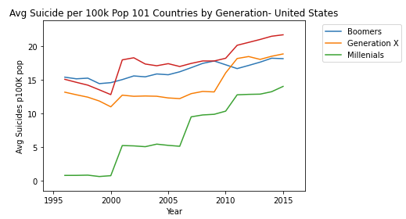
Analyze for Trends
Suicide /100 k people by Generation. Comparing United States with other Countries.
Generation | Oldest Age | Youngest | Age in 2005
 | Today* | Age Today*
The Silent Generation | 75 | 95 | (80 ,60)
Boomers | 56 | 74 | (59 ,41)
Gen X | 41 | 55 | (40 ,26)
Millennials | 26 | 40 | (25 ,11)

Slide 13
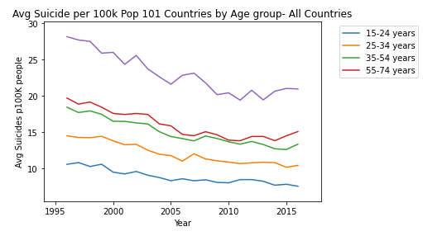
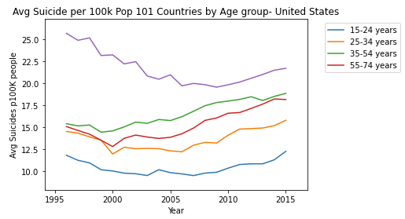
Analyze for Trends
Suicide /100 k people by Age Group. Comparing United States with other Countries.

Slide 14
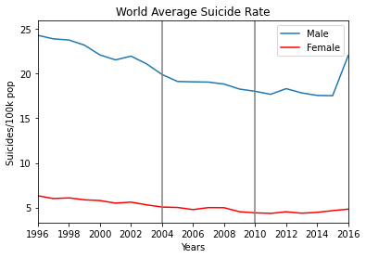
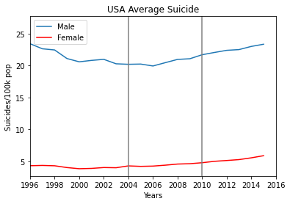
Analyze for Trends
Average Suicide Rate for the World and the USA based on Gender.

Slide 15
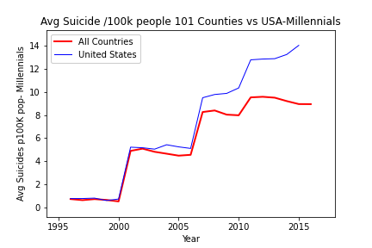
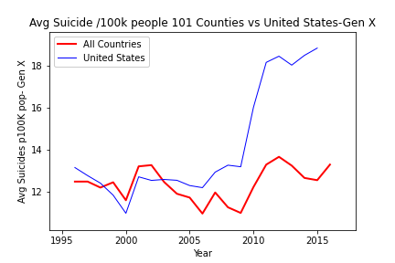
Analyze for Trends
Close Up Millennials

Slide 16
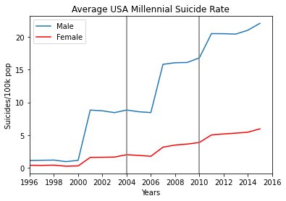
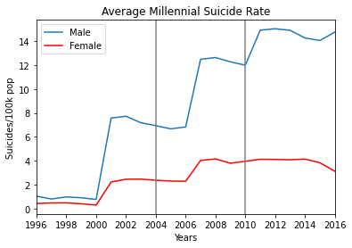
Analyze for Trends
Close Up Millennials based on gender.

Slide 17
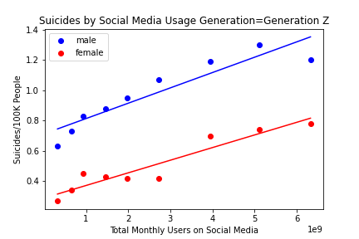
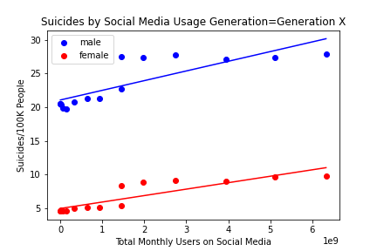
Analyze for Trends
Excluding everything prior to the start of our social media data, Generation Z and Generation X showed the highest correlation factors.
Generation Z
Correlation:
Male = 0.93
Female = 0.95
R-squared
Male = 0.86
Female = 0.9
Generation X
Correlation:
Male = 0.83
Female = 0.88
R-squared
Male = 0.69
Female = 0.78

Slide 18
Acknowledge Limitations
Even though there is trend and correlation of Suicide Rates and Usage or Social Media, there are other many factors that impact Suicides in a society that are not part of the scope of this project.

Slide 19
Conclusions
There are numerous psychological studies that link social media with anxiety and depression. With the information presented in this project the effects of social media might be taking a fata toll in United States

