Slide 1

Preventive maintenance of Propeller
By Ludovic Bocquillon

Slide 2
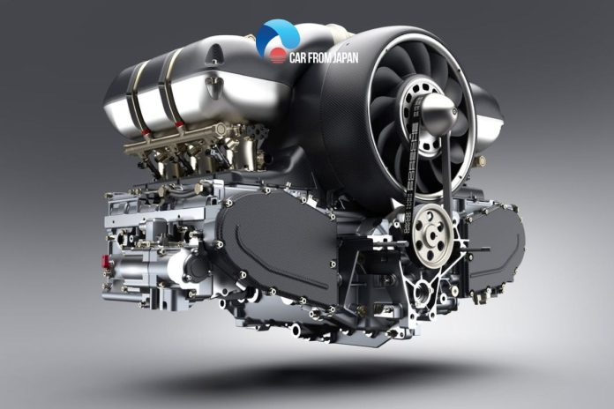
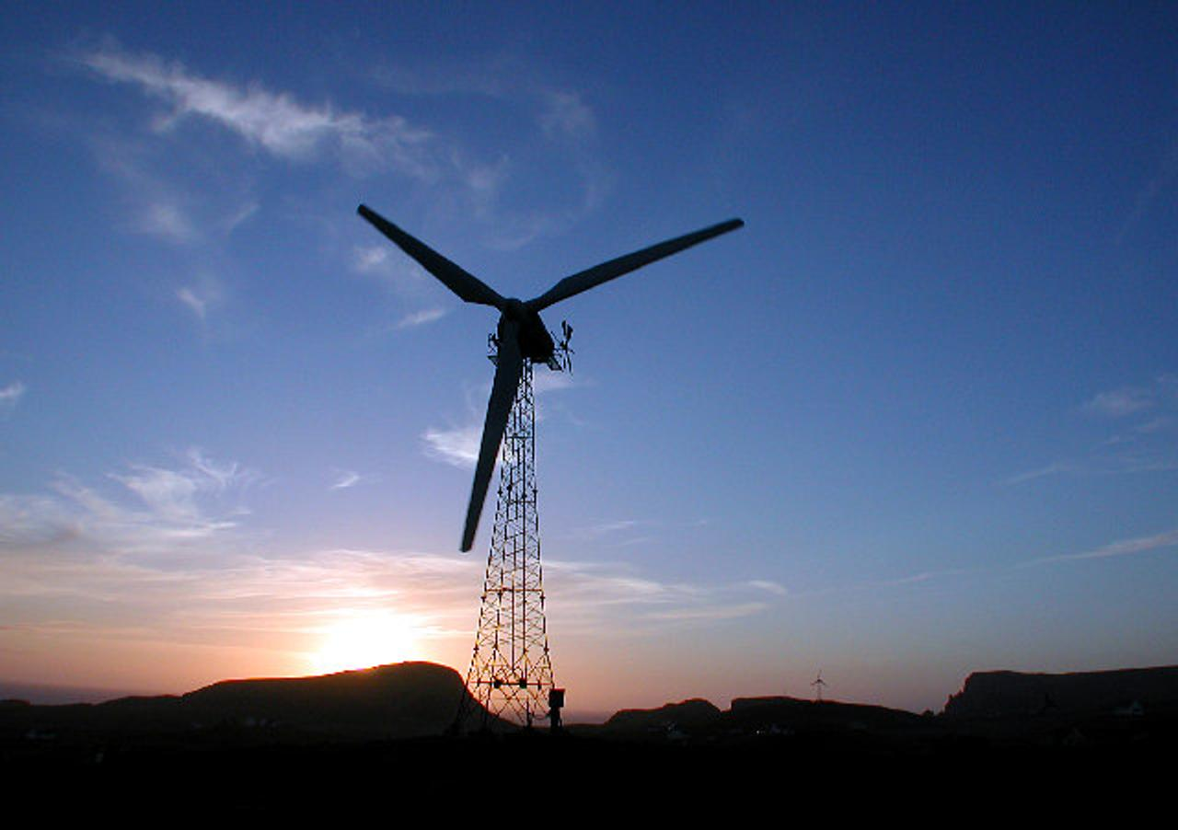
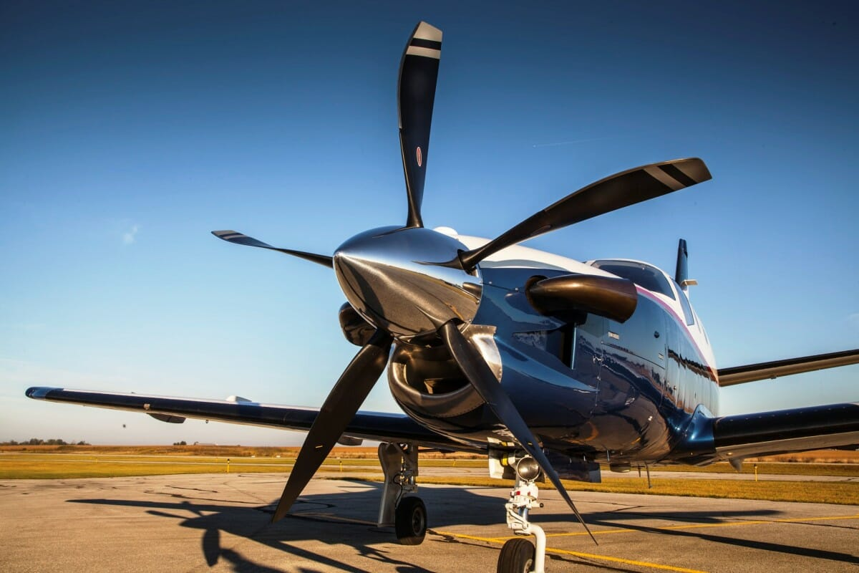



Business Case :
Vibration: "periodic oscillatory motion of an object around a central reference point"
Vibration analysis allows for the detection of defects in rotating machinery before they cause critical failures.
Detect
Identify
Predict

Slide 3
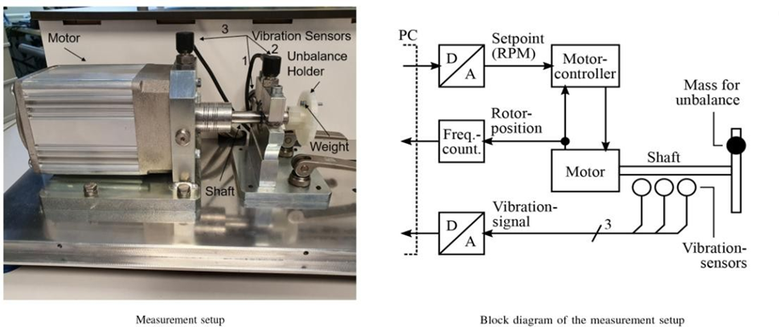
Setup & Objectives
Predict the imbalance level (wear-out / broken blade)
Linked to Academic course and Association project

Slide 4



Setup / Data collection
5 degrees of imbalance : 5 datasets
0 : no imbalance 1 : small imbalance 4 : strong imbalance
rotation speed varied between approx. 630 and 2330 RPM
sampling rate of 4096 values per second.

Slide 5
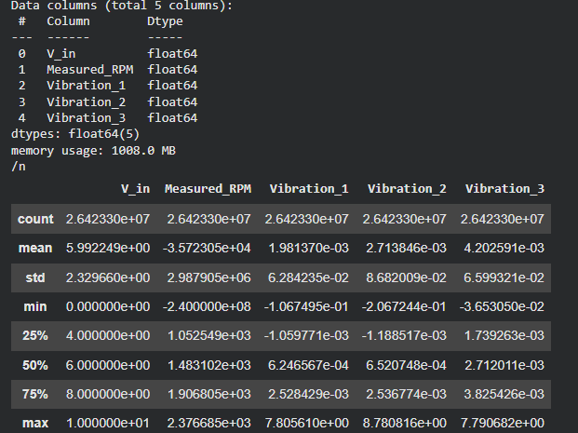
Dataset Exploration
V_in: Input voltage to the motor controller (V)
Measured_RPM: Rotor speed (RPM, computed from sensor measurements)
Vibration_1: Signal from the first vibration sensor
Vibration_2: Signal from the second vibration sensor
Vibration_3: Signal from the third vibration sensor

Slide 6
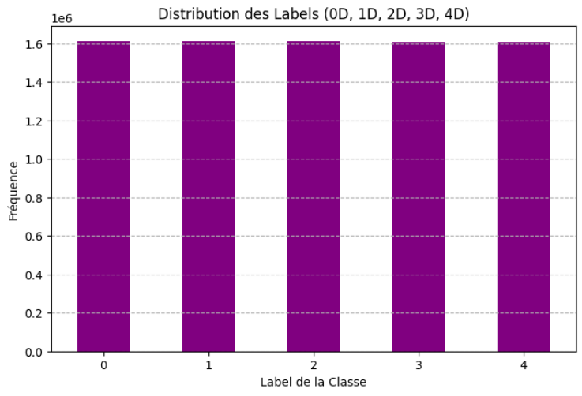
Outlier / Missing Value / Class Distribution
Problem Description | Solution
Outliers: "Measured_RPM" between [-24000;3400] while it should be approximately in [ 630; 2400] | Keep only the values in the admissible range
Missing Values : No missing Value | //
Label distribution : Homogeneous | //
Memory Limitation : too many lines, RAM issue | I took only a sample of each unique 'V_in' of each dataset The length of the sample is a user-chosen value

Slide 7
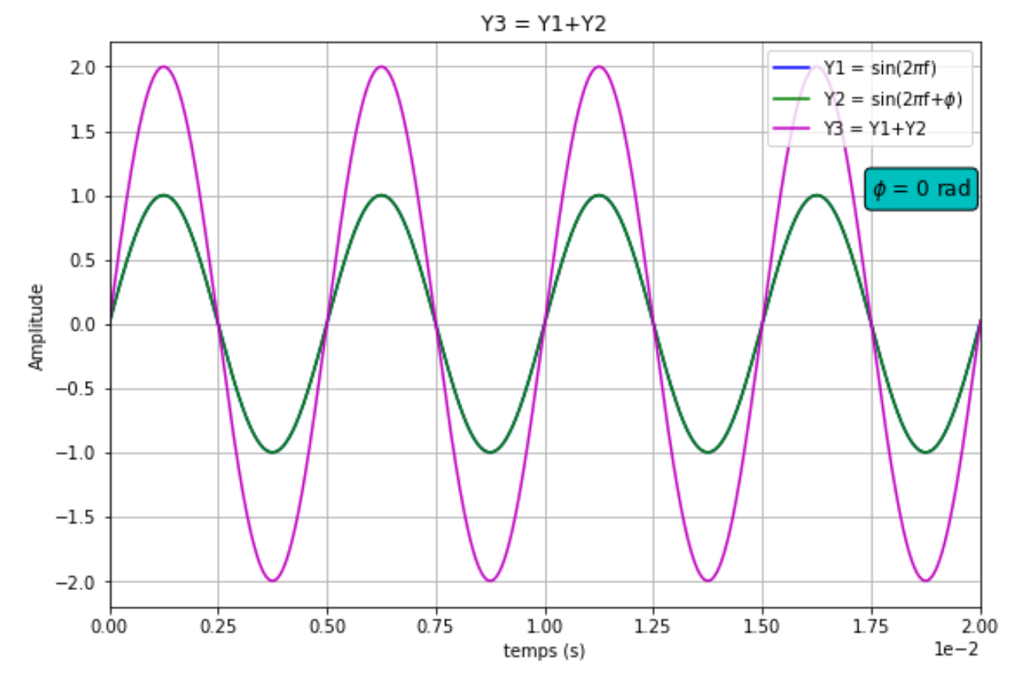
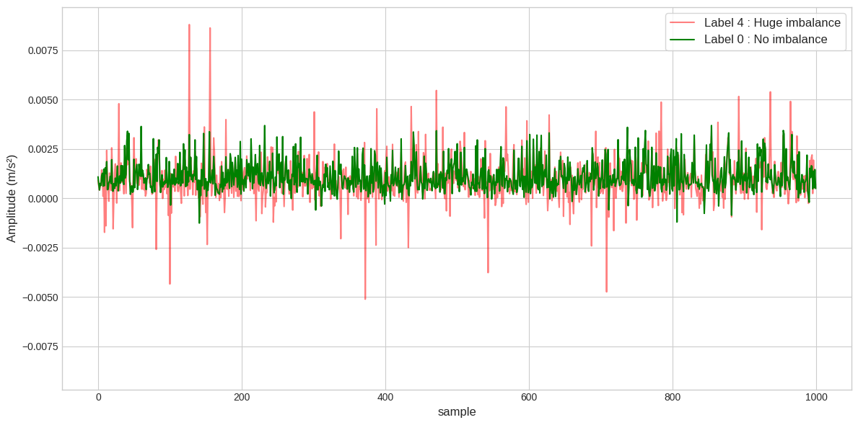
RAW Data Visualization
Vibration can normally be represented as a sinusoidal waveform.
Not always the case due to noisy data (assembly & measurement inaccuracies )
Expected
Obtained

Slide 8
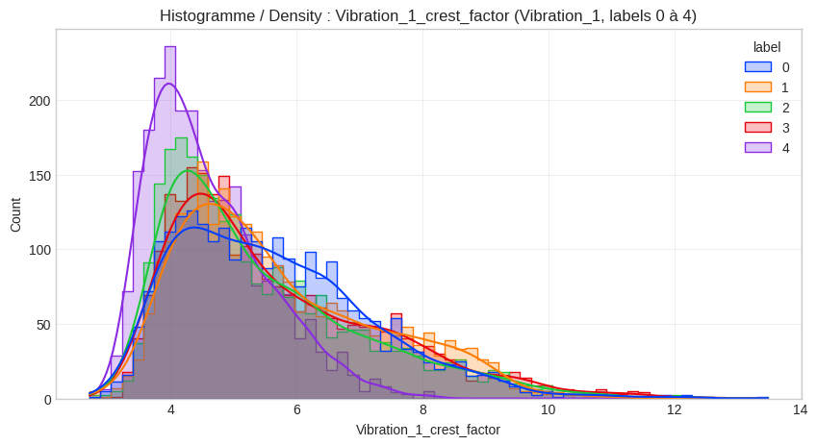
New Data visualization
We have to create new features such as the mean, the skewness, kurtosis …. to find valuable information on the signal
"Crest_Factor" measures the signal's impulsivity (e.g shock presence)
One might think that higher imbalance implies more shock implies higher Crest_Factor but it's not true. In fact, it might cause a centrifugal force which tend to make the signal smoother.
Either way, it's a great features to distinguish between label 4 and the other.

Slide 9
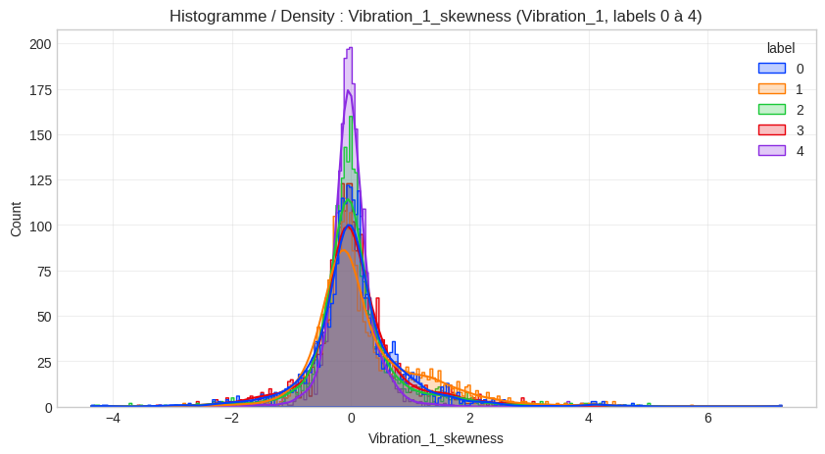
New Data visualization
Skewness is the asymmetry of the signal, and this graph confirms the latter as label 4 is more centered in 0 than the other.
Difference between Label 0 and 4 : Clear
Difference between label 0,1,2,3 : Subtle
XGBoost trained on these temporal feature :
Hit a plateau of 0.7 F-1 score

Slide 10

Small Recap of the model and score obtained
Until now, I used several algorithms on these temporal data :
Model | Accuracy | Weighted F1 | Trained on
Logistic Regression | 0.3457 | 0.3566 | Raw data
Random Forest | 0.5273 | 0.5514 | Raw data
XGBoost (x2) | 0.7546 | 0.7621 | Raw data / Raw data + new features
New features include :
Crest_Factor,
Skewness,
Kurtosis,
RMS,
Peak-to-Peak
Not all features were relevant to make graph but can still help XGBoost model

Slide 11
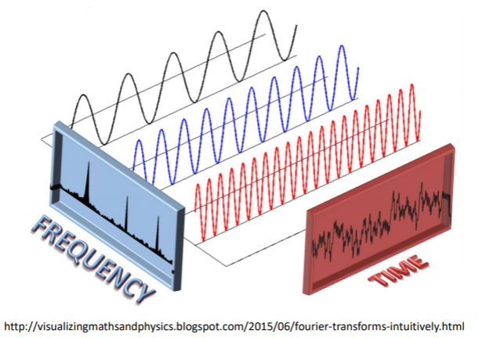
Popular solution
The FFT is a fast algorithm that converts a signal from the time domain to the frequency domain.
It decomposes a complex signal into a sum of simple sinusoidal waves.
It reveals invisible patterns in the raw signal like high oscillation and spectrum frequency pics.
Window Size : High ==> we know what but not when
L​​ow ==> we know when but not why
==> optimal empirical value N=650

Slide 12
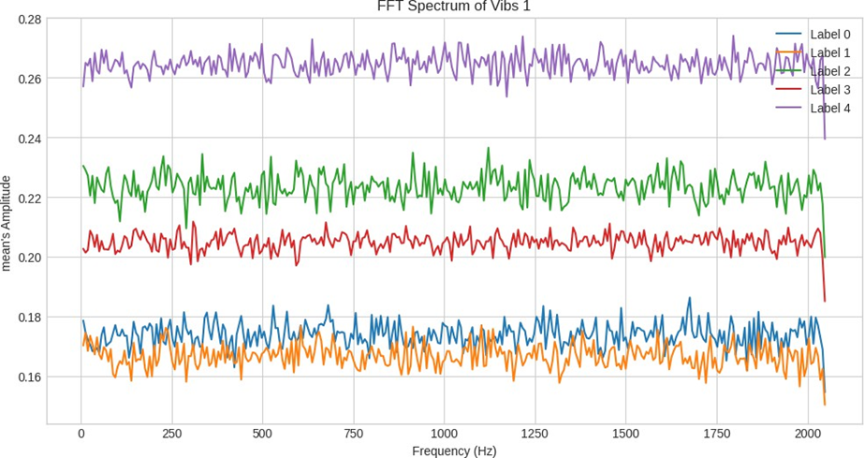
FFT Visualization
Thanks to the shift to the frequency domain, the analysis of the average amplitude spectrum as a function of frequency finally reveals a much clearer separation between the different levels of defect.

Slide 13
Overfitting and Optimisation
Temporal Feature ==> label 0,4
FFT Feature ==> 1,2,3
Standard Scaler ==> Scale issue between features
Max_depth [7,9,11] ==> depth of each tree
Learning_rate [0.05,0.1] ==> low value, lower overfitting risk
N_estimator [200,400] ==> lower learning rate require normally more iterations
GridSearch used to find optimal hyperparameters
The 2 domains are complementary

Slide 14
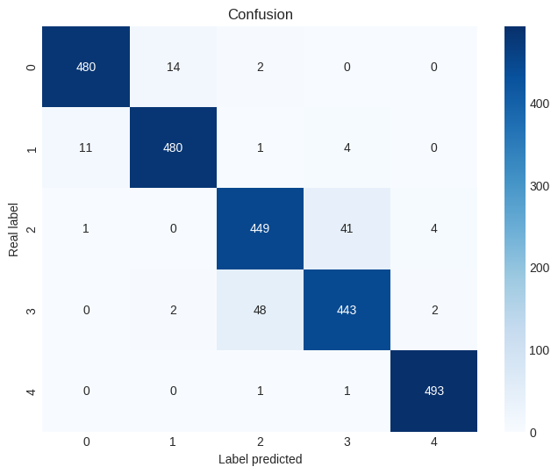
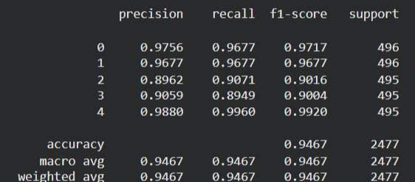
Final Result

Slide 15
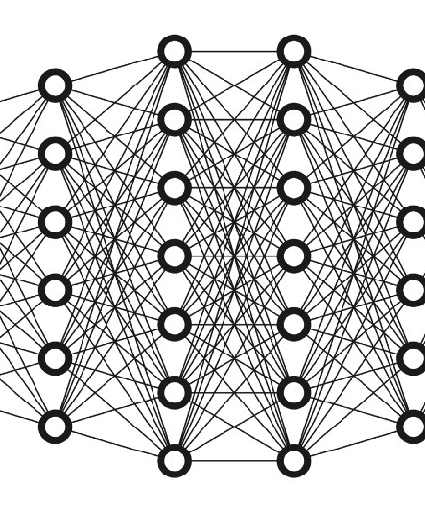
Limitations / possible tuning
analyse spectrale by Cepstrum : better isolate the defect harmonics in the noise.
Short-Time Fourier Transform (STFT) with sliding windows
Deep Learning (ANN etc...)

