Slide 1

Practicum 2: Monte Carlo simulation for SPECT

Slide 2
Practical information:
Work in groups of two (same groups as last week)
Hand in the notebook (in both .ipynb and .html format) via UFORA (UGent) or Canvas (VUB)
Deadline: in two weeks (1 November at 23:59)
For questions:
cathysse.thyssen@ugent.be
jens.maebe@ugent.be

Slide 3
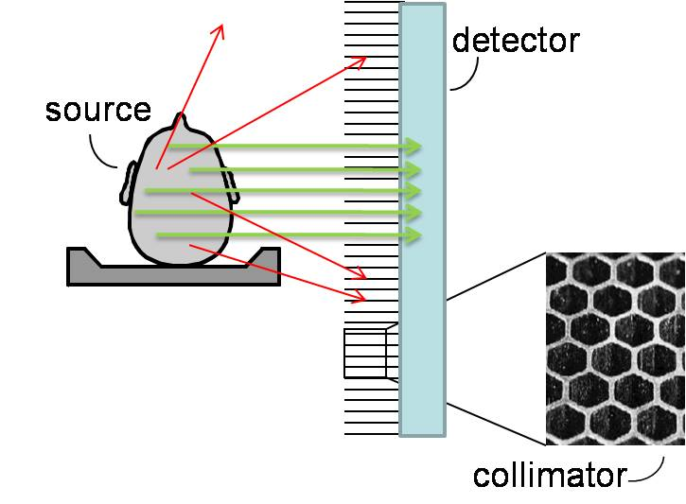
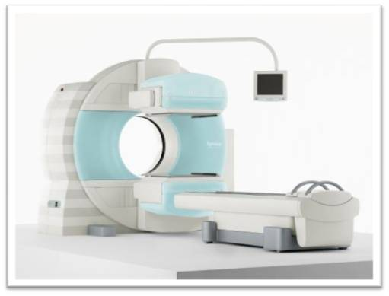
Background: SPECT camera

Slide 4

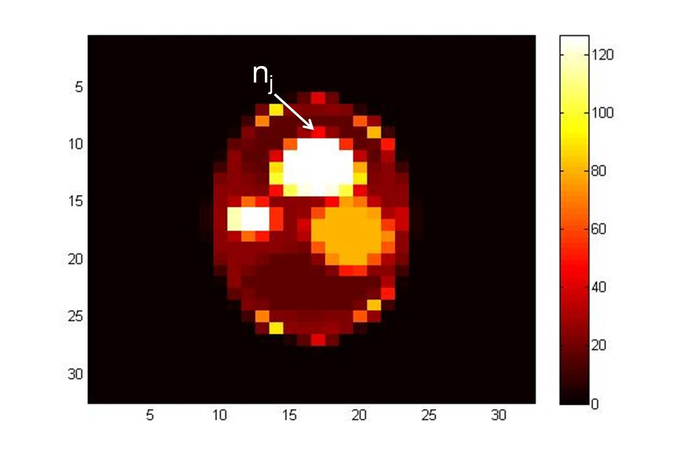
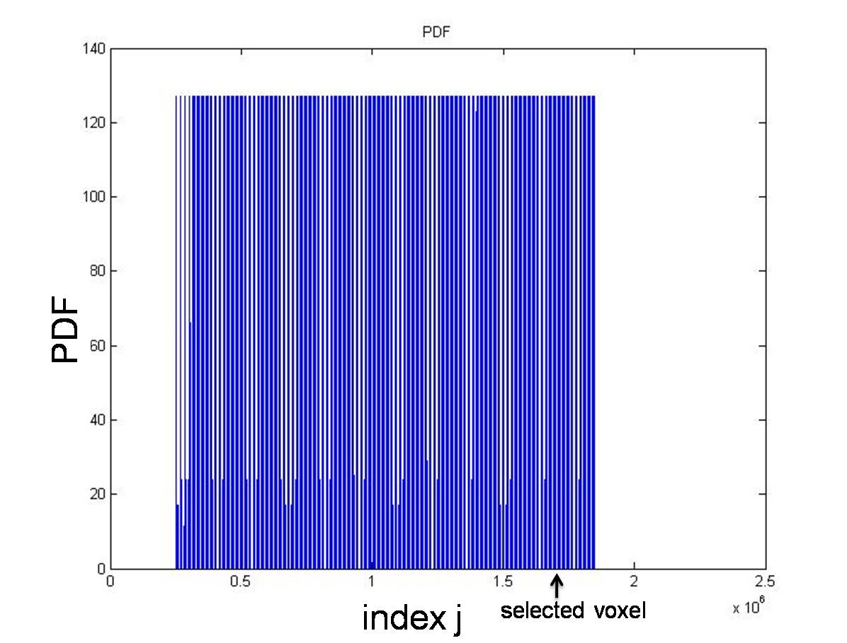
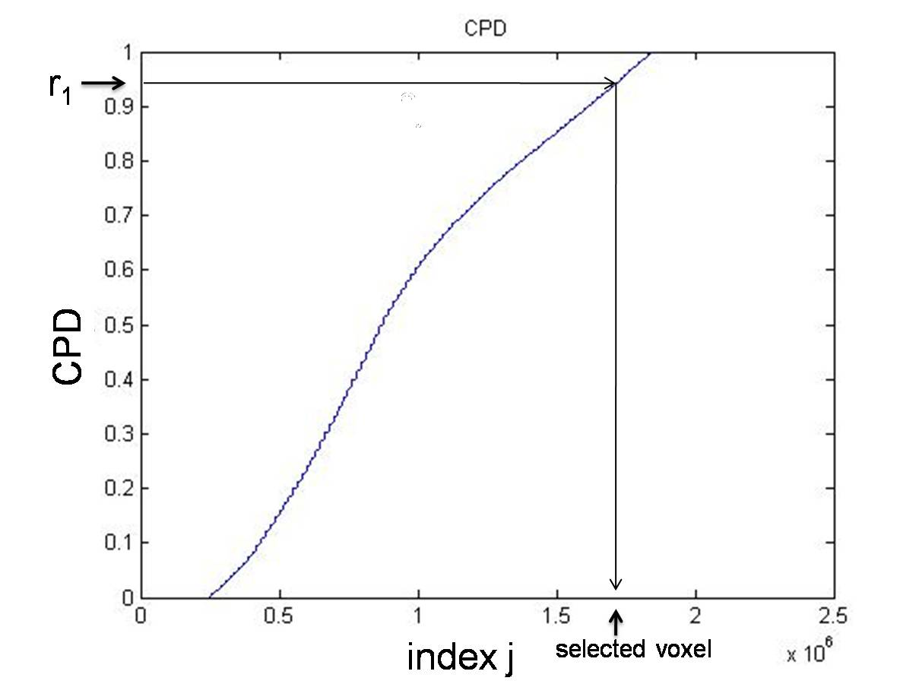
Monte Carlo simulation: part 1: sampling of the source
flatten
+ normalize
activity distribution
probability density function (PDF)
cumulative probability density (CPD)
=> A random number r₁ (0 < r₁ < 1) can be used to sample the source

Slide 5
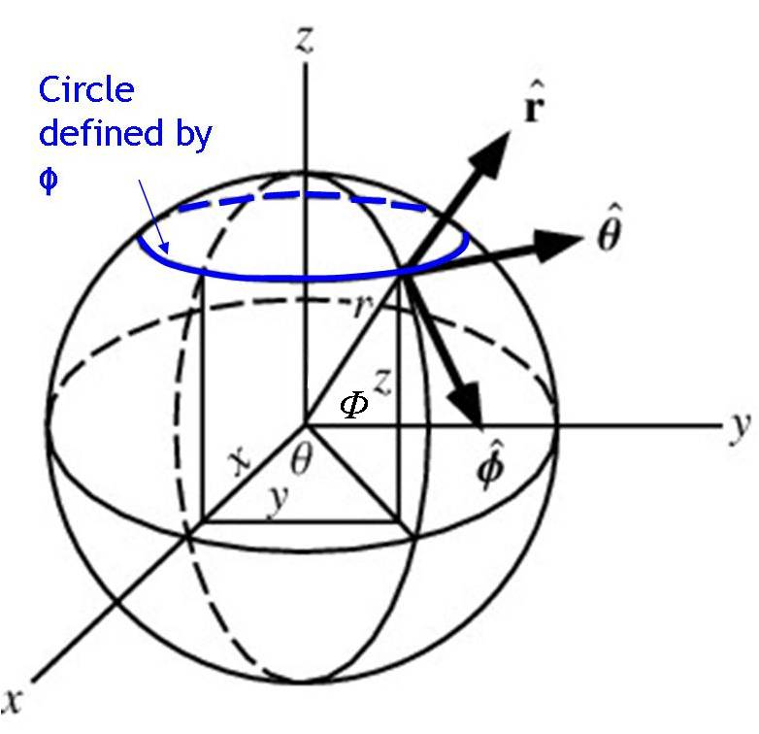


Monte Carlo simulation: part 2: simulating uniform emission
uniform (constant) PDF for θ:
PDF for ϕ should be proportional to the circumference of the circle defined by ϕ:

Slide 6
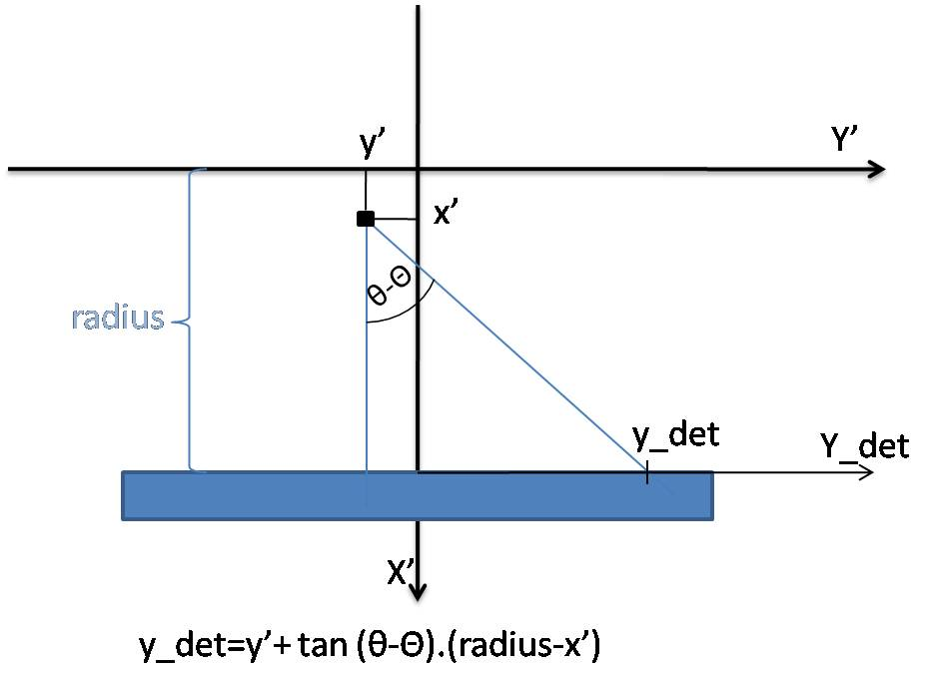
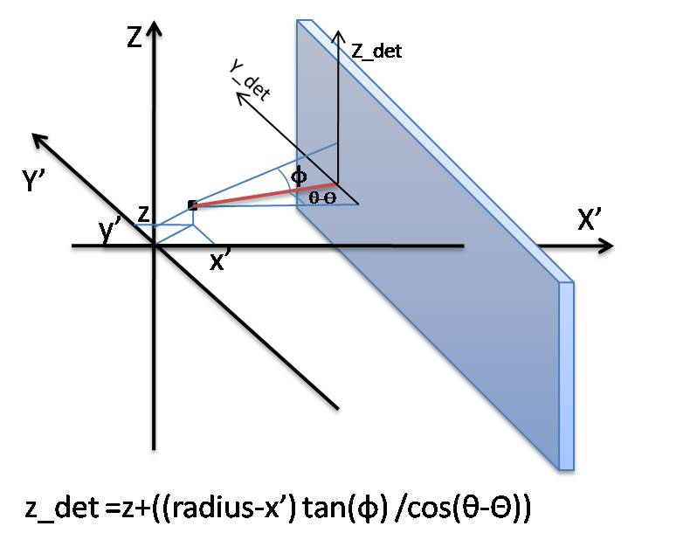
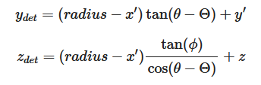

Monte Carlo simulation: part 3a: intersection with detector and collimator
Detector:
with

Slide 7
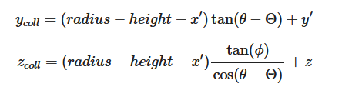
Monte Carlo simulation: part 3a: intersection with detector and collimator
Collimator:
with

Slide 8
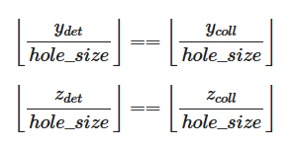
Monte Carlo simulation: part 3b: Check if the photon passed the collimator
For a parallel collimator:
Simply check if (y_{det}, z_{det}) and (y_{coll}, z_{coll})
lie within the same hole
=> Sinogram can be obtained from the sampled values of y_{det}, z_{det} and ϴ_{det}

Slide 9
Practicum:
Exercise 1:
Sample a given source and see how the obtained distribution changes for different numbers of samples.
Exercise 2:
Sample the emission angles θ and ϕ and check the impact of this sampling on the unit sphere for different values of θ and ϕ.
Exercise 3:
Perform a full Monte Carlo simulation for SPECT from start (a voxelized source) to finish (a 3D SPECT sinogram).

