Slide 1


A project by
Manuel Rigobello, Filippo Galli, Alessandro Leonardi, Ludovico Di Martino, Michele Scapinello

Slide 2
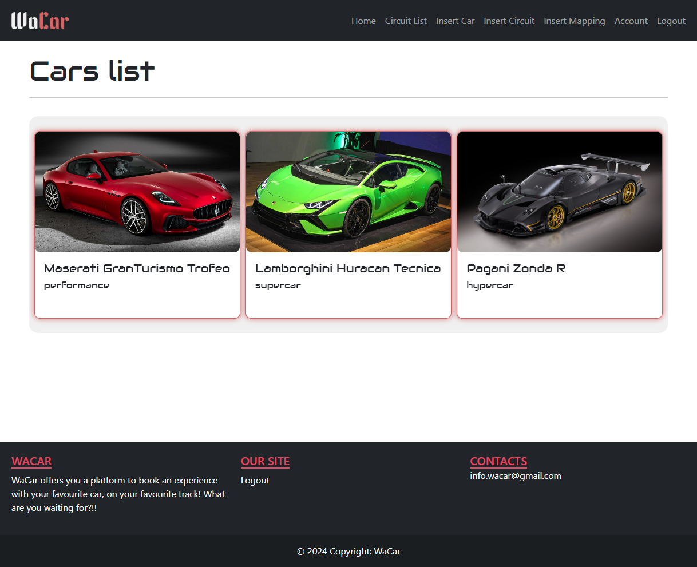
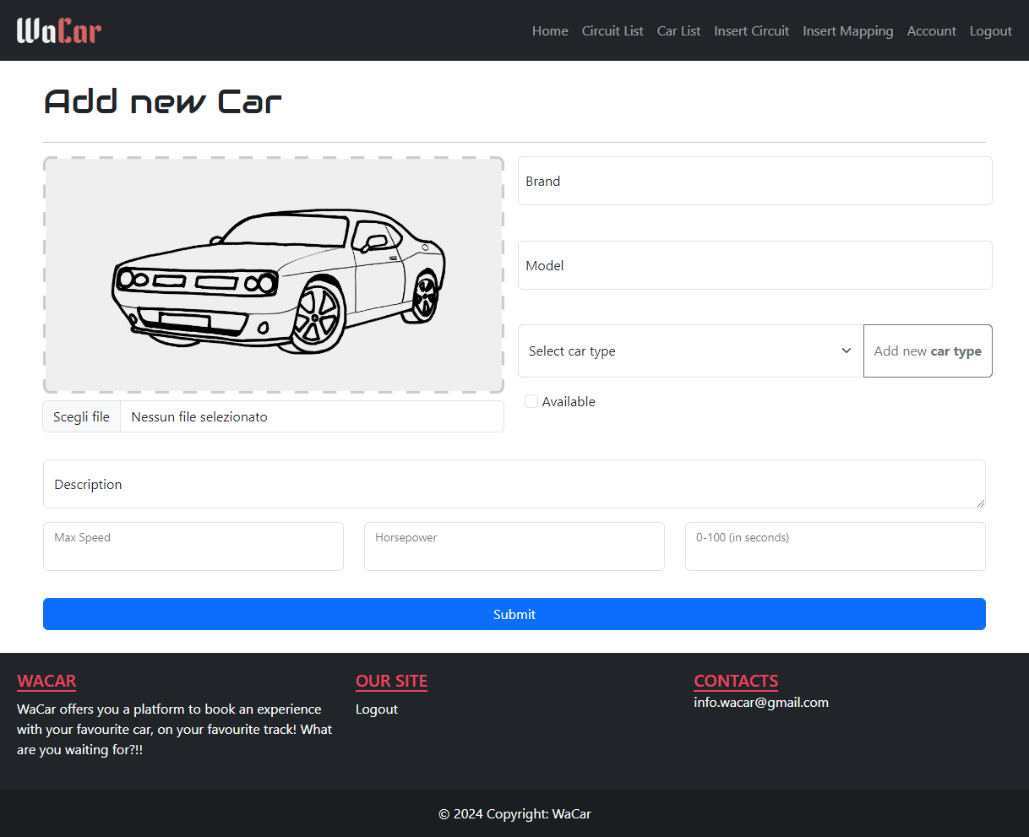



WaCar
CAR EXPERIENCE
MANAGEMENT SYSTEM

Slide 3
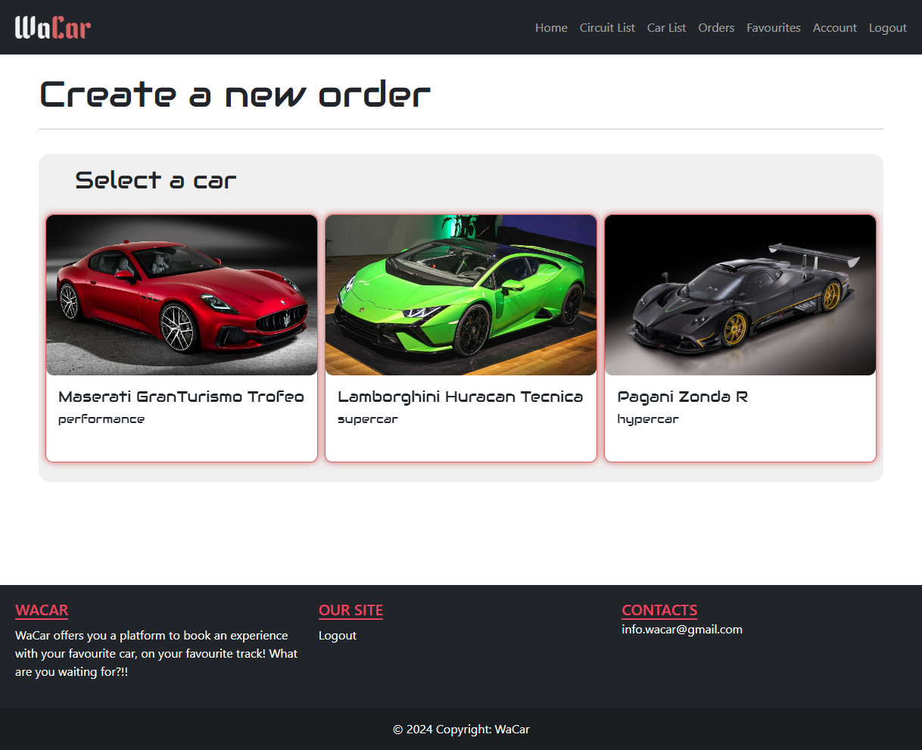
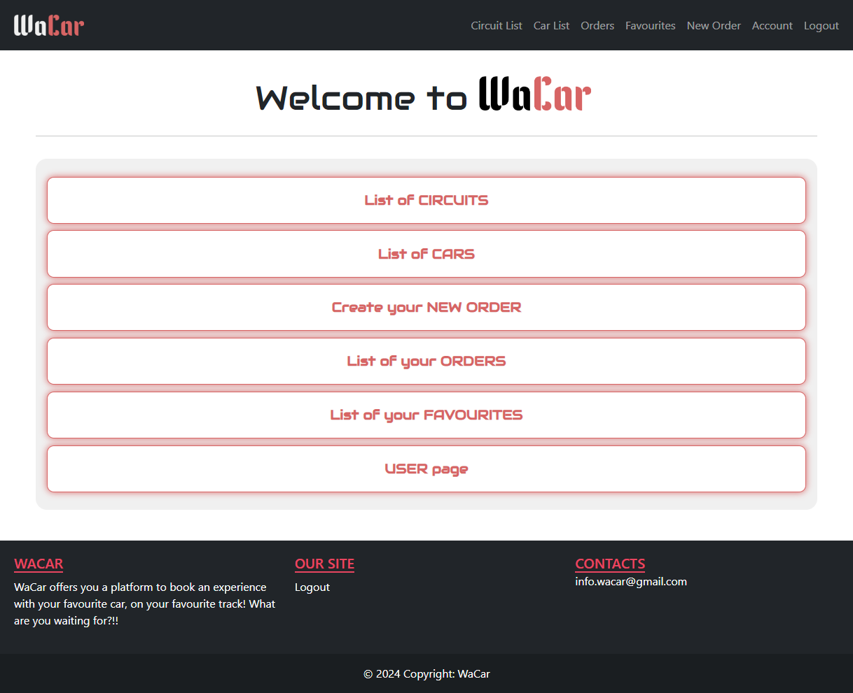
WaCar
Easier way to order | Easier management of the products | User-friendly & responsive design

Slide 4


Types of User
Customer
Create and Manage her/his own orders
Administrator
Administrator features
Cars and Circuits management

Slide 5
Types of User
Customer
Basic fetures
Create and Manage her/his own orders
Administrator
Basic features
Cars and Circuits management

Slide 6
REST Resources
URI | DESCRIPTION
wacar/rest/{car|circuit}/ | LIST all CARS/CIRCUITS
user/order/create/{complete|carType}
user/order/{orderId} | LIST ORDER based on the ID
user/favourite/{add|delete|search} | CREATE/DELETE/SEARCH favourites ORDER

Slide 7
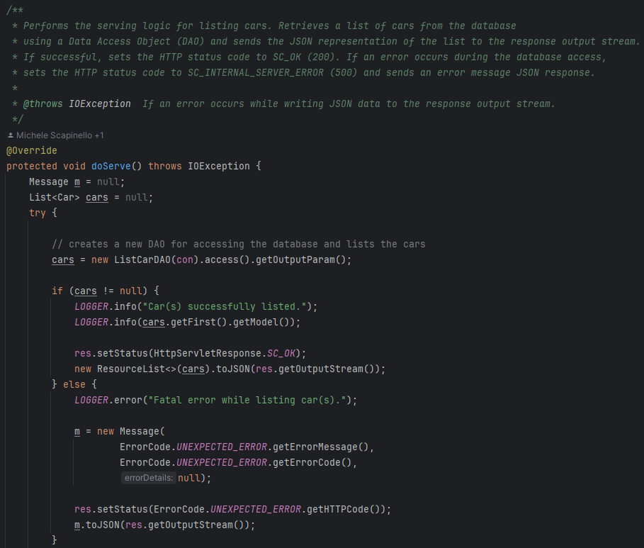
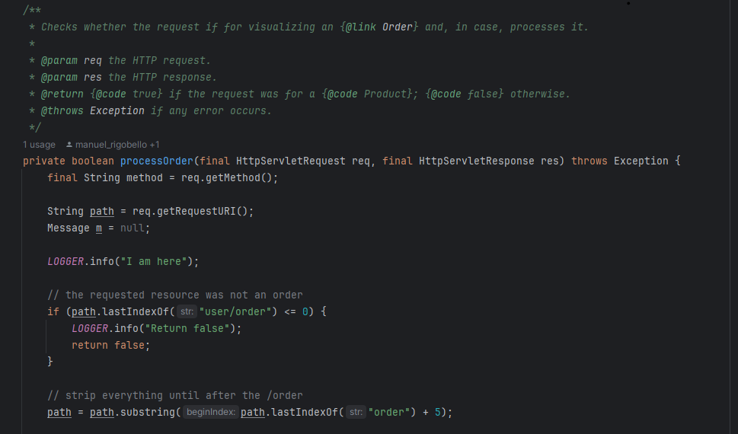
REST Flow
REQUEST
RESTDispatcherServlet
Rest Resource
DAO

Slide 8
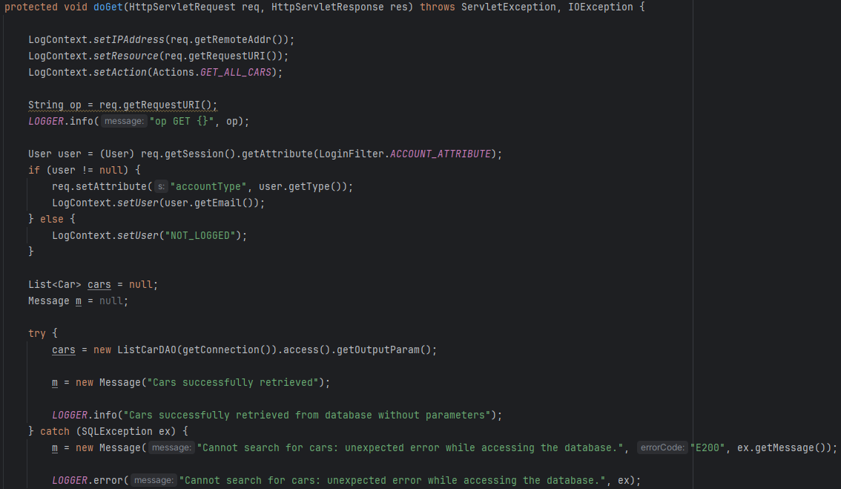
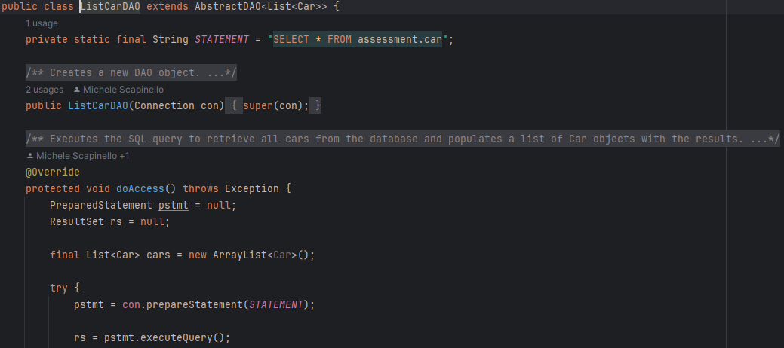
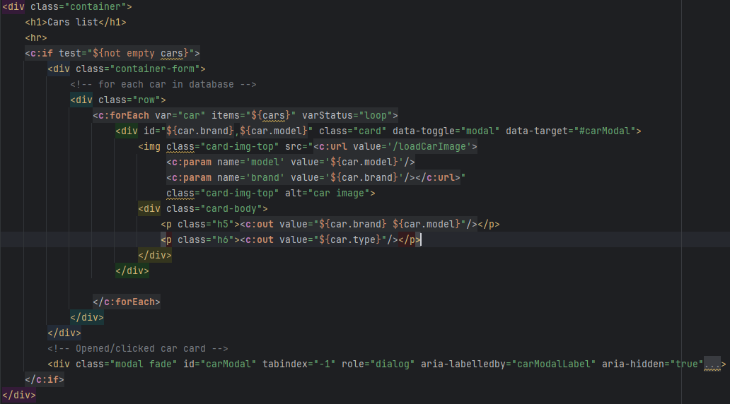
General Flow
Servlet
Post/Get
DAO
Return and
visualization
JSP

Slide 9








Order procedure
1. Select a Car
2. Select a Circuit
3. Select a Date
5(b). Add to Favourites
5(a). Complete Order
4. Select the Number of Laps

Slide 10
Admin Features
Manage Cars
Manage Circuits
Bind Car to Circuit

Slide 11
Car Management
Insert
Edit
Available/Unavailable

Slide 12
Circuit Management
Insert
Edit
Available/Unavailable

Slide 13
(Responsive Design)

Slide 14
Conclusions
WaCar satistifies the needs of customers and owners with its simple interface and usage
The goal of the project has been achieved by providing a solution that facilitates the book of such experiences and the management of the offered products

