Slide 1
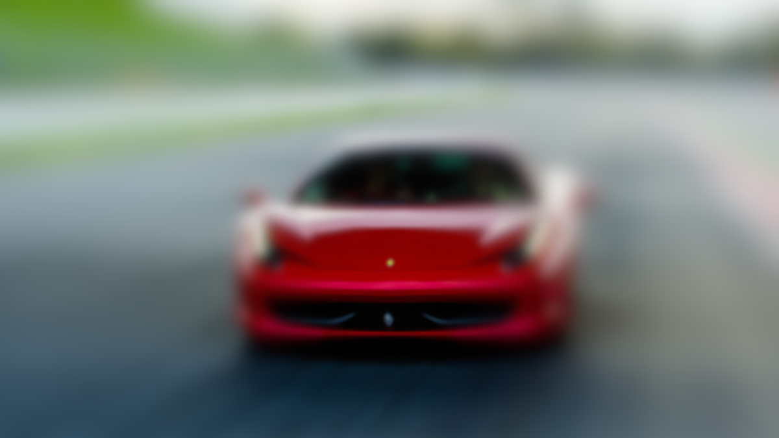

A project by
Di Martino Ludovico, Galli Filippo, Leonardi Alessandro, Rigobello Manuel, Scapinello Michele

Slide 2
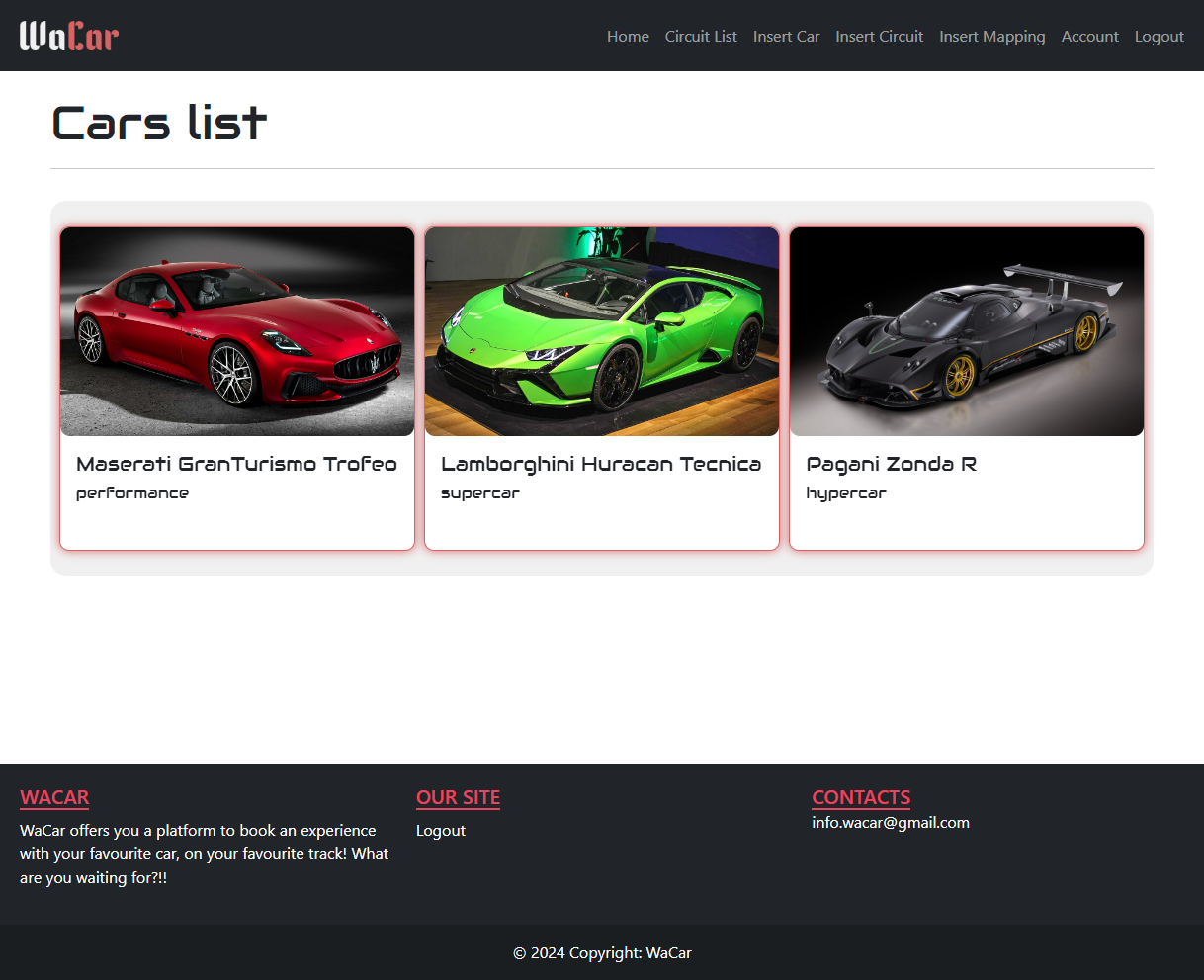
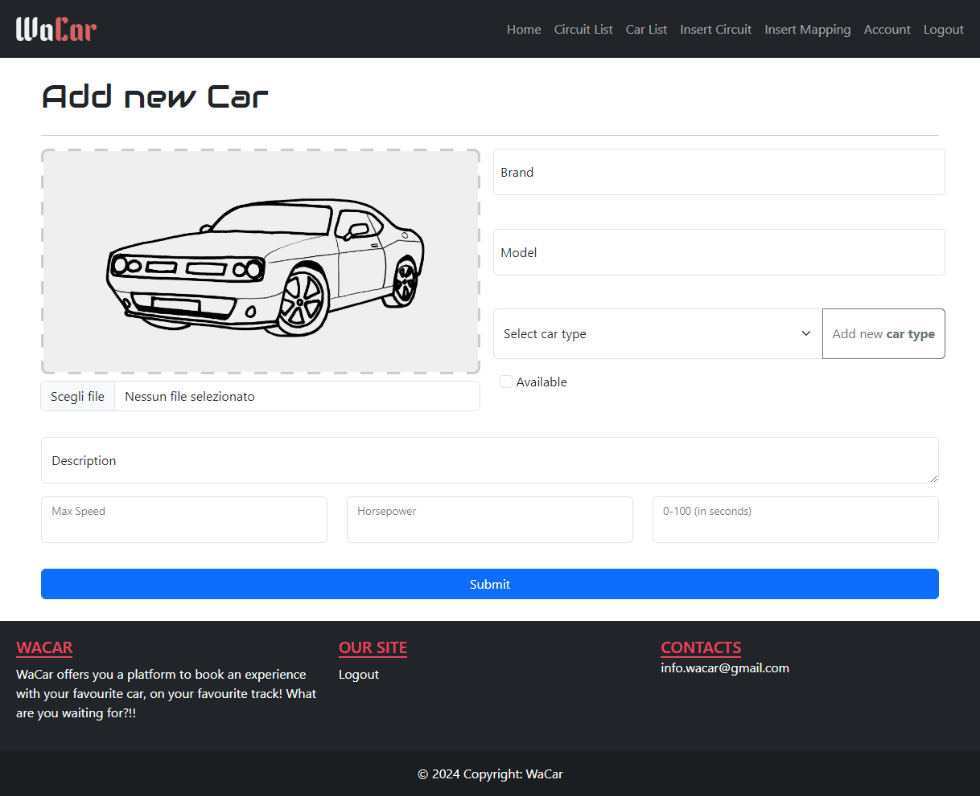



WaCar
CAR EXPERIENCE
MANAGEMENT SYSTEM

Slide 3
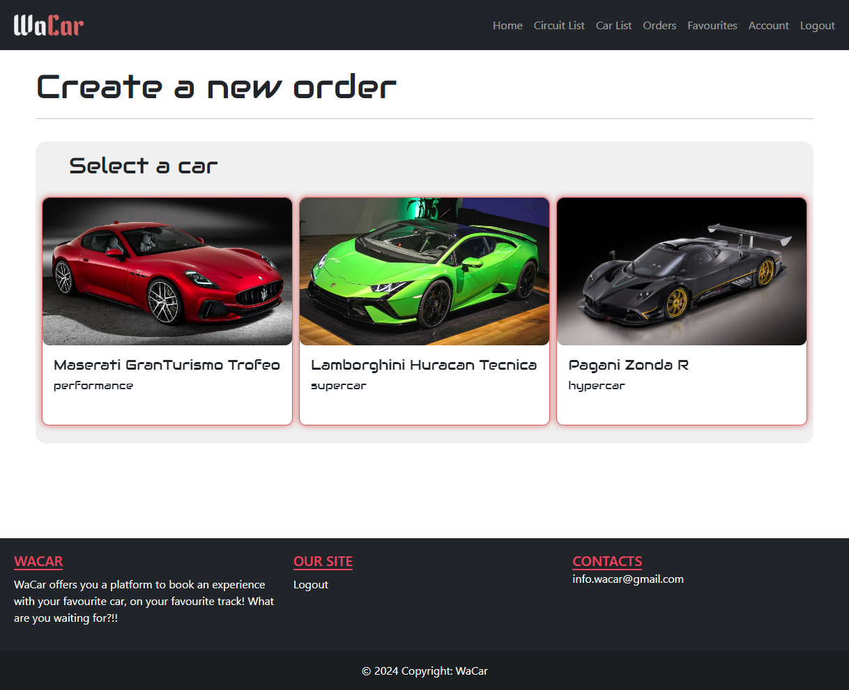
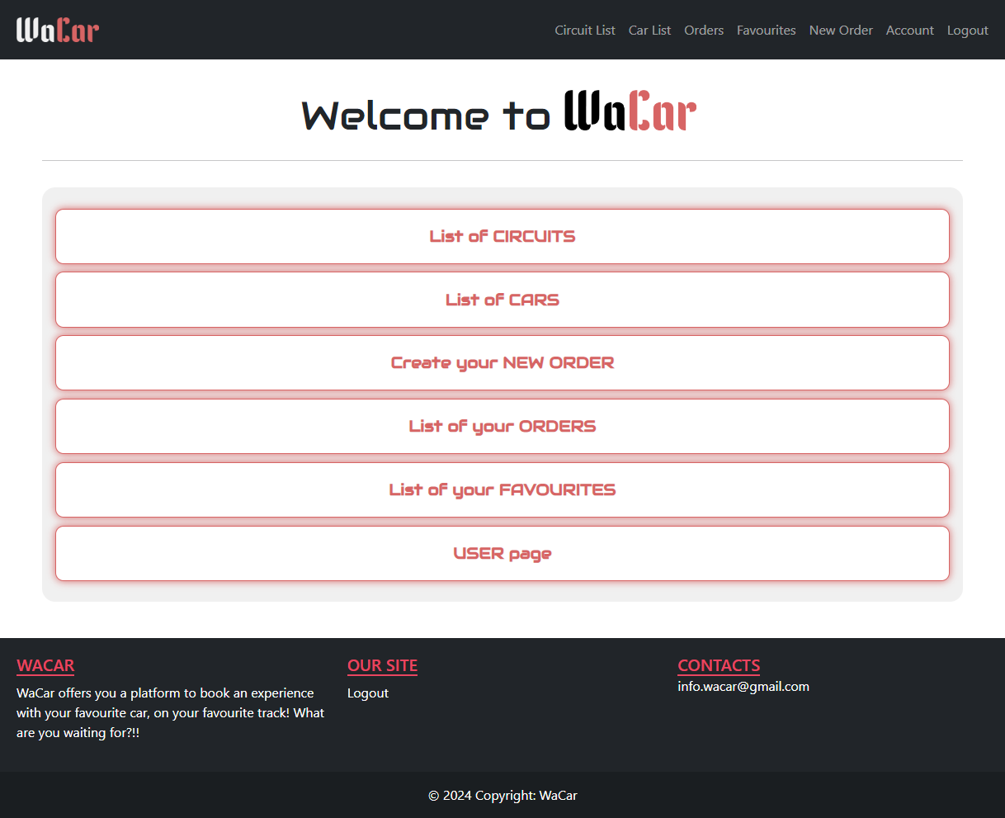
Goals
Easier way to order | Easier management of the products | User-friendly & responsive design

Slide 4


Types of User
Basic user
Create and Manage her/his own orders
Administrator
Administrator features
Cars and Circuits management

Slide 5
REST Resources
URI | DESCRIPTION
/rest/{car|circuit}/ | LIST all CARS/CIRCUITS
/rest/user/order/create/{carType} | GET Circuits based on {CarType}
/rest/user/order/create/complete | Create the Order
/rest/user/order/{orderId} | LIST ORDER based on the ID
/rest/user/favourite/{add|delete} | CREATE/DELETE favourites ORDER
/rest/circuit/{circuitName} | GET circuit with name={circuitName}
/rest/car/{carBrand}/{carModal} | GET car with brand={carBrand} and modal={carModal}
/rest/user/favourite/search/{circuitName}/{carBrand}/{carModel} | GET the favoruite with the selected values of the logged in user

Slide 6
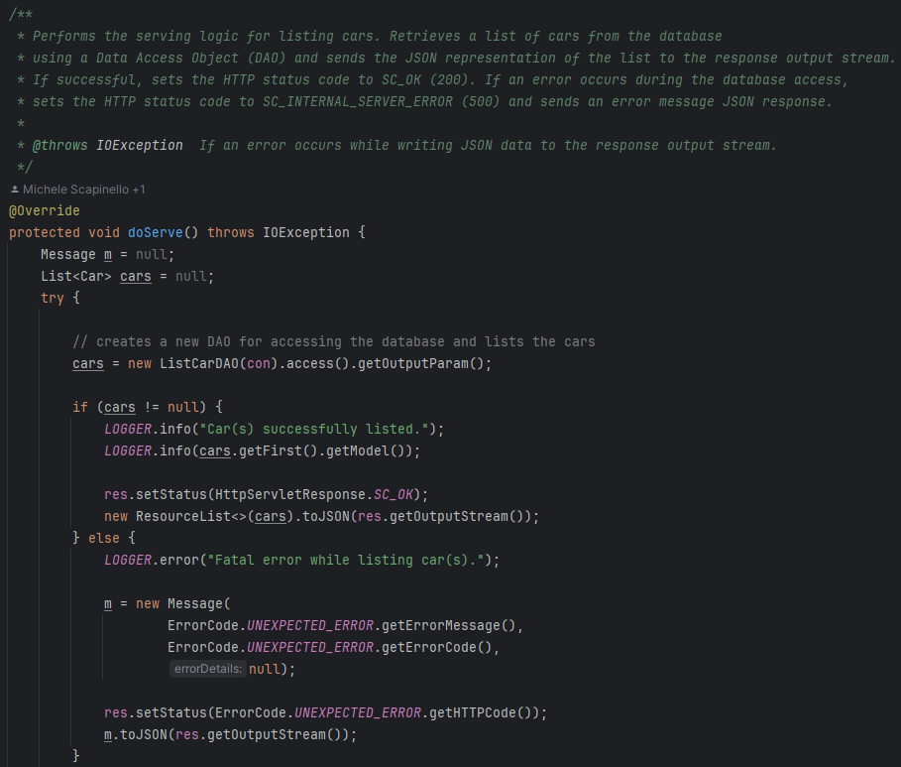
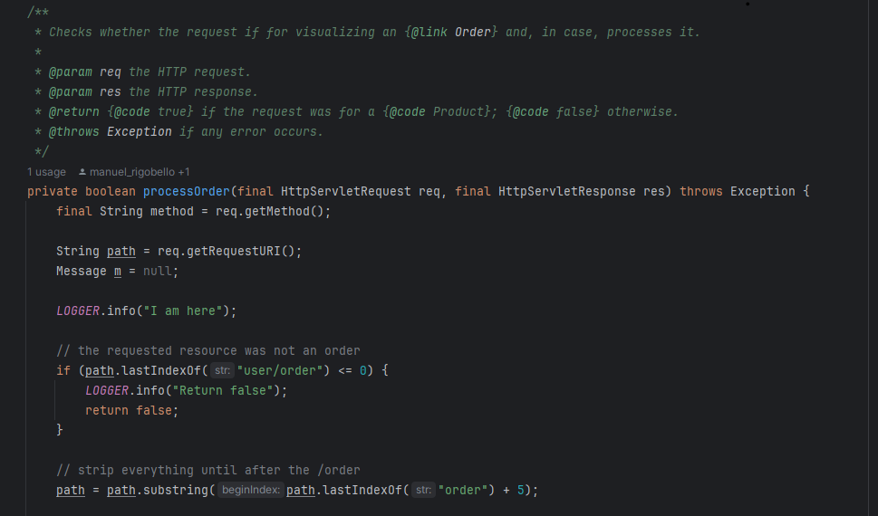
REST Flow
REQUEST
RESTDispatcherServlet
Rest Resource
DAO

Slide 7
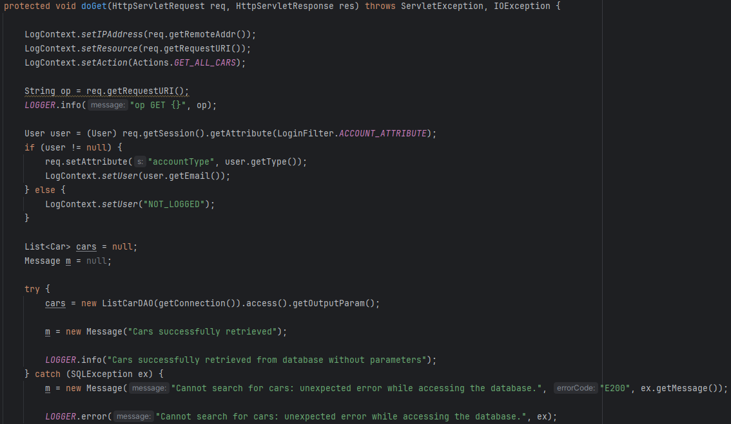
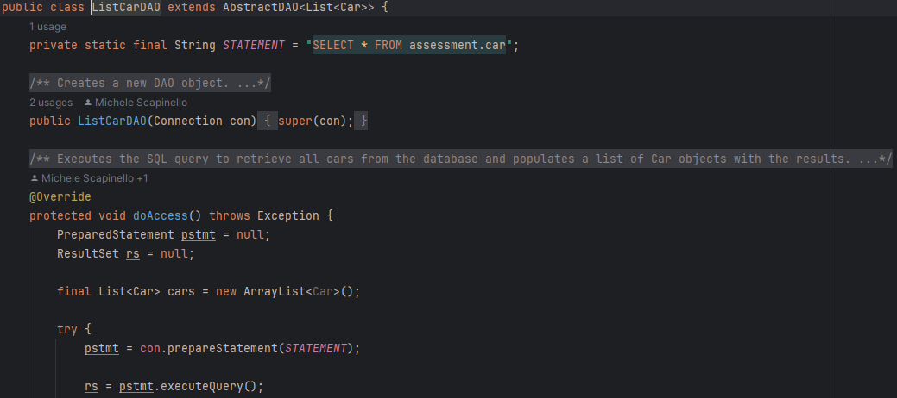
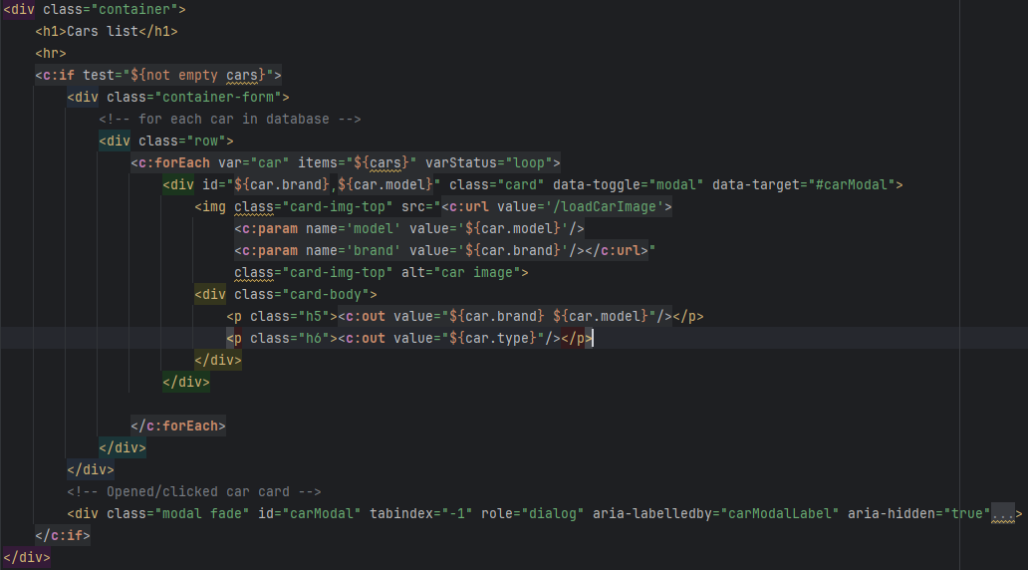
Generic Flow
Servlet
Post/Get
DAO
Return and
visualization
JSP

Slide 8

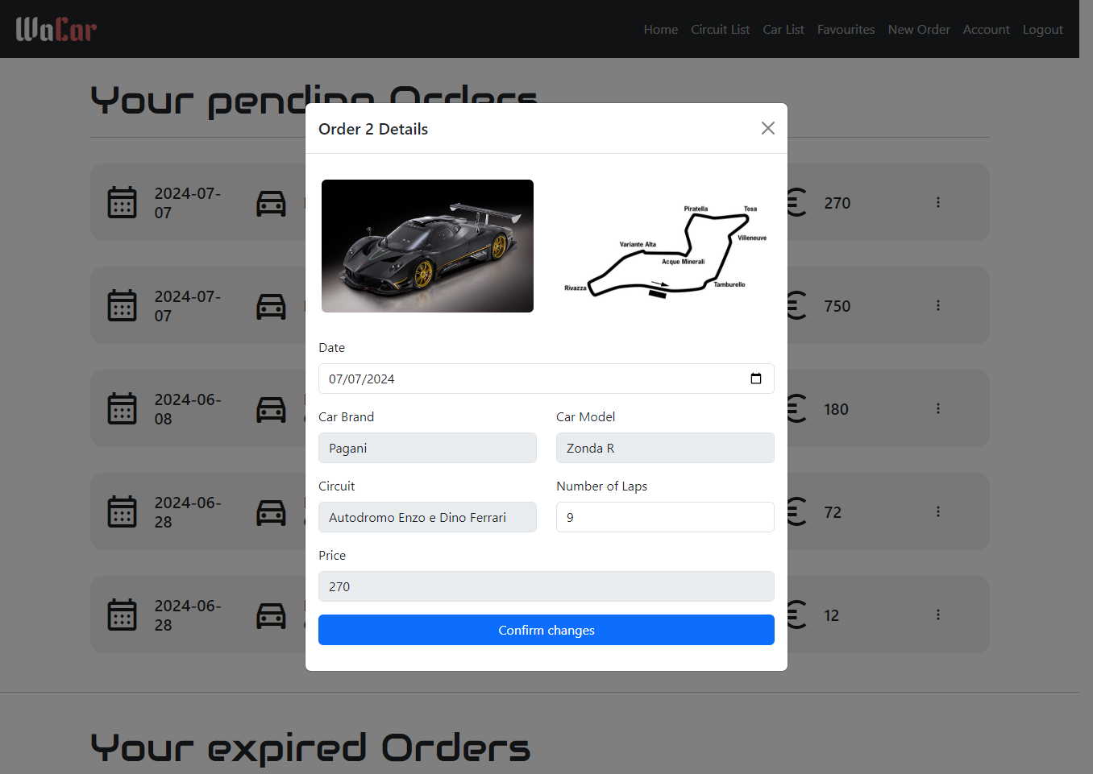
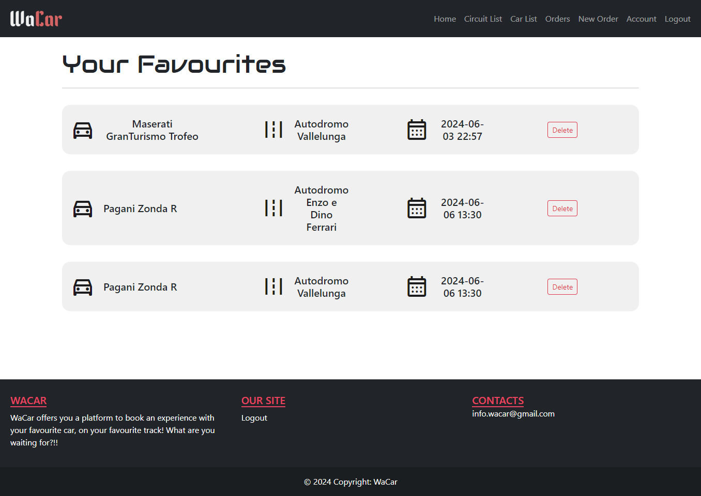
User features
Create and manage Orders
1. Create
2. Modify/Delete
3. Favourites feature

Slide 9







Order procedure
4. Select the
Number of Laps
1. Select a Car
2. Select a Circuit
3. Select a Date
5(b). Add to Favourites
5(a). Complete Order

Slide 10
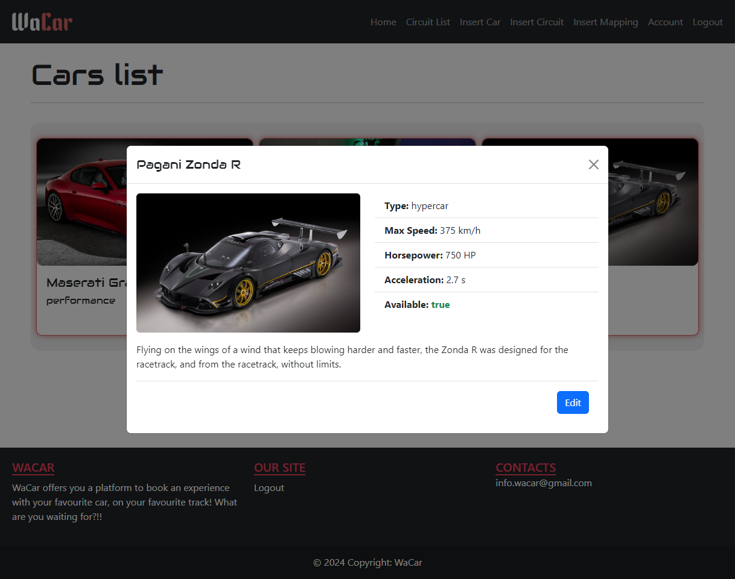
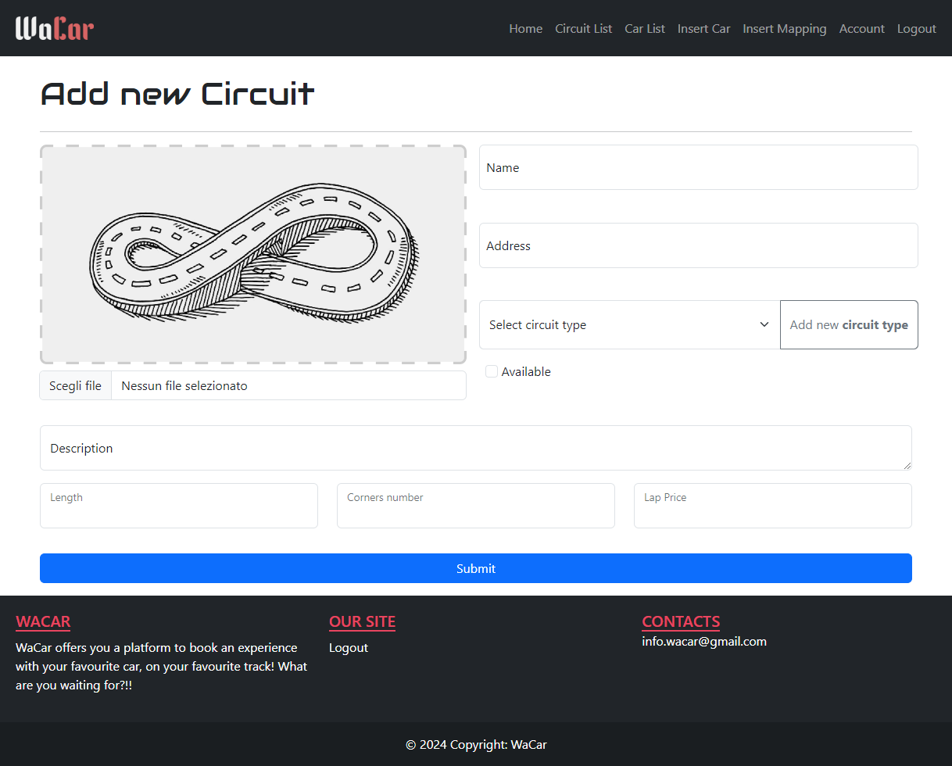
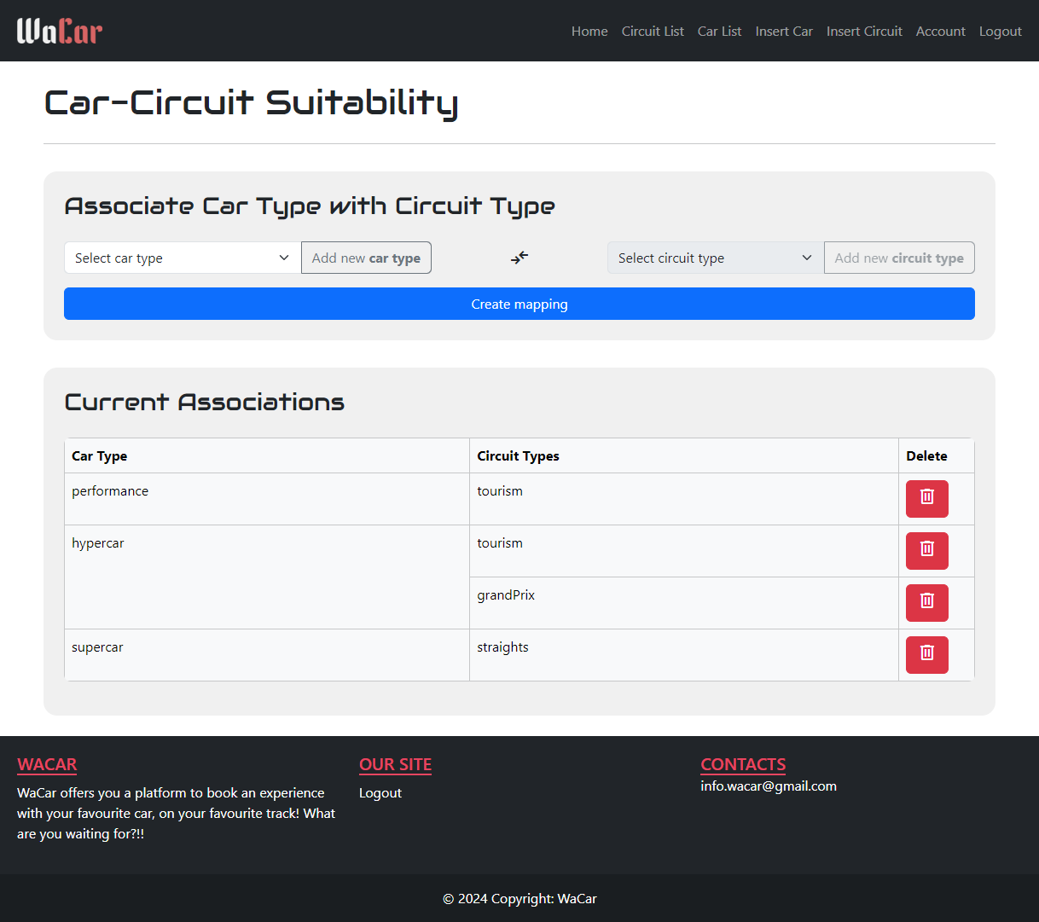
Admin Features
Cars/Circuits management
1. Edit
2. Insert
3. Map

Slide 11
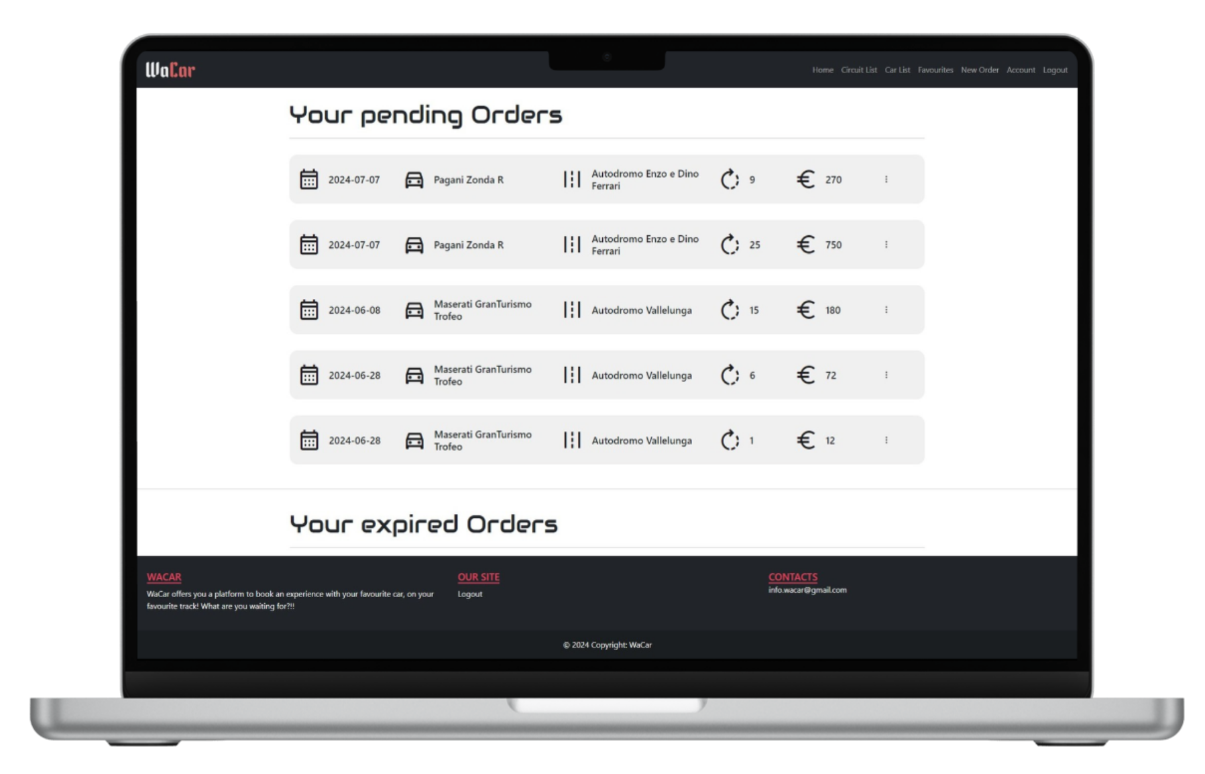
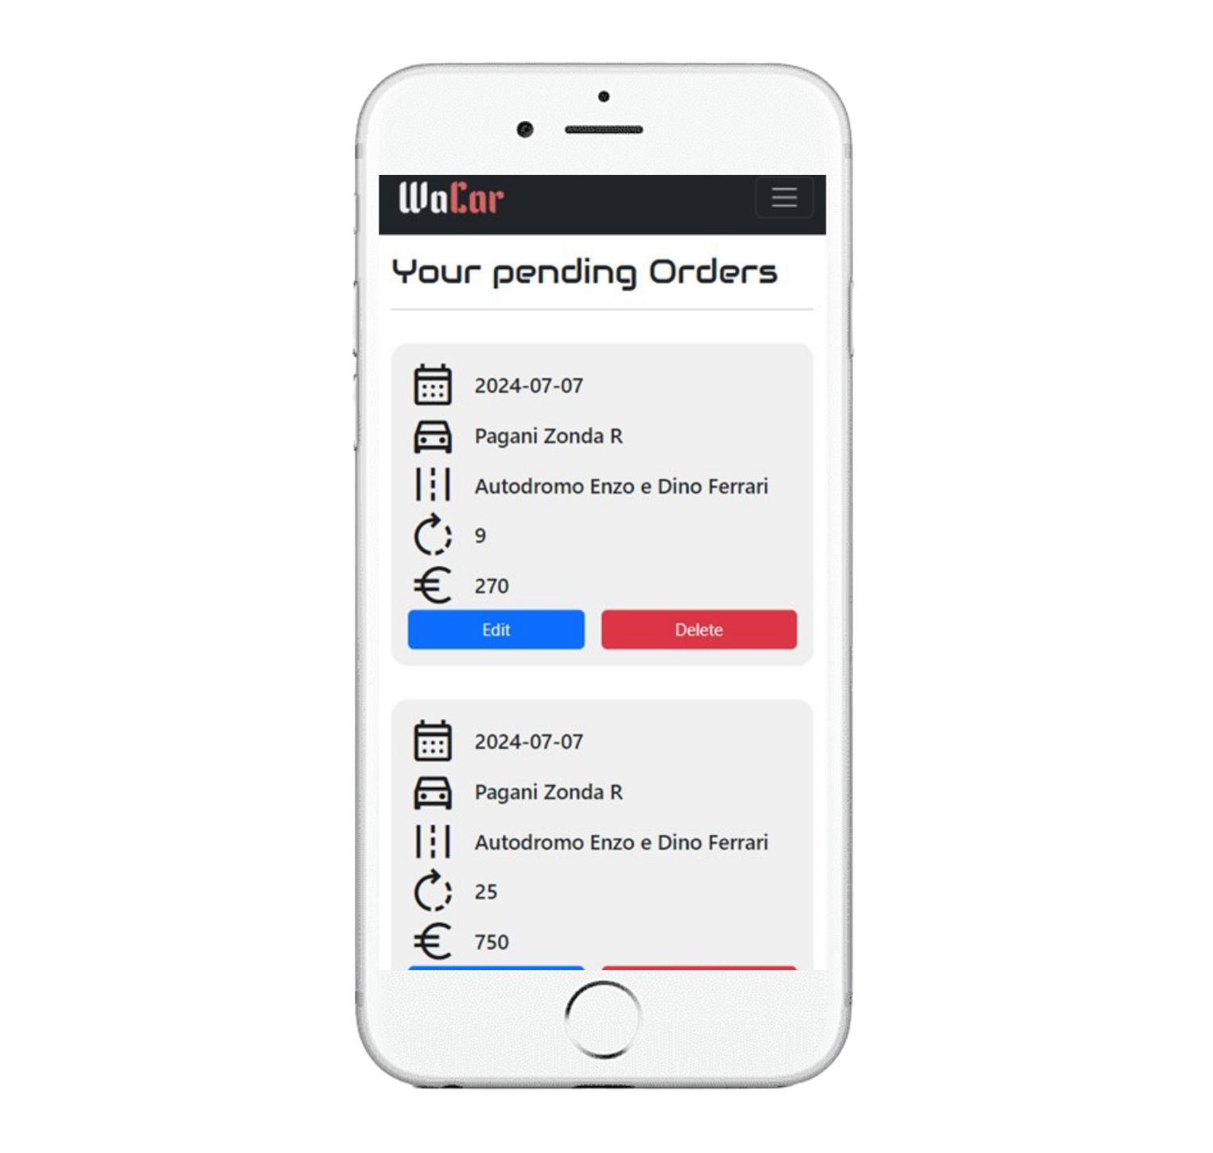
Responsive Design

Slide 12
Conclusions
WaCar satistifies the needs of customers and owners with its simple interface and usage
The goal of the project has been achieved by providing a solution that facilitates the book of such experiences and the management of the offered products
There is room for future improvements in the web application. Specifically, order management by the admin and the ability to manage order timing could be implemented.
12

Slide 13
Contributions
Di Martino Ludovico: developed the frontend of the admin section and the order recap modal for the basic user. Created and added the favicon and the logo on all the pages of the website.
Galli Filippo: developed the frontend for the login, the signup and the modify-order modal. Furthermore I have developed the UpdateOrder servlet and the navigation bar
Leonardi Alessandro: developed the frontend of the list favourite page. Contributed to the development of the frontend of the list order page.
Rigobello Manuel: developed the frontend of the list car, list circuit, their modals (with “edit” handling for the admin) and their respective REST. Developed the frontend of the create order page (no recap modal), the REST for getting the circuits based on the carType and the second modal with success/error message (error can arrive from PostgreSQL trigger). Developed the basic user Authentication header with BASIC authorization.
Scapinello Michele: developed the frontend of the list order page and the delete order modal and servlet. Development of the footer and part of the navbar. Preparation of the slides.
13

