Slide 1

A Greedy Approach for Proactive Caching in Mobile Scenarios with 5G mmWave Communications
University of Padova - Department of Information Engineering
Group members:
Ludovico Frizziero
Alberto Suman
Anthony Dell’Eva
March 2nd, 2018 Telecommunication Networks Group Project

Slide 2

Why proactive caching?
Reduced range of network cells in mmWave channel
Susceptibility to misaligned beams

Slide 3
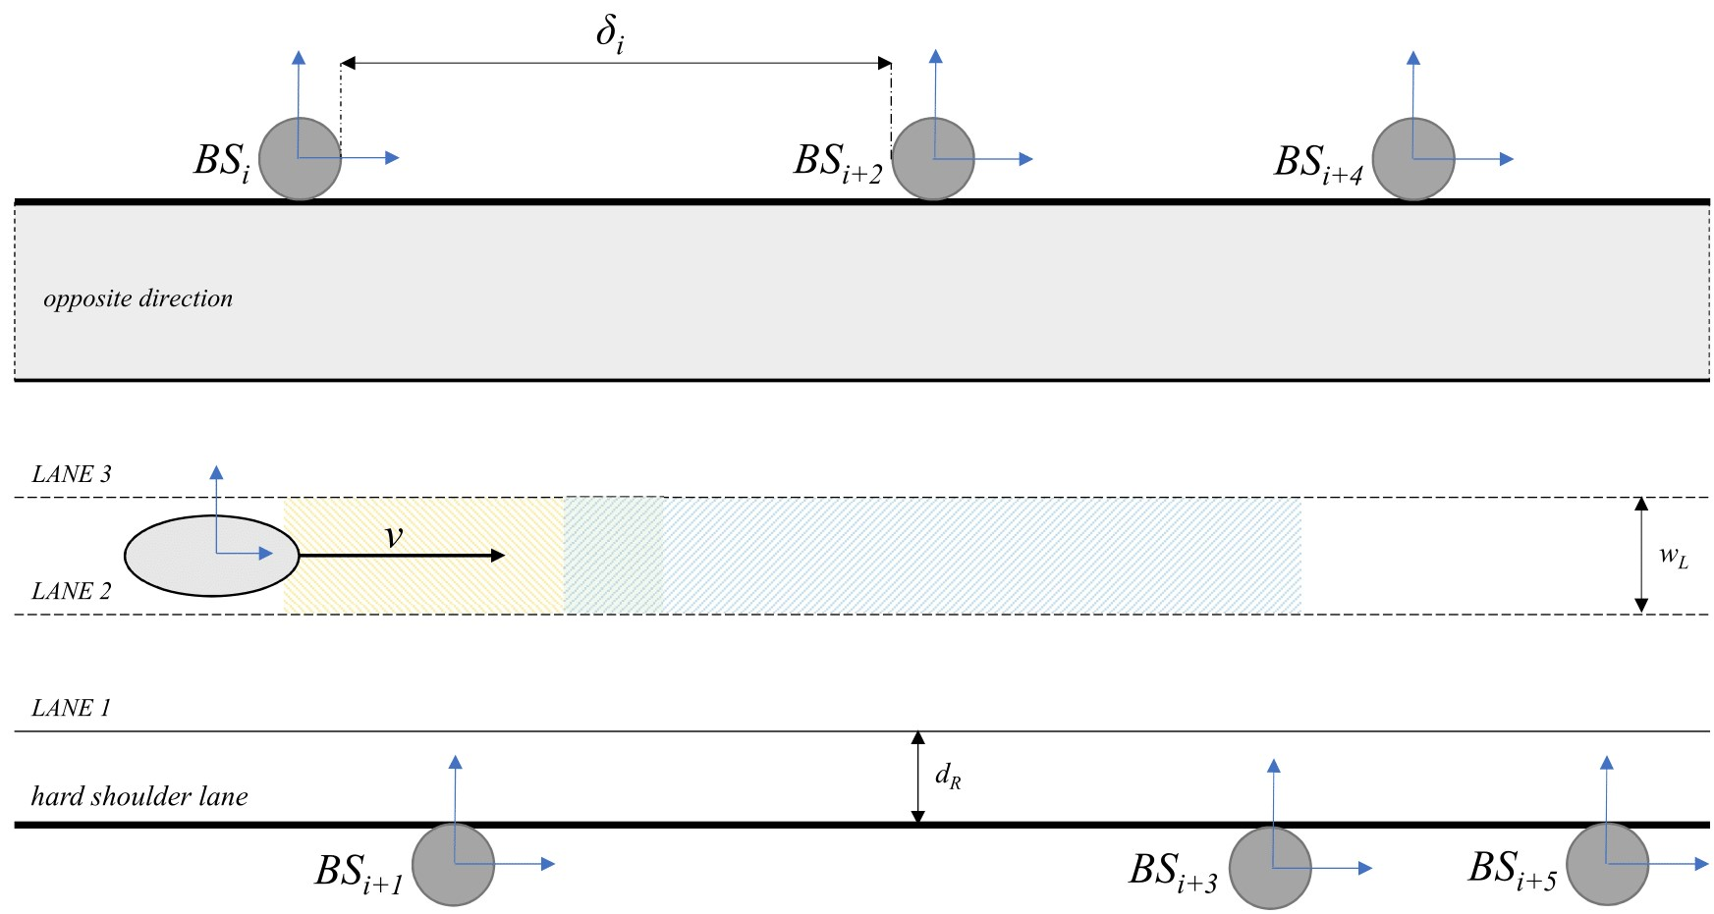
System Model

