Slide 1
JTL312 Lecture-1
Rajdeep Banerjee

Slide 2
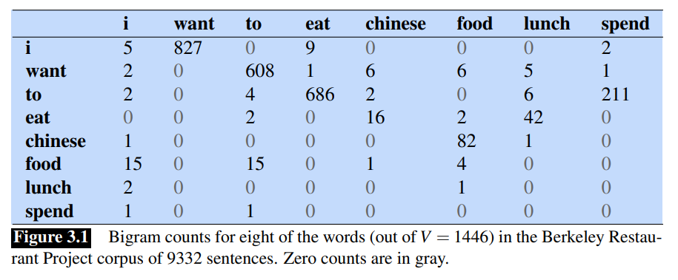
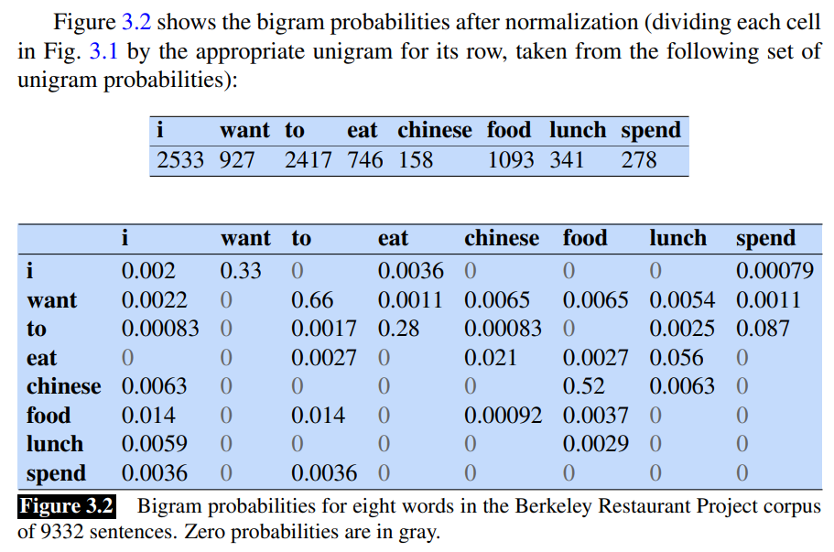
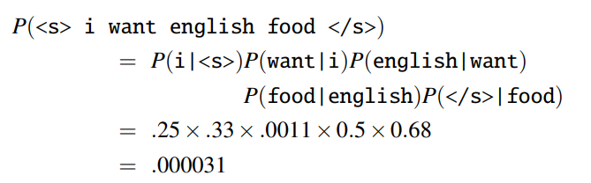
N-gram language model:

Slide 3
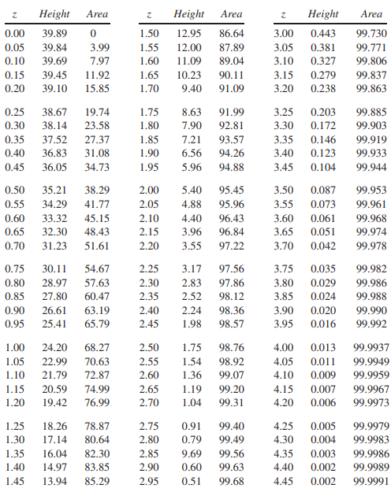
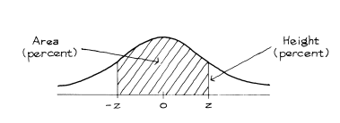
z-statistic

Slide 4
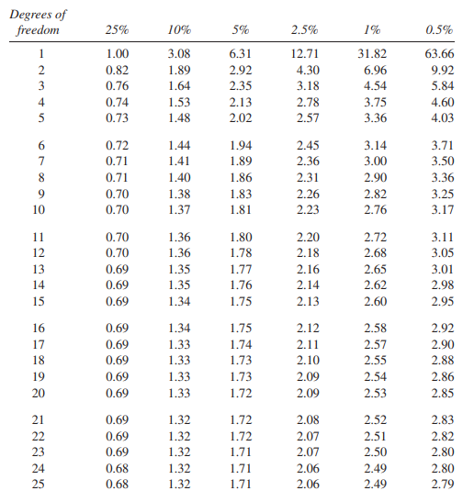
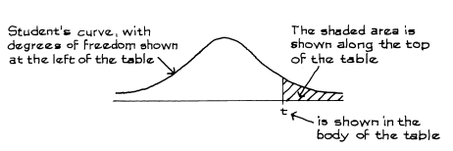
t-statistic

Slide 5
Design of experiments: The vaccine trials
The treatment and the control group should be as similar as possible except for the treatment.
If there is any other factor other than treatment, then this ‘other factor’ may get confounded with the result of the treatment.
The control and the treatment group should be chosen from the same population and randomly put into treatment or control – randomized control expt.
neither the subjects nor the doctors who measure the responses should know who was in the treatment group and who was in the control group – double blinded.

Slide 6
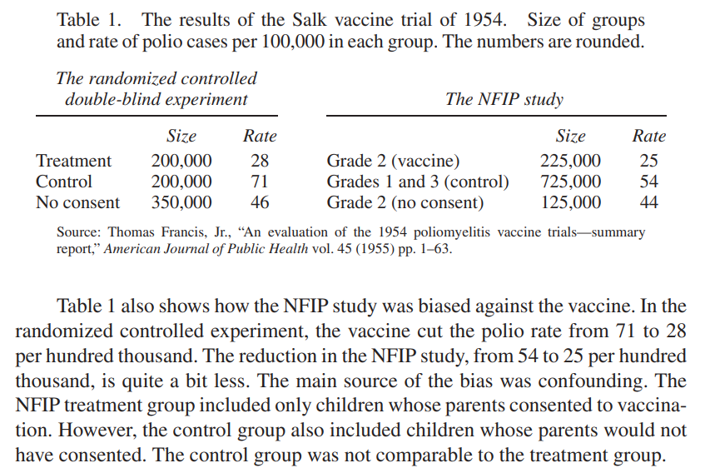
Example 1: Salk Polio vaccine trial

Slide 7
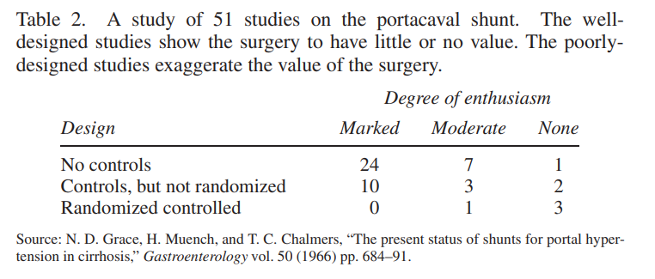
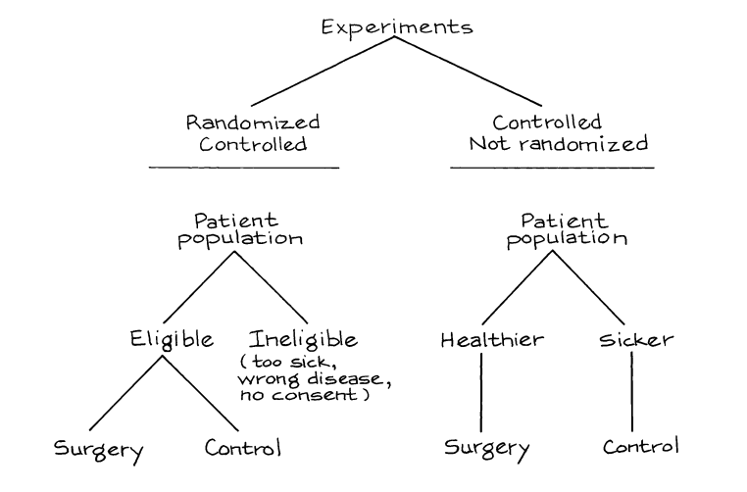
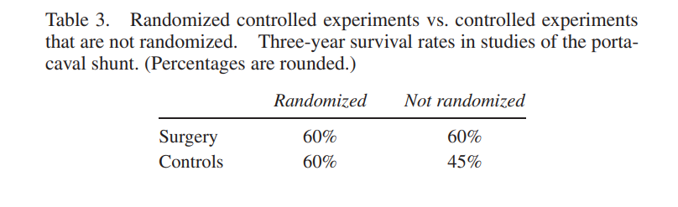
Example 2: Surgery or not surgery?

Slide 8
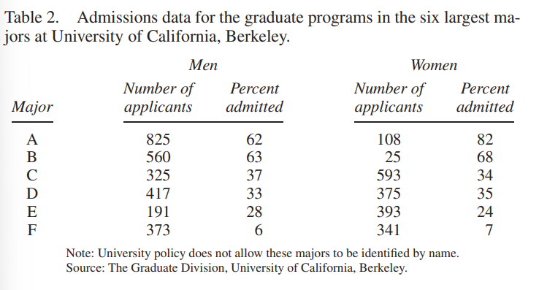
Do not jump to conclusions before looking at the data!
Univ. California, Berkeley:
Applied: 8442 men, 4321 women; Admitted: 44% men, 35% women.
Is the selection procedure biased against women?
More Women applied to C, D, E, F than men.
And for A and B – women admission percentages are higher!
Simpson’s paradox: relationship between percentages in soubgroups can be reversed when the subgroups are combined.

Slide 9
Solution? Look at the weighted average!
Weighted average admission rate for men: 39%
Weighted average admission rate for women: 43%

