Slide 1
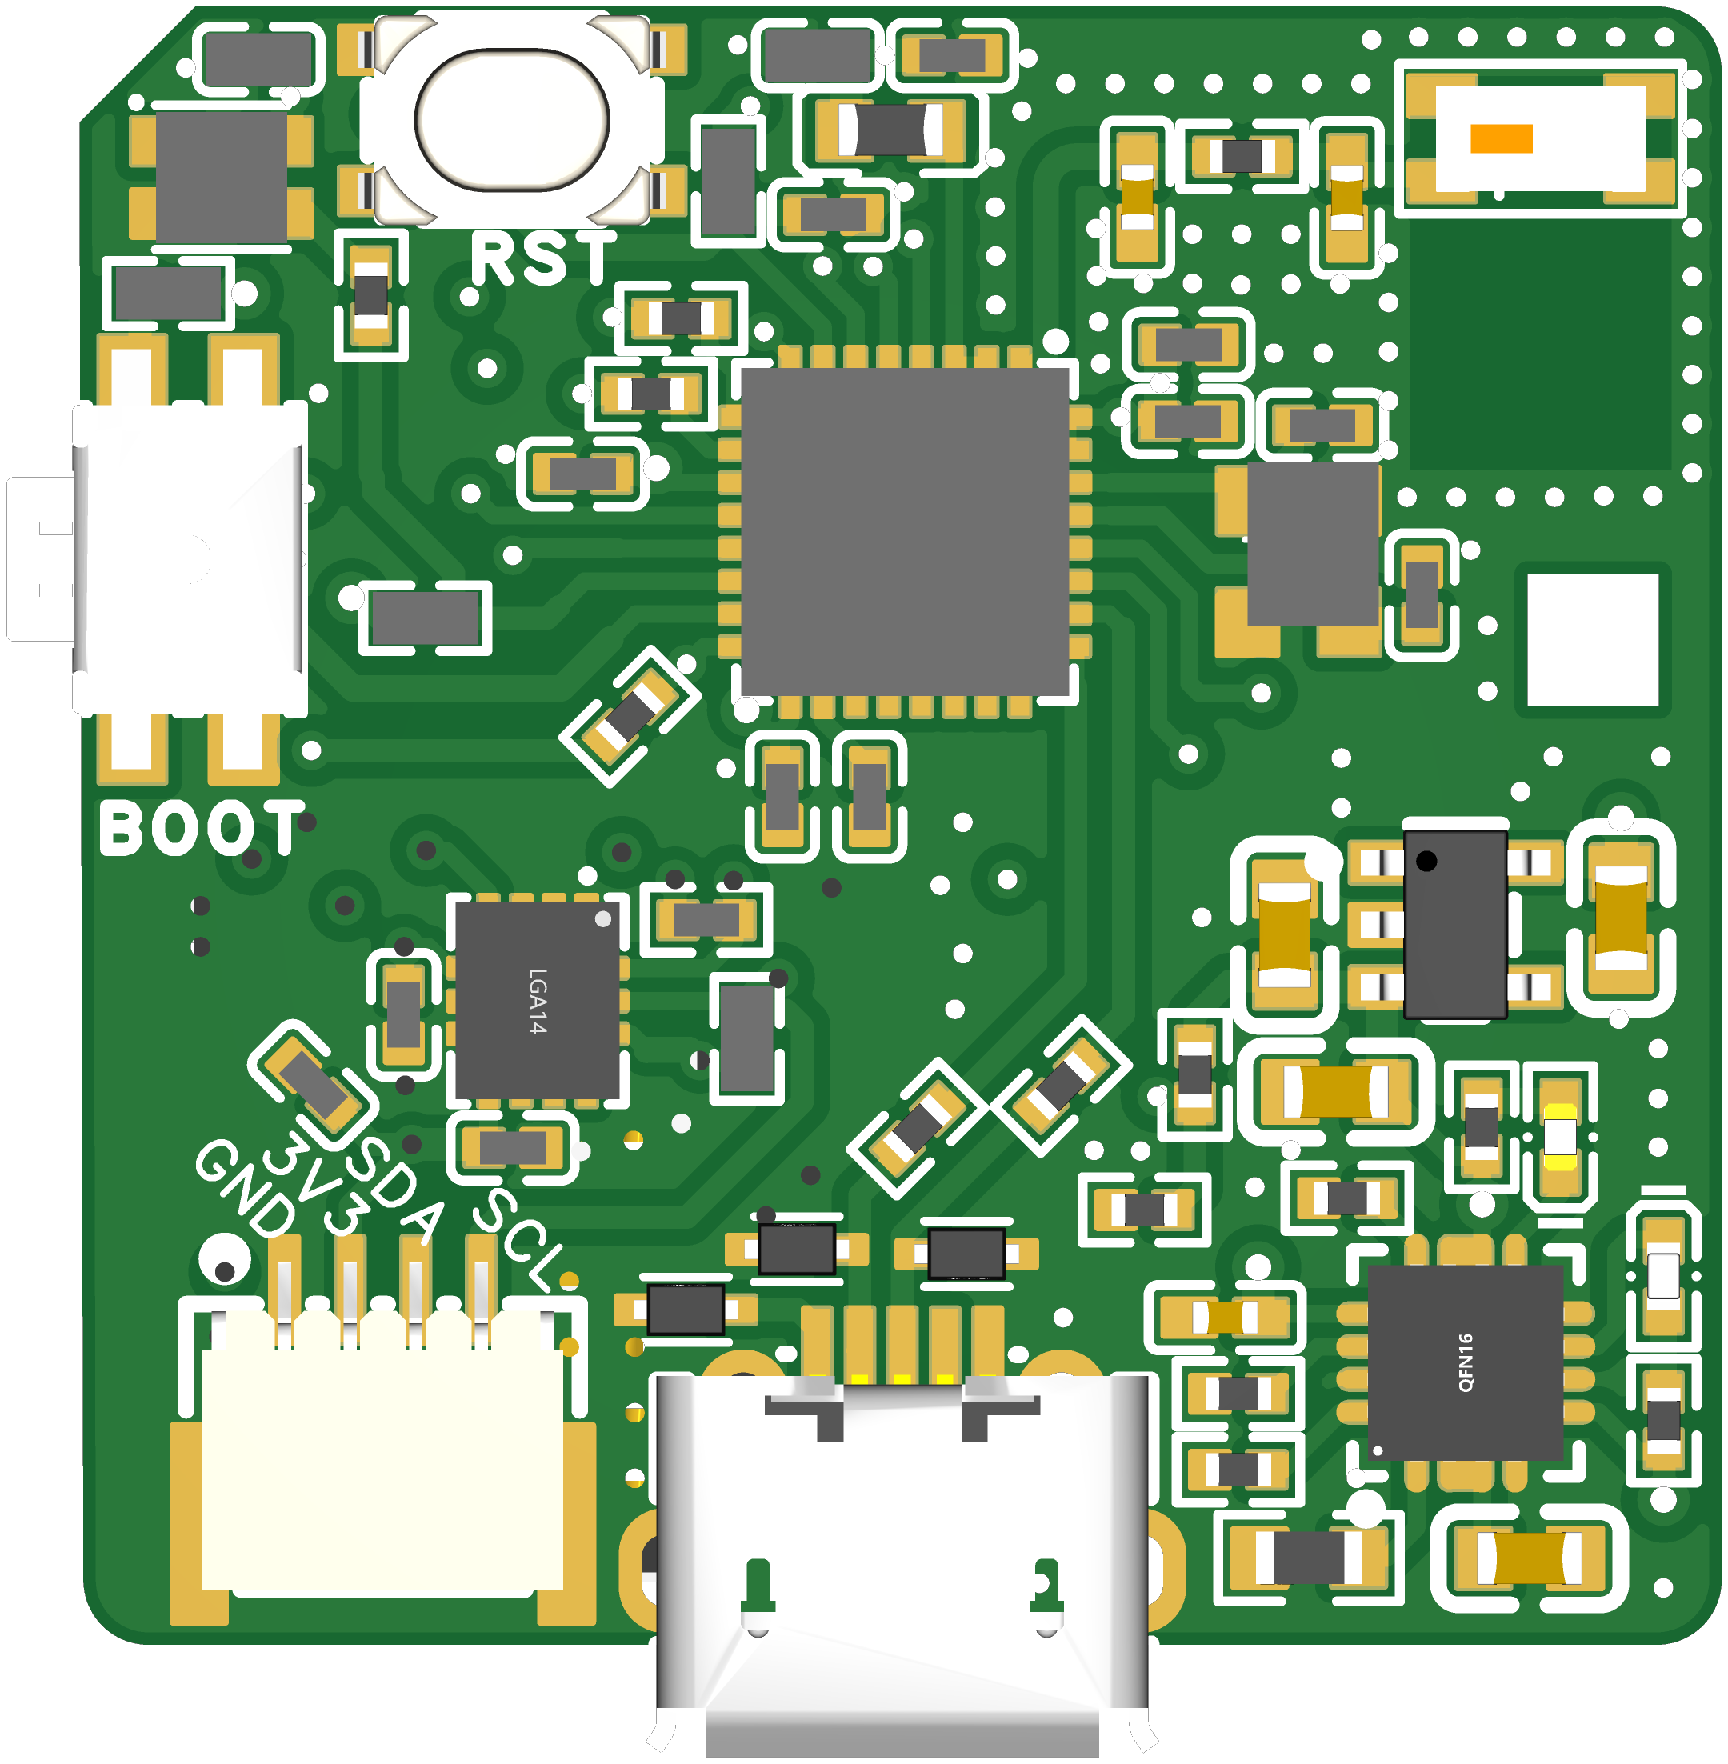

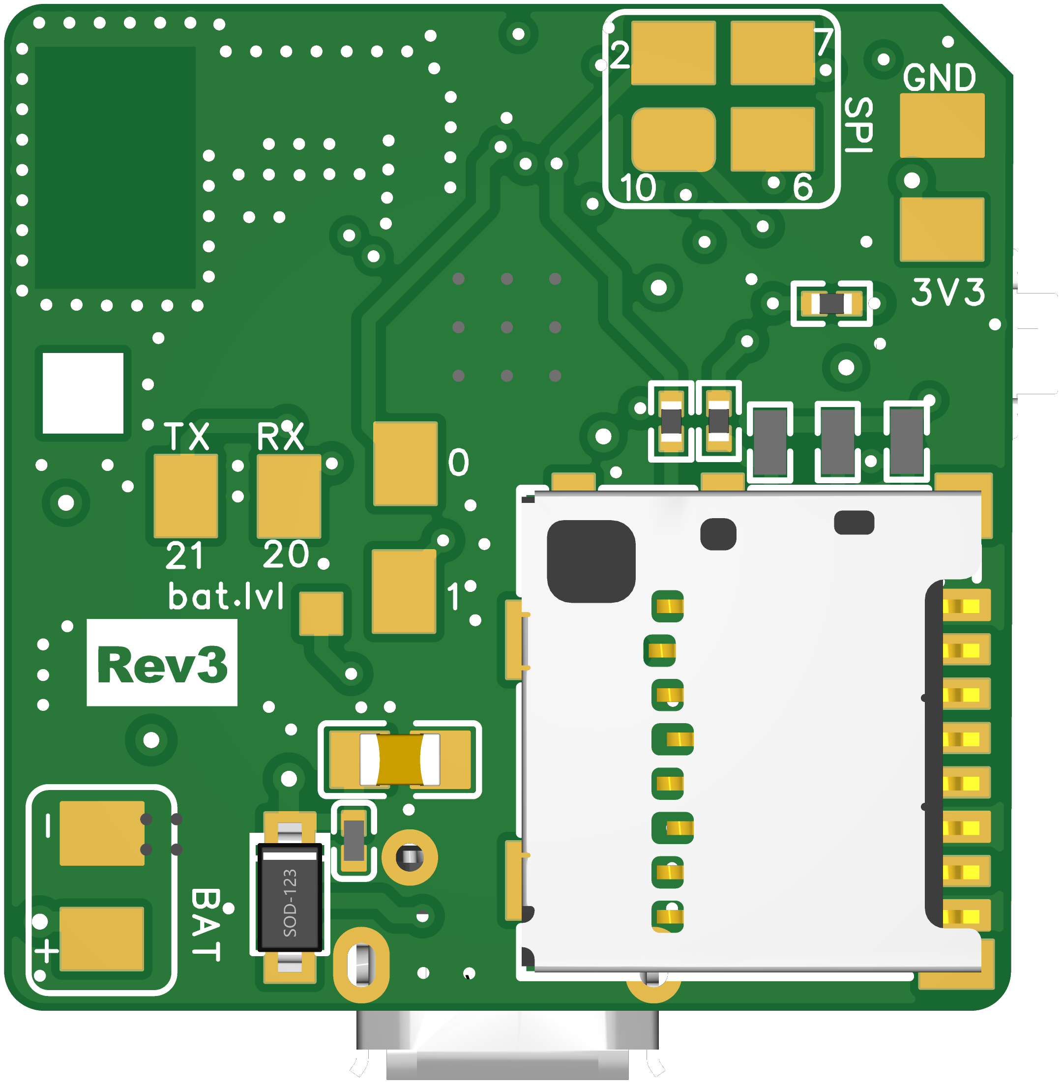

Top Layer
Reset PB
RGB LED
Antenna
ESP32-C3
Boot/Main PB
AP2112K-3.3TRG1 LDO
LSM6DS3TR-C IMU
QWIIC
BQ24075RGTR
Battery Manager
USB Connector
GND
D5
SCL
A5
3.3V
D4
SDA
A4
Bottom Layer
Color Legend
GND
Digital
3.3V
Ground
Analog
D7
MOSI
Power 3.3V
IIC
A0
D0
D6
CLK
Battery -
SPI
TX
D21
D2
MISO
A2
Battery +
UART
RX
D20
D10
CS
A1
D1
MicroSD Reader
Bat -
Bat +

