Slide 1
ASP.NET without Razor: React, Webpack & TypeScript
Rasmus Kromann-Larsen

Slide 2
Me
Developer at Templafy
Career Theme
C# + [anything]
Twitter: @rasmuskl
Blog: http://rasmuskl.dk
Github: https://github.com/rasmuskl/

Slide 3





Slides
VS Code
Visual Studio

Slide 4
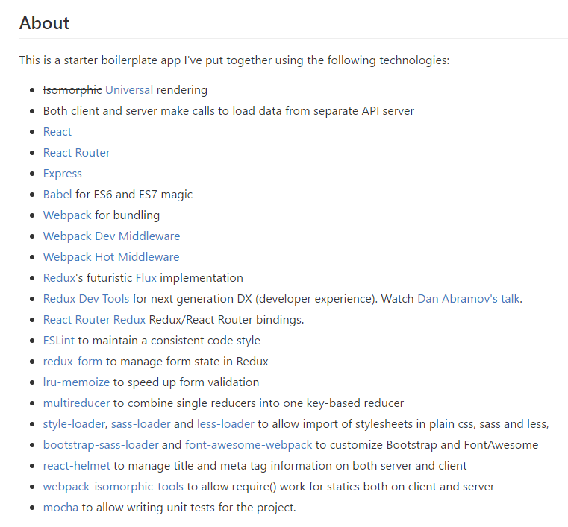
Problem
JavaScript ecosystem changes rapidly
Lots of ”starter projects” online
Usually 20+ npm packages
Usually 100+ lines of configuration
Usually out of date
Approach
Look at each technology in isolation
What we wish we had known when we started

Slide 5
Templafy
~30 employees
Mission: Help enterprises manage their templates
Distributing
Personalizing
Integrating
Distributed development team
Copenhagen: 4 developers
Århus: 1 developer
Romania: 2 developers, 1 tester
Poland: 1 designer
Tech stack: .NET on Azure

Slide 6

Our Rewrite
Migration from Knockout to React
Started in June 2016
Goals
Focus on core features
Performance
Productivity
Attracting new developers

Slide 7
Demo
D

Slide 8



Visual Studio
Extensions
NPM / Webpack Task Runner
TypeScript for Visual Studio
Our Pains
Visual Studio + ReShaper vs JavaScript Ecosystem
Visual Studio: TypeScript typings caching
TypeScript typings
TSD > Typings > npm @types
Webpack incremental build time
D

Slide 9
Thank you!
Advice
Understand your tools
Keep number of dependencies down
Investigate stability of dependencies
Resources
React, Webpack and TypeScript documentation sites
npm: create-react-app from Facebook (and create-react-app-typescript)
React communication: http://andrewhfarmer.com/component-communication/
Twitter: @rasmuskl
Blog: http://rasmuskl.dk
Presentation + Code will be shared at https://github.com/rasmuskl

Slide 10
React Reconcillation
div
div
diff
h1
ul
h1
ul
p
li
li
li
li
patch
DOM

Slide 11
React
Released by Facebook in 2013
“A JavaScript library for building user interfaces”
Library vs Framework
V in MVC
Declarative components for UI

Slide 12
React Component Lifecycle
Component added: Mount
componentWillMount
componentDidMount
Component updated
componentShouldUpdate
componentWillUpdate
componentDidUpdate
Component removed: Unmount
componentWillUnmount
Mount
Update
Unmount
D

Slide 13
TypeScript
Released by Microsoft in 2012
”TypeScript is a typed superset of JavaScript that compiles to plain JavaScript.”
Adds types and type inference
Adds support for new ECMAScript features
D

Slide 14
Webpack
Released by @sokra in 2013
”webpack is a module bundler for modern JavaScript applications.”
Similar tools
System.Web.Optimization
Gulp
Grunt
Browserify
…
Builds a graph of dependencies
D

Slide 15
Webpack Hot Module Reload
browser
server
Single Page App
Backend
Files
HMR Client
websocket
Webpack
Dev Server
watch

Slide 16
Javascript Versions
 | June 2016 | Templafy | March 2017
React | 15.1 | 15.2.1 | 15.4.2
Webpack | 1.6 | 1.14 | 2.2.1
TypeScript | 1.8 | 2.1.4 | 2.2
React Router | 2.4.1 | 2.4.1 | 3.0.2 (4.0-beta6)
React Hot Loader | 1.3 | 1.3.1 | 1.3.1 (3.0-beta6)

Slide 17

Why not Angular 2?
Angular 2 was released in September 2016
Big changes during beta and RC
Fragmentation on Stack Overflow
JSX + TypeScript vs custom template language
Errors from runtime to compile time
IDE support
D

