Slide 1
ASP.NET without Razor: React, Webpack & TypeScript
Rasmus Kromann-Larsen

Slide 2
Me
Developer at Templafy
Twitter: @rasmuskl
Blog: rasmuskl.dk

Slide 3


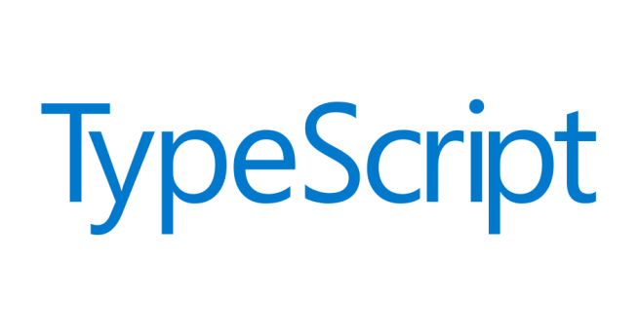


Agenda

Slide 4
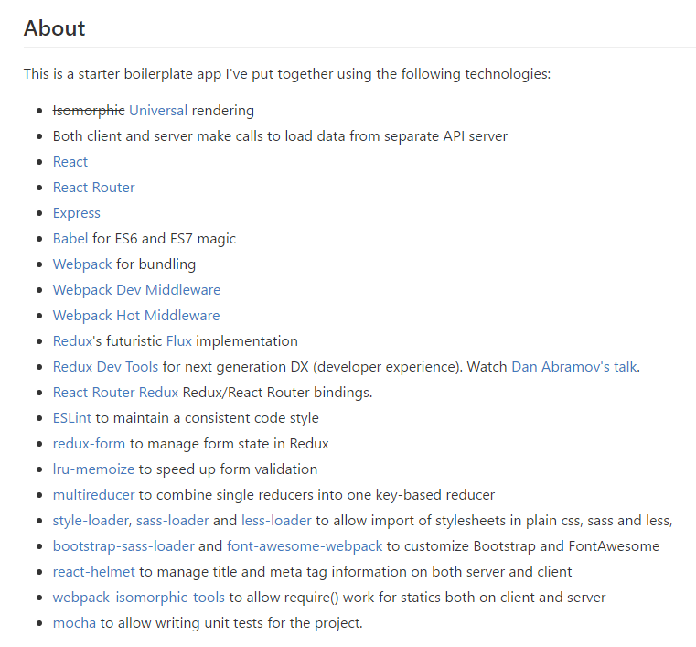
Why this talk?
JavaScript ecosystem changes rapidly
Lots of ”starter projects” online
Usually 20+ npm packages
Usually 100+ lines of configuration
Usually out of date
Show how everything works from the ground up
What we wish we had known when we started

Slide 5
Templafy
Distributed development team
Copenhagen: 4 developers
Århus: 1 developer
Romania: 2 developers, 1 tester
Poland: 1 designer

Slide 6

Our Rewrite
Migration from Knockout to React
Started in June 2016
Performance
Focus on core features
Developer productivity
Attracting new talent

Slide 7
React
Released by Facebook in 2013
“A JavaScript library for building user interfaces”
Library vs Framework
V in MVC
Declarative components for UI

Slide 8

Why not Angular 2?
Angular 2 was released in September 2016
Big changes during beta and RC
Fragmentation on Stack Overflow
JSX + TypeScript vs custom template language
Errors from runtime to compile time
IDE support

Slide 9
Demo

Slide 10
TypeScript

Slide 11
Demo

Slide 12
React Reconcillation
div
div
diff
h1
ul
h1
ul
p
li
li
li
li
patch
DOM

Slide 13
React Component Lifecycle
Component added: Mount
componentWillMount
componentDidMount
Component updated
componentShouldUpdate
componentWillUpdate
componentDidUpdate
Component removed: Unmount
componentWillUnmount
Mount
Update
Unmount

Slide 14
Webpack

Slide 15
Demo

Slide 16
Advice
Keep number of dependencies down
React
create-react-app from Facebook

Slide 17
Javascript Versions
 | June 2016 | Templafy | March 2017
React | 15.1 | 15.2.1 | 15.4.2
Webpack | 1.6 | 1.14 | 2.2.1
TypeScript | 1.8 | 2.1.4 | 2.2
React Router | 2.4.1 | 2.4.1 | 3.0.2 (4.0-beta6)
React Hot Loader | 1.3 | 1.3.1 | 1.3.1 (3.0-beta6)

