Slide 1
ASP.NET without Razor: React, Webpack & TypeScript
Rasmus Kromann-Larsen

Slide 2
Me

Slide 3



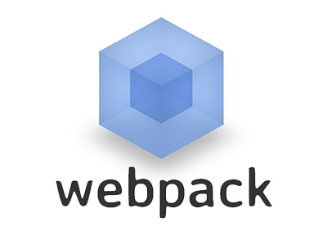

Agenda
Intro
Templafy story
React
TypeScript
Webpack
Visual Studio

Slide 4
Why this talk?
Sharing practical experiences – Templafy rewrite
What I wish I had known when we started
Boilerplates are complicated
Usually have 100+ lines of configuration and 20+ npm packages
Combination of things make it hard to separate and understand the fundamentals
http://andrewhfarmer.com/starter-project/

Slide 5
Approach
Show how everything works from the ground up
Each library in isolation to understand them
Common boilerplates usually have 100+ lines of configuration and 20+ npm packages

Slide 6
Templafy
Team
Distributed:
Copenhagen: 4 developers
Århus: 1 developer
Romania: 2 developers, 1 tester
Poland: 1 designer

Slide 7
Templafy Migration Story
Migration from Knockout.js to React

Slide 8
Goals
Basic understanding of React, Webpack and TypeScript
Describe fundamentals
Changes at a slower rate than API

Slide 9
Javascript Versions
 | June 2016 | Templafy | March 2017
React | 15.1 | 15.2.1 | 15.4.2
Webpack | 1.6 | 1.14 | 2.2.1
TypeScript | 1.8 | 2.1.4 | 2.2
React Router | 2.4.1 | 2.4.1 | 3.0.2 (4.0-beta6)
React Hot Loader | 1.3 | 1.3.1 | 1.3.1 (3.0-beta6)

Slide 10
React
Function from data to UI description
React Reconsilliation
http://madhukaudantha.blogspot.dk/2015/04/reactjs-and-virtual-dom.html

Slide 11
Why not Angular 2
Angular 2 was released in September 2016
Big changes during beta and RC of Angular
Fragmentation on Stack Overflow
JSX + TypeScript vs custom template language

Slide 12
React Component Lifecycle

Slide 13
ASP.NET Core

Slide 14
Getting Started
React
create-react-app from Facebook

