Slide 1
ASP.NET without Razor: React, Webpack & TypeScript
Rasmus Kromann-Larsen

Slide 2
Me
Developer at Templafy
Career Theme
C# + < anything >
Twitter: @rasmuskl
Blog: http://rasmuskl.dk
Github: https://github.com/rasmuskl/

Slide 3





Agenda

Slide 4
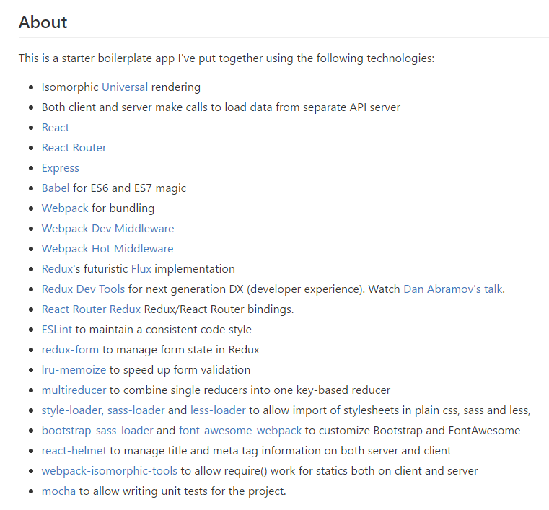
Why this talk?
JavaScript ecosystem changes rapidly
Lots of ”starter projects” online
Usually 20+ npm packages
Usually 100+ lines of configuration
Usually out of date
Show how everything works from the ground up
What we wish we had known when we started

Slide 5
Templafy
Founded in 2014 (spin-off from SkabelonDesign)
Approx. 30 employees
Mission: Help companies manage their templates
Distribution
Personalizing
Integration
Distributed development team
Copenhagen: 4 developers
Århus: 1 developer
Romania: 2 developers, 1 tester
Poland: 1 designer
Tech: .NET, Azure, React, VSTO, git, VSTS, Azure SQL

Slide 6

Our Rewrite Story
Migration from Knockout to React
Started in June 2016
Performance
Focus on core features
Developer productivity
Attracting new developers

Slide 7
React
Released by Facebook in 2013
“A JavaScript library for building user interfaces”
Library vs Framework
V in MVC
Declarative components for UI

Slide 8

Why not Angular 2?
Angular 2 was released in September 2016
Big changes during beta and RC
Fragmentation on Stack Overflow
JSX + TypeScript vs custom template language
Errors from runtime to compile time
IDE support
D

Slide 9
TypeScript
Released by Microsoft in 2012
”TypeScript is a typed superset of JavaScript that compiles to plain JavaScript.”
Adds types and type inference
Adds support for new ECMAScript features
D

Slide 10
React Reconcillation
div
div
diff
h1
ul
h1
ul
p
li
li
li
li
patch
DOM

Slide 11
React Component Lifecycle
Component added: Mount
componentWillMount
componentDidMount
Component updated
componentShouldUpdate
componentWillUpdate
componentDidUpdate
Component removed: Unmount
componentWillUnmount
Mount
Update
Unmount
D

Slide 12
Webpack
Released by @sokra in 2013
”webpack is a module bundler for modern JavaScript applications.”
Similar tools
System.Web.Optimization
Gulp
Grunt
Browserify
…
Builds a graph of dependencies
D

Slide 13
Webpack Hot Module Reload
browser
server
Single Page App
Backend
Files
HMR Client
websocket
Webpack
Dev Server
watch

Slide 14


Visual Studio
Extensions
Task Runner
TypeScript
Our Pains
Visual Studio + ReShaper vs JavaScript Ecosystem
Visual Studio: TypeScript typings caching
TypeScript
TSD > Typings > npm @types
Webpack incremental build time
D

Slide 15
Thank you!
Advice
Understand your tools
Keep number of dependencies down
Investigate stability of dependencies
React: Don’t introduce Flux until you need it
Resources
npm: create-react-app from Facebook
React communication: http://andrewhfarmer.com/component-communication/
React, Webpack and TypeScript documentation sites
Twitter: @rasmuskl
Blog: http://rasmuskl.dk
Presentation + Code will be shared at https://github.com/rasmuskl

Slide 16
Javascript Versions
 | June 2016 | Templafy | March 2017
React | 15.1 | 15.2.1 | 15.4.2
Webpack | 1.6 | 1.14 | 2.2.1
TypeScript | 1.8 | 2.1.4 | 2.2
React Router | 2.4.1 | 2.4.1 | 3.0.2 (4.0-beta6)
React Hot Loader | 1.3 | 1.3.1 | 1.3.1 (3.0-beta6)

