Slide 1
Project 3
Matthew Lueder
CIS 677

Slide 2
Overview
Developed / Tested on Lenovo Y-50 laptop
Uses Nvidia GeForce GTX 860M
Created 3 Kernels (2 1-D, 1 2-D)
Created a sequence of images for the heatmap using the library CImg, then turned the images to a gif with GIMP

Slide 3
Kernels
1-D Rod, Multi-block
This kernel applies the recurrent formula to all elements in the input rod and returns the rod after one time step
It uses shared memory but it still has to read each element out of global memory for each time step
Needs to read from global memory on edges of blocks (twice per block per time step)
The shared memory speeds it up because there are about two time the number memory of reads in each block as there are data elements assigned to that block
Can be used with any size rod
1-D Rod, Single-block
This kernel only uses one block
It is limited: can only work with rods of length 1024
Performs all time steps specified inside the kernel
Only reads from global memory once, uses shared memory after that.
2-D, Room, Multi-block
Allows input of a two dimensional array of any width/height
Applies the recurrent formula to all elements in the input rod and returns the rod after one time step
Uses a mixture of global and shared memory
Global memory used at block boundaries and to read in data at beginning of each time step
Shared data used by recurrent formula when referencing elements within the block

Slide 4
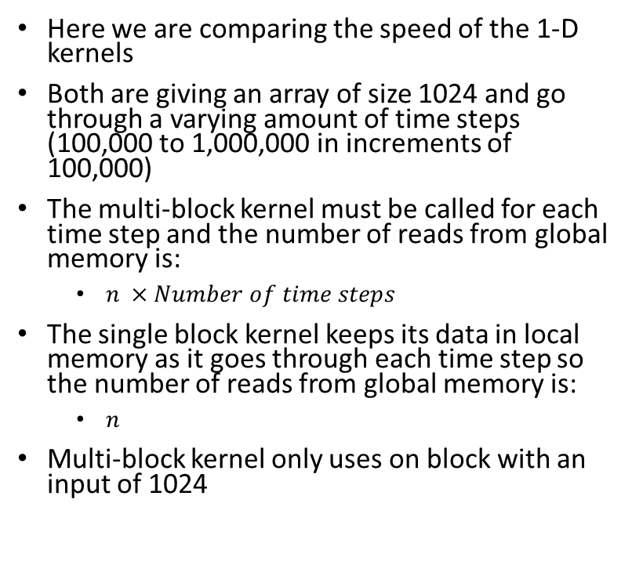
Kernel speed (How much faster is shared memory?)
Here we are comparing the speed of the 1-D kernels
Both are giving an array of size 1024 and go through a varying amount of time steps (100,000 to 1,000,000 in increments of 100,000)
The multi-block kernel must be called for each time step and the number of reads from global memory is:
$n ×Number of time steps$
The single block kernel keeps its data in local memory as it goes through each time step so the number of reads from global memory is:
$n$
Multi-block kernel only uses on block with an input of 1024

Slide 5

2-D Heatmap
Room size: 200 x 200
Total time steps until end: 1,000,000
Each frame = 10,000 time steps

Slide 6
Speed of 1-D vs 2-D Kernels
Number of elements: 1,000,000
Time steps: 100,000
Times:
1-D ≈ 21 seconds
2-D ≈ 35 seconds

Slide 7
Discussion
Shared memory can offer extreme improvements to speed if the problem you are solving is completely divisible into chunks which don’t need to interact, or the problem is small enough to fit in one block’s shared memory. The problem I was solving required each piece of data to interact with adjacent pieces of data. This means we could not make full use of its speed at large problem sizes because the data then needs to be split into multiple blocks. Multiple blocks cannot synchronize with each other, which means we have to call the kernel each time step. This results in the need to load each piece of data from global memory into shared memory at each iteration of the algorithm.
2-D shapes with the same number of elements, heat faster (in terms of number of time steps) than 1-D shapes
2-D shapes with the same number of elements take longer to calculate than 1-D shapes
This is likely because the 2-D shape requires that we access global memory more often (larger borders between blocks) and that work is divided into blocks more evenly in the 1-D shape

