Slide 1
Project 3 Report: ID3 Decision Tree
Matthew Lueder

Slide 2
Overview
Goal: Generate a decision tree via the ID3 algorithm and test its performance
Trees were built using 4 different datasets
All contained categorical variables
Car: Each entry contains attributes of a car. The oracle described if it was a good family car. This dataset was split into a training and test set to see how well the decision tree performs.
Contact lenses: Each entry describe attributes of a patient with poor eyesight. The oracle determined what type of contact lenses the patient should get.
Fishing: Attributes contained information about the weather. The oracle described if it was a good day to go fishing
House votes: Attributes described how US representatives voted on a number of bills. The oracle was the party the representative belonged to. The dataset had missing values. These were converted to the most common level for that attribute.
Created with Python and Pandas
Automatically creates a visualization of the tree using pydot
Uses entropy as purity metric

Slide 3
The ID3 Algorithm
ID3 (S)
if all examples in S are of the same class:
return a leaf with that class label
else if there are no more attributes to test:
return a leaf with the most common class label
else:
choose the attribute a that maximizes the Information Gain of S
let attribute a be the decision for the current node
add a branch from the current node for each possible value v of attribute a
for each branch:
“sort” examples down the branches based on their value v of attribute a
recursively call ID3(Sv) on the set of examples in each branch

Slide 4
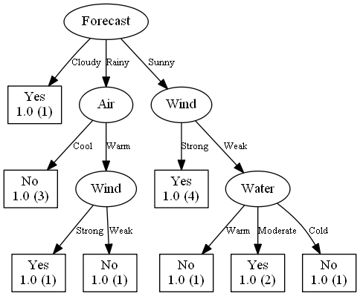
Results – Visualization (Fishing data)

Slide 5
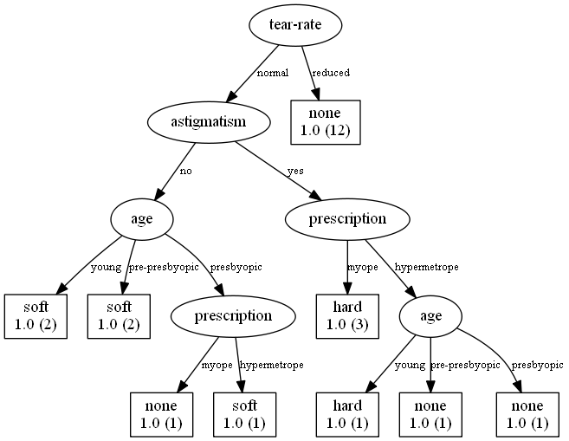
Results – Visualization (contact lenses data)

Slide 6
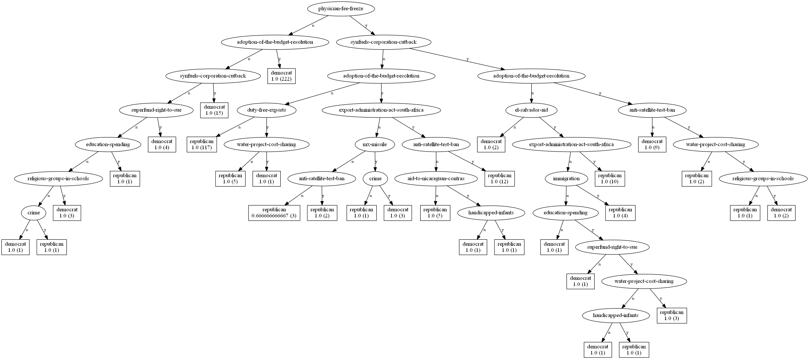
Results – Visualization (house votes data)

Slide 7
Results – Classification (Car data)
Precision
Acceptable: 0.86
Good: 0.714
Poor: 0.982
Vgood: 0.55
Recall
Acceptable: 0.755
Good: 0.484
Poor: 0.961
Vgood: 0.55
Recall hurt by unclassified examples
Predicted\Actual | acceptable | good | poor | vgood
acceptable | 80 | 4 | 7 | 2
good | 2 | 15 | 1 | 3
poor | 6 | 0 | 322 | 0
vgood | 3 | 6 | 0 | 11
unclassified | 15 | 6 | 5 | 4
Actual
Predicted

Slide 8
Discussion
Unclassified examples hurt performance of classifier.
Need to find a way to classify all examples, even when there wasn’t a training example with same attributes
Overfitting possibly an issue
Could perform better with pruning, random forest
Only works with categorical data

