Slide 1

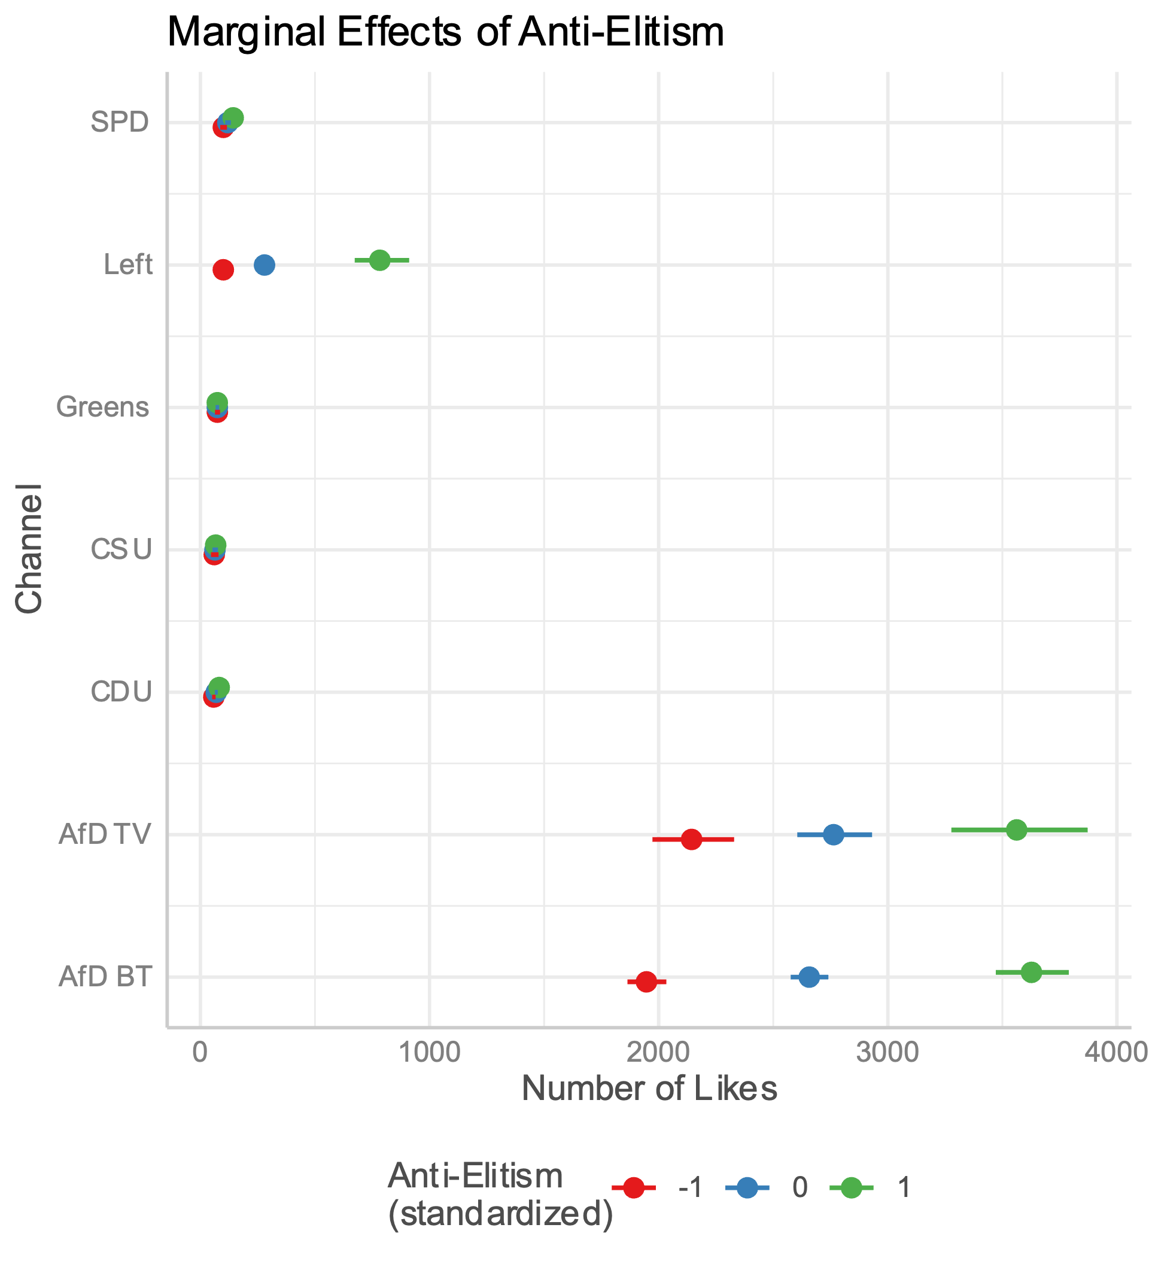
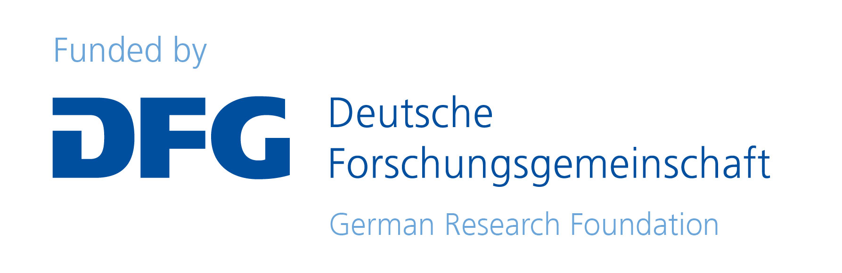

Institute for Social Sciences
Computational Social Science Lab, IRIS
Lukas Erhard
Populist Content on YouTube
Online-Communication Strategies of German Parties
Lukas Erhard <lukas.erhard@sowi.uni-stuttgart.de>
What is Populism?
While the definition of populism has been of some debate, in recent years, scholars have increasingly converged on the ideational definition (Rooduijn, 2019). Populism concerns an antagonistic relationship between the “corrupt elite” and the “virtuous people” and thus rests on two central concepts: anti-elitism and people-centrism (Mudde, 2004).
Why YouTube?
YouTube is the second most important site for young Germans to obtain news and information, trailing only behind Google (Feierabend et al., 2018)
Compared to other Social Media platforms, YouTube is under-researched
Data
All videos of all official party channels from December 6, 2017 – January 20, 2024
9,394 videos, totaling 1,485 hours and 708,504 sentences
Videos are transcribed using whisper-v3-large (Radford et al., 2022)
Populist dimensions are annotated using PopBERT (Erhard et al., forthcoming)
Literature
Erhard, L., Hanke, S., Remer, U., Falenska, A., Heiberger, R. H. (forthcoming). PopBERT. Detecting Populism and Its Host Ideologies in the German Bundestag. Political Analysis.
Feierabend, S., Rathgeb, T., & Reutter, T. (2018). JIM­studie 2018. Jugend, Information, Medien. Basisuntersuchung Zum Medienumgang 12­ Bis 19­Jähriger. (p. 80–81). Me­ dienpädagogischer Forschungsverbund Südwest, c/o Landesanstalt für Kommunika­tion (LFK) / Medienpädagogischer Forschungsverbund Südwest.
Hawkins, K. A., & Rovira Kaltwasser, C. (2017). The Ideational Approach to
Populism. Latin American Research Review, 52(4), 513–528.
Mudde, C. (2004). The Populist Zeitgeist. Government and Opposition, 39(4), 541–563.
Radford, A., Kim, J. W., Xu, T., Brockman, G., McLeavey, C., & Sutskever, I. (2022). Robust speech recognition via large-scale weak supervision. arXiv.
Rooduijn, M. (2019). State of the field: How to study populism and adjacent topics?
A plea for both more and less focus. European Journal of Political Research,
58 (1), 362–372.
Results
Each AfD Channel has more than double the followers of all other parties combined.
The number of likes of a video correlates positively with the proportion of anti-elitist sentences only for channels of populist parties
 | AfD BT | AfD TV | CDU | CSU | FDP | Greens | Left | SPD
N Videos | 5215 | 1442 | 613 | 141 | 461 | 455 | 429 | 469
N Followers | 388,000 | 250,000 | 21,900 | 5,170 | 23,300 | 26,100 | 29,000 | 24,200
N Sents | 295,255 | 142,810 | 53,017 | 10,337 | 36,094 | 45,667 | 45,912 | 65,523
N Anti-Elite Sents | 39,747 (13.4%) | 17,056 (11.9%) | 918 (1.7%) | 286 (2.8%) | 1,403 (3.8%) | 1,415 (3.1%) | 2,420 (5.3%) | 1,380 (2.1%)
N People-Centric Sents | 5,984 (2.0%) | 3,592 (2.5%) | 1,419 (2.6%) | 245 (2.4%) | 886 (2.5%) | 1,314 (2.9%) | 1,374 (3.0%) | 2,163 (3.3%)
Avg. Likes | 3,861.4 | 3,652.1 | 67.7 | 36.1 | 0.5 | 75.7 | 260.0 | 100.5
Avg. Views | 45,749.6 | 43,601.4 | 9,165.2 | 22,944.1 | 5,580.9 | 4,459.9 | 10,734.1 | 5,204.8
Avg. Video Duration (sec) | 436.5 | 666.1 | 661.3 | 453.4 | 670.5 | 901.3 | 878.3 | 1133.0
Avg. Comments | 397.6 | 398.4 | 43.1 | 7.6 | 0.7 | 0.2 | 46.3 | 25.7

