Slide 1
Game Assistant
Group Y
Muhammad Saim Akram, Lukas A. Feldgrill, Jan Zeller

Slide 2



Motivation
Games can be:
Complex
Hard to learn
Difficult
Players might:
Get stuck
Don’t know / Forget
Mechanics
Feel overwhelmed
Solution:
On-demand support
Real-time answers
Accurate information

Slide 3
Goal
Create an AI voice-to-voice assistant that:
Listens to questions when they arise
Answers concise and reliably
Doesn’t disrupt gameplay
🤖🔊
The target scope is: Food in Minecraft

Slide 4


Roles
User
Assistant
Asks game related questions
Listens to the response
Listens to user input
Searches DB for information (context)
Formulates a concise answer
Answers verbally

Slide 5
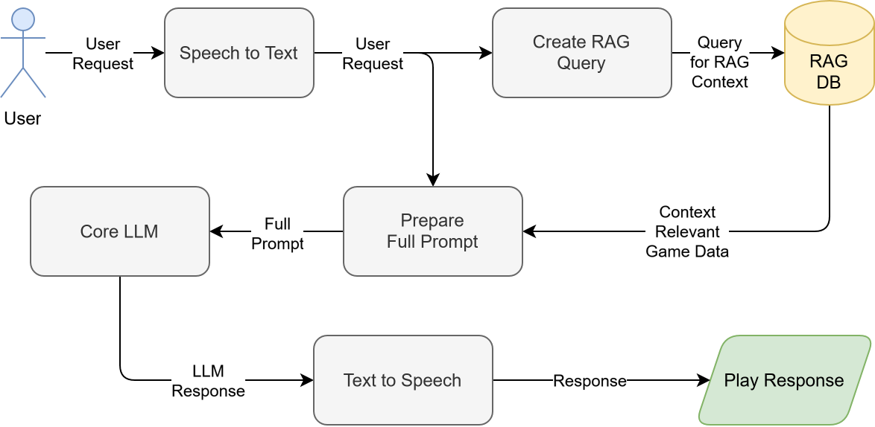
System Structure I

Slide 6
System Structure II
LLM
RAG
OLLAMA
qwen3:4b-instruct
Multi instance use
ChromaDB
Multi (2) Collection Layout
Intelligent* Querying
Text-To-Speech
Speech-To-Text
pyttsx3
OpenAI Whisper

Slide 7
Changes to the Idea
Planned
Implemented
Take game state into account
Evaluate responses before output
No GUI
Scope: Food in Minecraft
RAG holds Recipes
Game state is not observed
LLM handles fault input and missing context
Simple GUI
Scope: Food and Farming in Minecraft
RAG holds Recipes and Guides

Slide 8
Implemented
Techniques
RAG Improvements
Transforming recipes to clear-text
Converting guides to markdown – Chunking by chapters
User query intent classification – Guide vs. Recipe
User query keyword expansion
LLM Improvements
Start with system prompt to inform about role as Minecraft assistant
Pass to TTS after every sentence (don't wait for full answer)
Remove RAG context of previous request to save tokens

Slide 9
Outcome
LLM
RAG
Works good for the most part.
Some hallucinations.
Sometimes context is interpreted wrong.
Good performance, good accuracy.
Large context window for guides.
Query processing could be improved.
Text-To-Speech
Speech-To-Text
Uses default system voice in English
Easily understandable
Effectively converts verbal user requests into text for the RAG pipeline.

Slide 10

Demo

Slide 11
Next Steps
Expand Scope
Cover all the contents of Minecraft in the assistant.
Collect and preprocess the data (if necessary).
Improve RAG
Switch to Graph RAG to more accurately structure the data of the game.
Add improved query handling to more efficiently search for referenced entities.
Improve GUI And Explainability
Add Orchestrator
The GUI does not support switching I/O devices.
Referenced sources should also be evident from a user perspective.
Fine Tune LLM
..to more easily detect faulty input or faults inside the assistant pipeline; i.e. wrong context.
Prevent hallucination and word repetition.

Slide 12
Resources
How to Enhance the Performance of Your RAG Pipeline
Practical Tips and Tricks for Developers Building RAG Applications
What is LLM Orchestration?
Microsoft GraphRAG

