Slide 1
Game Assistant
Human-ai interaction I
Group Y
Muhammad Saim Akram, Lukas A. Feldgrill, Jan Zeller

Slide 2
Project Topic
Playing a new game can be challenging. The players are often presented with too much content too quickly.
We want to help players through their journey by guiding them whenever they request it.
The Game Assistant is a Speech-to-Speech AI application that can answer the player any game-related questions they have while playing.

Slide 3

AI In your Project

Slide 4
AI in your project - Overview
Multiple AI Components
  STT (Speech to Text) - transcribing input
  LLM (Text to Text) - processing user prompt*
  TTS (Text to Speech) - generating output
Input/Perception: User's speech (audio)
Output/Action: Response as speech (audio)

Slide 5
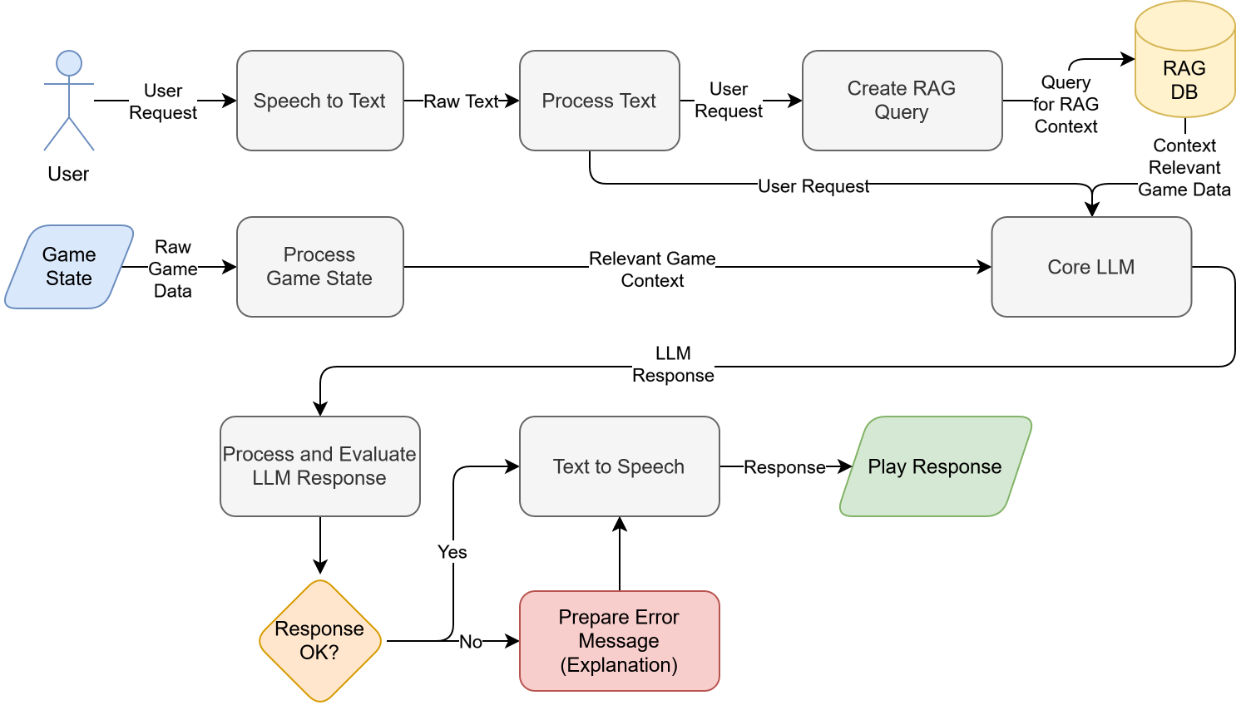
AI in your project - Flow

Slide 6
AI in your project - Reasoning
Current scope: Food and cooking in Minecraft
Player: "How do I get bread?"
Player inventory (from Game State): [2x wheat, (…)]
RAG query for item "Bread" fetches context info
User wants "Bread", bread is made from (3x) wheat (…)
Answer: "You can craft bread from three wheat. You have two wheat so you need one more wheat to craft bread!"

Slide 7
AI in your project - Technicals
STT Model: OpenAI Whisper (faster-whisper, whisper-tiny)
LLM: Ollama, Mystral, Qwen3 (instruction tuned)
TTS: Piper, Deepgram (API)
Optional: LM for internal prompt and game state processing?

Slide 8
AI in your project - Data
Data/Knowledge-Base for RAG
  General game data
  Preprocessed and stored locally
Memory for the System? (remember the last N user prompts?)
Remember user preferences for the session?
No session data is shared between instances

Slide 9
AI in your project - Understanding
AI needs to understand what item is referenced in the game context
  Filter/process the player prompt for keywords
  Ensure keywords are valid (context in scope)
AI must deliver an accurate, reasonable and understandable explanation
We must account for and correctly handle
  Out-of-context questions
  Missing context (from RAG)
  Faulty responses (i.e. hallucinations)

Slide 10
AI in your project - Convention
Agent needs to know about
  it's application (game assistant)
  game specifics (type of game, mechanics)
Agent may adapts to the player by knowing the
  player preferences (efficiency vs exploration)
  player type (newbie, recurring player)

Slide 11
Human In your Project

Slide 12
Human Interface in your project – Input Output Interface
Player input via microphone
Player gets output via speakers
GUI to visualize input and output (history)
Store interaction history to a log file

Slide 13
Human Interface in your project – Understanding the AI
Output must not be too short or too long
On point
Easy to understand
Explainable

Slide 14
Human Interface in your project - Technologies
What technologies will you use in the interface for human input?
Interface technologies: Whisper, Piper
User feedback included in the response (error message)
Data storage: Conversation history in GUI, stored user preferences

Slide 15
The Plan

Slide 16
Roadmap
M1 December 15. 2025
  Finished S2S pipeline
  Dummy input is successfully processed
M2 January 12. 2026
  Finished prototype
Requirements or needs:
  Do you need access to hardware? - No
  Do you need access to software? - No
  Will you work in the lab? - No

Slide 17
Thank you!
Next class

